Slide 1
Managing WHS Compliance of Contractors
EVALUATING AUSTRALIA POST & HELPING AUSTRALIA PTY LTD

Slide 2
SERVICES PROVIDED BY CONTRACTORS
BJS Group:
  Install fire penetrations on all pipework throughout the building
  Create a fire penetration register that includes penetration ID number, location, description of penetration, Barrier, Materials Installed, Test References, Type of Penetration, and Fire Rating.
  Provide Fire System Certification (Form 16).
FFS:
Design of a Fast Flow Rainwater Drainage system for the proposed project based on current plans.
Certify Siphonic system (Form 15)
Provide all drawings and technical data

Slide 3
LEGAL & WORKPLACE REQUIREMENTS
‘Workers’ (Contractors inclusive) have duties under section 28 of the WHS Act which are subject to consideration of what is ‘reasonable’. While at work, contractors have a duty to:
take reasonable care for your own health and safety
take reasonable care that your acts or omissions do not adversely affect the health and safety of other persons
comply, so far as you are reasonably able, with any reasonable instruction given by the PCBU
cooperate with any reasonable policy or procedure of the PCBU relating to health and safety at your workplace.
Contractors should be proactive in recognising potential hazards in your workplace and reporting those hazards to a HSR or manager. It is important that they are familiar with the workplace procedures that outline the actions you need to take when reporting an incident.

Slide 4
LEGAL & WORKPLACE REQUIREMENTS
It is also important that they understand the role and specific work activities you have been contracted to perform and are aware of your health and safety rights. These rights include:
ceasing unsafe work
participating in consultation
notifying health and safety issues
the organisation/PCBU’s duties.
Finally, they should be aware of your duties as a worker under the WHS Act and WHS Regulations. The primary health and safety duty under the WHS Act is owed by a PCBU. This duty is to ensure—so far as is reasonably practicable—the health and safety of workers engaged in work for the business or undertaking. This duty is owed to a PCBU’s workers, including you as a contractor or subcontractor.

Slide 5
INDUCTION REQUIREMENTS
All Contractors and Sub-Contractors working on a CCP&D Site, will have received a Contractors Letter prior to commencement of induction, this letter outlines the basic requirements for working for CCP&D.
All contractors are required to complete an Online Site Induction. This along with all other information required to work for CCP&D, is outlined within the Contractor Letter.
To access the Online Site Induction, follow the below link.
When accessing the Contractor online induction, at: https://leaponline.induction.com.au
On completion, of your online induction as well as this Contractor Induction handbook please email your certificate, and acknowledgement of the site rules statement to admin@ccgroup.ltd.

Slide 6
INDUCTION REQUIREMENTS
Prior to commencement of work the contractor must:
Complete the Online Contractor Induction,
Provide the following (as applicable)
  Any relevant licences, authorisations or certificates of competency
  Relevant work permits
  Evidence of appropriate insurance cover
  Safe work method statements, risk assessments or job safety analyses relating to the work to be performed
  Notice of any isolation requirements or other activities that may impact operation or cause discomfort or potential risk to workers including other contractors, or visitors.
  Evidence that all plant, equipment and tools are suitable for the work to be performed, have been maintained, tested and/or calibrated and are safe to use
  General construction induction card
  Any other relevant information or documentation requested by CCP&D

Slide 7
INDUCTION REQUIREMENTS
Upon arrival on-site, the contractor must report to the facility’s responsible officer who will issue them with:
Complete the Site-Specific Induction
Any relevant keys or access cards – all keys and access cards must be signed for. Where keys or access cards have been issued, these must be returned prior to leaving the facility unless otherwise arranged.
Any other relevant documentation or information (for example, confined space entry or hot work permits).

Slide 8
CODES OF PRACTICE
Code of Practice – WHS Consultation, Cooperation & Coordination
You must consult, so far as is reasonably practicable, with your contractors and sub-contractors and their employees, on-hire workers, volunteers and any other people who are working for you and who are directly affected by a health and safety matter.
Workers are entitled to take part in consultation arrangements and to be represented in relation to work health and safety by a health and safety representative.

Slide 9
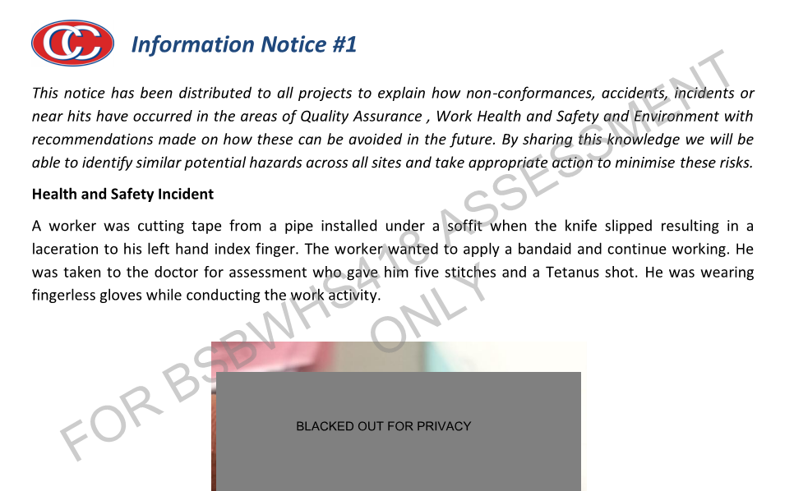
NON-COMPLAINCE - BJM
Non-Compliance: Not wearing appropriate PPE for job
Refer to attached Information Notice #1 for incident information and actions.

Slide 10
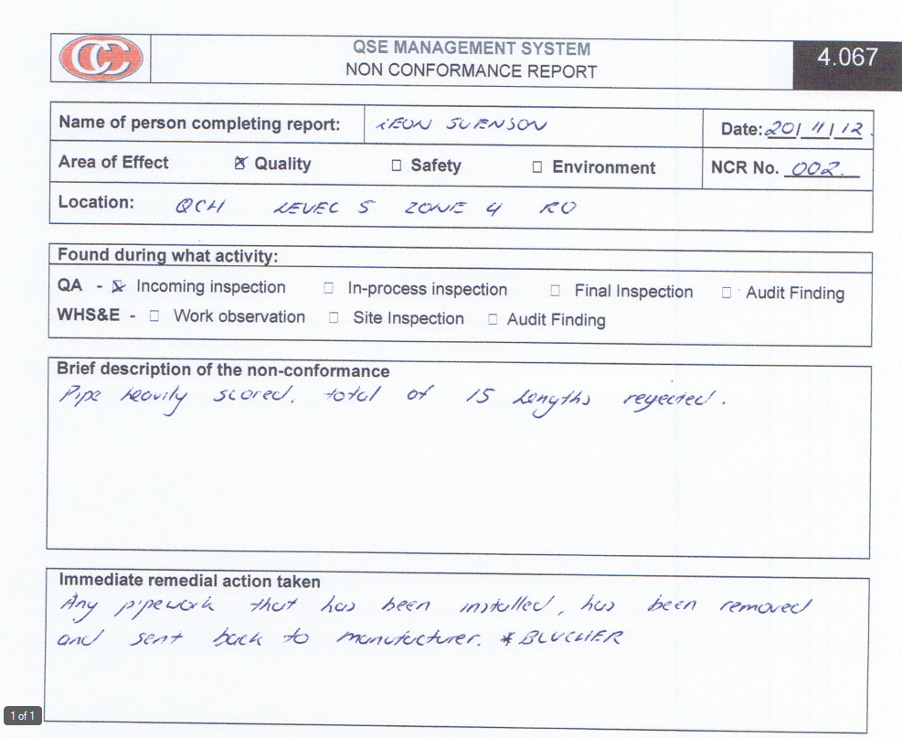
NON-COMPLAINCE - FFS
Non-Compliance: Siphonic pipework provided for install was not up to standard and was rejected by the site foreman once delivered.
Refer to Non-Conformance Report attachment.

Slide 11
CONSULTATION
Upon the issue of any warning/ notice/ directive by CCP&D, the contractor’s representative must notify CCP&D QSE Manager and Construction Manager. The Contractor must ensure all appropriate steps are taken immediately to remedy the breach in compliance with legislation with assistance from senior management where necessary.
CCP&D Quality Management System is structured with policy statements relating to each area of activity within the relative Operating Procedure.

Slide 12
REVIEW PROCESSES
Monitoring and supervising of subcontractor activities will be done by CCP&D supervisors. The supervision and monitoring of subcontractor’s work standards will be documented through the completion of random spot checks using the ‘Subcontractors Spot Check Sheet’.
A SWMS review is conducted periodically by the Project Manager and/or QSE Manager of to ascertain if SWMS are being followed as detailed of both CC P&D workers and subcontractors.

