Slide 1

PERSONAL PROTECTIVE EQUIPMENT
WORK HEALTH AND SAFETY OFFICER

Slide 2
Assessment criteria
Describe the statutory requirements relating to PPE
Describe PPE as an element of the hierarchy of control and the reasons it is the least favourable and effective method of control
Describe at least 3 general principles that must be considered during the selection of PPE
Describe the training requirements that are associated with the provision of PPE
List 2 items that should be included in a PPE plan

Slide 3
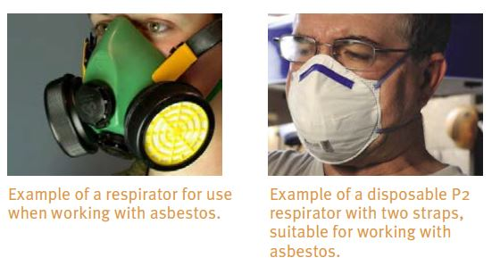
Definition
personal protective equipment means anything used or worn by a person to minimise risk to the person’s health and safety, including air supplied respiratory equipment.

Slide 4
Duties of PCBU
WHS Regulation 2011 s44: The person conducting a business or undertaking who directs the carrying out of work must provide the personal protective equipment to workers at the workplace, unless the personal protective equipment has been provided by another person conducting a business or undertaking.

Slide 5
Duties of Worker and others
WHS Regulation 2011 s46: The worker must, so far as the worker is reasonably able, use or wear the equipment in accordance with any information, training or reasonable instruction by the person conducting the business or undertaking.
WHS Regulation 2011 s47: A person other than a worker must wear personal protective equipment at a workplace in accordance with any information, training or reasonable instruction provided by the person conducting the business or undertaking at the workplace.

Slide 6
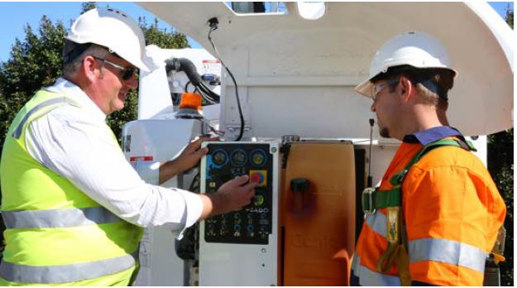
Examples of PPE
Ear muffs
Boots
Goggles
Helmets / Hats
Respirators
Gloves

Slide 7
Who pays?
If PPE is required, the PCBU must provide it to workers free of charge.
However, there may be circumstances where the payment for it can be negotiated.
In deciding who should provide PPE consider:
the availability of equipment
whether the equipment can generally be used outside work, such as sunglasses or boots
the need for a personal fit
the requirements in the relevant industrial award or enterprise agreement regarding provision of PPE.

Slide 8
Person not to levy workers
WHS Act 2011 s273: A person conducting a business or undertaking must not impose a levy or charge on a worker, or permit a levy or charge to be imposed on a worker, for anything done, or provided, in relation to work health and safety.

Slide 9
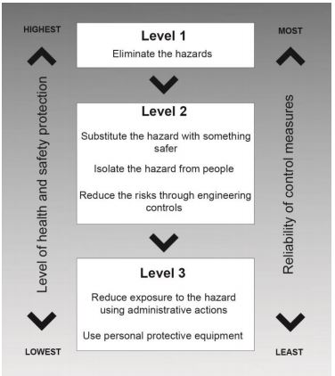
Risk Management Process

Slide 10
PPE as a control measure
PPE is an administrative control and should only be used:
when there are no other practical control measures available (as a last resort)
as an interim measure until a more effective way of controlling the risk can be used
to supplement higher level control measures (as a back-up).

Slide 11
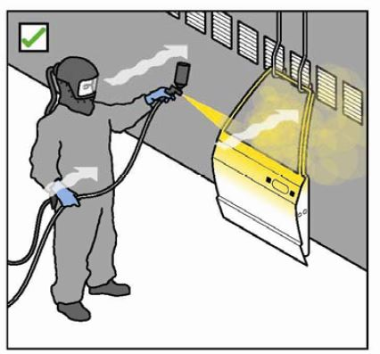
Limitations of PPE
Uncomfortable to wear
Makes work difficult
  Affects sensory perception
  Restricts movement or visibility
Creates secondary risk
  Limits body’s natural cooling

Slide 12
Selection of PPE
To ensure the PPE is suitable it should be:
Appropriate for the type of work
Give adequate protection to the user
Not create additional hazards
Be compatible with other PPE
Fit properly, be easy to use and be comfortable
Comply with the relevant Australian Standard
Consult with the workers when selecting PPE

Slide 13
Training in use of PPE
Induction
  before the worker starts
Specific Job Training
  as and when required
Ongoing Training
  periodical training

Slide 14
Storage
Personal protective equipment should be stored in a clean and fully operational condition.
Storage arrangements should ensure that the equipment is safe from interference and damage, and that it is easily accessible when needed.
Items of personal protective equipment should also be checked regularly, as specified by the manufacturer or supplier, to determine that they are in a serviceable condition, both during storage and in use.

Slide 15
Maintenance
Maintan PPE in a condition that ensures continued effective operation
Maintain in accordance with relevant Australian Standard
Repair or discard damaged or defective PPE

Slide 16
Maintenance
Determine and record:
maintenance duties and responsibilities;
designation of personnel;
storage procedures;
cleaning procedures;
checking procedures;
information about the duration of protection from gloves, respiratory canisters, etc; and
criteria for replacement.
*maintenance information should be part of the personal protective equipment plan

Slide 17
Sharing PPE
PPE is provided for the personal use of a worker but may be shared in some circumstances, for example where PPE is only required for limited periods.
Shared PPE must be properly cleaned and disinfected before it is used again to ensure there are no health risks to the next person. Refer to the manufacturer’s instructions for appropriate methods.

Slide 18
Personal Protective Equipment Plan
Determine and record:
  basis for selection
  necessary medical data
  worker training required
  exclusivity
  fitting requirements
  cleaning and disinfecting
  storage, maintenance and replacement

Slide 19
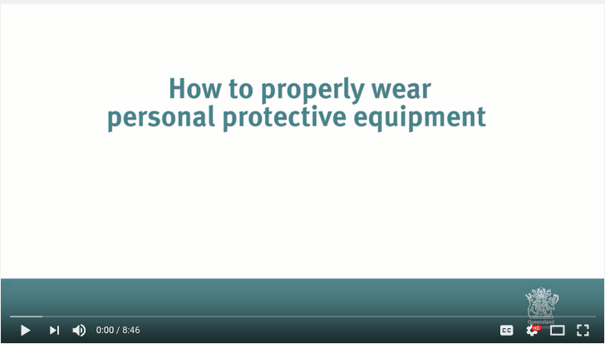
VIDEO How to properly wear personal protective equipment for airborne contaminants – WorksafeQueensland

Slide 20


