Slide 1

ELECTRICAL
WORK HEALTH AND SAFETY OFFICER

Slide 2
Assessment criteria
Describe the various types of electrical work, as defined in the Electrical Safety Regulation 2013.
Describe the electrical testing and tagging criteria for the various types of work.
Describe the requirement to use and test a residual current device in the various types of work.

Slide 3
Electrical risks
The most common electrical risks and causes of injury are:
electric shock causing injury or death. The electric shock may be received by direct or indirect contact, tracking through or across a medium, or by arcing.
arcing, explosion or fire causing burns. The injuries are often suffered because arcing or explosion or both occur when high fault currents are present
electric shock from ‘step-and-touch’ potentials
toxic gases causing illness or death. Burning and arcing associated with electrical equipment may release various gases and contaminants
fire resulting from an electrical fault.

Slide 4
Who has duties?
PCBU
Persons in control
Manufacturers
Importers
Suppliers
Installers
Officers
Workers
Other persons at the workplace
Duty holders

Slide 5
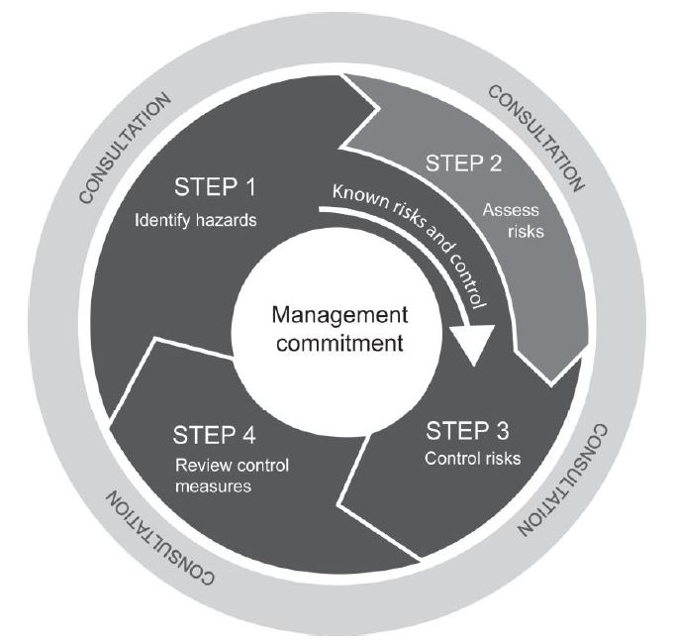
Managing the risk

Slide 6
Specific hazards
Ensuring power circuits are protected by the appropriate rated fuse or circuit breaker to prevent overloading
If a circuit keeps overloading, don’t increase the fuse rating as this creates a fire risk due to overheating. Instead ensure the circuit is not re-energised until the reason for the operation has been determined by a competent person.
Ensuring that leads, including cord extension sets and flexible cables, are arranged so they will not be damaged. For example, avoid running leads across the floor or ground, through doorways and over sharp edges, and use lead stands or insulated cable hangers to keep leads off the ground. In many heavy industries, cable protection ramps are used to protect cables.
Not using leads and tools in damp or wet conditions unless they are designed for those conditions.
Ensuring circuits where portable electrical equipment can be connected are protected by appropriate safety switches (as required by the ES Regulation) that are properly tested and maintained.
If safety switches, circuit breakers or other over current protective devices including fuses are triggered into operation, ensuring circuits are not re-energised until the reason for the operation has been determined by a competent person.
Ensuring safety switches are effective by regular testing.

Slide 7
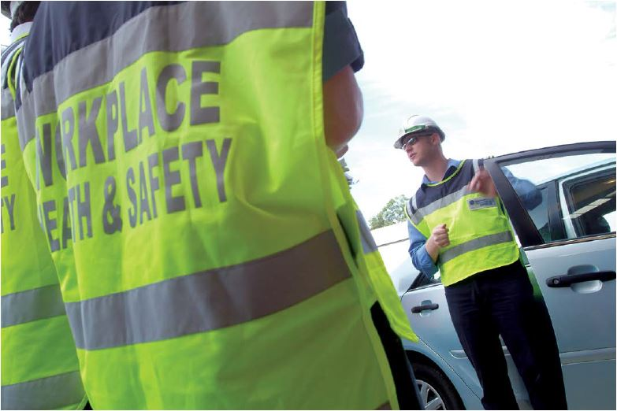
Types of electrical work
Construction work
Manufacturing work
Service work/office work
Amusement work
Rural industry work

Slide 8

Incidents and Notifications
Serious electrical incident:
a person is killed by electricity; or
a person received a shock or injury from electricity, and is treated for the shock or injury by or under the supervision of a doctor; or
a person received a shock or injury from electricity at high voltage, whether or not the person is treated for the shock or injury by or under the supervision of a doctor.

Slide 9
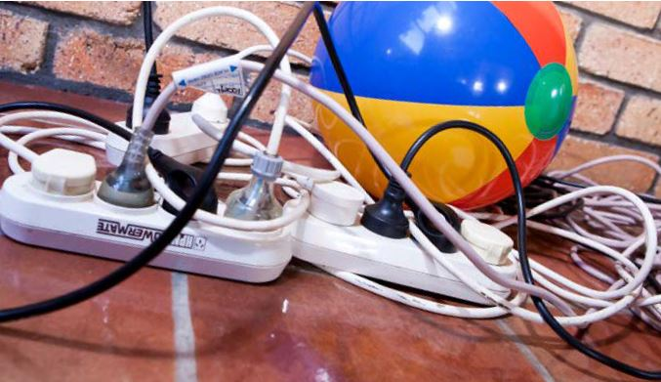
Incidents and Notifications
Dangerous electrical event:
when a person, for any reason, is electrically unsafe around high voltage electrical equipment, even if the person doesn't receive an electric shock or injury
significant property damage caused by electricity or something originating from electricity e.g. electrical fire
unlicensed electrical work
unsafe electrical work
unsafe electrical equipment or electrical equipment that does not have electrical equipment safety system (EESS) approval markings

Slide 10
Specified electrical equipment
Examples of specified electrical equipment used to perform manufacturing work—
a hand held grinder plugged into a socket-outlet
a hand held electric drill plugged into a socket-outlet that is used for drilling holes in steelwork in a light engineering workshop
Examples of specified electrical equipment used to perform service work –
a portable vacuum cleaner used in a hotel
a hand held blow dryer used in a hairdressing salon
Examples of specified electrical equipment used to perform office work –
a power board or extension lead used to supply power to office equipment

Slide 11
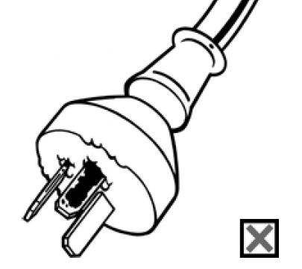
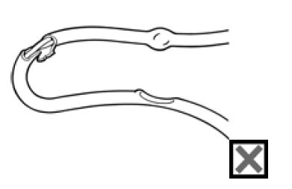
Unsafe electrical equipment
ES Regulation s101: A person conducting a business or undertaking must ensure that any unsafe electrical equipment at the workplace is disconnected (or isolated) from its electricity supply and, once disconnected, is not reconnected until it is repaired or tested and found to be safe or is replaced or permanently removed from use.
Electrical equipment is unsafe if there are reasonable grounds for believing it to be unsafe.

Slide 12
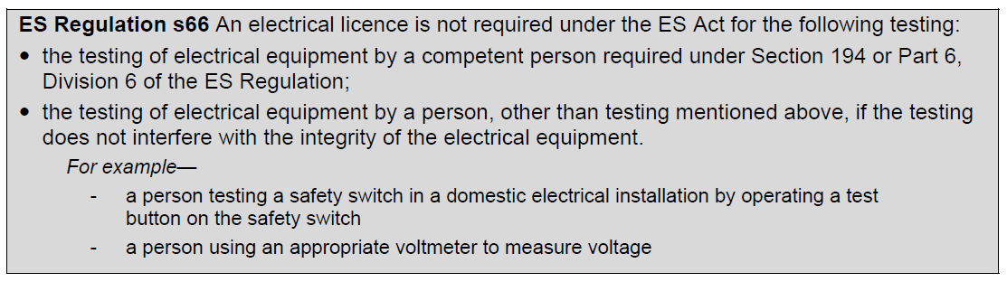
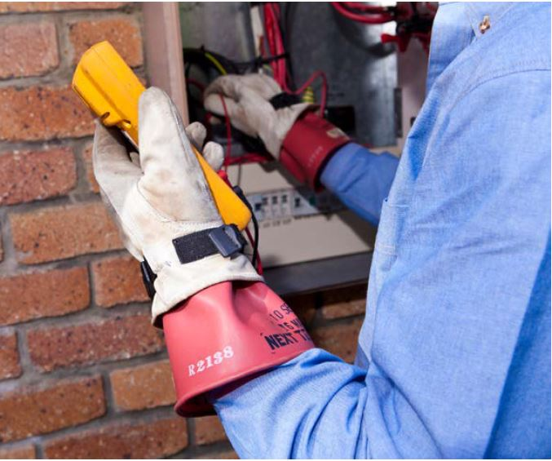
Inspecting and testing

Slide 13
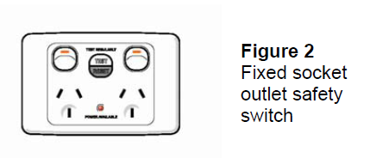
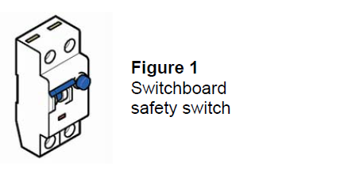
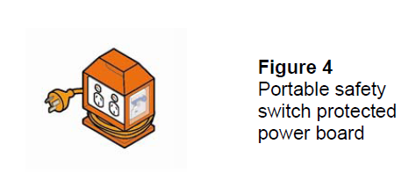
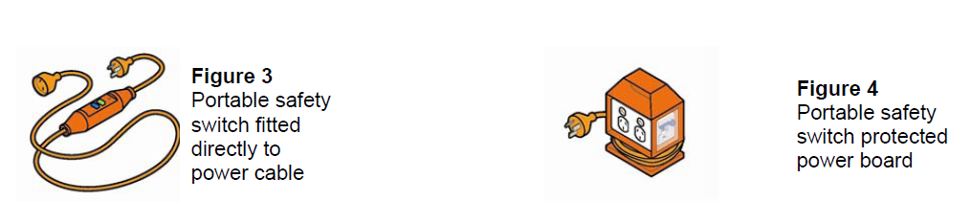
Safety switches
Non-portable (or “fixed”) and portable safety switches

Slide 14
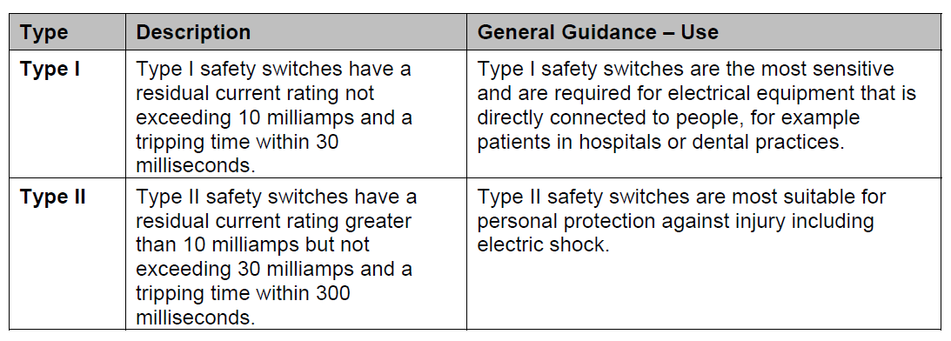
Safety switches

Slide 15


