Slide 1
Delivering Group Personal Training
SISFFIT023 Instruct group personal training programs

Slide 2
Defining
Group Personal Training
small group training presents the opportunity for people to experience the benefits of the creativity and motivation of a trainer while lowering the financial entry point and/or spending more time with the trainer for the available funds.
Some clients may potentially do one-on-one training so they can work on their individual concerns relating specifically to their bodies
  at the same time enjoy the experience of small group training. But they serve different purposes, so it’s important to understand the distinction.
Reference: Ross, J. https://www.acefitness.org/blog/2395/small-group-training-the-future-of-the-workout
Notes:
PC2.7, PE3

Slide 3
Group Personal Training vs Traditional Group Exercise
an effective small group training program has fewer than 10 participants and the instructor does not work out with the clients
traditional group exercise – instructor usually ‘works out’ while instructing the clients
  E.g., ‘spin’ class, ‘pump’, etc.
Reference: Ross, J. https://www.acefitness.org/blog/2395/small-group-training-the-future-of-the-workout
Notes:
PC2.7, PE3

Slide 4
Large Group vs Small Group
Large group boot camps
  instructors can use high energy to “put on a show” and use high-intensity exercises to justify the expense with sweat.
  often draws instructors with less-refined skills in movement and teaching since the large number of participants does not provide the opportunity to correct movement quality
Reference: Ross, J. https://www.acefitness.org/blog/2395/small-group-training-the-future-of-the-workout
Notes:
PC2.7, PE3

Slide 5
Large Group vs Small Group
Small group
  a systematic, periodised program designed for 2-10 people covering all aspects of exercise designed to get results with the majority of clients the majority of the time, in spite of the presence of multiple skill sets and goals.
  small enough to retain high quality
  have the ability to correctly supervise movement and make little corrections along the way
Reference: Rimmer, J. (2011). https://www.ptonthenet.com/articles/how-to-design-small-group-training-programs-3408
Notes:
PC2.7, PE3, PE4, KE3

Slide 6
Small Group Personal Training Program Length
ideally be around four to six weeks
  short enough for numerous people to commit without schedule conflicts, but is still long enough to see measurable progress.
Alternatives
  may be better to run a longer session. E.g., if you were creating a small group marathon training program, the timeline could be eight to 10 weeks because the lead time to prepare for this goal is typically longer.
Reference: Ross, J. https://www.acefitness.org/blog/2395/small-group-training-the-future-of-the-workout
Notes:
PC2.7, PE3

Slide 7
Small Group Training Sessions
ACE Integrated Fitness Training™ (IFT™) Model
  Phase 1 - Stability & Mobility
  Phase 2 - Movement
  Phase 3 - Load
  Phase 4 – Performance
  For example, have a Phase 4 exercise (mountain climbers) followed in the circuit by a Phase 1 exercise (Bird-dog)
    active recovery from the bigger effort while still providing significant benefit to the client.
Reference: Ross, J. https://www.acefitness.org/blog/2395/small-group-training-the-future-of-the-workout
Notes:
PC2.7, PE3

Slide 8
Small Group Training Programs
Three general models
  Equipment-based small group training
  Technique- or skill-based small group training
  Outcome-based small group training
Reference: Ross, J. https://www.acefitness.org/blog/2395/small-group-training-the-future-of-the-workout
Notes:
PC2.7, PE3

Slide 9
Small Group Training Programs
Equipment-based small group training
  appeal to people who prefer a certain style of training or equipment type
    E.g., kettlebells or suspension training devices.
Reference: Ross, J. https://www.acefitness.org/blog/2395/small-group-training-the-future-of-the-workout
Notes:
PC2.7, PE3

Slide 10
Small Group Training Programs
Technique- or skill-based small group training
  allow for a targeted approach to individuals preparing for an activity or sport,
    E.g., kickboxing or mixed martial arts, marathon training, or ski conditioning.
Reference: Ross, J. https://www.acefitness.org/blog/2395/small-group-training-the-future-of-the-workout
Notes:
PC2.7, PE3
Ross, J. Small Group Training: The Future of the Workout Experience and the Missing Link to Your Personal Training Career's Success. ACE Fitness. ONLINE: https://www.acefitness.org/blog/2395/small-group-training-the-future-of-the-workout. (Accessed 12-March-16)

Slide 11
Small Group Training Programs
Outcome-based small group training
  targets people who are looking for a specific physical result or change from the program
    E.g., weight-loss, wedding preparation, fitting into “skinny jeans,” etc.
Reference: Ross, J. https://www.acefitness.org/blog/2395/small-group-training-the-future-of-the-workout
Notes:
PC2.7, PE3

Slide 12
Small Group Training Programs
Exercises
Shuttle Runs
Walking Lunge
Push-ups / Body Weight Exercises
Burpees
Jumping Jacks
Squat jumps
And Many others!!!
Reference: Dawes, J. (2010). http://www.ideafit.com/fitness-library/small-group-training-techniques
Notes:
PC2.7, PE3
What Exercises Are Best for Small-group Personal Training?
http://healthyliving.azcentral.com/exercises-smallgroup-personal-training-15501.html
Shuttle Runs
several exercisers can work out at the same time with minimal equipment needs, shuttle runs will develop cardiovascular fitness and leg muscle endurance.
Walking Lunge
requires a good sense of balance and coordination.
The trainer can supervise several exercisers at the same time and the clients can measure their performances against each other.
Pushups
Body-weight exercises are ideal for group personal training because they require no equipment.
great group alternative to the bench press, and multiple exercisers can work out at once.
increase the intensity by changing your leg positioning. For example, if you place your feet on an elevated platform while performing a pushup, you increase the intensity and load dramatically. In general, you perform body-weight exercises using high repetitions, which will help you achieve greater endurance. You can also use pushups to measure muscular endurance. Count how many repetitions you can do within a given time frame, such as four minutes, or until you are unable to perform the exercise with proper form.

Slide 13
Small Group Training Programs
Structure
Supersets (as highlighted earlier)
  any two exercises—one performed immediately after the other, with minimal rest in between—that work an agonist and antagonist pair of muscles or muscle groups.
    E.g., push-up immediately followed by a pull-up
  Can maximize workflow, using greater training loads, as you transition clients from one exercise to the next
Reference: Dawes, J. (2010). http://www.ideafit.com/fitness-library/small-group-training-techniques
Notes:
PC2.7, PE3

Slide 14
Small Group Training Programs
Structure
Supersets - Examples
  Two clients are on cardio machines while two others superset three or four exercises, and then the pairs switch places.
  Groups perform three to four exercises that form giant supersets (depending how many are in the group).
Reference: Dunnett, A (2007). http://www.ideafit.com/fitness-library/new-business-model-partner-small-group-training
Notes:
PC2.7, PE3

Slide 15
Small Group Training Programs
Structure
Combination movements, or hybrid exercises
  combine two to three traditional exercises to form one complete movement or repetition
    E.g,. dumbbell squat followed immediately by an overhead press once the client reaches a standing position.
  allow greater volumes of training to be performed and can improve metabolic efficiency.
Reference: Dawes, J. (2010). http://www.ideafit.com/fitness-library/small-group-training-techniques
Notes:
PC2.7, PE3

Slide 16
Small Group Training Programs
Structure
Circuits - Examples
  format depends on the theme of the small group
    boot camp, plyometric training, sports conditioning, etc
    do a 10-minute warm-up with 10 stations (2 minutes at each station twice), then a cool-down and stretch.”
Reference: Durrett, A. (2007). http://www.ideafit.com/fitness-library/new-business-model-partner-small-group-training
Notes:
PC2.7, PE3

Slide 17
Small Group Training Programs
Structure
Sample Group Training Structure
  Clients would perform the exercises at the appropriate training load and then rotate from one station to the next with appropriate rest or transition time.
  Approximately 15 seconds of transition time is used in this model.
Reference: Dawes, J. (2010). http://www.ideafit.com/fitness-library/small-group-training-techniques
Notes:
PC2.7, PE3

Slide 18
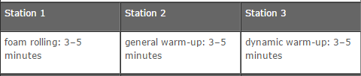
Small Group Training Programs
Structure
Sample Group Training Structure (Part 1)
  Perform the following section with all group members, beginning at Station 1 and progressing sequentially to Station 3.
Reference: Dawes, J. (2010). http://www.ideafit.com/fitness-library/small-group-training-techniques
Notes:
PC2.7, PE3

Slide 19
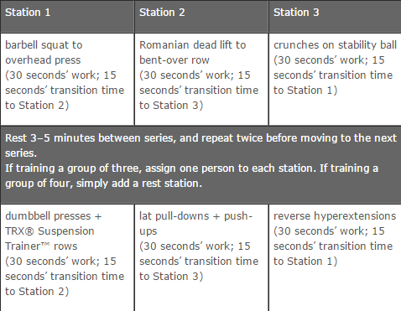
Small Group Training Programs
Structure
Sample Group Training Structure
(Part 2)
Reference: Dawes, J. (2010). http://www.ideafit.com/fitness-library/small-group-training-techniques
Notes:
PC2.7, PE3

Slide 20
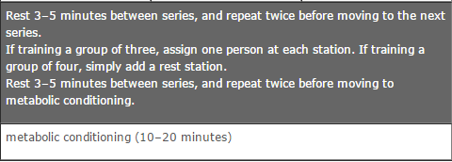
Small Group Training Programs
Structure
Sample Group Training Structure (Part 3)
Reference: Dawes, J. (2010). http://www.ideafit.com/fitness-library/small-group-training-techniques
Notes:
PC2.7, PE3

Slide 21
Small Group Training Programs
Exercise & Safety Concerns
Equipment challenges
Keeping different levels of ability motivated
Handling different physical limitations in the group
Supervision (keeping an eye on clients)
Reference: Durrett, A. (2007). http://www.ideafit.com/fitness-library/new-business-model-partner-small-group-training
Notes:
PC2.7, PE3
Exercise & Safety Concerns
Dealing With Equipment Challenges.
have as wide a variety of equipment as possible, including small pieces like bands and exercise balls
Keeping Different Levels of Ability Motivated.
Careful exercise selection allows clients to compete with themselves rather than against the group
explains to clients that he can make any exercise harder, and urges them to proceed at their own pace.
Handling Differing Physical Limitations. “
using three variations of a similar base routine. For example, one person may perform a regular squat with a bar or dumbbells, while her partner with a bad back uses a ball against a wall for support and the client with bad knees performs a squat lying supine on the ball.
Keeping an Eye on Clients.
vital that you make sure clients fill out all necessary forms before they come to the session

