Slide 1

STEEL CONSTRUCTION
WORK HEALTH AND SAFETY OFFICER

Slide 2
Assessment criteria
Describe the statutory and minimum requirements relating to steel construction.
List the hazards that are associated with the processes of steel construction.
Describe the control measures that are available to minimise or remove the risk associated with these hazards.

Slide 3
What is steel construction work?
Steel construction is any work to erect assembled portions and single components of structural steel, such as:
columns;
beams;
bracing;
rafters;
purlins;
girts;
bridging and fly bracing;
trusses; and
other related steelwork for example, free standing structures

Slide 4
Planning
Planning is an effective control measure for preventing the risk of injury or death arising from steel construction. Designers, principal contractors, erectors and fabricators have an important role in planning the work.

Slide 5
Factors to be considered in planning
The designer, principal contractor, fabricator and the erector must consult, cooperate and coordinate with each other about the structure to be erected.
Consultation should address the hazards, associated risks and control measures that will be implemented during the steel construction work and cover all phases of the project. In addition to the risks of falls from heights, falling objects and the stability of structure, the consultation should consider other factors such as the sequence and the method of erection, in particular:
access to work areas where erection is taking place
location of other trades relative to the erection work
restricted areas and the need for barricades
criteria for safety (e.g. sequential erection).

Slide 6
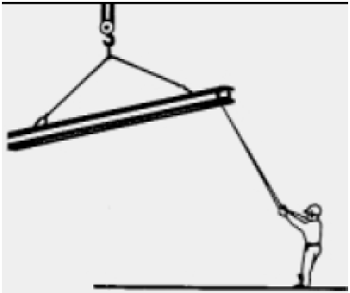
Hazards
There are a range of general hazards associated with the erection of structural steel. These include:
Falling objects
Falls from heights
Collapse of structure
Collapse of cranes.

Slide 7


