Slide 1

WORK-RELATED VIOLENCE
WORK HEALTH AND SAFETY OFFICER

Slide 2
Assessment Criteria
Identify and define work-related violence.
Understand the ‘risk management’ process for work-related violence.
Understand some controls to manage the risk of this hazard.
Understand the importance of the development of policies and processes to ensure the elimination or minimisation of harm to workers as a result of work-related violence.

Slide 3
Duties
PCBU
Officer
Worker

Slide 4
What is work-related violence?
Any incident where a worker is abused, threatened or assaulted in the course of their work.
abuse - ill treatment and/or insulting language
threat - when a person’s words or actions causes another to believe their safety is at risk
assault - an attempt or act of unlawful physical attack
Any incident where a worker is abused, threatened or assaulted in the course of their work.

Slide 5
Examples of work-related violence
Biting, spitting, scratching, hitting and kicking
Throwing objects
Pushing, shoving, tripping and grabbing
Verbal threats, armed robbery and sexual assault
Attacking with any type of weapon (e.g. knives, guns, clubs)

Slide 6
Sources of work-related violence
External violence
Perpetrator is someone from outside the workplace
Usually associated with robbery or other crimes
Includes victims of domestic violence who are threatened or assaulted at work.
Service-related violence
Arises when providing service to clients, customers, patients or prisoners
Often unintentional (e.g. a teacher pushed over while intervening in a schoolyard brawl).

Slide 7
Work factors which can increase the risks
investigating and enforcing specific legal requirements (police, ambulance, prison officers)
where patients / clients are intoxicated or affected by drugs (hospitals, aged care, disability services)
working with people who are unable to manage their emotional responses (education, child care)
dealing with frustrated customers (parents of students, call centres).

Slide 8
Work factors which can increase the risks
working at night, alone or in isolation (service station attendants)
handling cash or working with drugs or objects of value (banks, jewellers, pharmacies)
working in environments where political, cultural, religious, or racial intolerance is present
walking to cars or public transport alone at night.

Slide 9
Notify authorities
Notify the Queensland Police Service of any work-related violence.
Required to Notify WHSQ
Fatality
Hospitalisation as an in-patient.

Slide 10
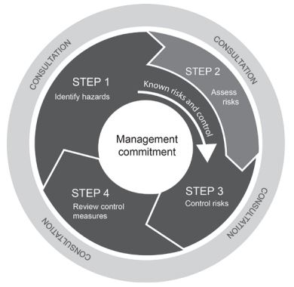
Risk management process

Slide 11
Identify and assess
Violence hazards generally arise as a result of:
Identify the hazard
Assess the risk
To determine if violence is a potential hazard:
Review hazard and incident reports
Examine local crime statistics
Review workers’ compensation claims
Inspect the workplace
Talk with HSRs, HSCs, workers, customers & clients
How tasks are performed
The work environment including external factors
The way work is designed and managed

Slide 12
Controlling the risks
Physical work environment and security
Can affect the likelihood of violent incidents and the ease in which people can respond
Work systems & Procedures
Should form part of the overall workplace prevention strategies. They are insufficient on their own.
Training
Should form part of an overall strategy (i.e. not the overall approach).

Slide 13
Review the controls
Following an incident
Before introducing changes to the workplace
If a HSR requests a review
A new hazard is identified
Consultation indicates a review is necessary

Slide 14
Case study
Local council parking inspectors often work alone and in unfamiliar work environments. They are often threatened, sometimes assaulted, when issuing parking fines.
The council, in consultation with its HSRs and HSCs, completes a risk assessment which identifies the following risk factors:
Inspectors work alone and sometimes at night
Work locations are unpredictable and uncontrolled
Threats are more common when inspectors enforce parking laws near pubs and clubs.
As a group, identify some short-term and long-term risk controls

Slide 15
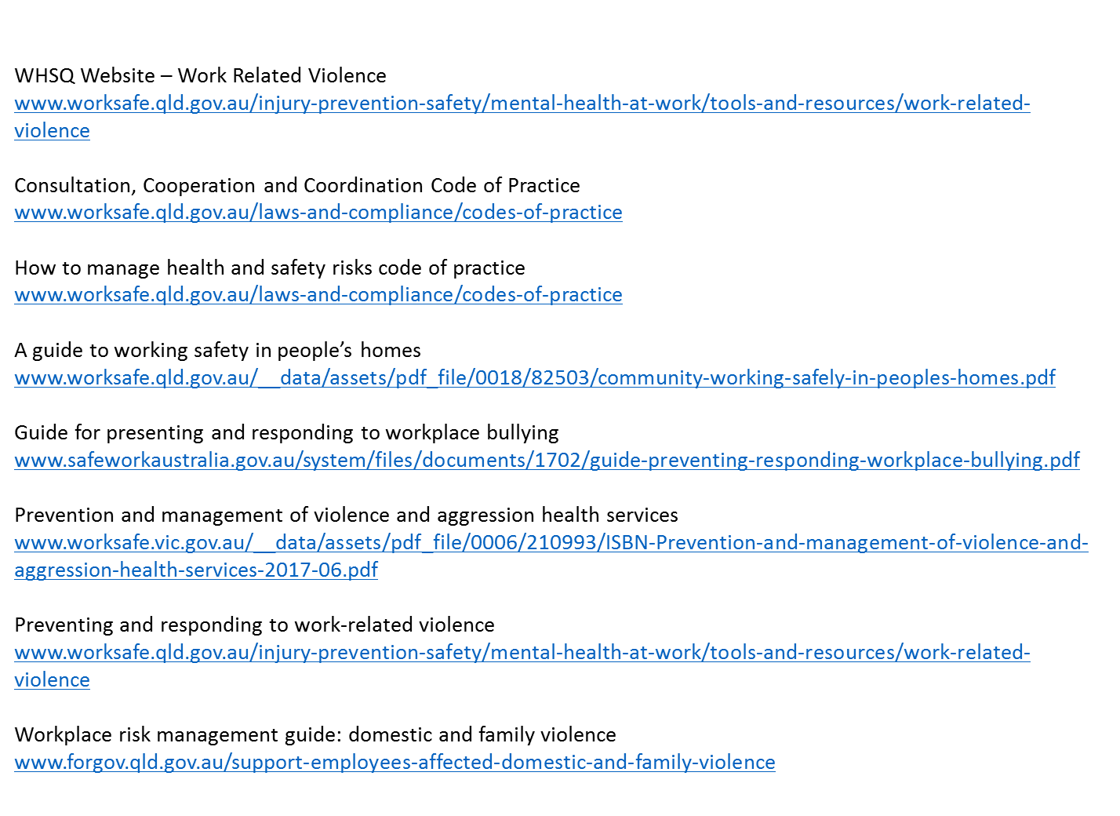
Resources

Slide 16


