Slide 1

Person centred-care:
Using positive person work
& avoiding malignant psychology.

Slide 2
Person Centred-care
The person comes first.
“The person with dementia is equal to the person caring for them.” (Kitwood, 1997)

Slide 3
Personhood
Is the value we instil in someone, whilst taking into account what makes them who they are. Placing importance on reciprocal relationships.
“A standing or status that is bestowed upon one human being by others, in the context of relationship and social being. It implies recognition, respect and trust.”
(Kitwood, 1997)

Slide 4
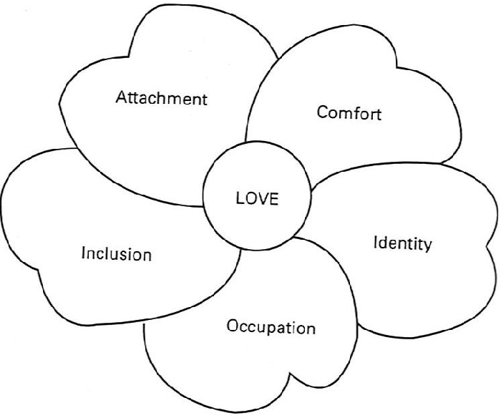
Psychological needs

Slide 5
Positive Person Work
Comfort = Warmth, Holding, Relaxation, Timalation
Identity = Celebration, Respect, Acceptance, Negotiation
Attachment = Acknowledgement, Validation, Genuineness
Occupation = Empowerment, Enabling, Facilitation, Collaboration
Inclusion = Recognition, Including, Belonging, Fun/Play

Slide 6
Malignant Social Psychology
Undermines comfort, identity, attachment, occupation and inclusion.
YOU are CRUCIAL to ensuring the PERSONS psychological needs are met.
YOU WILL MAKE A POSITIVE DIFFERENCE!

Slide 7
References:

