Slide 1

CHCECE004
Promote and provide healthy food and drinks

Slide 2

Promote healthy eating
1.1 Engage children in experiences, conversations and routines that promote relaxed and enjoyable mealtimes and promote healthy lifestyles and good nutrition

Slide 3

Positive experiences and conversations
You may give children the opportunity to watch and participate in the preparation of food.
You can increase the sense of enjoyment by encouraging children to combine ingredients in the creation of recognisable shapes and patterns
They may be encouraged to think about the healthy qualities of fruit and vegetables
However, you shouldn’t criticise the children or keep on nagging them about the importance of making healthy choices.

Slide 4
Healthy routines
You should aim to serve meals at set times each day, so that children engage with the routine of eating healthily
The meals should be quite definite occasions and involve educational staff or carers where possible
As a general rule children should be provided with three meals and one or two snacks per day.

Slide 5

Activity 1A

Slide 6
Promote healthy eating
1.2 Model, reinforce and implement healthy eating and nutrition practices with children during mealtimes

Slide 7
Acting as a role model
You should be aware that you can make a significant difference to the perceptions and beliefs of children in relation to healthy eating
If you are able to gain the children’s trust and respect then they will look up to you and follow the example that you set
You should place a reasonable portion of food on your plate and ensure a healthy balance of vegetables and other nutritious ingredients.

Slide 8

Acting as a role model
It is important for you to eat the same types of food that the children are given
You should take over the use of utensils, keep your mouth closed when eating, and show that you are enjoying the food
You should also adopt a relaxed and controlled manner at the dining table.

Slide 9
Activity 1B

Slide 10
Promote healthy eating
1.3 Support and guide children to eat healthy food

Slide 11
Providing support and guidance
It is important for children to begin eating healthily from the earliest age and onwards
You should provide them with support and guidance to ensure that they make appropriate meal choices
You can make the adjustment easier by introducing healthy foods gradually and accepting when children reject food that they actively dislike
Children are likely to be more engaged and happy about the prospect of eating healthy food if they are involved in meal preparation.

Slide 12
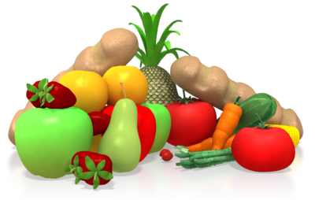
Fundamental principles of healthy eating may include:
Enjoy a wide variety of nutritious food
Eat plenty of vegetables, legumes, and fruits
Eat plenty of cereals, preferably wholegrain
Include lean meat, fish, poultry, and alternatives
Include milks, yogurts, cheese, or alternatives. Reduced fat varieties should be chosen where possible.

Slide 13

Fundamental principles of healthy eating may include:
Drink plenty of water
Take care to limit saturated fat and moderate total fat intake
Choose foods low in salt
Consume only moderate amounts of sugars and food containing added sugars.

Slide 14
Activity 1C

Slide 15
Promote healthy eating
1.4 Check that children have ready access to water and are offered healthy food and drinks regularly throughout the day

Slide 16

Ways of encouraging consumption of water include:
Putting cups of water on tables at meal times
Providing cool and refreshing water after activities
Putting up posters emphasising the importance of drinking water
Setting a positive example to the children and drinking water throughout the day
Serving water in decorative jugs and cups
Adding lemon or orange slices for flavour.

Slide 17
Healthy food
You should ensure that children are provided with healthy food at regular intervals throughout the day
It would be advisable to ask whether they are hungry at different times
The children should also feel confident of asking for you food
However, you should restrict the consumption of snacks so that children do not spoil the main meals
Examples of healthy food include fruit, vegetables, and wholegrain bread.

Slide 18
Activity 1D

Slide 19
Promote healthy eating
1.5 Assist in ensuring that furniture and utensils are suitable to encourage children to be positively involved in and enjoy mealtimes

Slide 20
Ensuring suitability of furniture and utensils
Each child should be allocated a comfortable and sturdy seat at the dining table
The seating should be suitably sized and ensure easy access to the table
Children should be able to rest their forearms on the table edge while relaxing their shoulders
They should also be able to touch the floor with their feet when in a seated position.

Slide 21
Ensuring suitability of furniture and utensils
The utensils should be chosen in accordance with the children’s size and other requirements
You may arrange differently coloured eating and serving utensils so that the children are able to distinguish and make appropriate choices
The utensils should be durable and safe to use.

Slide 22
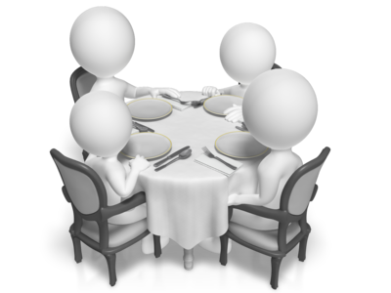
Ensuring suitability of furniture and utensils
The dining area should be as visually attractive as possible
You may use colourful table cloths and place the children’s favourite cups or mugs on the table
Colourful serving dishes may also be included for aesthetic appeal.

Slide 23
Activity 1E

Slide 24
Plan food and drinks that are nutritious and appropriate for each child
2.1 Within scope of own work, ensure children are provided with food and drink consistent with the guidelines for healthy eating

Slide 25
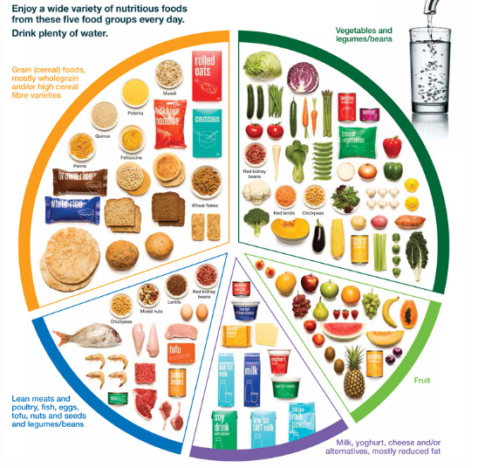
Australian guide to healthy eating:

Slide 26
Children and adolescents should have the following dietary habits:
Eating plenty of vegetables, legumes and fruits
Eating plenty of cereals (including breads, rice, pasta and noodles), preferably wholegrain
Including lean meat, fish, poultry and/or alternatives
Including milks, yoghurts, cheeses and/or alternatives.
Choosing water as a drink.

Slide 27
Activity 2A

Slide 28
Plan food and drinks that are nutritious and appropriate for each child
2.2 Assist in ensuring children’s individual needs are consistent with advice provided by families about their child’s dietary requirements, likes, dislikes and any cultural or other requirements families have regarding their child’s nutrition

Slide 29
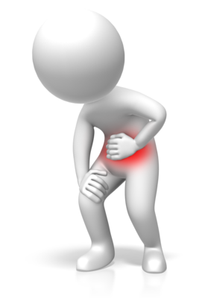
The signs of food allergies include:
Hives
Eczema
Redness of the skin or around the eyes
Itchy mouth or ear canal
Nausea or vomiting
Diarrhoea
Stomach pain.

Slide 30
The signs of food allergies include:
Nasal congestion or a runny nose
Sneezing
Slight, dry cough
Odd taste in mouth
Uterine contractions.

Slide 31

Likes and dislikes
All children should have healthy balanced diets
However, it is extremely common for them to have specific food preferences
They may like or dislike foods due to the colour, texture, or taste
Parents and carers may be able to provide helpful information about such preferences.
It might be possible to introduce some foods gradually or combine them with other ingredients which the children like.

Slide 32

Culturally based food requirements and preferences may include:
Religious observations
Meal patterns
Foods used
Hot or cold meals
Spices and flavourings used.

Slide 33
Activity 2B

Slide 34
Read and interpret food labels and other information about food contents
2.3 Read and interpret food labels and other information about food contents

Slide 35
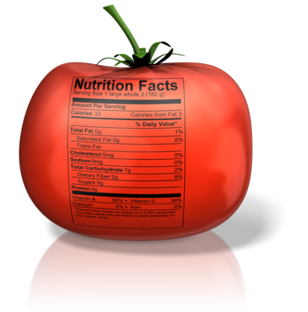
Nutritional value of the following elements may be specified:
Energy
Fat
Carbohydrate
Fibre
Sodium (salt).

Slide 36

Other details that should be specified on food labels include:
Information for allergy sufferers
Food additives
Use and storage instructions
Country of origin.

Slide 37

The following terms may be found on food labels:
Low fat
Fat free
Lite/light
No added sugar
Reduced fat/salt
Organic/certified organic.

Slide 38
Activity 2C

Slide 39
Read and interpret food labels and other information about food contents
2.4 Assist in providing education and support to families around healthy eating

Slide 40
Providing education and support
You should take the opportunity to engage in conversation with parents and carers
It might be possible to arrange school health activities such as healthy eating seminars
The food and nutrition policy should be available to read within the handbook for your organisation
It would also be worth using different communication methods for the circulation of menus.

Slide 41
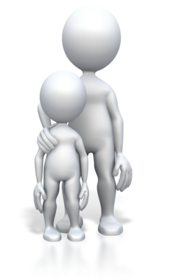
Subjects that may be addressed include:
Child development
Ways of communicating with children about health and diets
Monitoring the everyday behaviour of children
Modelling healthy eating behaviour.

Slide 42

Ways of communicating with families may include:
Informal discussions
Arranged meetings
Parent’s evenings
Flyers
Memos
Email messages
Blogs
Letters
Event schedules.

Slide 43
Activity 2D

Slide 44
Read and interpret food labels and other information about food contents
2.5 Assist to develop and display a cycle of written menus detailing the food that is provided to children

Slide 45
Developing and displaying menus
The development of written menus will enable you to ensure that the children’s dietary requirements are being met and that they are being provided with a good variety of meals
You should ensure that the children’s religious and cultural requirements are taken into account
It will be important to include food types which will aid the children’s growth and development
However, you should ensure that there isn’t any risk of triggering allergic reactions or intolerances.

Slide 46

Additional considerations may include:
Suitable nutritional elements for the children’s stage of development
Combinations of ingredients which look appealing
Australian dietary guidelines.

Slide 47
You may use the following strategies in the development of menus:
Planning the protein element of the meal first
Combining new foods with foods that the children are used to
Giving the children choice over the types of ingredients and meals that are prepared (within reason)
Ensuring a balance between strong and mild foods
Restricting the number of unhealthy options on the menu

Slide 48

You may use the following strategies in the development of menus:
Taking a record of the children’s reactions to different types of food and developing menus accordingly
Encouraging the involvement of parents and carers
Arranging theme days, providing the opportunity for trying foods from different cultures.

Slide 49
Activity 2E

Slide 50
Maintain food safety while carrying out food-handling activities
3.1 Assist in developing and maintaining food safety procedures according to relevant guidelines

Slide 51
Maintain food safety while carrying out food-handling activities
3.2 Within scope of own work role, carry out food-handling, preparation and storage according to service policies and procedures and regulatory requirements

Slide 52
Maintain food safety while carrying out food-handling activities
3.3 Follow food safety procedures when preparing food

Slide 53
Policies and procedures may relate to:
Food receiving, storage, preparation, display, service and disposal
Methods of food hazard control for each critical point
Systematic monitoring of hazard controls and record keeping
Personal hygiene, suitable dress, and personal protective equipment and clothing.

Slide 54

Policies and procedures may relate to:
Record maintenance
Corrective actions when hazards are found not to be under control
Pest control
Cleaning and sanitation
Equipment maintenance.

Slide 55
Personal hygiene requirements may include:
Taking all practicable measures to ensure that a food handlers body, and anything they are wearing does not contaminate food or surfaces
Taking all practicable measures to prevent contact with ready-to-eat food
Wearing a level of outer clothing appropriate for food handling
Only using waterproof bandages and dressings on exposed body parts.

Slide 56
Personal hygiene requirements may include:
Not eating over unprotected food or surfaces likely to come into contact with food
Not sneezing, blowing or coughing over unprotected food or surfaces likely to come into contact with food
Not spitting, smoking or using tobacco or similar preparations in areas in which food is handled
Not urinating or defecating except in the toilet.

Slide 57
Personal hygiene requirements may include:
Washing hands:
  whenever hands are likely to be a source of contamination
  immediately before working with ready-to-eat food after handling raw food
  immediately after using the toilet
  before commencing or recommencing food handling
  immediately after smoking, coughing, sneezing, using a handkerchief or disposable tissue, eating, drinking or using tobacco or similar substances

Slide 58

Personal hygiene requirements may include:
When washing hands:
  use hand washing facilities provided
  thoroughly clean hands using soap or other effective means, and warm running water
  thoroughly dry hands on a single use towel or other way that is not likely to transfer pathogenic micro-organisms to the hands.

Slide 59
Preparation
It is the responsibility of the employer to ensure that there are adequate facilities for food preparation and storage
There should be a ready supply of hot and cold water, waste disposal facilities, and appropriate storage for different types of food
Any surfaces that you are intending on using for food preparation should be thoroughly cleaned and sanitised.

Slide 60
Preparation
You should be aware of the risk of cross contamination and ensure the separation of food and items which may have been exposed to bacteria
It will be necessary to wash any items used for the purposes of food preparation immediately after use
Work surfaces should also be cleaned and disinfected
It is important that you don’t touch ready-to-eat foods with your bare hands
You may use clean and sanitised gloves, tongs, or other utensils for such purposes.

Slide 61
Standards for safe food storage include:
Keep raw foods and ready-to-eat foods separate to avoid cross-contamination
Store food in clean, non-toxic, food storage containers; don’t store food in opened cans
Make sure food storage containers have not been used to store things other than food, and wash and sanitise them before use
Cover food with tight fitting lids, foil or plastic film, to protect it from dust, insects and cross-contamination.

Slide 62

Standards for safe food storage include:
Store food in areas specially designed for food storage
Never store food in areas containing chemicals, cleaning equipment, clothing, or personal belongings
Remove and avoid using foods past their “use by” dates, spoiled foods, or foods in damaged containers
Make sure food is thoroughly cooked, and that the centre of the cooked food has reached 75°C
Avoid keeping high-risk food in the Temperature Danger Zone.

Slide 63
Activity 3A

Slide 64
Summative Assessments
Summative assessments consist of:
Skills Activity
Knowledge Activity
Performance Activity.
Your assessor will provide you with further guidance on how and where to complete these assessments.

Slide 65

Summary and Feedback
Did we meet our objectives?
How did you find this session?
Any questions?

