Slide 1

CHCECE025
Embed sustainable practices in service operations

Slide 2

An introduction to the National Quality Framework (NQF)
The National Quality Framework (NQF) was established in 2012 by the government as a measure to raise the quality and standards of early childhood education and care
This is overseen by the Australian Children’s Education and Care Quality Authority (ACECQA), in conjunction with the individual state and territory regulatory bodies.

Slide 3

The NQF includes:
The National Law and National Regulations
The National Quality Standard (NQS)
National learning frameworks
Assessment and quality rating process.

Slide 4

Develop a sustainability management plan
1.1 Identify aspects of sustainability in the service

Slide 5
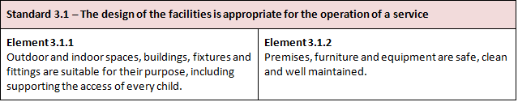
Quality Area 3 – Physical environment
The National Quality Standards, within the National Quality Framework, includes a standard on the physical environment within its seven quality areas.

Slide 6

Identify current sustainable practices within the service
You may want to look at:
Energy efficiency
Water usage
Waste management
Practices that the children may undertake.
Compile a list of the recognised sustainable practices already performed and use this to determine any areas for improvement.

Slide 7

Activity 1A

Slide 8
Develop a sustainability management plan
1.2 Consider areas of potential change in all aspects of the service’s delivery and environments

Slide 9

Making sustainable changes
When looking to make changes for sustainability, make small changes that don’t overwhelm
Implementing and maintaining small changes will provide a platform for making further changes in the future.

Slide 10

Improving practices for service delivery
Within the service, identify areas that could be more sustainable.
Look at what you may use and order on a regular basis:
Food items
Service equipment
Cleaning materials.

Slide 11

The outdoor environment
Create a garden
Create a worm farm or compost waste
Observe nature and local wildlife
Create an area for a pet.

Slide 12

The indoor environment
Encourage the children to:
Reuse items
Recycle items
Place recycling and rubbish in the correct bins
Look after equipment/items that they use
Use half-flush on toilets
Turn off taps after using them
Turn on/off lights.

Slide 13
Activity 1B

Slide 14
Develop a sustainability management plan
1.3 Ensure that nature, waste, energy and toxins have been considered

Slide 15
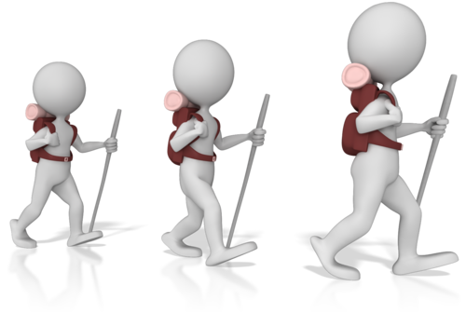
Exploring and considering nature
Nature should be a place of enjoyment and learning for all
Choose activities appropriate to the seasons
If your service needs to make changes to its operations, building(s) or surroundings, make
sure that the impact to nature is considered
Be aware of the natural habit and how to
co-exist with it.

Slide 16

Toxins in the environment
Toxins are commonly found in plants
Be aware of the wildlife around that may also be a potential threat
Toxins may also come from food products.

Slide 17

Toxicants
Sources of toxicants may include:
Detergents
Chemical cleaners
Air fresheners
Food additives and preservatives
Pesticides, herbicides and fertilisers
Etc.

Slide 18
Activity 1C

Slide 19
Develop a sustainability management plan
1.4 Identify areas where change can be instigated to enhance environmental sustainability and increase children’s connection with nature, in consultation with children

Slide 20
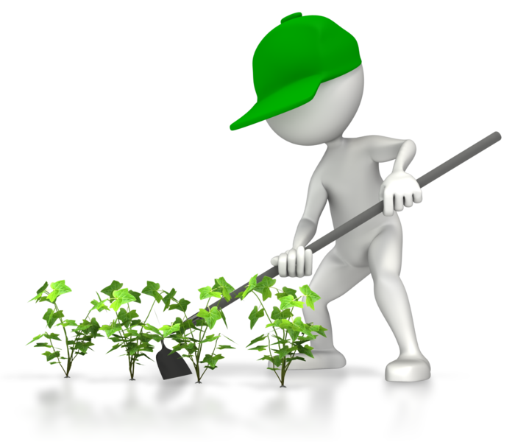
Helping children to connect with nature
Children can connect with nature through:
Outdoor play
Learning activities
Caring for nature, for example
planting seedlings/plants.

Slide 21

Include the thoughts of the children
Examples that you can discuss with the children:
Recycling – how items can be reused
Which animals live in your habitat
What animals need to survive in the environment
What we need to exist in the environment
Etc.

Slide 22
Activity 1D

Slide 23
Develop a sustainability management plan
1.5 Develop strategies to address these areas of change in consultation with children

Slide 24
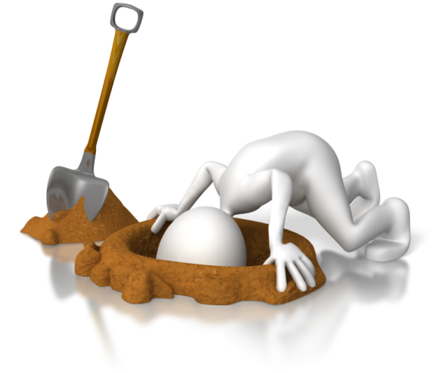
Develop strategies with the children
Strategies will help you and the service to plan for opportunities to achieve sustainability
Once the strategies have been identified, assess the potential impact of each, against the outcomes that you want to achieve.

Slide 25
Develop a sustainability management plan
1.6 Implement strategies and evaluate outcomes

Slide 26

Use your strategies
Allow time to ensure that the strategies are embedded into the practices of the service
Check how the strategies are working and if you have achieved the results you were hoping for
Evaluate the strategies and adjust them if needed.

Slide 27
Activity 1E

Slide 28
Support children to develop an understanding and respect for the natural environment
2.1 Provide children with a wide range of natural and recycled materials in their indoor and outdoor environments

Slide 29

Use natural materials for the service’s needs
Use natural and recycled materials as much as possible within the environments of the service for displays and for the children to interact with in activities and learning
You could construct an inside habitat area with logs, rocks and sand and other natural objects.

Slide 30

Use recycled items for sustainability
A recycled item can be anything that is no longer needed, and no longer serves its original purpose. With imagination, a lot of items can be adapted and reused within crafts, activities and displays.

Slide 31
Activity 2A

Slide 32
Support children to develop an understanding and respect for the natural environment
2.2 Create opportunities to discuss with children the natural environment and the interdependence between people, plants, animals and the land

Slide 33
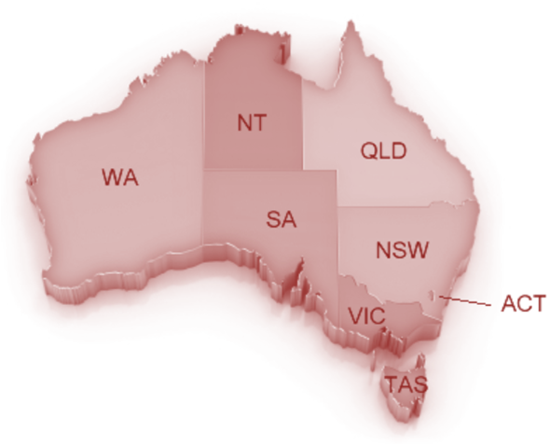
Talk about geography and the environment
Look at the different areas within Australia and at the range of wildlife that also lives there
Look at how the weather cycles are continually operating and at how they change.

Slide 34

Living with and off the land
Make opportunities to discuss the ways in which humans, animals and plants are dependent on the natural environment for their needs
Look at how we can also support the environment and give back to it, to replenish the resources that we use.

Slide 35
Activity 2B

Slide 36
Support children to develop an understanding and respect for the natural environment
2.3 Role-model respect, care and appreciation for the natural and constructed environments

Slide 37

Be a good role model for others
Treat all others with respect
Take time to appreciate your surroundings
Take care of your surroundings and environment
Look to sustainable practices above all others
Speak to parents and families and invite
them to visit and join in with activities at
the service
Speak kindly and take time to explain issues of sustainability to all.

Slide 38
Support children to develop an understanding and respect for the natural environment
2.4 Share information and provide children with access to resources about the environment and the impact of human activities on environments

Slide 39
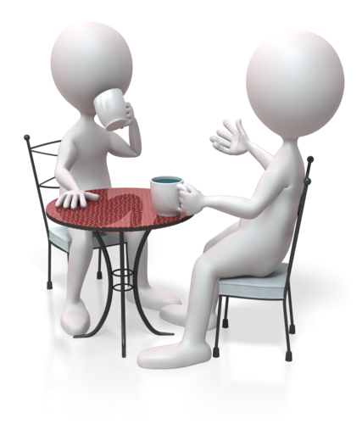
Our impact on the environment
Find out information about the ways that we use the environment and the effects that occur. Share this information with the service, the children and the families of the children.
Quantitative information –information sourced from verifiable facts and figures
Qualitative information – information based on narrative descriptions and characteristics.

Slide 40
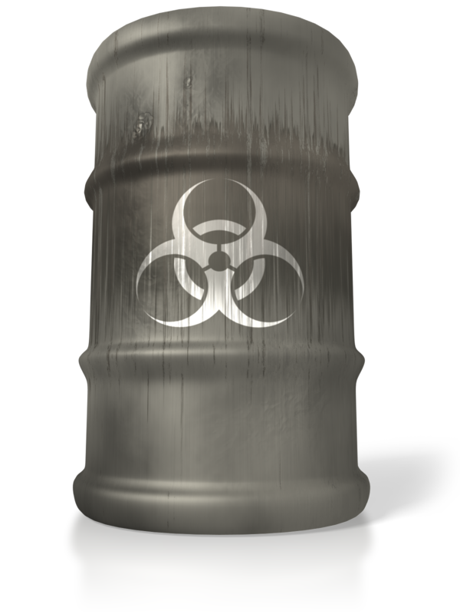
Human impact on the environment includes:
Deforestation
Land clearing for urban development
Introduction of non-indigenous species
Climate change
Depletion of the ozone layer
Energy use
Pesticides.

Slide 41
Activity 2C

Slide 42
Support children to develop an understanding and respect for the natural environment
2.5 Create spaces that promote the development of life skills, such as growing and preparing food, waste reduction and recycling

Slide 43

Cultivation
Create a garden for growing vegetables and herbs for food
Teach the children about the different types of food plants and about the parts of the plants that we can eat
Let them share the experience of taking care of and watering the vegetables and herbs.

Slide 44

Improvements to areas of waste
Ensure that the area for your waste and recycling is clearly laid out and that each bin is clearly marked for the relevant type of waste
Place trays or storage boxes within designated spaces to collect and store items that could be used in activities and crafts.

Slide 45

Create definite spaces for activities
You should look at the overall space you have for your group, look at how you can create separate spaces within this, with clear pathways and boundaries for each area
By creating different areas, you can create different themes and moods for the learning experiences you want to provide.

Slide 46
Activity 2D

Slide 47
Support children to develop an understanding and respect for the natural environment
2.6 Encourage children to exchange thoughts and ideas about sustainable practice through intentional teaching, learning experiences and projects

Slide 48

Learn about sustainability
Through the learning experiences and activities that are carried out, stimulate the children to think about how they can use sustainable practices.

Slide 49

Introduce fun projects for the children
Create a project around the subject of sustainability that the children can work on over time
You could encourage parents and families to participate with their children
Your service could introduce a sustainability program.

Slide 50
Activity 2E

Slide 51
Support children to develop an understanding and respect for the natural environment
2.7 Explore ethical dilemmas of waste disposal for sustainability with all stakeholders

Slide 52

Discuss waste management with the stakeholders
Stakeholders may include:
Service organisation
Service management
Service staff
Kitchen staff
Cleaning staff/company
Parents and families.

Slide 53

How can the service’s waste be managed better?
Look at:
Using reusable cloth nappies instead of disposable nappies (or use more eco-friendly versions)
Using less disposable items, such as wet wipes
Using and cooking only the amount of food that you need to use for that day
Etc.

Slide 54
Activity 2F

Slide 55
Support others in implementing sustainable practice
3.1 Encourage children to participate in sustainable practice discussions and learning experiences

Slide 56

Encourage others to participate in sustainable practices
Talk about sustainable options
Show examples of sustainable practices
Join together to form sustainable ideas and practices that all can use
Make it a part of everyday life
Provide enriching learning experiences to improve knowledge and inspire better practices for all.

Slide 57
Support others in implementing sustainable practice
3.2 Engage with adults and children to encourage their participation in the service’s sustainable practices

Slide 58

Engage with the community
Look to share information and examples of sustainability with the whole community
Look at examples of good environmental practices that are already being carried out within the community.

Slide 59
Activity 3A

Slide 60
Embed sustainability into service policies and procedures
4.1 Review the service philosophy, policies and procedures in relation to sustainable practice

Slide 61

A service philosophy
A philosophy describes the values and beliefs which will lay the foundation for the policies developed and used on a daily basis.

Slide 62

Make a review
Review your service philosophy
You should also check the service’s policies and procedures to ensure that these also correspond to the principles and practices of your service.

Slide 63
Embed sustainability into service policies and procedures
4.2 Identify areas of potential change in the service philosophy, policies and procedures

Slide 64

Identify areas of change
Once you have reviewed your documentation, look at the elements and areas that you may need to make changes to.

Slide 65
Activity 4A

Slide 66
Embed sustainability into service policies and procedures
4.3 Discuss with stakeholders any identified areas of potential change

Slide 67

Discuss any potential changes with stakeholders
Meet with stakeholders and discuss the suggested changes and improvements to sustainable practices within the service’s operations
Explain the strategies that were used to implement the new practices
Provide information on the outcomes, the successes and any problems encountered.

Slide 68
Embed sustainability into service policies and procedures
4.4 Finalise changes after agreement with appropriate stakeholders

Slide 69

Agree and finalise the changes to be made
Discuss with the relevant stakeholders the proposed changes, and whether these should be made
Confirm the changes with the stakeholders, so that agreements can be obtained.

Slide 70
Activity 4B

Slide 71
Summative Assessments
Summative assessments consist of:
Skills Activity
Knowledge Activity
Performance Activity.
Your assessor will provide you with further guidance on how and where to complete these assessments.

Slide 72

Summary and Feedback
Did we meet our objectives?
How did you find this session?
Any questions?

