Slide 1

CHCDIS002
Follow established person-centred behaviour supports

Slide 2

Housekeeping
Emergency procedures
Mobiles and security issues
Break times and smoking policy
This course is interactive – ask questions
Practise respect and confidentiality
Ground rules

Slide 3
Objectives
Discover how to apply a person-centred approach to minimise behaviours of concern
Know how to review context of behaviours of concern
Learn how to provide positive behaviour support according to individualised behaviour support plan
Understand how to complete documentation
Gain the skills and knowledge required for this unit

Slide 4

Apply a person-centred approach to minimise behaviours of concern
1.1 Support the person to maintain their activities of daily living in accordance with organisation policies and procedures and the individualised behaviour support plan

Slide 5

Support people to maintain daily activities
To help establish successful activities and routines that promote positive behaviour, a behavioural support plan will provide an effective map for managing and supporting this process.

Slide 6
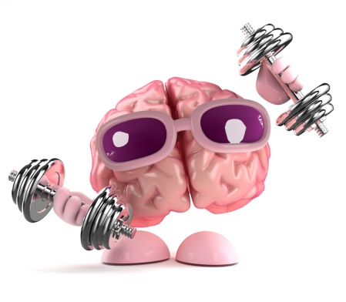
Behaviour support plans
This plan will identify the supports required for the person, their carers and family to address the unmet needs
It will include factors such as redesigning the environment, acquisition of skills and changing the systems already in place.

Slide 7

Positive interactions with all persons
Positive interactions may be characterised by the following:
Cultural sensitivity
Eye contact
Positive body language
Respect for personal preferences
Overcoming difficulties in communicating.

Slide 8

Activity 1A

Slide 9
Apply a person-centred approach to minimise behaviours of concern
1.2 Consider the person’s individual needs, strengths, capabilities and preferences when engaging in activities of daily living and routines

Slide 10

Person-centred approach
This type of approach to care focuses on viewing each client as an individual
By honing in on the individual interests, needs, strengths and preferences, you can deliver a much more personal and tailored service.

Slide 11

Strengths-based approach
You should take the opportunity to move away from looking at what the client can't do and focus on what they are capable of. This is known as a strengths-based approach.

Slide 12

Engage people in daily activity
In order to engage people, activities need to possess the following qualities:
Meaning
Input
Expectations
Freedom
Belief
Targets
Working relationships.

Slide 13
Activity 1B

Slide 14
Apply a person-centred approach to minimise behaviours of concern
1.3 Identify problems with engaging or motivating the person and seek appropriate assistance

Slide 15
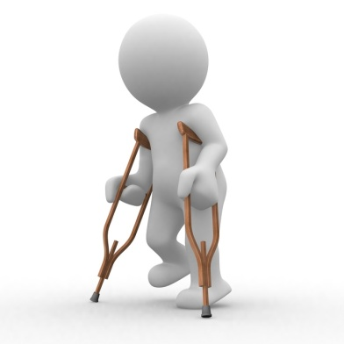
Problems with engaging clients
This can be down to a multitude of reasons, such as:
Client is emotional
Client is not feeling well
Client does not enjoy the activity
Client has a personal problem with staff
The environment is unfamiliar
Mental disorders
Physical disorders.

Slide 16

The social model of disability
The social model of disability dictates that disability is a result of the organisation of society and its views, rather than the physical or mental impairment itself.

Slide 17

The impact of social devaluation on an individual’s quality of life
Social devaluation is when you (or a group of people) attribute low or no value to an individual or a group on the basis of a certain characteristic – this is usually a difference.

Slide 18

Social role valorisation (SRV)
This may include:
Respect
Dignity
Acceptance
Self-worth
Education
Value of their opinion
Better standard of living
Opportunities for work.

Slide 19
Activity 1C

Slide 20
Apply a person-centred approach to minimise behaviours of concern
1.4 Provide a safe environment for the person conducive to positive and adaptive responses

Slide 21

Safe environments
Providing a safe and predictable environment may include:
Containing the person
Having familiar people present
Having familiar items and resources
Removal of hazards
Etc.

Slide 22

Positive and adaptive responses
Positive response:
This is where the person responds to the environment with a desirable behaviour and does not react unexpectedly.
Adaptive response:
This is where the person with a disability uses their other functioning aspects of the body in order to adapt to their environment and complete tasks.

Slide 23
Activity 1D

Slide 24
Review context of behaviours of concern
2.1 Recognise behaviours of concern outlined in the individualised behaviour support plan

Slide 25

Check your behaviour support plan
Your behavioural plan may include:
Client information
Activities (daily and weekly)
Behavioural concerns and the triggers Areas/factors to be avoided
Physical, sensory and social interaction needs
Strategies to employ for positive behaviour in activities
Etc.

Slide 26

Behaviours of concern
Behaviours of concern can be defined as:
“Behaviour of such intensity, frequency and duration that the physical safety of the person or others is placed or is likely to be placed in serious jeopardy, or behaviour which is likely to seriously limit use of, or result in the person being denied access to ordinary community facilities, services and experiences.”
(Emerson 1995)

Slide 27
Activity 2A

Slide 28
Review context of behaviours of concern
2.2 Consider what happened before, during and after the behaviour of concern

Slide 29

Situations causing concern
Consider the following:
What led to the incident
The signs that were displayed by the client immediately beforehand
The incident itself
Whether the client was not having a need met
The duration and the intervention needed (if any)
Etc.

Slide 30

Engage in inclusive communications
You may need to:
Use short words and sentences
Use repetition
Use visual aids, such as picture cards
Take time to listen
Communicate by sign language
Communicate in writing
Etc.

Slide 31
Activity 2B

Slide 32
Review context of behaviours of concern
2.3 Consider the type, frequency and triggers of the behaviour

Slide 33

Behaviour likely to put the person and/or others at risk of harm
Behaviour likely to put the person and/or others at risk of harm may:
Have the potential for physical harm or destruction
Last for an excessively long time
Isolate the person
Interfere with the person’s learning
Etc.

Slide 34

Triggers of behaviour
The triggers of behaviour can be audible, visual, sensual, olfactory or taste-related. They can be situational or environmental, time-related and many other things.

Slide 35
Activity 2C

Slide 36
Review context of behaviours of concern
2.4 Consider environmental factors in the context of the behaviour

Slide 37

Environmental factors
Environmental factors can be described as any other external influence impacting upon the client.
These may include:
People
Location and type of environment
Objects in the environment
Etc.

Slide 38

Environmental re-design
By changing staff attitudes and controllable physical aspects, you can ensure that behaviours of concern have a minimal chance of occurring.

Slide 39
Activity 2D

Slide 40
Review context of behaviours of concern
2.5 Consider the person’s emotional well-being in the context of the behaviour

Slide 41

Ensure emotional wellbeing
It is important for emotional wellbeing to interact and be a part of society
Keep a check on your clients’ responses and reactions when participating in activities, and be aware of potential mood changes
It is important that activities can be performed and that a sense of achievement is made.

Slide 42

Behaviour of concern
If behaviour of concern is triggered, knowing and understanding your client will help you assess if their outburst will cause them, or you, harm
You may be able to distract your client and change their frame of mind, or develop methods that resolve a client’s negative behaviour.

Slide 43

Critical incident counselling
One form of crisis management is critical incident (CI) counselling. It is one of the therapy tools belonging to the field of crisis management
CI counselling is therefore focused on how to immediately reduce stressful reactions and return emotions to their normal state.

Slide 44
Activity 2D

Slide 45
Review context of behaviours of concern
2.6 Consider the person’s health status in the context of the behaviour

Slide 46

Looking at the health of the client
Health status may include:
Under the influence of alcohol
Under the influence of drugs
Wounded
Normal
Elevated heart rate
Elevated blood pressure
Excessive sweating
Dilated pupils
Pain in a specific area.

Slide 47

Consider the nutrition needs of the client
It is important that the correct nutrition is being received by your client to maintain their health and energy levels
Check with your client’s family or carer(s) that their diet is appropriate and contains the right balance of food types for the individual and their condition, and that they are eating as required.

Slide 48
Review context of behaviours of concern
2.7 Consider the person’s medication in the context of the behaviour

Slide 49

Medication requirements
You will need to observe and record person's medication in the context of harmful behaviour as, again, this can be used to assess and reduce the behavioural triggers.

Slide 50

Duty of care
It requires an individual to provide a standard of reasonable care while carrying out any activity that could potentially harm others. Breaching duty of care means that you, as an individual, are liable to legal action from the claimant.

Slide 51
Activity 2F

Slide 52
Review context of behaviours of concern
2.8 Record all observations accurately and objectively in consultation with supervisor using terms that can be clearly understood

Slide 53

Keeping records
It is part of your legal and organisational requirements to record information on your work with your clients
This helps to document changes, progress and any areas of concern for the client and also keeps accurate accounts for your organisation.

Slide 54

Your records of observations may include:
Client activities, how they respond and how well they carry these out
Client social/leisure activities undertaken and the responses of the client
Changes in any routines/circumstances
Behaviours of concern and their frequency
Progress made against objectives/goals
Etc.

Slide 55

Further records
You may also need to fill out other documentation for your organisational requirements.
This may include:
Incident and accident reports
General administration.

Slide 56
Activity 2G

Slide 57
Provide positive behaviour support according to individualised behaviour support plan
3.1 Recognise the difference between appropriate and inappropriate interventions when addressing behaviours of concern

Slide 58
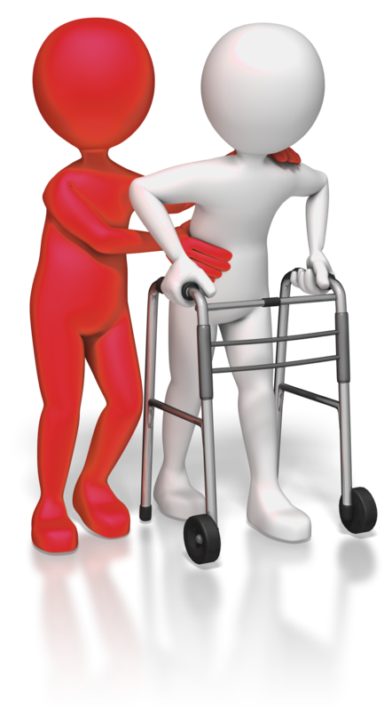
Defining appropriate interventions
Intervention should be used only if necessary to control and calm a situation of difficult behaviour, and if the safety of any persons present is in doubt
Using a positive behaviour support strategy in your interventions will help you to maintain the dignity and human rights of the client.

Slide 59

Understanding inappropriate interventions
Inappropriate interventions are those that infringe on a person’s dignity and quality of life
Actions that do not support the wellbeing of the individual, such as physical restraint can be detrimental to the individual.

Slide 60
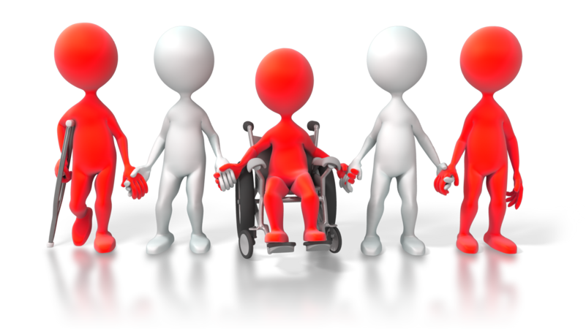
Disability Discrimination Act 1992
Equal opportunities and access for those with a disability is specified. It works against discrimination to disable persons and their family members or carers.

Slide 61
Activity 3A

Slide 62
Provide positive behaviour support according to individualised behaviour support plan
3.2 Interpret and follow behavioural support strategies

Slide 63

Devise strategies for positive behaviour support
Strategies help you to determine and choose a course of action for achieving goals and objectives. By planning how best to achieve a goal, you are able to identify what can and needs to be done to get you to that point.

Slide 64

Strategies that avoid behaviour escalation
Showing empathy
Re-direction
Distraction
Removing stimuli
Removing them from the environment containing the stimuli.

Slide 65
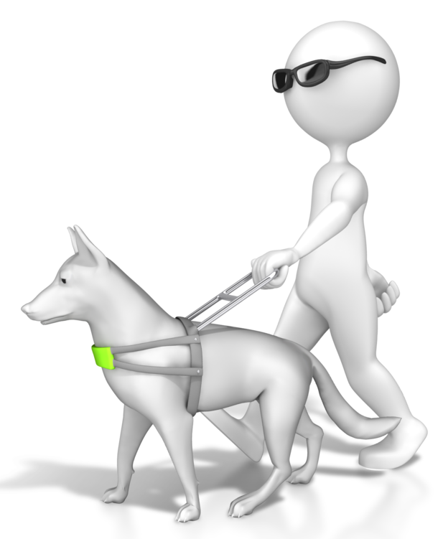
Strategies of positive behaviour support include:
Using clearer methods of communication, to help them understand daily life
Changing their work and home environment to meet their needs and remove behavioural triggers
Adding interesting and enjoyable activities into their routine/life
Etc.

Slide 66

Reinforcement
Positive reinforcement:
This is where a motivating reward/stimulus is presented in response to the behaviour.
Negative reinforcement:
This is when a certain stimulus is removed when a particular behaviour is exerted.

Slide 67
Activity 3B

Slide 68
Provide positive behaviour support according to individualised behaviour support plan
3.3 Ensure that all interventions are in line with the plan and organisation policies and procedures

Slide 69

Using a behavioural support plan
All of the aforementioned observations of behavioural triggers, environment context, emotional wellbeing, health status and medication will be used in your behavioural support plan
Ongoing records of the client’s activities will also reflect the progress made and will refer to the plan.

Slide 70

Responding to behaviours of concern
Once triggers and behaviours are identified, the plan must be adapted to address and resolve them. This should involve discussion between carers, care home managers, family carers and the person with a disability themselves.

Slide 71
Activity 3C

Slide 72
Provide positive behaviour support according to individualised behaviour support plan
3.4 Follow organisation procedures to ensure safety of the person, self and other people

Slide 73

Safety is paramount
In your work, there is the chance that unknown factors will give rise to a difficult situation when you are with a client
Looking for the triggers before they escalate will help you to alter a situation to a manageable one
Knowing and understanding your client will ensure that you minimise or eliminate such situations.

Slide 74

Organisational procedures
Your organisation will have established procedures that are designed to cover all circumstances and eventualities
Make sure you are aware of all procedures that impact upon your job role.

Slide 75
Activity 3D

Slide 76
Provide positive behaviour support according to individualised behaviour support plan
3.5 Respond to critical incidents in accordance with organisation’s intervention and notification procedures

Slide 77
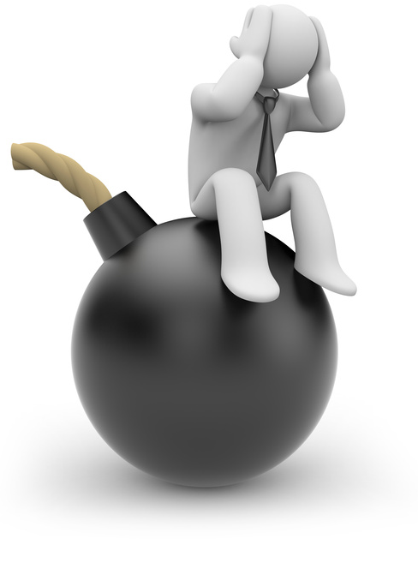
Crisis management
In the event of an unexpected or event, you should have a crisis management plan available and ready
This is a reactive strategy, which clearly tells staff how to respond during an undesirable behaviour episode
The role of the strategy is to keep people safe and to de-escalate a crisis.

Slide 78

Use of basic self-protective strategies
You should employ passive self-defence at all times – in other words, being aware of your surroundings at all times and making decisions accordingly. The aim here is to avoid getting into a physical confrontation.

Slide 79
Activity 3E

Slide 80
Provide positive behaviour support according to individualised behaviour support plan
3.6 Monitor strategies to determine effectiveness in consultation with supervisor

Slide 81

Monitoring strategies
Observing the strategy
Questioning the person in charge of implementation
Gathering feedback
Participating yourself.

Slide 82

Strategies can be judged based on:
Skill
Reactions
Cost
Lifespan
Difficulties
Special requirements
Resources available.

Slide 83

Positive lifestyle enhancement strategies include:
Motivation
Stress management
Engaging in meaningful activities
Support relationships
Improvements to the environment and systems.

Slide 84
Activity 3F

Slide 85
Provide positive behaviour support according to individualised behaviour support plan
3.7 Identify and report changes in person’s needs and behaviours in consultation with supervisor

Slide 86

Opportunities for skill development
This can include things like:
Communication opportunities
Direct education
Exposing clients to new situations
Social interaction
Problem-solving
Physical activities
Group activities.

Slide 87
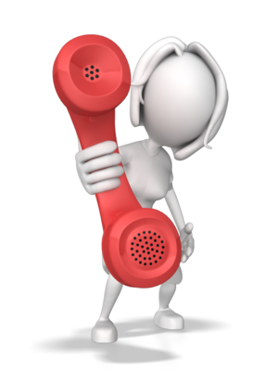
Identify and report changes in person’s needs
People will change as time goes by, whether this is in a physical or mental capacity – as such their needs will change accordingly.

Slide 88

Changes to clients’ personal care requirements can be related to:
Sensory difficulties
Mobility issues
New conditions
Injuries
New requirements
Worsening of existing condition
New or changed preferences.

Slide 89
Activity 3G

Slide 90
Provide positive behaviour support according to individualised behaviour support plan
3.8 Follow referral procedures in consultation with supervisor

Slide 91
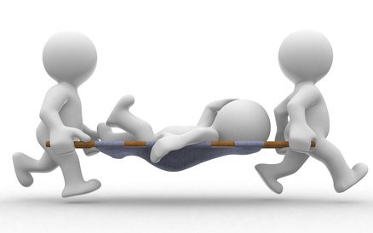
Referral procedures for specialist services
The services you may need to refer clients to include:
Psychologists
Psychiatrists
Local doctor/nearest hospital
Emergency rescue services
Critical incident counsellors
Educational support.

Slide 92

Working with specialists
When determining the best care and support for your client you should look at the options available and match this against the needs of your client
Consult with your supervisor to discuss the outcome and to decide upon the best course of action
Information on the client will be shared in confidence with the specialist, as relevant to the needs of the referral.

Slide 93
Activity 3H

Slide 94
Complete documentation
4.1 Comply with the organisation’s reporting requirements

Slide 95

Documentation
Documentation should be completed as soon as possible after any event/incident
Written documents can include progress reports, case notes and incident reports
Progress notes are legal documents and should be written in the active voice rather than the passive.

Slide 96

Documents should be:
Concise
Objective
By exception
Appropriate in language and terminology (no slang, unless recording direct speech)
Include only necessary information.

Slide 97

Verbal reports
These can be done face-to-face or over the telephone. You should use this method of reporting when communication is required urgently, or in an emergency situation i.e. those involving the immediate safety of carers or the people in care.

Slide 98
Activity 4A

Slide 99
Complete documentation
4.2 Maintain documentation according to organisation’s requirements

Slide 100

Maintaining records appropriately
Documentation must be maintained in line with reporting requirements – this means ensuring that it is kept in a safe place, backed up and easily accessible for future use. It can also mean updating and amending existing documentation.

Slide 101

Sorting and filing documents
Pick up each document or folder and decide what needs to be done with it and what you need to keep
If you find some documents that should not be sitting with you, try to send it to the appropriate personnel
After sorting the documents, you will be ready to file them into their respective folders and into a clear system of storage.

Slide 102
Activity 4B

Slide 103
Skills and Knowledge Activity

Slide 104
Major Activity
This activity should take anywhere between 1-2 hours to complete and can be found at the end of your workbook.
Your instructor will let you know whether they wish for you to complete it in session time or your own time.

Slide 105

Summary and Feedback
Did we meet our objectives?
How did you find this session?
Any questions?

Slide 106

Congratulations!
You have now finished the unit…
‘Follow established person-centred behaviour supports’

