Slide 1
Bsbwhs414 prac 1
BSBWHS414
Hazard number 1
Noise pollution

Slide 2
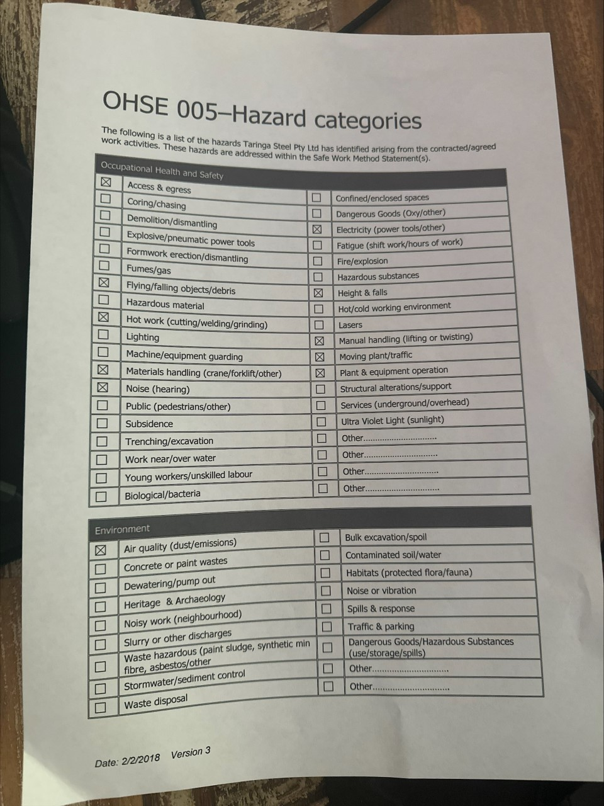
Workplace checklist

Slide 3
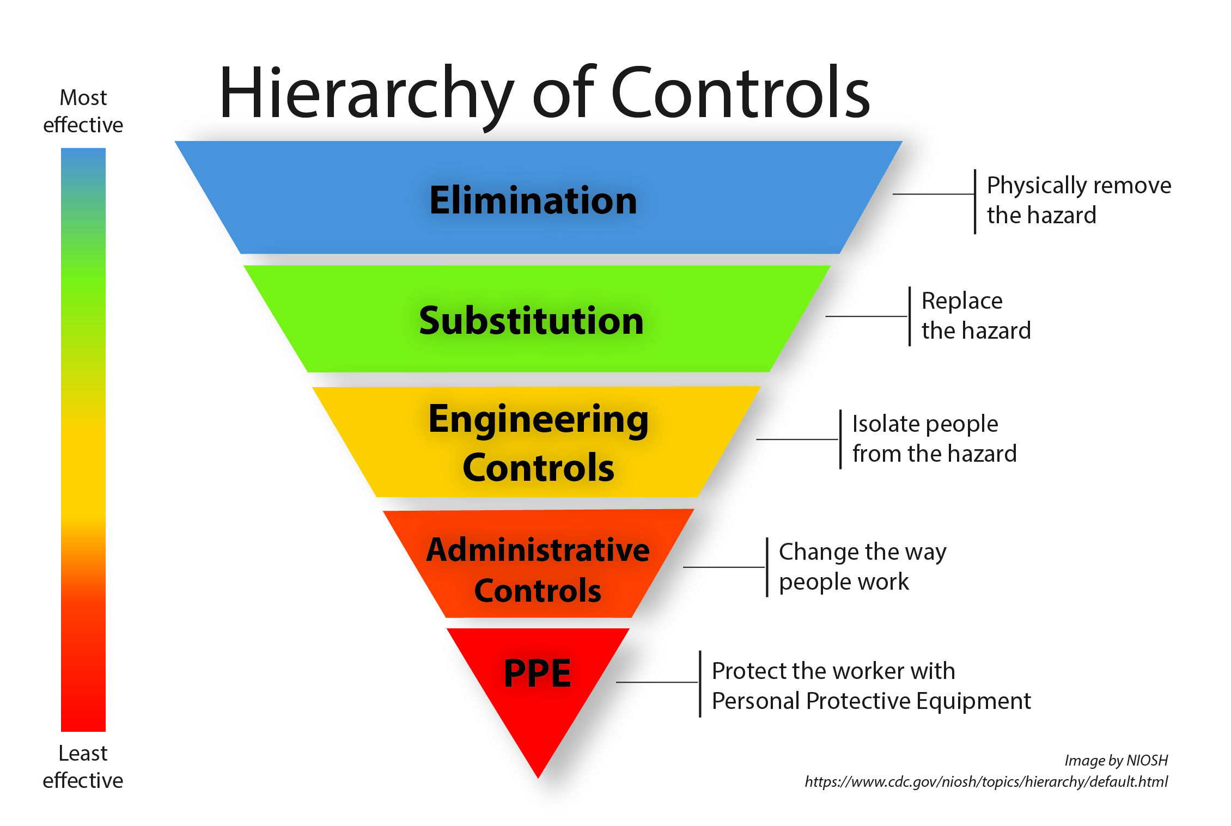
Hazard identification 1 – noise pollution

Slide 4
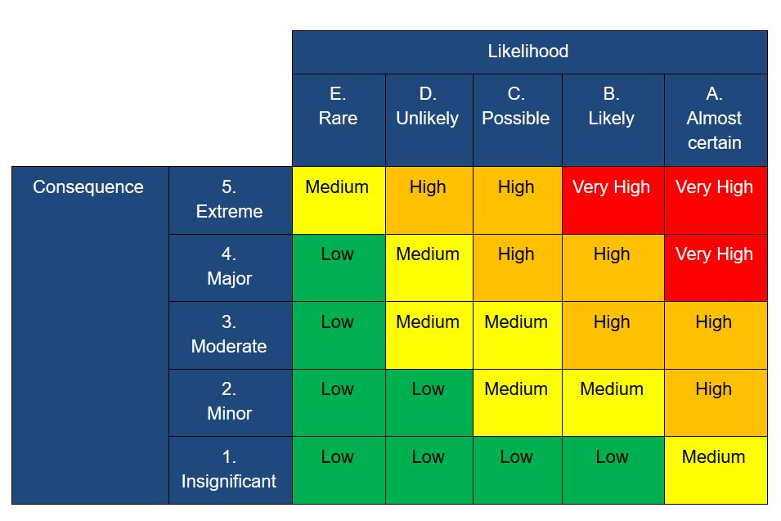
Risk matrix

Slide 5
Noise pollution risk assessment.
Noise pollution is put at a medium risk. Going off the risk matrix its consequence is moderate, but chances of being exposed are medium.
Using the hierarchy of control we can come to the conclusion excessive noise cannot be eliminated in the steel fabrication industry with grinders and hammers constantly being used. However mandatory ear plugs eliminate the exposure down to a mandatory level.
It is up to the pcbu to monitor decibel limits in workshops and provide employees with ear protection if needed.
It is also up to the employee to wear the earplugs if written in work policies
section 19 (3)(g) of the work health and safety act 2011 (qld) outlines that a pcbu must ensure, so far as reasonably practicable, that the health and safety of workers and the conditions at the workplace are monitored for the purpose of preventing illness and injury of workers arising from the conduct of the business or undertaking.
Section 28 of the work health and safety act 2011(qld) outlines that workers are to comply, so far as they are reasonably able, with any reasonable instruction given by the pcbu to allow the pcbu to comply with whs laws, and cooperate with any reasonable policy or procedure of the pcbu relating to health or safety at the workplace that has been notified to workers (e.g. implement risk controls as specified by the pcbu)

Slide 6
Recommendations
As the HSR my recommendations for monitoring the noise pollution risk are as follows
1- Pcbu to monitor noise levels
2- have policies in place to make earplugs mandatory
3- Ear protection to be provided by workplace as required

