Slide 1

BSBSMB407
Manage a small team

Slide 2

Housekeeping
Emergency procedures
Mobiles and security issues
Break times and smoking policy
This course is interactive – ask questions
Practise respect and confidentiality
Ground rules

Slide 3
Objectives
Discover how to develop staffing plan
Know how to recruit, induct, train and retain team
Learn how to comply with industrial relations obligations
Understand how to maintain staff records
Recognise how to manage staff
Develop the skills to review team performance
Gain skills and knowledge required for this unit

Slide 4

Develop staffing plan
1.1 Determine staffing requirements to allow the business to run effectively, in accordance with requirements outlined in the business plan
1.2 Identify and compare existing skills/competencies of owner/s and staff with business requirements to identify any gaps

Slide 5

Staffing requirements
Staffing requirements may include:
Full-time, part-time, permanent, temporary or casual
Number of staff
Self, other owners,
Family and/or friends
Sub-contractors
Time commitment.

Slide 6
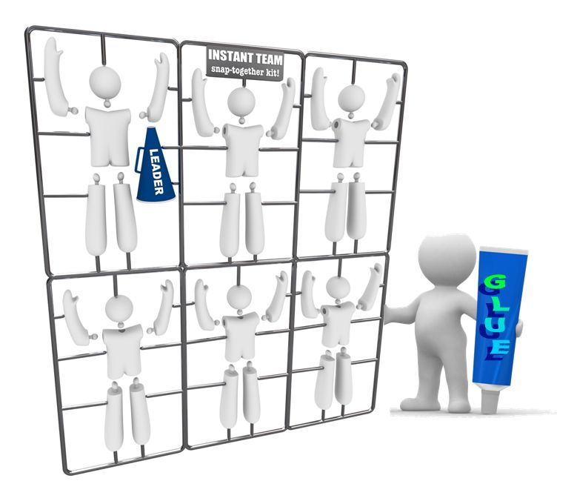
Determine staffing requirements
Assume the Business Plan is completed, which would outline the purpose of the business.

Slide 7
Organisational chart
Project manager
Line manager
Team member
Team member
Team member

Slide 8
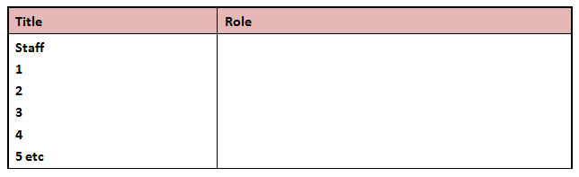
Staffing needs
Staffing needs may include:
List of roles
Management structure
Job descriptions
Number of employees
Availability
Training plan.

Slide 9

Activity 1A

Slide 10
Develop staffing plan
1.3 Develop policies and procedures for owner/s and staff, in accordance with the business plan

Slide 11

Types of procedure
Types of procedure may include:
Complaint and grievance procedures
Culturally appropriate entitlements and procedures
Employment conditions, equal opportunity, anti-discrimination, cultural diversity
Induction and training
WHS
Recruitment and selection
Performance measures
Professional development.

Slide 12
Activity 1B

Slide 13
Recruit, induct, train and retain team
2.1 Develop job/position descriptions, competencies required and selection criteria to meet business’ needs

Slide 14

Key elements
The three key elements of job/position descriptions are:
Position profile – outlines the details of the job e.g. job title, department etc.
Position summary – briefly explains the purpose of the position
Selection criteria – the qualifications and experience needed for the role.

Slide 15
Activity 2A

Slide 16
Recruit, induct, train and retain team
2.2 Judge information obtained from each candidate against specified selection criteria, and select according to business needs and legal requirements

Slide 17

Addressing the selection criteria
You should consider:
Do they have prerequisites for the position?
Do they have special requirements in your organisation e.g., certifications or special education?
What qualifications and attributes are critical to high performance in this particular position?

Slide 18

Attributes
Important attributes may include:
Flexibility
Achievement Oriented
Initiative
Professionalism
Decisiveness
Integrity
Attention to detail
Independence.

Slide 19

The process
The selection process involves:
Looking for key criteria e.g. basic qualifications
Setting up a process to flag and identify your top candidates e.g. tiering/rating
Extending an invitation e.g. to interview or further selection event.

Slide 20
Activity 2B

Slide 21
Recruit, induct, train and retain team
2.3 Induct new staff members in accordance with policies and procedures of the business
2.4 Induct new staff members in accordance with policies and procedures of the business

Slide 22

Inductions
You staff start, you should:
Introduce them to other staff
Show around premises
Provide uniform, locker, email, passwords
Appoint a work colleague as a 'buddy'
Informal staff meetings
Documented probationary meetings
Remember – induction is ongoing.

Slide 23

Duty of care
As an employer in Australia you have a duty of care to ensure all employees are protected.
New staff need to be made aware of:
Possible threats to their health and safety
Procedures that ensure they do not suffer injury or illness while at work
The proper use of protective equipment.

Slide 24
Activity 2C

Slide 25
Recruit, induct, train and retain team
2.5 Develop and implement a staff development program and career paths based on requirements of business and staff competencies

Slide 26

Staff development program and career paths
Development programs may include:
Attendance at courses
Career planning
Coaching
Flexible learning
Job rotation
Mentoring
On-the-job training
Professional development
Succession planning.

Slide 27
What should they ensure?
Contain input from staff
Respond to needs identified in staff feedback
Be flexible enough to change as priorities shift
Be consistent with the organisations overall planning and strategy process
Support supervisors in their role as developers of staff
Advise and guide staff of development options
Align the development program activities with the strategic direction of the organisation
Highlight any other priority issues.

Slide 28
Activity 2D

Slide 29
Recruit, induct, train and retain team
2.6 Advertise staff vacancies appropriately in accordance with staffing plan

Slide 30

Advertising methods
There are many different advertising methods available to advertise vacancies:
Electronic (radio, television and internet)
Noticeboards
Print media
Word-of-mouth.

Slide 31

Things to avoid
Try to avoid:
Job listing is too vague
No mention of required skills
Job listing is incomplete
Too many requirements
Impossible requirements
Asking candidates their salary requirements
Job listing illegally asks for personal information
No call to action.

Slide 32
Activity 2E

Slide 33
Comply with industrial relations obligations
3.1 Clarify workplace rights and obligations of employers and employees, in accordance with legal requirements and codes of practice

Slide 34

Industrial relations
Is the framework for work conditions and sets the guidelines for the workplace relationship between employer and employee.
In Australia, Awards and Enterprise Agreements set the terms and conditions of work for over 80% of wage and salary earners.

Slide 35
The new Fair Work system
Key elements of the new system includes a legislated safety net of 10 National Employment Standards.
This includes:
New modern awards
Revised enterprise bargaining arrangements
Streamlined protections e.g. protection against discrimination and unfair dismissal
Two new organisations to regulate the system: Fair Work Australia and the Fair Work Ombudsman.

Slide 36

Fair Work Information Statement
Fair work includes:
Maximum weekly hours of work
Request for flexible working arrangements
Parental leave and related entitlements
Annual leave
Personal/compassionate leave
Community service leave
Long service leave
Notice of termination and redundancy pay.

Slide 37
WHS legislation and codes of practice
WHS legislation includes:
Common law duties to meet the general duty of care requirements
Health and safety representatives and committees
Prompt resolution of health and safety issues
Provision of information, induction and training
Regulations relating to hazards present in work area
Relevant state/territory legislation
Maintenance and confidentiality of records.

Slide 38

Discrimination
Employees should be treated equally, regardless of:
Race
Religious belief or activity
Sex
Marital status
Pregnancy
Sexual orientation
Disability
Age.

Slide 39

Unacceptable workplace behaviours
Policies and training should be in place to minimise the likelihood of these behaviours:
Bullying
Harassment
Sexual Harassment
Workplace Violence
Threat
Physical attack.

Slide 40
Activity 3A

Slide 41
Comply with industrial relations obligations
3.2 Counsel staff, if required, in a positive and constructive manner and record outcomes accurately

Slide 42

Counselling policy
A commitment to improving performance or conduct by an employee using staff counselling and a performance management review process
Several forms of warnings, opportunities for improvement and personal counselling.
The employee has been given adequate opportunity to improve.

Slide 43

Reoccurring behaviour
If the employee has recurring problems, you could:
Demote the employee to a lower level position
Suspend the employee without pay from work for a specified period of time
Terminate the employment of the employee.

Slide 44
Activity 3B

Slide 45
Maintain staff records
4.1 Develop staff records system to provide timely and accurate information, in accordance with confidentiality, legal and taxation requirements
4.2 Monitor and accurately maintain system for recording and retrieving personnel and payroll information, and seek specialist advice where required

Slide 46

Developing staff records
Staff records system must include:
Disciplinary and grievance procedures
Employee records (including tax file number, remuneration, leave and training records)
Job/position descriptions
WHS record
Records of taxation and superannuation payments made.

Slide 47

Manual and electronic record
Manual record keeping systems consist of paper based records in journals, books and other formats.
It is usual for complete IT infrastructure, including record keeping.

Slide 48
Record keeping system
Make your record keeping system:
Useful — Don’t waste your time keeping records you will never use
Easy to use — Simple and neat to encourage you to use the system
Accurate — Bad records can lead to poor decisions
Compulsory – These are the records you are required to keep by law e.g. financial records for tax returns.

Slide 49
Activity 4A

Slide 50
Manage staff
5.1 Regularly review contribution and skills of self and other team members to ensure performance is in line with agreed performance measures

Slide 51

Performance measures
Performance measures may relate to:
Overall staff productivity
Percentage of chargeable hours/days per week
Performance of key people
Ratio of direct workers to those who support, supervise or manage them
Ratio of sales dollars per employee
Staff morale, work ethic, work satisfaction.

Slide 52

Reviewing staff performance
The most difficult part of the performance appraisal process is to accurately and objectively measure the employee performance.
Measuring performance will generally cover a range.
This can vary depending on the organisation, role, industry, reason to appraise, outcomes and objectives.

Slide 53

Feedback
Feedback should be collected from a range of sources:
Supervisors
Peers
Customers
Clients
Providers of products to the business (vendors)
The employee.

Slide 54

Be prepared
Look at:
Job description
Performance standards
Planned performance goals
Performance measures collected throughout the time period
Any critical incidents details
Past appraisals of the employees.

Slide 55
Set future goals or recommendations
Type of goal | Details
Specific | Become more proficient in..................................
Measurable | You will need to track your performance in .................through training programs XYZ.
Actionable | You will need to attend: Counselling session.......... Training program.............. External course............
Realistic | The deadline set for completing these tasks is 1 year....... This should be sufficient time for you to complete the tasks but an application for any extension must be made within 3 months.
Time | Complete by January 1, 2013 in time for next year’s appraisal process.

Slide 56
Activity 5A

Slide 57
Manage staff
5.2 Monitor and adjust staffing requirements to respond to any changes in tasks and functions required by the business

Slide 58

Monitoring and adjusting staffing requirements
Budget and operating costs will often dictate change.
Changes in tasks and functions occur after:
Appraisals
Resignations
Skills upgrades
Product changes
Industry change and general business directions.

Slide 59

Determine workload data
Determine the core aspects of your business and any ongoing projects unfulfilled.
Identify areas that are technically complex or need specialist training.
Review the labour or applicant pool that you may have on file.
Factor in a staffing relief for shortages.

Slide 60
Activity 5B

Slide 61
Manage staff
5.3 Support and encourage staff, and acknowledge and reward their contribution
5.4 Regularly provide opportunities for staff to discuss work related

Slide 62

Support and encourage staff
Recognition of achievement in the form of positive feedback should be a regular management and good business practice.
Owners and managers are responsible for contributing to a work culture that rewards and recognises staff achievements.

Slide 63

Flexible recognition
You should:
Allow flexible work schedules
Give time for family or personal issues
Send a handwritten note
Create a weekly event to boost morale
Reward effort as well as success
Applaud their efforts.

Slide 64

Employee engagement
Engagement is a key strategy that drives employee performance.
Employees are most engaged when they are accountable and can see and measure the outcomes of their performance.

Slide 65
Activity 5C

Slide 66
Manage staff
5.5 Develop contingency plans to cope with unexpected or extreme situations and take appropriate corrective action as required

Slide 67

Contingency plans
Contingency plans are good for:
Accidents or emergencies
Environmental issues
Fluctuating workloads
WHS
Unpredicted customer demand/busy periods
Unpredicted staff shortages.

Slide 68
A continuity plan
A contingency plan’s purpose is to ensure the continuation of business activities during and following any unexpected or extreme situation or incident.
Planning for prevention
Being prepared
Responding
Recovery

Slide 69

What do you need to do?
Create a distribution list for the contingency plan.
Conduct a risk management.
Identify critical business activities and conduct an impact analysis to determine the level of disruption.
Recovery means returning to business activities as normal – how long would this take?

Slide 70
Activity 5D

Slide 71
Review team performance
6.1 Develop positive and constructive relationships with and between team members

Slide 72

A common purpose
A team’s purpose and its performance are closely related.
Without a common purpose a team will quickly break apart and operate as a collective of individuals or smaller teams.
Usually some form of direction from management creates the momentum for the team to begin operating.

Slide 73
Activity 6A

Slide 74
Review team performance
6.2 Review and update team objectives in support of business goals on a regular basis in consultation with team members

Slide 75

Specific performance goals
Specific performance goals:
Allow broad objectives to be broken down into measurable units of achievement
Facilitate clear communications and constructive conflict within the team
Allow the team to focus on achieving.

Slide 76

Mutual accountability
Mutual accountability creates a team; until this is present the group will remain simply that, a group.
This accountability underpins two critical aspects of teams, commitment and trust.

Slide 77
Activity 6B

Slide 78
Review team performance
6.3 Identify strengths and weaknesses of team against current and expected work requirements

Slide 79
The team challenge
Consider:
Can you convene easily and frequently?
Can you communicate with all members easily and frequently?
Are your discussions open and interactive for all members?
Does each member understand the others’ role and skills?
Do you need more people to achieve your ends?
Are sub teams possible or necessary?

Slide 80

Strengths and weaknesses
First you need to identify the skills and training that your team has.
Next assess whether the team has got adequate levels of complementary skills.
You will need to look at relevant skills for the job/responsibilities.
Take information from supervisor feedback and performance reviews.

Slide 81
Activity 6C

Slide 82
Review team performance
6.4 Schedule time, on a regular basis, for team members to review work operations to maintain and improve operational

Slide 83

Reviewing your approach
Think about:
Is the approach concrete, clear and really understood and agreed to by everybody?
Will it result in achievement of the objectives?
Will it capitalise on and enhance the skills of all members?
Is it consistent with other demands on the members?

Slide 84

Maintaining and improving
Encourage team members to identify ways to maintain good performance and improve by providing opportunities for discussion and feedback.
This can be through:
Meetings
One-to-one sessions
Drop-in sessions
Brainstorming sessions
Suggestion boxes.

Slide 85
Activity 6D

Slide 86
Review team performance
6.5 Encourage team members to monitor their own performance, suggest improvements and identify professional development needs, in accordance with personal and business requirements

Slide 87

Tuckman’s Stages of Team Development
Forming – transition from individual to member status.
Storming – figuring out how to work together and can involve conflict
Norming – a team’s opportunity to make up.
Performing – the team is functioning well and producing measurable outcomes.

Slide 88

The W.I.S.H. Team Review
WELL – Looking at what you do WELL as a Team
IMPROVE – Looking at what needs to be IMPROVED in your team.
STRATEGY – What strategy do you need to develop to improve your teamwork
HOW - Now that you have a strategy – HOW are you going to implement it into your team environment?

Slide 89

Areas to consider
Think about:
Your attitude
Your skills
Your communication
Your abilities
Your level of co-operation
Your compatibility.

Slide 90
Activity 6E

Slide 91
Review team performance
6.6 Monitor and review staff turnover rate

Slide 92

Measuring and benchmarking turnover
You can measure your current staff turnover in percentage terms. Try this formula example.
Add together the number of staff working at the beginning of the time period and the number of staff working at the end of the period and divide by two.
This will give you your average number of staff working within this time period - you will need this number for the next stage.

Slide 93

Patterns of employee turnover
The characteristic pattern of employee turnover is high for new staff, then decreasing. This pattern will vary in any single organisation and can be shown graphically.
It is known as the 'survival curve' and can be extremely helpful in understanding the nature of employee turnover, but must always be used in conjunction with employee turnover rate.

Slide 94
Activity 6F

Slide 95
Skills and Knowledge Activity

Slide 96
Major Activity
This activity should take anywhere between an 1-2 hours to complete and can be found at the end of your workbook.
Your instructor will let you know whether they wish for you to complete it in session time or your own time.

Slide 97

Summary and Feedback
Did we meet our objectives?
How did you find this session?
Any questions?

Slide 98

Congratulations!
You have now finished the unit…
‘Manage a small team’

