Slide 1

PLANT
WORK HEALTH AND SAFETY OFFICER

Slide 2
Assessment Criteria
Describe the legislative interpretation of plant
Describe employers obligation with respect to plant in a workplace
Describe the general principles of risk management as they apply to plant

Slide 3
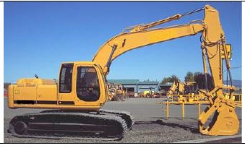
Definition of Plant
Plant includes any machinery, equipment, appliance, container, implement and tool, and includes any component or anything fitted or connected to any of those things. Plant includes items as diverse as lifts, cranes, computers, machinery, conveyors, forklifts,
vehicles, power tools
and amusement devices.
WHS Act 2011 Schedule 5

Slide 4
Definitions
Competent Person
Person/s with management or control

Slide 5
Duty holders
A person conducting a business or undertaking has the primary duty under the Act to ensure, so far as is reasonably practicable, that workers and other persons are not exposed to health and safety risks arising from the business or undertaking.
This duty includes ensuring, so far as is reasonably practicable:
the provision and maintenance of safe plant
the safe use, handling, storage and transport of plant.

Slide 6
Additional duty holders
Persons with management or control
Officers
Workers
Designers
Manufacturers
Importers and suppliers
Installers

Slide 7
Persons with management or control
Persons who conduct a business or undertaking involving the management or control of fixtures, fittings or plant at a workplace also have a duty to ensure, so far as is reasonably practicable, that the fixtures, fittings and plant are without risks to the health and safety of any person.

Slide 8
Officers
Officers, for example company directors, have a duty to exercise due diligence to ensure that the business or undertaking complies with the WHS Act and WHS Regulation. This includes taking reasonable steps to ensure that the business or undertaking has and uses appropriate resources and processes to eliminate or minimise risks that arise from plant used in the workplace.

Slide 9
Workers
Workers have a duty to take reasonable care for their own health and safety and must not adversely affect the health and safety of other persons. Workers must comply with any reasonable instruction and cooperate with any reasonable policy or procedure relating to health and safety at the workplace.

Slide 10
Designers
A designer is a person who conducts a business or undertaking that designs, redesigns or alters the design of plant or any part of the plant that is to be used or could reasonably be expected to be used at a workplace.
Designers have a duty to ensure, so far as is reasonably practicable, that the plant is without risks to health and safety to workers throughout the life of the plant.

Slide 11
Manufacturers
Manufacturers have a duty to ensure, so far as is reasonably practicable, that the plant is manufactured to be without risks to workers throughout the lifecycle of the plant.

Slide 12
Importers and Suppliers
In addition to other duties, Importers of plant from outside Australia must take all reasonable steps to obtain information from the manufacturer and then pass this information on when supplying the plant.
Suppliers of second-hand plant must ensure, so far as is reasonably practicable, that any faults in the plant are identified.

Slide 13
Installers
An installer is a person who conducts a business or undertaking who sets up, assembles, places in position and connects or otherwise makes plant ready for use.

Slide 14
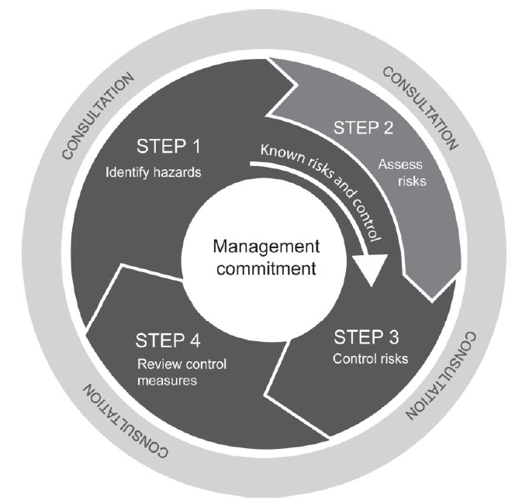
Management of Risk – Identify Hazards
Inspect the plant
Review safety information
Review incident records and data

Slide 15
PURCHASING AND HIRING PLANT
Purchasing second-hand plant
Duty to supply safe plant
Out dated or non-existent safety features of second-hand plant
Adequate information to be provided about condition of second-hand plant
Suppliers’ duties and agents or auctioneers selling used agricultural plant at clearing sales
Supplying scrap and spare parts
Hiring plant

Slide 16
Installation and commissioning of plant
Installing plant
Positioning plant in the workplace
Commissioning plant

Slide 17
Instruction, Training and Supervision
This information may be supported with safe work procedures that include instructions on:
the correct use of guarding and other control measures
how to safely access and operate the plant
who may use an item of plant, for example only authorised or licensed operators
how to carry out inspections, shut-down, cleaning, repair and maintenance
traffic rules, rights of way, clearances and no-go areas for mobile plant
emergency procedures
Any emergency instructions relating to an item of plant should be clearly displayed on or near it.

Slide 18
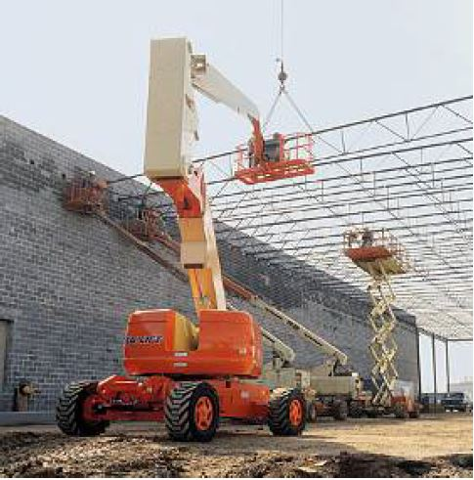
Using Plant in the workplace

Slide 19
Inspecting Plant
WHS Regulation 2011 Section 213: A person with management or control of plant at a workplace must ensure that maintenance, inspection, and if necessary testing, of plant is carried out by a competent person in accordance with manufacturer’s recommendations, or if those aren’t available, in accordance with recommendations of a competent person. If it is not reasonably practicable to comply with the manufacturer’s recommendations or the recommendations of a competent person, the inspection and testing must occur annually.

Slide 20
Maintenance, repair and cleaning of plant
Plant must be maintained and repaired according to the manufacturer’s specifications or, in the absence of such specifications, in accordance with a competent person’s recommendations.
WHS Regulation 2011 Section 210: If there is a need to operate plant during maintenance or cleaning, the person with management or control of the plant must ensure that the operators’ controls allow the safe operation of the plant while a person is undertaking the maintenance or cleaning. If the plant is operated by a person other than the person who is carrying out the maintenance or cleaning, the person operating the plant must be authorised to do so by the person with management or control of the plant.

Slide 21
Storing Plant
WHS Regulation section 207: A person with management or control of plant at a workplace must ensure that plant not in use is left in a state that does not create a risk to the health or safety of any person.

Slide 22
Decommissioning, dismantling and disposing of Plant
WHS Regulation section 204: A person with management or control of plant at a workplace must ensure that:
plant is not decommissioned or dismantled unless it can be carried out without risks to health and safety so far as is reasonably practicable
the person who decommissions or dismantles the plant is a competent person and is provided with all available information necessary to eliminate, or where this is not reasonably practicable, minimise risks to health and safety
the processes associated with the decommissioning and dismantling include inspections to ensure, so far as is reasonably practicable, that risks associated with these activities are monitored.

Slide 23
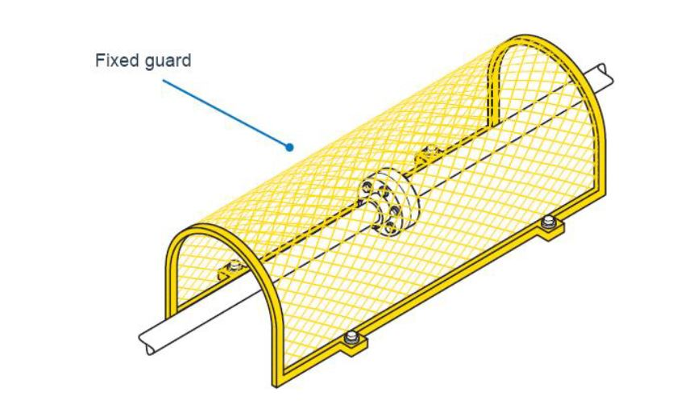
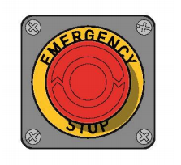
Specific control measures
Guarding Plant
Operator Controls
Emergency stops
Warning devices
Isolation of energy sources

Slide 24
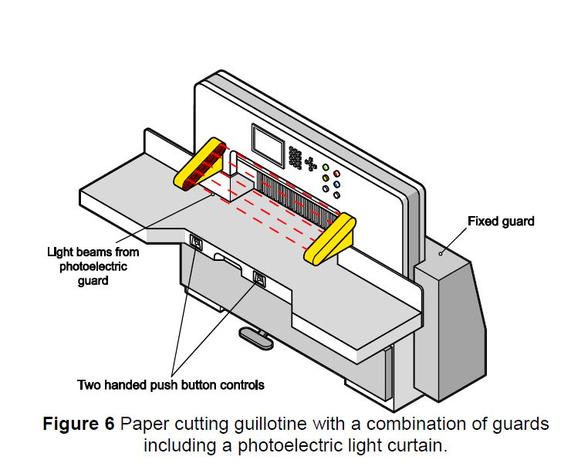
Guarding Plant
VIDEO – Guarding Machinery WorkSafeQueensland

Slide 25
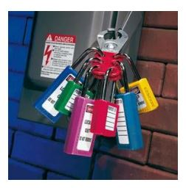
Isolation of energy sources
VIDEO – Isolating machinery when not in production

Slide 26
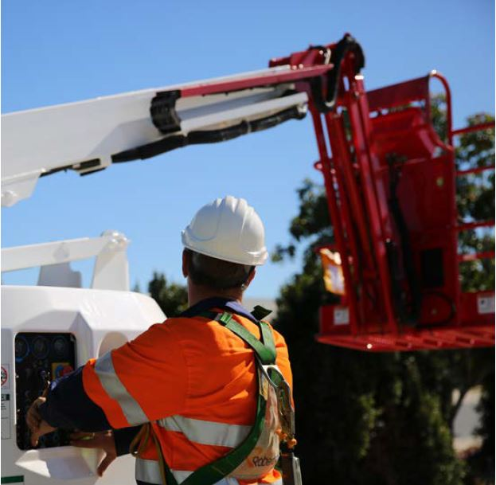
Plant registration and licensing
Certain items of plant and types of plant designs must be registered.
Registrable plant must be:
design registered before it is supplied
item registered before it is used.
Certain types of plant, such as industrial lift trucks and some types of cranes, require the operator to have a high risk work licence before they can operate the plant. Schedule 3 of the Regulation sets out the classes of high risk work licences and the types of plant involved.

Slide 27
Keeping records
WHS Regulation 2011 Section 237: A person with management and control of plant must keep a record for plant that requires design or item registration including records of all tests, inspections, maintenance, commissioning, decommissioning, dismantling and alterations of the plant.
These records must be kept for the period the plant is used or until the person relinquishes control of the plant.
The records must be available for inspection under the Act and be made available to any person to whom the person relinquishes control of the plant, for example if you sell the plant, those records should be transferred to the person who purchased the plant.
If there is a presence sensing safeguarding system at a workplace the person with management or control of the plant must keep a record of safety integrity tests, inspections, maintenance, commissioning, decommissioning, dismantling or alterations for the life of the plant or until control is relinquished or in any other case for five years.
While you must keep records associated with plant requiring design or item registration, it is good practice to keep records for other types of plant in your workplace.

Slide 28


