Slide 1
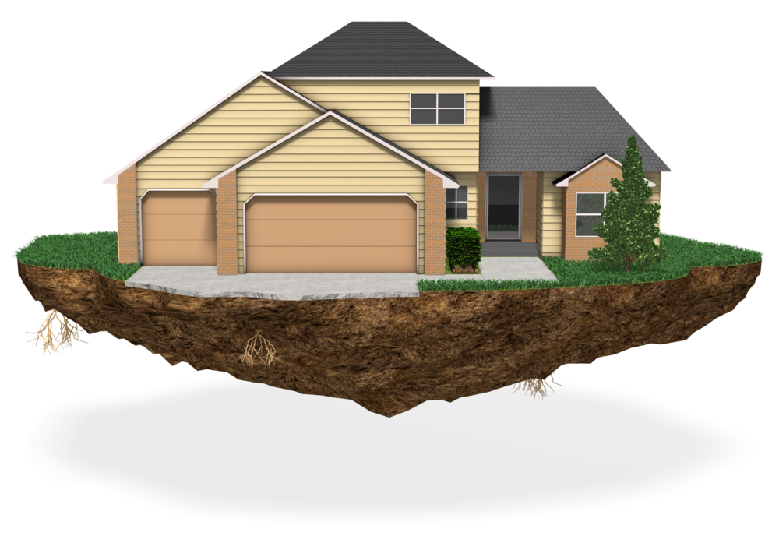
CHCHCS001
Provide home and community support services

Slide 2

Housekeeping
Emergency procedures
Mobiles and security issues
Break times and smoking policy
This course is interactive – ask questions
Practise respect and confidentiality
Ground rules

Slide 3
Objectives
Discover how to determine requirements of individual plan
Know how to establish relationship in the home
Learn how to operate respectfully in the home
Understand how to complete reporting and documentation
Gain the skills and knowledge required for this unit

Slide 4

Determine requirements of individual plan
1.1 Read and interpret individual plan, goals and confirm required equipment, processes and aids

Slide 5

Client service delivery plan
A client service delivery plan may include:
A description of the service and its aims and objectives
A profile/description of the client and their needs
Any infringement of rights that needs to be rectified
Service activities and steps needed to take
Staff responsible for the various activities
Resources needed
Evaluation strategies and contingency plans.

Slide 6
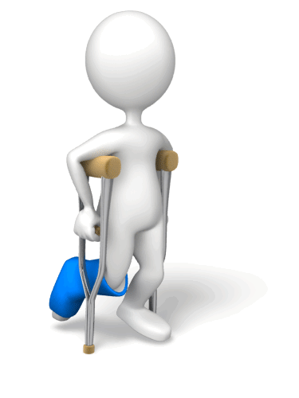
Equipment needed
Mobility aids (walking sticks, Zimmer frames etc.)
Toilet aids/adaptations
Medical/pharmaceutical supplies and equipment
Short-term oxygen supply
Basic toiletries (toothpaste, shampoo, tissues, talcum powder etc.)
Transport.

Slide 7

Activity 1A

Slide 8
Determine requirements of individual plan
1.2 Confirm purpose and time of visit with the relevant person

Slide 9

Confirming the purpose and time of visit or session
You may like to confirm a variety of information:
The time and date of the visit
The time the visit is estimated to take
How often the client is to have visits/sessions
What is involved– what to expect
Who it is that will be arriving or running the programme and their names.

Slide 10

Community support services
Community support services are wide ranging and may include:
Supported living
Day services
Outreach
Preparation for employment.

Slide 11
Activity 1B

Slide 12
Determine requirements of individual plan
1.3 Prepare equipment, resources and/or documents required for the purpose of the visit and contingencies

Slide 13

Preparing equipment, resources and documents
Resources will vary but may include:
Sporting equipment
Medical supplies
Calculator
Pens
Notepad
Vehicles
Cleaning products
Gloves
Hoists
Food and drink
Games
Documents

Slide 14
Activity 1C

Slide 15
Establish relationship in the home
2.1 Follow organisation’s procedures to assure the person of your identity before entering the house

Slide 16

Identification with clients
Before you enter someone else's premises, they have a right to see your official identification before letting you in.
You should carry a picture ID with you that shows the organisation you work for and your job title.
This ID is usually attached to your uniform or hung around your neck on a lanyard.

Slide 17
Activity 2A

Slide 18
Establish relationship in the home
2.2 Communicate with the person to provide information, clarify purpose of visit and confirm the person’s consent

Slide 19

An agreed standard of care and informed choice
There is a legal requirement for clients be consulted and have choice when it comes to their care needs.
You should provide accurate information for people so that they can make an informed decision about their support needs.

Slide 20

Consent
Two types of consent:
Implied – client follows instructions of health care professional
Explicit consent – the client states agreement which is either:
  Verbal
  Written.

Slide 21
How can we involve clients?
Involving clients in decision-making can be done by:
Asking questions/their opinion
Discussing options in groups
Discussing options through people in their social network
Discussing options with others who have experienced what you are attempting to gain the client's consent on
Trialling options with them.

Slide 22
Activity 2B

Slide 23
Establish relationship in the home
2.3 Provide opportunity for the person to identify and express any issues or concerns in relation to the visit and/or associated matters

Slide 24

Issues and concerns
Clients may have issues or concerns relating to their visit, or other matters to do with their care such as specific preferences.
Ask them openly if they have any questions or concerns so that these can be recorded and discussed.
If you do not know the answer to a client query consult with a supervisor.

Slide 25

What is active listening?
Active listening is a form of communication that requires the listener to feedback what they hear to the speaker.
This can be done by paraphrasing some or all of what they have said to ensure that you have understood them.

Slide 26

Benefits of active listening
By using active listening techniques you are showing the client that you are listening and are taking their comments and thoughts into consideration.
This shows that you care and that you are taking their input seriously, and can help them develop their relationship with you by building trust and respect.

Slide 27

General communication considerations
Openness
Attentiveness
Empathy
Awareness
Discovery
Body language
Sensitivity
Power and authority
Gender appropriateness
Religion
Honour

Slide 28
Activity 2C

Slide 29
Establish relationship in the home
2.4 Engage appropriately with others in the place of residence in accordance with organisation policies

Slide 30

Engaging others in the place of residence
Try and find something in common
Use positive, confident and co-operative language.
Be interested in what people are saying
Interpret non-verbal and verbal messages
Try to be accommodating
Be aware of age differences
Be aware of cultural differences.

Slide 31
Activity 2D

Slide 32
Establish relationship in the home
2.5 Check for hazards to own and others’ health and safety and implement controls to manage risk

Slide 33

Hazards
A hazard is the threat of potential injury, harm to a person, property, environment
It is also the threat of damage to your organisation for example through reputation damage or inadequate working practices.

Slide 34
Possible safety issues
You suspect the medication needs to be amended
Faulty equipment or lack of appropriate equipment to carry out your role e.g. hoists
You are concerned about hazards/near misses
You are concerned about infection control
You fear for client welfare
The environment is a danger to the client for example, the client does not have heating in his/her home
Protocols are not being followed.

Slide 35

Check safety and efficiency of equipment
Checking safety of equipment will involve:
Looking to see if everything is in tact
Are there any worn areas
Is anything missing?
Test it prior to use to make sure it works efficiently.

Slide 36

Changes in the work environment
Things that you might notice in between visits with a particular client include:
Positioning of furniture
Faulty electrical equipment
Spills or leaks
New equipment or furniture
Obstructed access
People or animals are now present
Altered storage patterns.

Slide 37

Ways to report safety issues
Report the issue verbally to a delegating or supervising health professional
If this fails (or for some reason you cannot) you can report the issue:
  to another senior member of the team
  through formal procedures e.g. an incident form
  to a health and safety specialist/representative
  to your union representative.

Slide 38
Activity 2E

Slide 39
Activity

Slide 40
Operate respectfully in the home
3.1 Negotiate how to best implement the individual plan to suit the person within organisation procedures and respecting that the work setting is the person’s home and personal space

Slide 41

Respecting the work setting
While you are technically in the workplace, you are also in someone else's home. Therefore, it is vital that you respect their personal space and their belongings/property.
You must ensure that you treat things you use (e.g. vacuum cleaners) as though they were your own property and strive to maintain their condition.

Slide 42
Activity 3A

Slide 43
Operate respectfully in the home
3.2 Comply with duty of care requirements of role in relation to the person and any other people

Slide 44

Duty of care
Duty of care is written legally into the Workplace Health and Safety Act 1995
It is a moral duty to anticipate possible hazards and causes of injury and try to prevent/remove/minimise these causes.
This means that all adults in the workplace are responsible for health and safety.

Slide 45
Codes of practice and legislation
Carer and respite programs
Disability Services Program standards and policies
Health records legislation
Community Care Common Standards (CCCS)
National Program Guidelines for the Home and Community Care Program
Packaged Care Guidelines
Quality management policy and practice
Relevant health regulations and guidelines
State and Territory community care program policies

Slide 46

Common causes of fires
BBQ’s
Candles
Christmas tree lights
Clothes dryers
Electric blankets
Heaters
Power-points
Mulch
Smoking
Ceiling/roof space – electrics being covered by insulation
Kitchen fires e.g. stoves, pans etc.

Slide 47
Fire safety recommendations
At least one Australian Standards AS3786 approved smoke alarm should be installed in every home.
Hard wired alarms must be fitted by a qualified electrician
You must replace your smoke alarm every ten years and test it once a month
Clean your smoke alarm with a vacuum annually
If you do not have a 10-year sealed smoke alarm, you will need to replace the battery every year
Install alarms in positions that will ensure to wake up everyone in the home and allow them time to evacuate
Create a home escape plan and make it known to everyone.

Slide 48

Dignity of risk
Dignity of risk is about allowing the people you care for, with or without disabilities, to have the right to make decisions and exercise personal autonomy regarding their own learning, skills and independence, and taking calculated risks.

Slide 49
Activity 3B

Slide 50
Operate respectfully in the home
3.3 Demonstrate respect and sensitivity toward the person and their place of residence

Slide 51

Demonstrating respect and sensitivity
Respecting clients and their place of residence involves maintaining their dignity and privacy.
Remember that you are in someone else’s home – it is vital that you respect their personal space and their belongings/property.

Slide 52

Tips for showing respect and sensitivity
Knocking before you enter the house or a room and awaiting an invitation inside
Asking to use materials, equipment etc.
Being careful with client’s personal possessions
Closing doors when personal care is in progress
Asking permission before touching clients
Be mindful of clients’ feelings and mood – be sensitive and empathetic to their needs.

Slide 53
Activity 3C

Slide 54
Operate respectfully in the home
3.4 Deal with ethical dilemmas, behaviours of concern, possible abuse and/or neglect in accordance with relevant policies and procedures

Slide 55
Defining abuse
Financial exploitation – this is the unauthorised use of a person's money.
Physical abuse – this is the deliberate use of force on a person, causing them pain, injury or disability.
Emotional abuse –involves treating people in any way that causes them distress or emotional pain.
Sexual abuse – this includes contact with a person without their consent.
Neglect/abandonment – this includes failure to fulfil carer duties and is responsible.

Slide 56

Observe and monitor changes in client behaviour
Anything that appears different from the client's usual state
Blurred vision
Confusion
Feelings of dizziness
Headache
Slurring of speech
Swelling
Untidiness.

Slide 57

What if you suspect abuse?
Report it to the appropriate person:
Supervisor
Member of senior management
Colleagues
Carers
Health professionals
External agencies
Law enforcement officer.

Slide 58
Activity 3D

Slide 59
Operate respectfully in the home
3.5 Maintain confidentiality in accordance with legislation and organisation policy and procedures

Slide 60

Confidentiality
Organisation policy on confidentiality may relate to:
Access to records
Carriage and storage of records
Collection and use of client's personal and health information
Destruction of records
Release of information.

Slide 61

How can you keep confidential information safe?
Keeping it in locked filing cabinets
Keeping it away from unauthorised people
Keeping it in locked rooms
Having it password protected on computers
Refraining from naming clients in public discussion
Discussing things in soundproof rooms.

Slide 62
Activity 3E

Slide 63
Complete reporting and documentation
4.1 Comply with the organisation’s reporting requirements, including reporting observations to supervisor

Slide 64

Complying with reporting requirements
Passing information on can be through:
Case notes
Verbal or written handover
Memo
Checklists.
Other forms according to procedures for individual organisations.

Slide 65

Reporting changes
When you are with the client you should observe them and check for:
Any physical or behavioural changes that may require reporting to your supervisor.
Changes in the work environment, for example positioning of furniture, faulty electrical equipment, leaks etc.

Slide 66
Activity 4A

Slide 67
Complete reporting and documentation
4.2 Complete and maintain documentation according to organisation policy and protocols and using technology required in the workplace

Slide 68

Completing and maintaining documentation
There are certain things that need to be reported in the care industry, such as:
Accidents and injuries
Clients’ progress
Medical care and medication
Mandatory notification.

Slide 69

Follow organisational procedures
Following organisational procedures ensures that reports are:
Received correctly
Sent to the right person
Gathered
In the appropriate format and include all required information
Handled correctly.

Slide 70
Activity 4B

Slide 71
Complete reporting and documentation
4.3 Ensure any arrangements for follow up visits are recorded and implemented

Slide 72

Arranging follow up visits
You might arrange follow up visits at the end of the session/visit
Or, wait to contact the client at a later point or let the client contact you (only if appropriate).
You should record any further visits that are needed appropriately.
You might have a formal booking system.

Slide 73

Booking procedures
Booking procedures may relate to:
The amount of notice prior to appointment e.g. 24 hours needed
Method of making appointment e.g. telephone, online, through referral etc.
The duration of appointment
Cancellation e.g. notice period
Complaints e.g. how to complain.

Slide 74
Activity 4C

Slide 75
Major Activity
This activity should take anywhere between1-2 hours to complete and can be found at the end of your workbook.
Your instructor will let you know whether they wish for you to complete it in session time or your own time.

Slide 76

Summary and Feedback
Did we meet our objectives?
How did you find this session?
Any questions?

Slide 77

Congratulations!
You have now finished the unit…
‘Provide home and community support services’

