Slide 1

Crystalline Silica Management
Silica, also know a silicon dioxide or Si02, is a colourless, white, chemical compound. Crystalline silica, a form that includes quartz, can be toxic if inhaled. Working with RCS is high risk work.

Slide 2
Hazard Identification
Identifying respirable crystalline silica (RCS), you must first identify whether RCS is being generated and released into the air at your workplace. Workers are exposed to RCS whenever it is airborne and they can breath it in.
Hazard identification can be found in MSDS, Labelling on the back of the product, review Product Data Sheet from the manufacturer or the supplier.

Slide 3
There are 3 types of RCS
Solid form e.g. brick
Respirable form e.g. mortar
Liquid form e.g. slurry

Slide 4
Respirable Crystalline Silica
The difference between a hazardous substance and a crystalline silica substance?
A hazardous substance is in a respirable form (respirable meaning ‘fit for breathing’.
A crystalline silica substance is not in respirable form (meaning the opposite)

Slide 5
Legal and Organisational requirements
Work Health and Safety Regulations 2011 state that a PCBU must not carry out a class of high risk work unless the person holds a high risk work licence for that class of high risk work.
PCBU must identify all sources of and even potential sources of RCS
When identifying and assessing hazards and making decisions about risk control measures, PCBU’s must consult with their employees and especially their workplace health and safety representatives.

Slide 6
Risk Assessment of RCS
The potential exposure to crystalline silica dust involving specific tasks or processes
The form of crystalline silica identified e.g. concrete, basalt
The proportion of crystalline silica in the material
Atmospheric monitoring results
The likely frequency and duration of exposure to crystalline silica dust
Information about incidents, illnesses or diseases associated with exposure to crystalline silica dust at the workplace

Slide 7
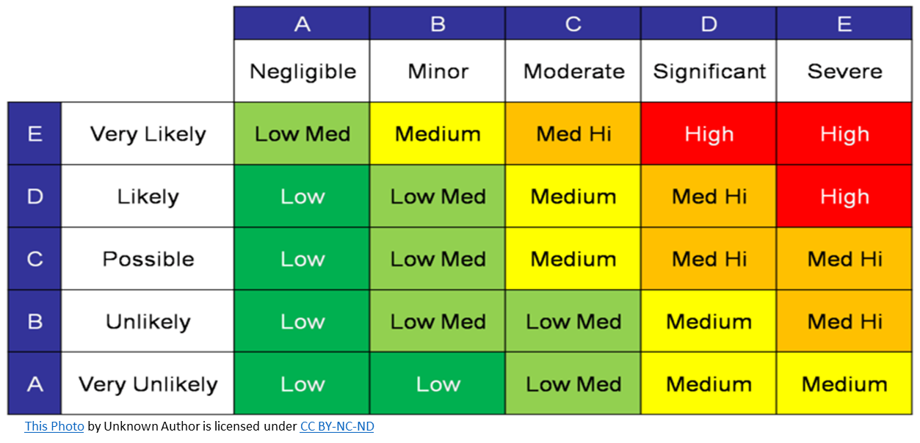
Risk Assessment of RCS

Slide 8
Duty Holder/s responsibilities
A duty holder, in managing risks to health and safety, must—
(a) eliminate risks to health and safety so far as is reasonably practicable; and
if it is not reasonably practicable to eliminate risks to health and safety—minimise those risks so far as is reasonably practicable

Slide 9
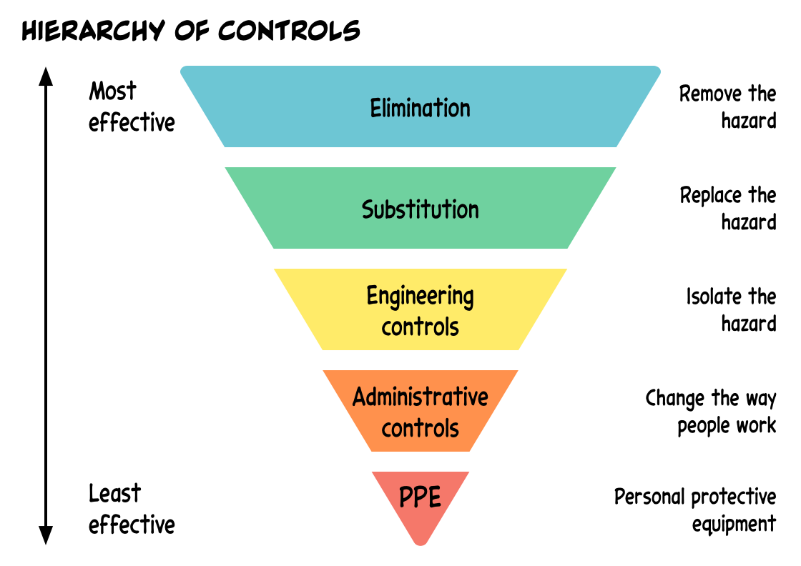
Hierarchy of controls
This Photo by Unknown Author is licensed under CC BY

Slide 10
Elimination: Remove the hazard entirely. For crystalline silica, this could mean using materials that do not contain silica.
Substitution: Replace the hazardous material with a less hazardous one. For example, using materials with lower crystalline silica content.
Engineering Controls: Implement physical changes to the workplace to reduce exposure. This includes using local exhaust ventilation, wet cutting methods to suppress dust, and isolating the work area.
Administrative Controls: Change the way people work. This can involve rotating workers to limit exposure time, implementing strict housekeeping practices to reduce dust accumulation, and providing training on safe work practices.
Personal Protective Equipment (PPE): Use equipment to protect workers. This includes respirators and protective clothing.

Slide 11
Risk Management, Controls and Review
Management of risks for crystalline silica would be;
Sources of RCSD generation in the workplace
Hazards and health effects associated with working with RCSD
How exposures are monitored and reports are read
How to control exposure following the hierarchy of controls
Training for workers on RPE at work and when to wear it
Purpose and process of RPE fitting
How to use and care for your RPE equipment
Consultation with workers at all times in regards to monitoring and reviewing controls

Slide 12
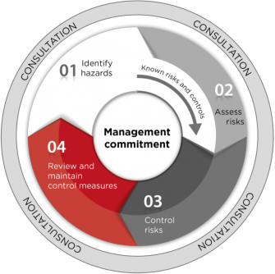
Risk Control

