Slide 1

DEMOLITION WORK
WORK HEALTH AND SAFETY OFFICER

Slide 2
Assessment Criteria
Describe the statutory and minimum requirements relating to demolition work and the Removal of Asbestos.
List the hazards that are associated with the processes of general demolition and additionally where Asbestos is involved.
Describe the control measures that are available to minimise or remove the risk associated with these hazards.

Slide 3
What is demolition work?
Demolition work means to demolish or dismantle a structure or part of a structure that is load bearing or otherwise related to the physical integrity of the structure, but does not include:
the dismantling of formwork, falsework, scaffolding or other structures designed or used to provide support, access or containment during construction work
the removal of power, light or telecommunication poles.

Slide 4
Structure
A structure is anything that is constructed, whether fixed or moveable, temporary or permanent, and includes buildings, sheds, towers, chimney stacks, silos, storage tanks.

Slide 5
Duties
PCBU
Principal Contractor
Designers
Officers
Workers

Slide 6
Identifying hazards
Examples of demolition hazards include:
unplanned structure collapse
falls from one level to another
falling objects
the location of above and underground essential services, including the supply of gas, water, sewerage, telecommunications, electricity, chemicals, fuel and refrigerant in pipes or lines
exposure to hazardous chemicals – these may be present in demolished material or in the ground where demolition work is to be carried out (contaminated sites)
hazardous noise from plant and explosives used in demolition work
the proximity of the building or structure being demolished to other buildings or structures.

Slide 7
Assessing the risks
When assessing the risks associated with demolition work, consider the following:
the structure to be demolished and its structural integrity
the method of demolition including its sequencing
the scheduling of the work
the layout of the workplace, including whether there are fall hazards both for people and objects
what plant and equipment will be used and the skill and experience required by the people who will use it safely
what exposures might occur, such as to noise or ultraviolet (UV) rays
the number of people involved
local weather conditions.

Slide 8
Controlling the risks
Factors that should be considered when choosing suitable control measures include:
items of plant and equipment – large structures may require scaffolding or powered mobile plant to work on suspended floors
stockpiling arrangements at the workplace (e.g. the location of demolished material to control dust)
transporting the demolished material, including access to the workplace, the length and nature of the haul route, and the type of load shifting equipment to be used.

Slide 9
Building or structure
The person conducting a business or undertaking in control of the demolition work should consult with the designer and/or the principal contractor if appointed where reasonably practicable, to obtain a written report specifying the hazards associated with the design and the structure in the planning stage of the demolition work.

Slide 10
Hazardous chemicals and materials
WHS Regulation section 49: A person conducting a business or undertaking at a workplace must ensure that no person at the workplace is exposed to a substance or mixture in an airborne concentration that exceeds the exposure standard for the substance or mixture.

Slide 11
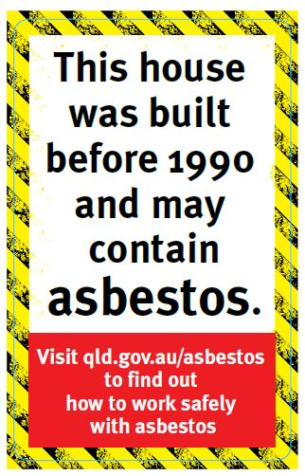
Asbestos
WHS Regulation section 450: Where a structure is to be demolished, a person conducting a business or undertaking carrying out demolition work must obtain a copy of the asbestos register for the workplace from the person with management or control of that workplace.
WHS Regulation section 451: If there is no asbestos register, the person carrying out the demolition work must:
not carry out the work until the structure or plant has been inspected to determine whether asbestos or ACM are fixed to or installed in the structure or plant
ensure that the determination is undertaken by a competent person
if asbestos of ACM are determined or presumed to be present, inform the occupier and owner of the premises (if domestic premises) and the person conducting a business or undertaking with management or control of the workplace.

Slide 12
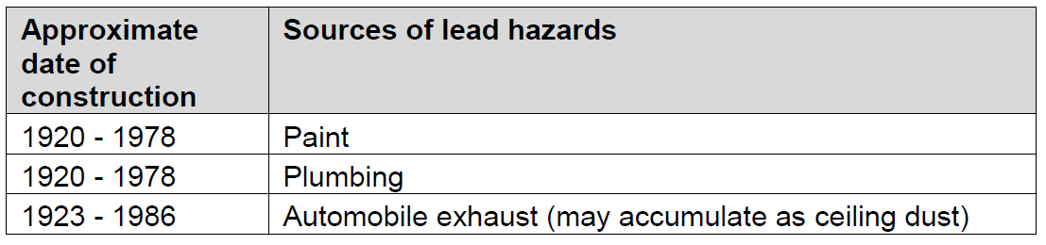
Lead
Lead is found in paint, old water pipes and other plumbing fittings, sheet lead, solders, lead flashing, lead light windows and glass. The age of a structure may be directly related to the amount of lead that can be present

Slide 13
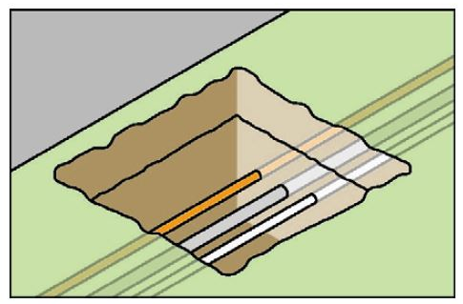
Planning demolition work
Demolition work should be carefully planned before work starts so it can be carried out safely.
One of the most important elements of pre-demolition planning is the location and disconnection of all essential services
Underground essential services exposed by ‘potholing’

Slide 14
Notifiable Demolition work
WHS Regulation section 142: A person conducting a business or undertaking who proposes to carry out the following demolition work must give written notice to the regulator at least 5 days before any of the following work commences:
demolition of a structure, or a part of a structure that is load bearing or otherwise related to the physical integrity of the structure, that is at least 6 metres in height
demolition work involving load shifting machinery on a suspended floor, or
demolition work involving explosives.

Slide 15
Safe work method statement (SWMS)
If the demolition work is or involves high risk construction work, a person conducting a business or undertaking must prepare a SWMS before the work starts.

Slide 16
Demolition Licensing
A person conducing a business or undertaking (PCBU) must hold a licence to carry out certain types of demolition work.
You must have a demolition work licence to demolish or dismantle a structure that:
contains pre-tensioned or post-tensioned structural components
involves use of load shifting equipment (e.g. use of combination front-end loader and backhoe, skid steer loader, excavator, crane).
involves the use of explosives or another induced collapse method.
You must have a demolition work licence for all other demolition work unless the structure being demolished or dismantled is:
a domestic house
a structure built as, and still generally having the characteristics of, a domestic house (e.g. a domestic house converted to flats or an office)
a structure that is ancillary to a domestic house or a structure with the characteristics of a domestic house (e.g. a carport or garage for a domestic house)
and
the structure does not contain the structural components described in (1) above and the work does not involve the use of load shifting equipment, or the demolition methods described in (2) or (3) above.

Slide 17
Securing the work area
Exclusion zones
Public access and protection

Slide 18
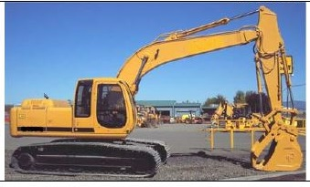
Plant, equipment and powered mobile plant

Slide 19
Training
Training specific to the demolition work and to the site should be provided to workers by a competent person.

Slide 20
Demolition methods
Manual demolition
Mechanical demolition
Induced collapse
Using explosives

Slide 21
Demolition of special structures
Special structures are complex and/or unusual because of the nature of their construction or condition. They include:
pre or post-tensioned construction
pre-cast concrete panel and framed structures
stressed skin structures (i.e. buildings that rely on the sheeting, cladding or decking to stiffen and restrain the structural framework)
slung structures (e.g. floors or roofs) that are in some way suspended from a framework, supported by a structural core.

Slide 22


