Slide 1

“But first… Coffee!”
Coffee at work… Does it work?

Slide 2


The Coffee Culture
“Coffee culture describes a social atmosphere or series of associated social behaviors that
upon coffee…”
depends heavily

Slide 3
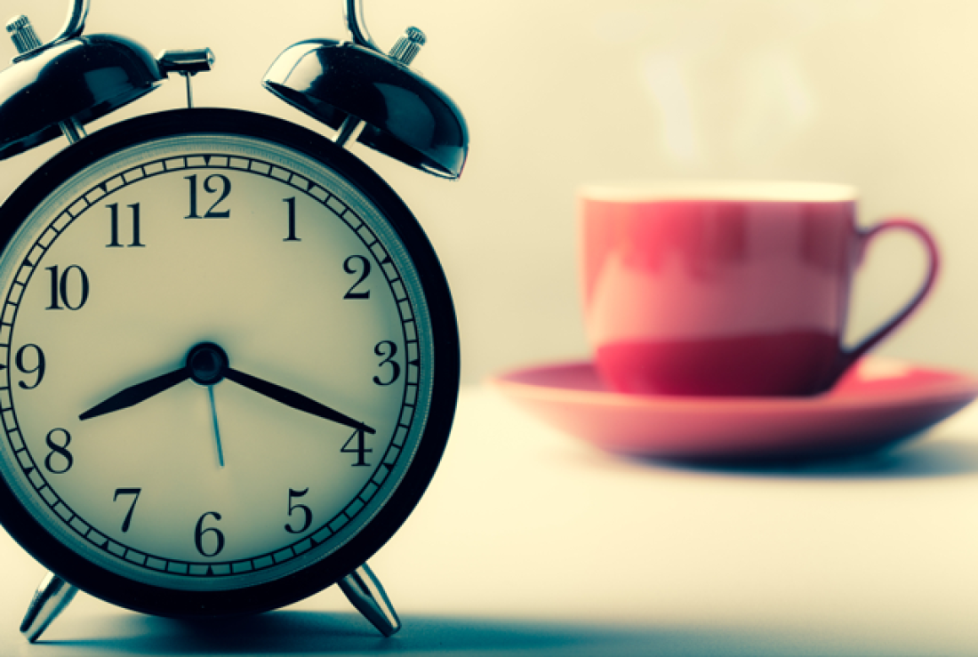
Are you a morning person?

Slide 4
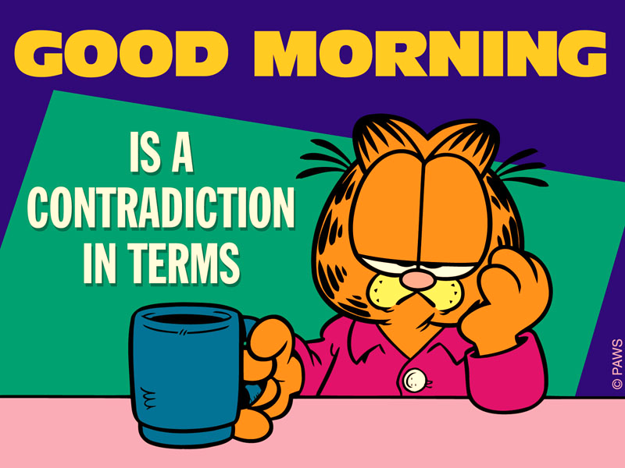

Slide 5

With its intoxicating aroma and an ensuing jolt of alertness, coffee serves as the for many of us that helps us power through our lives. It’s no surprise that coffee is one of the most consumed beverages in the world.
daily wake-up call

Slide 6
Can drinking coffee really productivity..?
What about at work?
improve
Extremely accurate graph based on true facts and events

Slide 7

It keeps you alert
Caffeine is a common stimulant – it helps people keep awake and provide the central nervous system with a boost. That’s sure to keep you productive throughout the day!

Slide 8
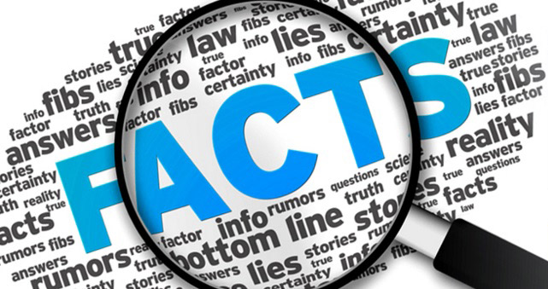
Can’t argue with the
A 2010 study at MIT showed that employees who take coffee breaks together demonstrate an overall improvement in their productivity.
Coffee breaks are a great place for employees to share both personal and work-related experiences.

Slide 9

It’s an everyday pain moderator for those long hours at the office desk
The National Institute for Health also conducted a study.
They concluded that consuming caffeine before performing pain-inducing computer work resulted in decreased pain development.
Someone get some coffee in this guy!

Slide 10
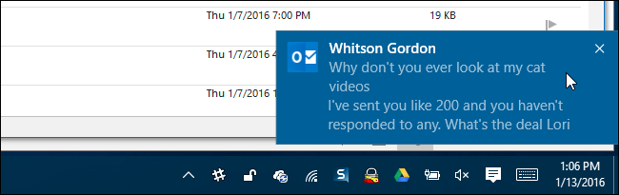

The social aspect…
You have 1 new email
“Coffee time? Downstairs in 5 ☺”
“Yess! Just what I need ;)”
Being a coffee drinker in an office setting lends itself to greater social interaction that can be directly tied to increased productivity. More importantly, coffee drinkers at work tend to be happier in their jobs.

Slide 11
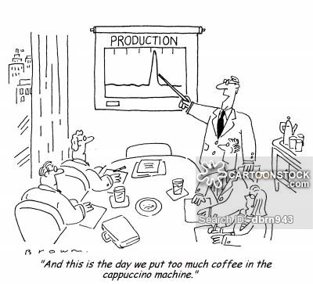
Need I say more?

Slide 12

Have we become dependant?
If you just can’t work without it… maybe it is time to give it up?

Slide 13
HAHAHAHAHA... LOL! Good one Zoe…

Slide 14


