Slide 1
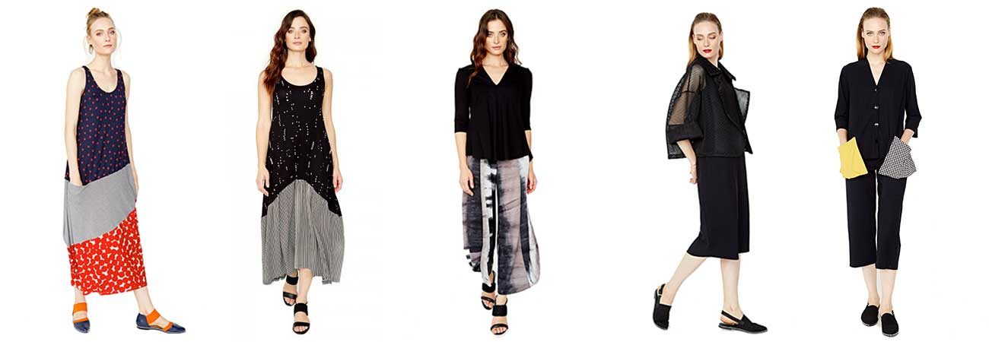
Changes at Simply Clothing
Leilah chadburne

Slide 2
Agenda
New sizes
New Mission – Fast Fashion
Price Rise

Slide 3
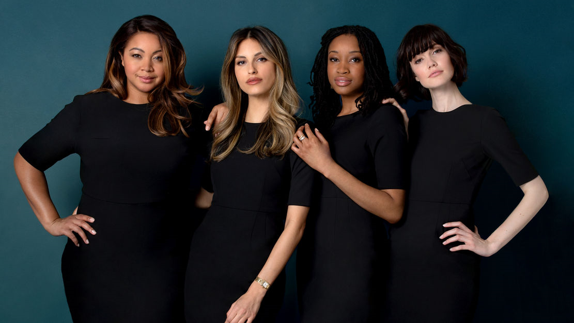
New sizes
As you all know we don’t have as many sizes as we should. We will now be extending our size range to a size 6 to a size 18 to suit all different types of body shapes.

Slide 4
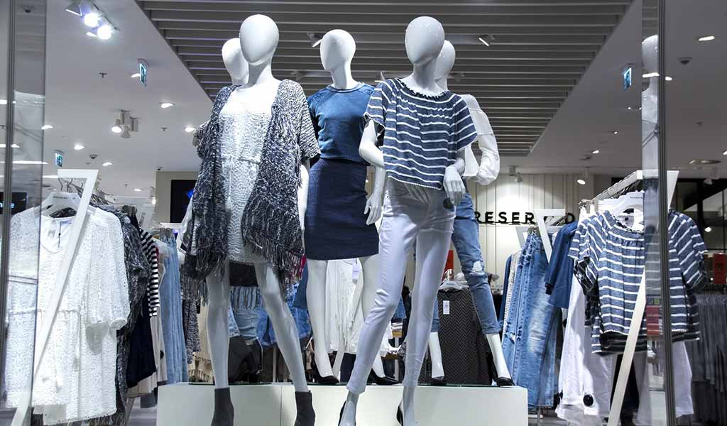
New Mission – Fast Fashion
We will now start to do fast fashion. We will be bringing in more trendy clothing and making our shop more trendy and inviting. To find more information on this feel free to check out this website to find more information on fast fashion https://goodonyou.eco/what-is-fast-fashion/

Slide 5

Price Rise
Our price will be rising in 2020. We have found a new supplier who can give us a different range of clothes. Due to this supplier being more expensive we will have to increase our price. Most items will be rising by 10% but I will have another meeting later in the year to go through all prices.

