Slide 1
Organising Workplace Information.

Slide 2

Plan AHEAD
Make sure to draft before you start the project
A timeline can help with that.

Slide 3

Keep information relevant
Don’t have extra padding for your info.
Keep everything sharp and precise
Use language that people will understand (Not slang)

Slide 4
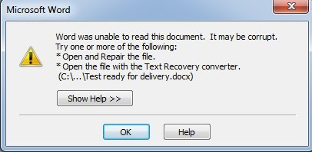
Storing Documents
Make sure that you’re documents are stored in multiple different places.
A physical drive and a cloud drive is always a good idea.
Make sure to keep copies of old work as well

Slide 5
The End

