Slide 1
Introduction to HSEQ RISK MANAGEMENT Procedure

Slide 2
Agenda
In this session we will cover:
    External requirements for HSEQ Risk Management
    Overview of the draft HY HSEQ Risk Management Procedure
    Quick recap on how to navigate Teams (if time permits)

Slide 3
External HSEQ RISK MANAGEMENT Requirements

Slide 4
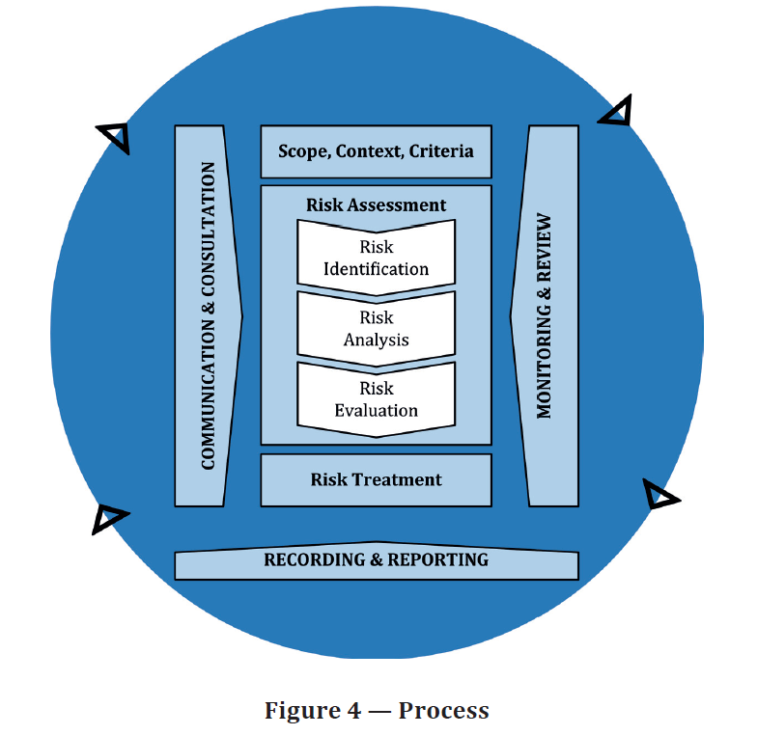
Risk Management
AS ISO 31000:2018 RISK MANAGEMENT - GUIDELINES
    Includes a risk management framework that can be customised to any organisation and context
    Central to the framework is risk assessment (identification, analysis, evaluation) & risk treatment
    Does not mandate specifics (e.g. use of risk matrix, risk registers etc.)

Slide 5

H&S Risk Management
WORK HEALTH AND SAFETY (H&S) LEGISLATION
    Requires H&S risks to be eliminated, and if this is not reasonably practical, risks to be minimised so far as is reasonably practicable
    In minimising risk, controls must be implemented in accordance with the hierarchy of controls
    Controls must be maintained so as they remain effective. They must also be reviewed and, as necessary, revised as required.
    Risk assessment only mandatory for entry into confined spaces, live electrical work and general diving work

Slide 6
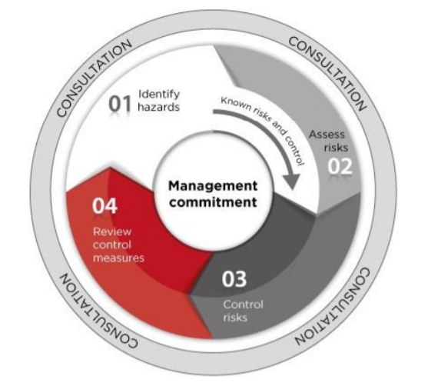
H&S Risk Management
HOW TO MANAGE WORK HEALTH AND SAFETY RISKS (MODEL CODE OF PRACTICE) MAY 2018
    Risk assessment not required when H&S risks are well known and have well established and accepted control measures
    A risk assessment should be done when there is
      uncertainty about how a hazard may result in injury or illness
      the work activity involves a number of different hazards and there is a lack of understanding about how the hazards may interact with each other to produce new or greater risks, or
      changes at the workplace occur that may impact on the effectiveness of control measures

Slide 7

H&S Risk Management
FSC AUDIT CRITERIA GUIDELINES
WH12 Hazard Identification Risk Assessment and Control (HIRAC)
Includes requirement for documented process for:
    HIRAC methodology that includes:
      Identifying and recording potential hazards
      Assessing the level of risk
      Defining controls to manage hazards
      Calculating levels of risk and determining control measures as per AS/NZS ISO 31000
    Defining acceptable risk level and associated management actions
    Ensuring control measures are established in accordance with hierarchy of control, legislation, Codes of Practice and Australian Standards

Slide 8

Environment Risk Management
ENVIRONMENTAL LEGISLATION
    SA, ACT, TAS, and QLD jurisdictions include a general environmental duty to not cause environmental harm (VIC commencing 1 July 2021)
    The NSW POEO Act 1997 does not have an equivalent ‘general environmental duty’
    All reasonable and practicable measures must be taken to prevent or minimise environmental harm of activities
    In deciding the measures consideration must be given to the
      nature of the harm (or potential harm)
      sensitivity of the receiving environment
      current state of technical knowledge for the activity
      likelihood of successful application of the different measures
      financial implications of the different measures

Slide 9



HSEQ Risk Management
AS/NZS ISO 45001 (OHS), AS/NZS ISO 14001 (ENVIRONMENT) & AS/NZS ISO 9001 (QUALITY)
    All three standards require a risk based approach when developing, implementing and maintaining a management system
    AS/NZS ISO 45001 also requires that an organisation has a process for the elimination of hazards and reduction of OH&S risks using the hierarchy of controls

Slide 10
Overview of Draft Risk Management Procedure

Slide 11
HY HSEQ Risk Management PROCEDURE
CONSULTATION GROUP BRIEF
The newly drafted HSEQ Risk Management Procedure:
    Is an overarching, high level document that covers how the company manages risk
    Is limited to four pages so it can be used as a quick guide throughout the business
    Is written to align with Australian Legislative requirements of managing risks
    Explores potential consequence at a national business level including: Areas of WHS, Quality, Financial, Reputation, Client involvement, Compliance, and impact on Operations
    Doesn’t go into detail about controlling hazards, though does include assessing the effectiveness of current controls
    Outlines clear expectations around likelihood
    Introduces an extreme rating to the risk matrix to convey risks that have a highly significant impact to the business
    Provides clear guidance for escalating situations – who makes business decisions at each level
    Reduces bureaucracy by simplifying requirements for record keeping and training based on legislative requirements which allows us to streamline these processes

Slide 12
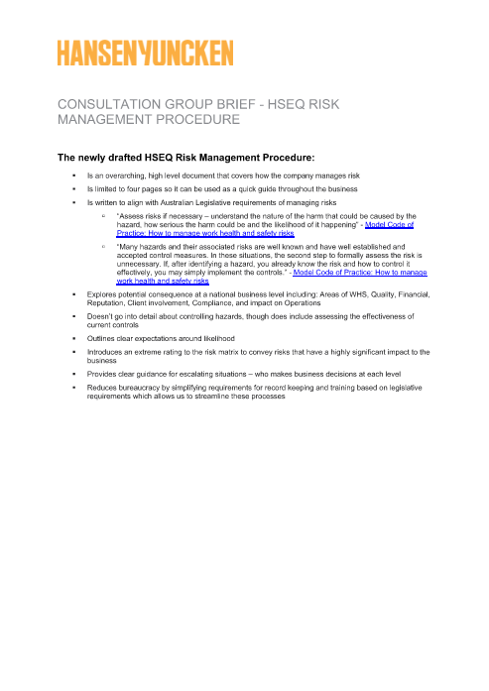
HY HSEQ Risk Management PROCEDURE
CONSULTATION GROUP BRIEF
The Consultation Group Brief has been developed to give an overview of the document and to summarise key points.
This will be made available on the Consultation Homepage, along with this presentation, and a recording of this morning’s session.
After the review has ended and the HSEQ Risk Management Procedure has been finalised, a similar “post-consultation” summary will be developed for the wider staff base.

Slide 13
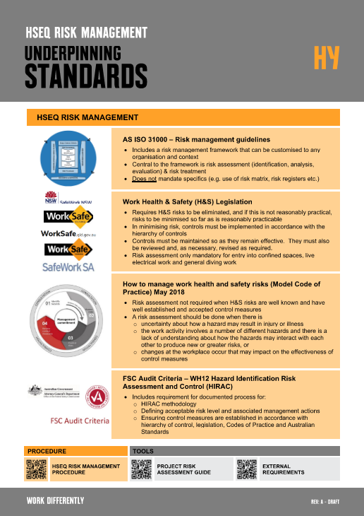
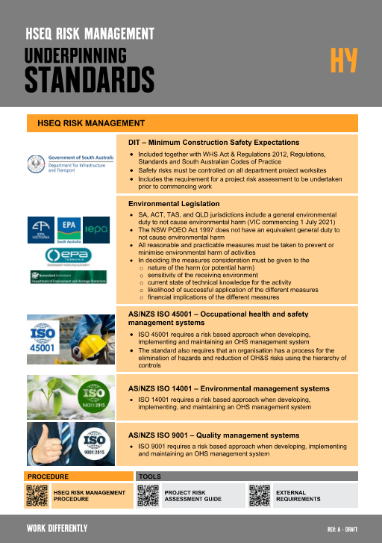
HY HSEQ Risk Management PROCEDURE
UNDERPINNING STANDARD
An Underpinning Standard has been drafted to assist in the review process for this round of consultation. It reflects the procedure in its current state (first draft, pre-consultation).
It outlines our legislative requirements in regards to managing risks.
The Underpinning Standard is not part of this review round, it is a view-only document at this point.
Once feedback from this round has been collected and the HSEQ Risk Management Procedure has been finalised, the Underpinning Standard will be amended to reflect the final content.
Underpinning Standards will be reviewed in Round 5 of consultation.

Slide 14


THANK YOU FOR PARTICIPATING – Q&A

