Slide 1

BSBSMB405
Monitor and manage
small business operations

Slide 2

Housekeeping
Emergency Procedures
Mobiles, Security Issues
Break times / Smoking policy
This course is “interactive” – ask questions
Respect, Confidentiality, Practice
Ground Rules

Slide 3

Objectives
Know how to develop a marketing plan
Discover how to implement operational strategies and procedures
Learn how to monitor business performance
Understand how to review business operations
Gain skills and knowledge required for this unit

Slide 4

Develop operational strategies and procedures
1.1. Develop an action plan to provide a clear and coherent direction, in accordance with business goals and objectives

Slide 5

Develop a business plan
Production/operations plans are created in accordance with the business goals and objectives and in fact an operations plan is part of the Business Plan.

Slide 6

Operational plan
Start within your limits!
The production/operations plan component of your business plan is designed to describe how the business functions on a continuing basis.

Slide 7

What it contained
It was also stated that when writing a business plan, the operations plan section of a small business in not much different to that of a larger scale operation.

Slide 8

How it is best presented
Mission & Vision
Period covered by the operations plan
Differentiation

Slide 9
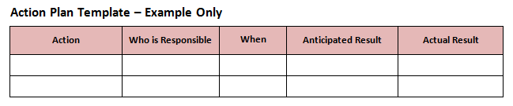
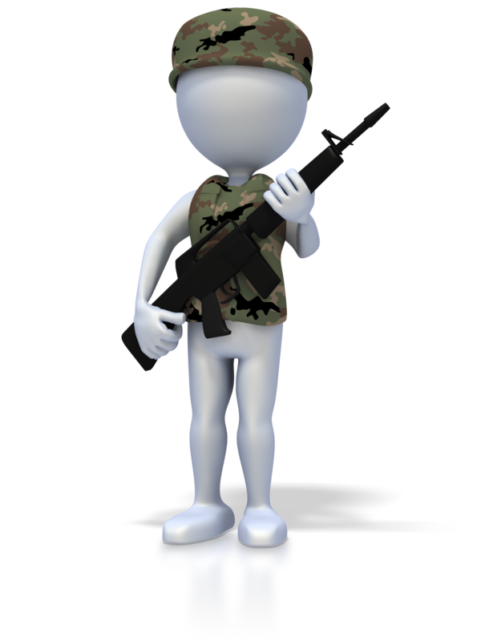
Action Plan

Slide 10
Business goals and objectives
Examples of business goals and objectives are:
Customer needs/marketing projections
Family or community benefits
Financial projections
Goals, objectives, plans, systems and processes
Lifestyle issues
Short, medium or long-term goals.

Slide 11

Activity 1A

Slide 12
Develop operational strategies and procedures
1.2 Identify work health and safety (WHS) and environmental issues and implement strategies to minimise risk factors

Slide 13

WHS and environmental issues
WHS and environmental issues include:
Controls
Establishment and maintenance of procedures
Establishment and maintenance of procedures for identifying risks to health and safety
Environmentally sustainable purchase and supply of goods and services
Waste and by-products.

Slide 14
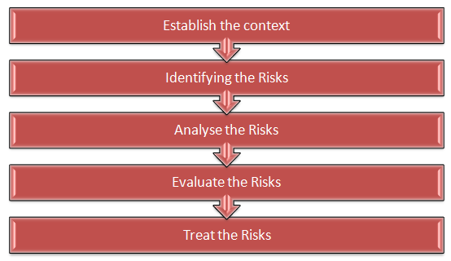
Identify existing and potential hazards

Slide 15

The process
Designated health and safety officers
Health and safety representatives
Supervisors
Managers
Team leaders
Other persons authorised.

Slide 16
Workplace hazard inspection TEMPLATE
Contact Officer | WHS Officer - xxxxx
Approval Date | XX / XX / XXXX
Approval Authority | Director - Facilities Management
Date of Next Review | XX / XX / XXXX
Document Identification | ABC / 123

Slide 17
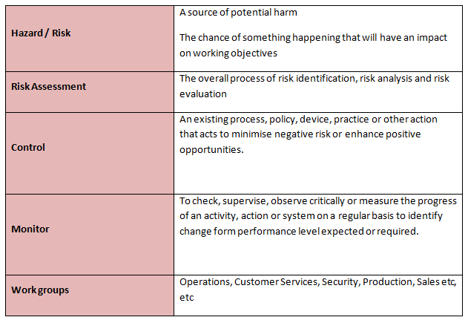
Some definitions used in the assessment

Slide 18

Operating suggestions
Operations suggestions include:
The inspection program
Specific responsibilities
Inspection checklist

Slide 19
Activity 1B

Slide 20
Develop operational strategies and procedures
1.3. Develop a quality system for the business in line with industry standards, compliance requirements and cultural criteria

Slide 21
Quality system
Quality systems may include:
Manual or computer quality control systems
Quality assurance/management approaches
Random inspections and assessments
Random inspections and assessments of processes against standards
Random sampling and follow-up of customers.

Slide 22
Activity 1C

Slide 23
Develop operational strategies and procedures
1.4 Develop performance measures and operational targets to conform to the business plan

Slide 24

Performance measurement in the organisation
Organisations usually develop their own categories of performance measurement as they relate to specific targets. These can be grouped as “characteristics” of performance measurement

Slide 25

SMART criteria

Slide 26
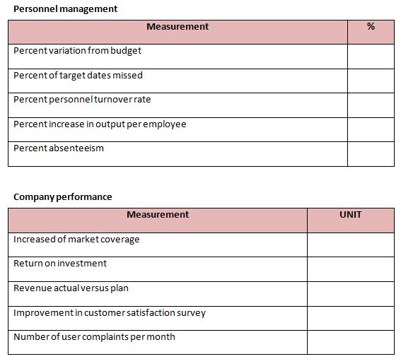
Management Performance Measures

Slide 27
Activity 1D

Slide 28
Develop operational strategies and procedures
1.5 Develop strategies for innovation, including utilisation of existing, new or emerging technologies, where practicable, to optimise business performance

Slide 29
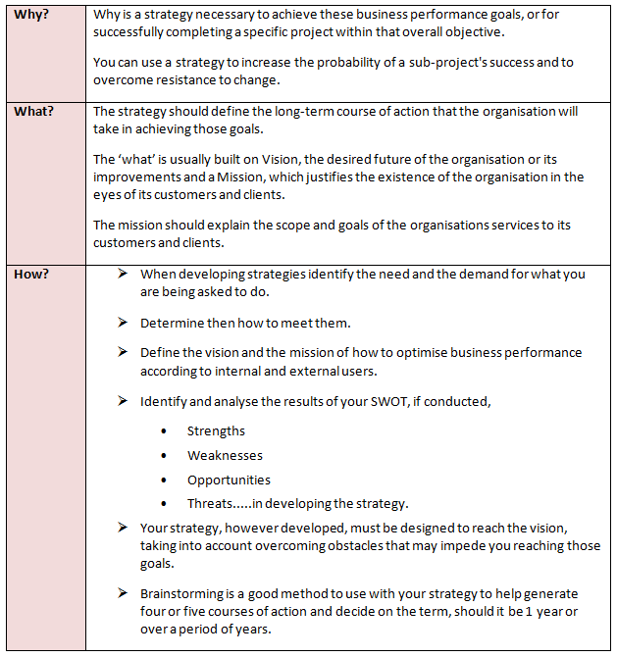
Strategies to optimise business performance

Slide 30

How to determine what to achieve?
In determining innovation in any environment, the first stage is to determine what is it that will optimise business performance?

Slide 31

Utilisation of existing, new or emerging technologies
review
optimisation
assessment
performance measurement

Slide 32

Aggregating data
It is especially important that technology used to develop strategies for innovation or to optimise business performance has the capacity to access the organisations existing performance data and the ability to evaluate its progress against the new or current goals.

Slide 33
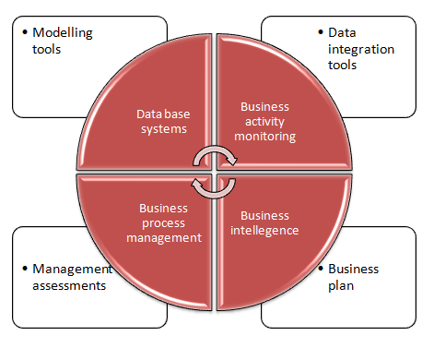
Automated business performance model

Slide 34
Activity 1E

Slide 35
Implement operational strategies and procedures
2.1 Implement systems and key performance indicators/targets to monitor business performance and customer satisfaction

Slide 36

Implement systems and key performance indicators
Successful business management requires the ongoing monitoring of performance.
Improvement in performance can only be realistically achieved when management is properly informed about current performance as a result of monitoring.

Slide 37

Monitoring
KPIs can be used to also monitor:
Financial performance
Business development
Provision of and the delivery of professional services
Personnel relationships within the organisation.

Slide 38
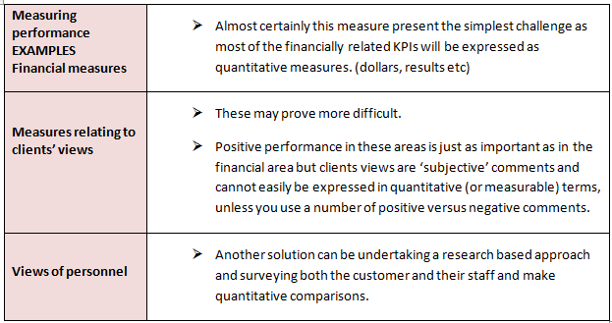
Monitoring

Slide 39
Activity 2A

Slide 40
Implement operational strategies and procedures
2.2 Implement systems to control stock, expenditure/cost, wastage/shrinkage and risks to health and safety in accordance with the business plan

Slide 41

Software systems
...used to control stock, expenditure/cost, wastage/shrinkage. There are NUMEROUS propriety software packages available. Search on stock control system returns over 10 Million pages. There are over 10,000 different software systems available.

Slide 42
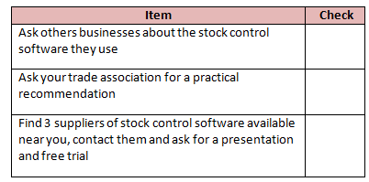
Checklist of stock control system requirements

Slide 43
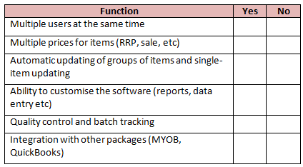
Stock system
Can the system handle…

Slide 44
Manual systems
However, before the age of computers, stock control was handled manually usually by the accounts department in a “stock control records book” or similar name.

Slide 45
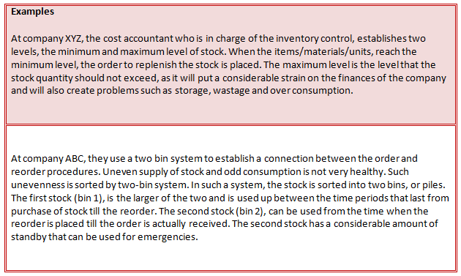
Stock, expenditure, cost, wastage and shrinkage

Slide 46
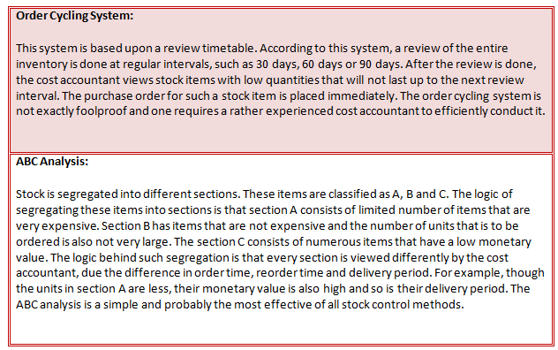
Stock, expenditure, cost, wastage and shrinkage

Slide 47
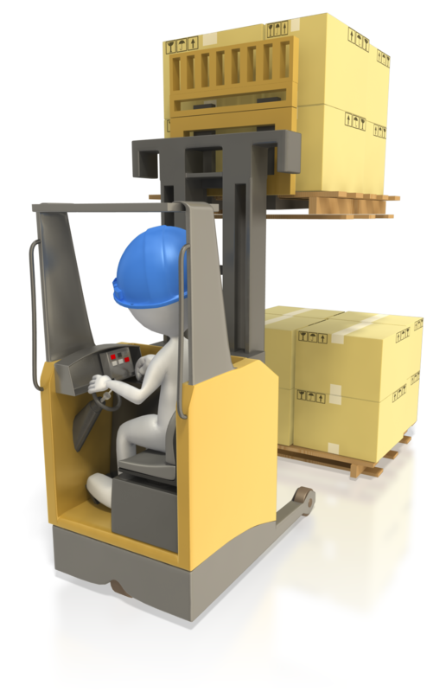
Warehousing
The key to getting productivity gains from inventory management is placing real-time intelligent information processing in the warehouse.
Real-time intelligent information processing in the warehouse provides those responsible to take actions that will achieve immediate results.
This uses combinations of hardware including material handling and software data collection technologies.

Slide 48

Criteria for rotating stock
Criteria include:
Carry out stock rotation procedures for merchandise and wrapping and packing materials routinely
Place excess stock in storage
Maintain safe lifting and carrying techniques in line with occupational health and safety.

Slide 49
Activity 2B

Slide 50
Implement operational strategies and procedures
2.3 Maintain staffing requirements, where applicable, within budget, to maximise productivity

Slide 51

Maintain staffing requirements,
Three issues vied for third place among the most significant headaches:
  Difficult market conditions
  Government red tape
  Lack of time to enjoy family life.

Slide 52
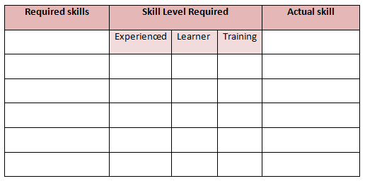
Staffing estimates

Slide 53
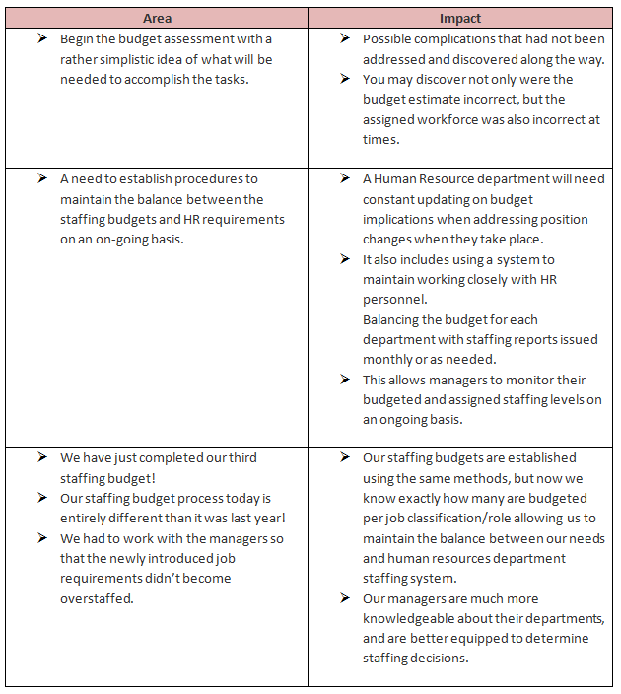
Within budget

Slide 54
Implement operational strategies and procedures
2.4 Carry out provision of goods/services in accordance with established legal, ethical cultural and technical standards

Slide 55

Technical standards
Technical standards include:
Current and generally agreed descriptions of what the product/service is
How it should be produced/delivered
The environmental sustainability, quality, safety and efficiency.

Slide 56

Legislative Provisions (The Laws)
There are many statutes which impact on contracts in Australia.

Slide 57
Activity 2C

Slide 58
Implement operational strategies and procedures
2.5 Provide goods/services in accordance with time, cost and quality specifications, and customer requirements
2.6 Apply quality procedures to address product/service and customer requirements

Slide 59
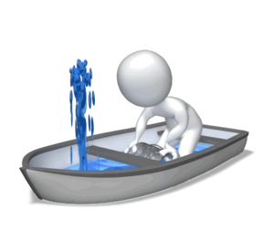
Providing goods/services
You will need to consider:
Quality procedures
Product/service
Address customer requirements.

Slide 60
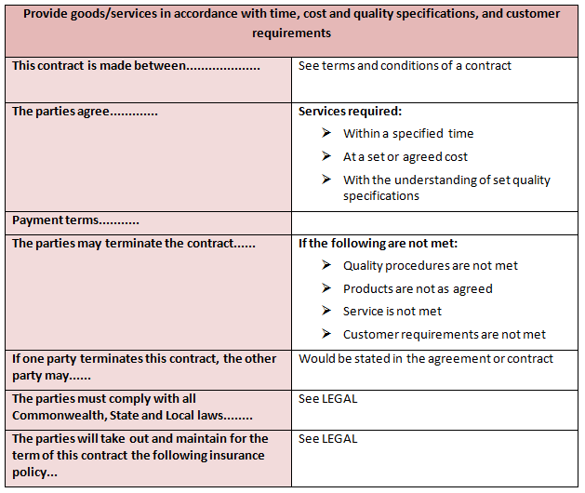
Example contract terms to cover these items

Slide 61

Call on the quality management policy
Provide goods/services in accordance with:
Time
Cost
Quality specifications
Customer requirements
Address product/service requirements.

Slide 62
Activity 2D

Slide 63
Monitor business performance
3.1 Regularly monitor/review achievement of operational targets to ensure optimum business performance, in accordance with business plan goals and objectives
3.2 Review systems and structures, with a view to more effectively supporting business performance
3.3 Investigate and analyse operating problems to establish causes and implement changes as required, as part of the business quality system
3.4 Amend operational policies and procedures to incorporate corrective action

Slide 64

Holistic review systems
The purpose of an assessment document is to identify all business impacts and report findings to stakeholders both internal and external, using the suggested items in the elements, 3.1, 3.2, 3.3 and 3.4.

Slide 65

Business impact assessment objectives
General objectives include:
Identifying any gaps in operational targets
Identifying other impacts
Investigate and analyse operating problems
Amend operational policies and procedures
The impact on stakeholders.

Slide 66
Optimum business performance

Slide 67
Gap analysis
Identifying and recognising a Gap exists within the captured analysis which will impact on business, processes.
The analysis/monitoring identifies the difference between current performance and targets and then you will need to identify the extent of the impact on business, processes.

Slide 68

Impact analysis
Review the overall result below
Identification of the impacts from the monitoring will help to identify key areas of focus such as stakeholder management.

Slide 69
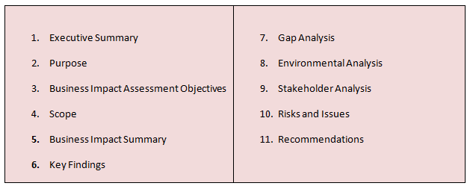
Template for a Report Format

Slide 70
Activity 3A

Slide 71
Review business operations
4.1 Review and adjust business plan, as required, to maintain business viability, in accordance with business goals and objectives

Slide 72

Reviewing business plan
Annually schedule a review of the business plan as a strategic assessment, not just a reactive change process.

Slide 73

Key review criteria
Ensure the business plan is practical and that there is a good chance for success.
Be brave- make changes!
Show options at key decision points.
Share the plan review. Don’t isolate the assessment.
Funding arrangements are vital to survival.

Slide 74

Detailed assessments of sub-areas
Lease agreements
Advertising agreements
Do you just keep renewing?
Insurance policies

Slide 75
Activity 4A

Slide 76
Review business operations
4.2 Clearly record proposed changes to aid future planning and evaluation

Slide 77
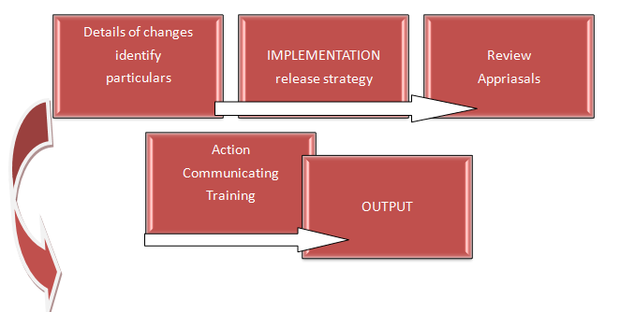
Clearly record proposed changes to aid future planning and evaluation

Slide 78
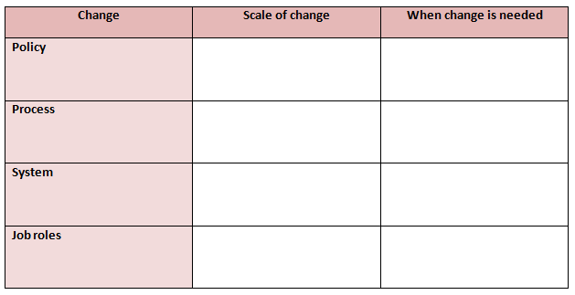
Type of change (examples only)

Slide 79

Aid future planning and evaluation
Describe the reason for the change and its benefits to the business:
  Scope the change
  Describe who in the business it includes
  How far reaching in the organisation is the change?

Slide 80
Activity 4B

Slide 81
Review business operations
4.3 Undertake ongoing research into new business opportunities and adjust business goals and objectives as new business opportunities arise

Slide 82

Ongoing research into new opportunities
Ongoing research will obviously need to be RELEVANT to a series of objectives.
  Are you expanding?
  Are you changing direction?
  Are you looking for additional but similar product/service opportunities?

Slide 83

Focus on new opportunities on the horizon
Alignment: of the forces both internal and external that will get you there;
Leverage: the relationships and stakeholders for their best input
Differentiation: establish the points of difference that are required as a new direction

Slide 84
Activity 4C

Slide 85
Skills and Knowledge Activity

Slide 86
Major Activity
This activity should take anywhere between an 1-2 hours to complete and can be found at the end of your workbook.
Your instructor will let you know whether they wish for you to complete it in session time or your own time.

Slide 87

Summary and Feedback
Did we meet our objectives?
How did you find this session?
Any questions?

Slide 88

Congratulations!
You have now finished the unit…
‘Monitor and manage small business operations’

