Slide 1
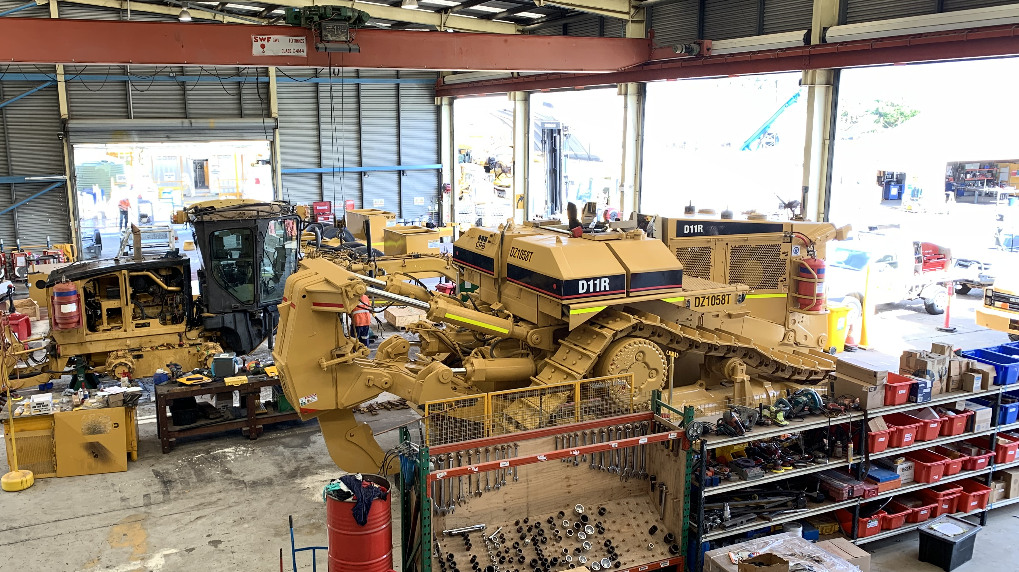
PCBU
Work Health & Safety
Consultation and Participation with Workers Recommendations

Slide 2
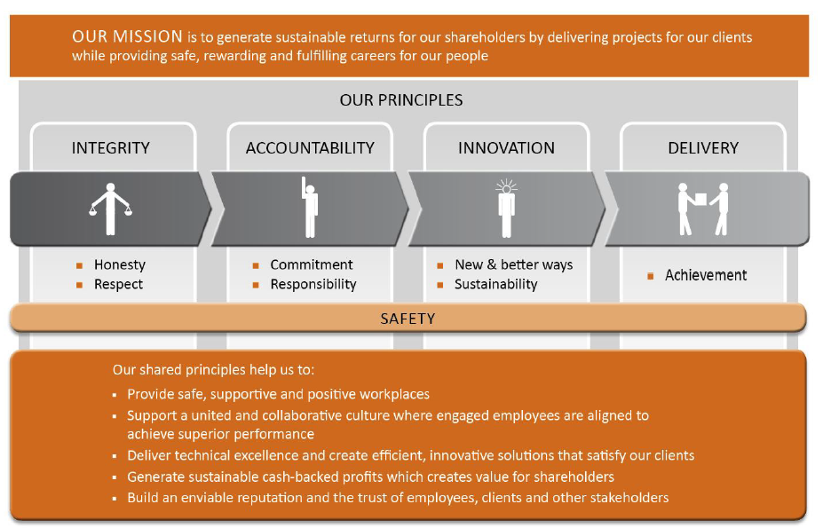
Our Mission and Principles

Slide 3
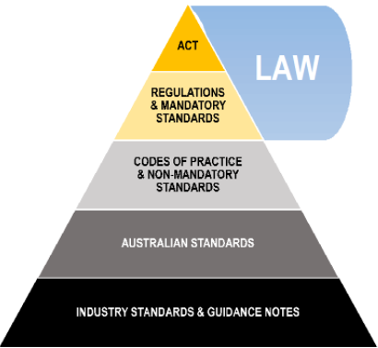
Legislative Framework

Slide 4
References
Work Health and Safety Act 2011: https://www.legislation.qld.gov.au/
Work Health and Safety Regulations 2011: https://www.legislation.qld.gov.au/
Work Health and Safety (Construction Work) Code of Practice 2015: https://www.legislation.qld.gov.au/
How to manage work health and safety risks – Code of Practice – SafeWork Australia: https://www.safeworkaustralia.gov.au/
Work health and safety consultation, co-operation and coordination Code of Practice 2021
https://www.worksafe.qld.gov.au/
Guidance: Health and Safety Representatives, Worksafe Qld: https://www.worksafe.qld.gov.au/
Guidance: Information for employers and company executives, Worksafe Qld: https://www.worksafe.qld.gov.au/
Worker Representation and Participation Guide, SafeWork Australia: https://www.safeworkaustralia.gov.au/
Work health and safety consultation, co-operation and coordination Code of Practice 2021
https://www.worksafe.qld.gov.au/
Guidance: Health and Safety Representatives, Worksafe Qld: https://www.worksafe.qld.gov.au/
Guidance: Information for employers and company executives, Worksafe Qld: https://www.worksafe.qld.gov.au/
Worker Representation and Participation Guide, SafeWork Australia: https://www.safeworkaustralia.gov.au/
Communication, Co-operation and Consultation Policy, knowledge document – CMS internal policies and procedures

Slide 5

Workers Duties– Where to find them
Workers Duties:
Take reasonable care for their own health and safety
Take reasonable care for the health and safety of others
Follow the guidance of the PCBU where reasonably practicable to do so
An operator must, within a specified time implement and identify major incidents and major hazards, consider control measures and conduction a review. They must also facilitate and implement a safety role for workers to enable them to contribute to the conduct of reviews
Keep communication open – Consultation between workers
Work Health and Safety Act 2011, Part 5, section 47- 49, 50-54, 55-59, 61-62. https://www.legislation.qld.gov.au/
Work Health and Safety Regulations 2011, Chapter 2, Division 1, 16 – 17, 20, 32-38, 297https://www.legislation.qld.gov.au/
Work Health and Safety Regulations 2011, 9.5, 574 – 576 https://www.legislation.qld.gov.au/
Work Health and Safety (Construction Work) Code of Practice 2015, 1.8 https://www.legislation.qld.gov.au/
How to manage work health and safety risks – Code of Practice – SafeWork Australia: https://www.safeworkaustralia.gov.au/
Work health and safety consultation, co-operation and coordination Code of Practice 2021
https://www.worksafe.qld.gov.au/
Guidance: Health and Safety Representatives, Worksafe Qld: https://www.worksafe.qld.gov.au/
Guidance: Information for employers and company executives, Worksafe Qld: https://www.worksafe.qld.gov.au/
Worker Representation and Participation Guide, SafeWork Australia: https://www.safeworkaustralia.gov.au/
Communication, Co-operation and Consultation Policy, knowledge document – CMS internal policies and procedures

Slide 6
Workers Rights – Where to find them
Workers Rights:
Cease work if unsafe
Consulted during the preparing of Safe Work Method Statements (SWMS) and during the review stages
Be represented in consultation by a health and safety representative (HSR) who has been elected by their work group
Be consulted at all steps of the risk management process
Workers must be allowed reasonable time with their HSRs to discuss WHS matters
Workers elect the HSRs and determine how the election will be conducted
Workers must be informed by the PCBU of the election outcome
If workers request for a HSR, the PCBU has 14 days to negotiate with workers and settle on the number of work groups and how many HSRs will represent each work group
Workers can request a variation to change work groups at any time and must be notified of the outcome from the PCBU as soon as is practicable to do so
If the majority of workers in the work group write a declaration, they can remove a HSR they no longer want to represent them.
Work Health and Safety Act 2011, Part 5, section 47- 49, 50-54, 55-59, 61-62. https://www.legislation.qld.gov.au/
Work Health and Safety Regulations 2011, Chapter 2, Division 1, 16 – 17, 20, 32-38, 297https://www.legislation.qld.gov.au/
Work Health and Safety Regulations 2011, 9.5, 574 – 576 https://www.legislation.qld.gov.au/
Work Health and Safety (Construction Work) Code of Practice 2015, 1.8 https://www.legislation.qld.gov.au/
How to manage work health and safety risks – Code of Practice – SafeWork Australia: https://www.safeworkaustralia.gov.au/
Work health and safety consultation, co-operation and coordination Code of Practice 2021 https://www.worksafe.qld.gov.au/
Guidance: Health and Safety Representatives, Worksafe Qld: https://www.worksafe.qld.gov.au/
Guidance: Information for employers and company executives, Worksafe Qld: https://www.worksafe.qld.gov.au/
Worker Representation and Participation Guide, SafeWork Australia: https://www.safeworkaustralia.gov.au/
Communication, Co-operation and Consultation Policy, knowledge document – CMS internal policies and procedures

Slide 7
Workers Responsibilities - Where to find them
Workers Responsibilities:
Take reasonable care for their own health and safety
Take reasonable care for others health and safety
Follow WHS instructions
Follow workplace WHS polices and procedures
Work safely
Comply with all reasonable instructions, policies and procedures set out by the PCBU
If a HSR is removed, a member of the work group, who is nominated by the workers must inform the workers the HSR has been removed and inform the PCBU. Only then does the removal of the HSR take effect
Work Health and Safety Act 2011, Part 5, section 47- 49, 50-54, 55-59, 61-62. https://www.legislation.qld.gov.au/
Work Health and Safety Regulations 2011, Chapter 2, Division 1, 16 – 17, 20, 32-38, 297https://www.legislation.qld.gov.au/
Work Health and Safety Regulations 2011, 9.5, 574 – 576 https://www.legislation.qld.gov.au/
Work Health and Safety (Construction Work) Code of Practice 2015, 1.8 https://www.legislation.qld.gov.au/
How to manage work health and safety risks – Code of Practice – SafeWork Australia: https://www.safeworkaustralia.gov.au/
Work health and safety consultation, co-operation and coordination Code of Practice 2021 https://www.worksafe.qld.gov.au/
Guidance: Health and Safety Representatives, Worksafe Qld: https://www.worksafe.qld.gov.au/
Guidance: Information for employers and company executives, Worksafe Qld: https://www.worksafe.qld.gov.au/
Worker Representation and Participation Guide, SafeWork Australia: https://www.safeworkaustralia.gov.au/
Communication, Co-operation and Consultation Policy, knowledge document – CMS internal policies and procedures

Slide 8
PCBUs Duties– Where to find them
PCBUs Duties:
Share information with workers
Give workers the opportunity to share their ideas, views and raise issues
Give workers the opportunity to contribute and make decisions
Build positive relationships with HSRs
Communicate changes
Keep a record of covered topics, noting all feedback
Monitor how effective the meeting / talks are and if measures are implemented and working
Provide training to all workers
To assist HSRs to be available during working hours to discuss WHS matters.
Work Health and Safety Act 2011 section 46-49, 50-54, 55-59, 70-72: https://www.legislation.qld.gov.au/
Work Health and Safety (Construction Work) Code of Practice 2015, Section 1.8: https://www.legislation.qld.gov.au/
Work Health and Safety Regulations 2011, 18- 21, 32-38, 39.https://www.legislation.qld.gov.au/
How to manage work health and safety risks – Code of Practice – SafeWork Australia: https://www.safeworkaustralia.gov.au/
Work health and safety consultation, co-operation and coordination Code of Practice 2021
https://www.worksafe.qld.gov.au/
Guidance: Health and Safety Representatives, Worksafe Qld: https://www.worksafe.qld.gov.au/
Guidance: Information for employers and company executives, Worksafe Qld: https://www.worksafe.qld.gov.au/
Worker Representation and Participation Guide, SafeWork Australia: https://www.safeworkaustralia.gov.au/
Communication, Co-operation and Consultation Policy, knowledge document – CMS internal policies and procedures

Slide 9
PCBUs Rights – Where to find them
Rights:
To let a worker go if they aren’t following all policies and procedures set out by the PCBU
To let a worker go if they are causing harm to themselves or others
The facility to employ a Work Health Safety Officer (WHSO), and can act as evidence that a PCBY has taken action to moderate health and safety risks
The Person Conducting Business or Undertaking (PCBU) must prepare a Work Health and Safety (WHS) Management plant, identifying all workers and their positions, roles and responsibilities regarding health and safety
The PCBU must, where reasonably practicable, consult all workers carrying out the business or are directly affected by a work health or safety matter
A PCBU must cooperate and coordinate activities between themselves, workers and any work health and safety representative
A PCBU still has the right to make the final decision on how to manage the business.
Work Health and Safety Act 2011 section 46-49, 50-54, 55-59, 70-72: https://www.legislation.qld.gov.au/
Work Health and Safety (Construction Work) Code of Practice 2015, Section 1.8: https://www.legislation.qld.gov.au/
Work Health and Safety Regulations 2011, 18- 21, 32-38, 39.https://www.legislation.qld.gov.au/
How to manage work health and safety risks – Code of Practice – SafeWork Australia: https://www.safeworkaustralia.gov.au/
Work health and safety consultation, co-operation and coordination Code of Practice 2021 https://www.worksafe.qld.gov.au/
Guidance: Health and Safety Representatives, Worksafe Qld: https://www.worksafe.qld.gov.au/
Guidance: Information for employers and company executives, Worksafe Qld: https://www.worksafe.qld.gov.au/
Worker Representation and Participation Guide, SafeWork Australia: https://www.safeworkaustralia.gov.au/
Communication, Co-operation and Consultation Policy, knowledge document – CMS internal policies and procedures

Slide 10
PCBUs Responsibilities - Where to find them
Responsibilities:
The PCBU has 14 days to negotiate with workers and settle on the number of work groups and how many HSRs will represent each work group after a request has been made
Create procedures and policies for reporting hazards and WHS issues
Create procedures for participation and consultation
Communicate and consult with workers and HSR regarding about work health and safety
Communicate and consult with workers and HSR regarding Personal Protective Equipment (PPE)
Establish a WHS committee
Sharing of information
Provide mandatory training for workers, with refresher training every 3 years (CPB Contractors policy is every 2 years)
The PCBU must provide Workplace Health and Safety QLD a list of all HSRs and deputy HSRs for each work group
A PCBU must pay the HSRs when they are using their authority or functions as an HSR or doing HSR training at their rate of pay, including shift and allowances that they are entitled to
If workers request a variation to change to their work groups, the PCBU must notify them as soon as is practicable to do so.
Conduct WHS activities such as inspections and audits with worker, manager and supervisor involvement
Provide relevant information to the HSR regarding hazards that may affect the work group
Provide assistance, resources, and facilities to the HSR for the work group they represent
Allow a worker that is assisting a HSR to have access to the workplace when necessary.
Work Health and Safety Act 2011 section 46-49, 50-54, 55-59, 70-72: https://www.legislation.qld.gov.au/
Work Health and Safety (Construction Work) Code of Practice 2015, Section 1.8: https://www.legislation.qld.gov.au/
Work Health and Safety Regulations 2011, 18- 21, 32-38, 39.https://www.legislation.qld.gov.au/
How to manage work health and safety risks – Code of Practice – SafeWork Australia: https://www.safeworkaustralia.gov.au/
Work health and safety consultation, co-operation and coordination Code of Practice 2021 https://www.worksafe.qld.gov.au/
Guidance: Health and Safety Representatives, Worksafe Qld: https://www.worksafe.qld.gov.au/
Guidance: Information for employers and company executives, Worksafe Qld: https://www.worksafe.qld.gov.au/
Worker Representation and Participation Guide, SafeWork Australia: https://www.safeworkaustralia.gov.au/
Communication, Co-operation and Consultation Policy, knowledge document – CMS internal policies and procedures

Slide 11
Work Health and Safety Representatives (HSRs) Duties – Where to find them
HSRs Duties:
Represent the workers in the work group regarding work health and safety issues
Monitor the procedures and measures put in place by the PCBU
Investigate complaints from workers in the work group regarding work health and safety
Query any issues that may be a risk to health or safety of workers in the work group
To help consulate to ensure WHS risk is lowered and improved by communication with workers and encourage them to have input into discissions and planning
Identify any training that is needed
Recognise any barriers that may affect consultation and participation regarding WHS
Conduct training needs analysis to find any gaps in workers WHS knowledge / roles
Listen to workers
Work Health and Safety Act 2011, Sections, 46-49, 50- 59, 60 - 67, 68 – 69, Division 6 & 7: https://www.legislation.qld.gov.au/
Work Health and Safety Regulations 2011, Chapter 2, Division 2, section 18-21: https://www.legislation.qld.gov.au/
Work Health and Safety (Construction Work) Code of Practice 2015, 4.2, https://www.legislation.gov.au/
SafeWork Australia: Code of Practice: How to manage work health and safety risks: https://www.safeworkaustralia.gov.au/
Work health and safety consultation, co-operation and co-ordination Code of Practice 2021, WorkSafe Qld, https://www.worksafe.qld.gov.au/
Guidance: Health and Safety Representatives, Worksafe Qld: https://www.worksafe.qld.gov.au/
Guidance: Information for employers and company executives, Worksafe Qld: https://www.worksafe.qld.gov.au/
Worker Representation and Participation Guide, SafeWork Australia: https://www.safeworkaustralia.gov.au/
Communication, Co-operation and Consultation Policy, knowledge document – CMS internal policies and procedures

Slide 12
Work Health and Safety Representatives (HSRs) Rights – Where to find them
HSRs Rights:
Be provided with a 5 day HSR training course within three months of being elected to the role, with refresher training every 3 years (CPB Contractors policy is every 2 years)
Be given support and during their working hours to be available to discuss WHS matters with PCBU
HSRs must be paid, including shift and allowances that they are entitled to,
when they are using their authority or functions as an HSR or doing HSR training
A HSR can stop work under certain circumstances if the matter is not resolves with the PCBU and if there is no attempt to resolve the issue. The only exception to this is if the risk is imminent that consultation cannot take place before ceasing work
Issue provisional improvement notices (PIN)
A HSR has the responsibility to act on matters that affect workers in their work group, however, they have a responsibility to other work groups if they notice a serious risk to health or safety, exposure to a hazard or if another representative asks for assistance regarding a different work group.
A HSR can hold the term of office for 3 years and may be re-nominated for election when this expires
Be given information relating to hazards that may affect the work group
Be provided with any resources, facilities and assistance for their work group
A HSRs term of office is 3 years, they can be re-elected at the end of each 3 year term
They can resign in written notice to the manager / supervisor or if they cease to work for the PCBU
Work Health and Safety Act 2011, Sections, 46-49, 50- 59, 60 -67, 68 – 69, Division 6 & 7: https://www.legislation.qld.gov.au/
Work Health and Safety Regulations 2011, Chapter 2, Division 2, section 18-21: https://www.legislation.qld.gov.au/
Work Health and Safety (Construction Work) Code of Practice 2015, 4.2, https://www.legislation.gov.au/
SafeWork Australia: Code of Practice: How to manage work health and safety risks: https://www.safeworkaustralia.gov.au/
Work health and safety consultation, co-operation and co-ordination Code of Practice 2021, WorkSafe Qld, https://www.worksafe.qld.gov.au/
Guidance: Health and Safety Representatives, Worksafe Qld: https://www.worksafe.qld.gov.au/
Guidance: Information for employers and company executives, Worksafe Qld: https://www.worksafe.qld.gov.au/
Worker Representation and Participation Guide, SafeWork Australia: https://www.safeworkaustralia.gov.au/
Communication, Co-operation and Consultation Policy, knowledge document – CMS internal policies and procedures

Slide 13
Work Health and Safety Representatives (HSRs) Responsibilities - Where to find them
Workers Responsibilities:
Conduct and inspection of the workplace where a worker in the worker group works either by giving notice to the PCUB or without notice if it relates to an incident or serious risk to health or safety
Attend an inspection with an inspector where a worker in the worker group works
If the worker consents, a HSR can be present at an interview regarding work health and safety with an inspector and or a PCBU
Create a safety committee
Consulted during the preparing of Safe Work Method Statements (SWMS) and during the review stages
If failure to negotiate happens between the PCBU and the work groups / HSR, a regulator can be appointed
Work Health and Safety Act 2011, Sections, 46-49, 50- 59, 60 - 67, 68 – 69, Division 6 & 7: https://www.legislation.qld.gov.au/
Work Health and Safety Regulations 2011, Chapter 2, Division 2, section 18-21: https://www.legislation.qld.gov.au/
Work Health and Safety (Construction Work) Code of Practice 2015, 4.2, https://www.legislation.gov.au/
SafeWork Australia: Code of Practice: How to manage work health and safety risks: https://www.safeworkaustralia.gov.au/
Work health and safety consultation, co-operation and co-ordination Code of Practice 2021, WorkSafe Qld, https://www.worksafe.qld.gov.au/
Guidance: Health and Safety Representatives, Worksafe Qld: https://www.worksafe.qld.gov.au/
Guidance: Information for employers and company executives, Worksafe Qld: https://www.worksafe.qld.gov.au/
Worker Representation and Participation Guide, SafeWork Australia: https://www.safeworkaustralia.gov.au/
Communication, Co-operation and Consultation Policy, knowledge document – CMS internal policies and procedures

Slide 14

Daily Prestart – Workers Recommendations

Slide 15
Daily Prestart
The daily prestart is designed to provide workers at CPB Contractors Plant Yard with relevant information regarding works that are to be conducted that day, before commencing work.
It is a relaxed environment where workers can provide feedback, and discussions can take place about how works should be approached.
All relevant information from the leadership team is complied into a PowerPoint template every afternoon. This is then emailed to the leadership team and printed the following morning where it is presented to all workers.
Once the information has been passed along to the workers, the floor is opened up for workers to discuss concerns, raise questions and offer advice or support to others. This information is captured by a supervisor for reference throughout the meeting, for improvements on how works are conducted.
The daily prestart, along with the discussions are saved onto our network drive for review at any time. Any changes that are made are shared with all workers the next day at prestart.

Slide 16
Daily Prestart– Workers Recommendations
The number one barrier that workers presented at daily prestart was the lack of confidence they feel regarding speaking up in front of each other and senior management
Workers would like everyone to be consistent in policies and procedures (including senior management and the leadership teams)
Content can be repetitive; Can workers contribute to presenting prestart each day / week
Workers would like an opportunity to speak up regarding a safety issue they may have witnessed on site or on another project.
Rewards and recognition: Workers would like to be shown they are appreciated with a bunnings voucher, bottle shop vouch, gym voucher, dinner voucher or paid time off
Team moral: have a team dinner / lunch together, paid for by the PCBU, one a month with an open floor to discuss issues as they arise

Slide 17
Daily Prestart - Ideas To Create Engaging Meetings
What do you want to achieve?
  Be clear about what you are saying
  Encourage workers to contribute by asking relevant questions
  Reinforce your key messages
Plan your meeting
  Take into account what works are happening and what information needs to be discussed
  Consider how long you have for the meeting. Remember to allow time for workers to discuss issues and provide feedback
  Familiarise yourself with the material that you are going to present to the workers
Rotate who delivers the meeting
  Allowing all workers to deliver a Daily Prestart meeting is a great way to have workers show leadership skills and to help engage them in a new activity. It helps them to appreciate the effort that goes into the planning and preparing each day for the Daily Prestart meetings. It also helps everyone to pay attention so they are prepared for their turn.
  Encouraging workers to deliver Daily Prestart meetings, brings an individual approach and perspective to the team meetings and allows for fresh and engaging content

Slide 18
Toolbox Talk – Workers Recommendations

Slide 19
Toolbox Talk
The monthly toolbox talk is designed to be a more formal, more in depth meeting that takes place at CPB Contractors Plant Yard once a month. The purpose of the toolbox talk is to communicate and reinforce safety procedures and practices with workers to help prevent accidents and injuries and to discuss the data from the previous month.
A Power Point presentation is created each month with the data from the QLD Plant teams and QLD WHS teams. This is then sent to the supervisors for review and input before being finalised and presented to all workers at the toolbox talk.
Calendar invitations are sent out 6 months in advance and all workers must attend. Reminders are set for the toolbox talks in our Daily Prestart each day, so workers won’t forget. All workers that work from home are expected to be in the office whenever a toolbox talk is to take place. If a worker is unable to attend, they are provided with the information discussed at the meeting at a later time.
The toolbox talk is typically presented by a supervisor or a designated safety representative. The presenter will discuss the safety topic (CPB Contractors Safety Essentials) and explain any hazards that may be associated with the work being performed. The emergency evaluation plan is also tested, whereby all workers walk the Plant Yard together and point out where the evaluation assembly areas are. We run through fictional situations that may arise and senior management will ask all workers, for scenarios on the best way to deal with the problem/s. These scenarios are written down along with photos to show what was discussed.
After the presentation, workers are encouraged to ask questions and engage in a discussion about the topic. This is an opportunity for workers to share their experiences, concerns, and ideas about how to work safely.
A record of who attended the meeting, the topics discussed, and any questions or concerns raised during the discussion are scanned and saved to our network drive.
Overall, the toolbox talk is an important tool for promoting safety in the construction industry in Australia. By taking the time to communicate and reinforce safety practices, workers can stay safe and avoid accidents and injuries on the job site.

Slide 20
Toolbox Talk – Workers Recommendations
The number one barrier that workers presented at toolbox was the lack of confidence they feel regarding speaking up in front of each other and senior management
Content for toolbox can be long and not engaging
Workers would like to adjust the meeting. Invite the safety team from the BU to present the toolbox occasionally and to walk around the Plant Yard to show the safety team the issues that workers see arise daily
Workers would like a turn at presenting a section of the toolbox talk: Discuss safety issues that are relevant to the Plant Yard
Rewards and recognition: Workers would like to be shown they are appreciated with a bunnings voucher, bottle shop vouch, gym voucher, dinner voucher or paid time off
More paid training options for workers

Slide 21
Toolbox Talk - Ideas To Create Engaging Meetings
Engage workers
  Consider what content to include in the toolbox talk and how engaging this will be for workers. Ask yourself, is it relevant? does this apply to the works we have planned for the day? How could health and safety been affected?
  Include fresh content
  Consider your delivery style
Mix up your content
  The point of holding Toolbox meetings is to inform workers not only of important information regarding works that are happening, but to highlight work health and safety topics that might affect them and to build a team morale
  Consider starting your meeting with positive feedback. Recognising team members who have actively been keeping their workplace safe should be identified and acknowledged. A certificate that is presented to this worker, in front of their colleagues, is a symbol that reinforces to everyone the priority of health and safety in the workplace

Slide 22

Feedback & Recommendations

