Slide 1

RISK MANAGEMENT WORKSHOP
WORK HEALTH AND SAFETY OFFICER

Slide 2
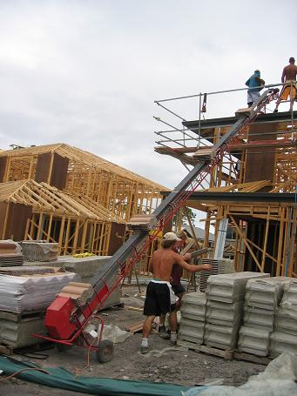
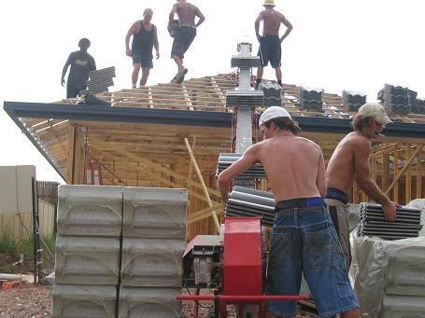
Jim the Roof Tiler

Slide 3


