Slide 1

BSBSMB404
Undertake small
business planning

Slide 2

Housekeeping
Emergency Procedures
Mobiles, Security Issues
Break times / Smoking policy
This course is “interactive” – ask questions
Respect, Confidentiality, Practice
Ground Rules:

Slide 3
Objectives
Know how to identify elements of the business plan
Discover how to develop a business plan
Learn how to develop strategies for minimising risks
Gain skills and knowledge required for this unit

Slide 4

Identify elements of the business plan
1.1. Identify purpose of the business plan

Slide 5
Business plan
Business plans may be influenced by:
Amount and types of finance available
Expected financial viability
Skills of operator
Details of ownership/management
Finance, expenditure statement
Balance sheet and cash flow forecast
Expected level of inflation and taxation.

Slide 6
Business plan
A business plan has three primary functions:
To serve as an action plan
To serve as a road map
To serve as a sales tool.
Drawing up a business plan will help you to identify your strengths and weaknesses, key areas where you need to develop expertise and the financial risk involved in setting up the business.

Slide 7

Activity 1A

Slide 8
Identify elements of the business plan
1.2. Identify and review essential components of the business plan
1.3. Identify and document business goals and objectives as a basis for measuring business performance

Slide 9
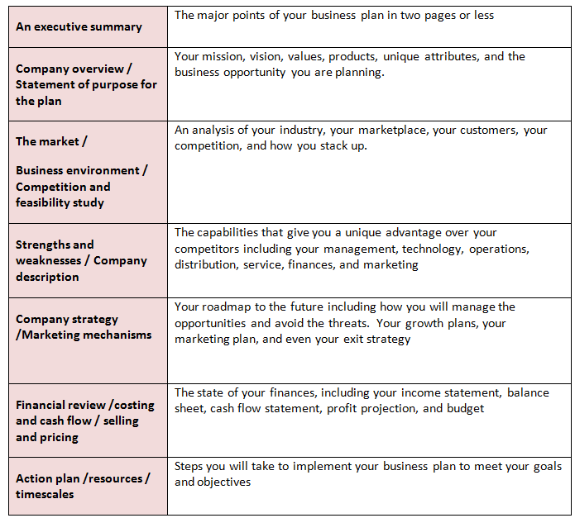
The components of a business plan

Slide 10

Target analysis
You may need to document the facts of each and every target, including:
  Current method of operation
  Market preferences and why
  Potential products in the target period
  Relationships
  Contact details

Slide 11

Business goals and objectives
Business goals and objectives may include:
Customer needs/marketing projections
Financial projections
Goals, objectives, plans, systems and processes
Lifestyle issues
Proposed size and scale of the business
Short - medium- or long-term goals
Social responsibility

Slide 12

Goals and objectives
Goals should be SMART:

Slide 13

Goals and objectives
Use “Goal” language here:
If you are brainstorming your business plan, the less formal “goal” descriptions have strong advantages.
In most creative instances, people generally use conceptual thought processes.
If you have to comply with the S.M.A.R.T objective rules, creativity could be compromised.

Slide 14

Strategy formation
Strategy formation includes:
Strategy – assists the design of the business plan and how the organisation is to carry out the business
Formation - involves exploration and the search for new advantages.

Slide 15
Activity 1B

Slide 16
Develop a business plan
2.1. Research resources, legal and compliance requirements, specifically in relation to workplace health and safety (WHS), in accordance with business goals and objectives

Slide 17
Business plan
CONTENTS
The Business
The Market
Business Plan Summary
The Future
Finances
THE BUSINESS
Risk management
The Legals
Products/services
Organisation chart
THE MARKET
Environmental
S.W.O.T
Advertising & sales
Research

Slide 18
Business plan
THE FUTURE
Mission
Goals/objectives
Action plan
Vision
FINANCES
Start-up costs
Profit and loss
Cash flow
Financial review

Slide 19

Workplace health and safety
WHS issues may include:
Identification of specific hazard
Management of the organisation
Provisions for ensuring safety of members of the public and contractors
Research resources.

Slide 20

WHS legislation and codes of practice
WHS legislation and codes of practice may include:
Common law duties
Health and safety representatives
Prompt resolution of health and safety issues
Provision of information, induction and training
Relevant state/territory legislation
Requirements for the maintenance of records.

Slide 21

Develop a business plan
You will have to consider:
Duties of employees and contractors
Legal requirements of your business
Legal considerations

Slide 22
Trade Practice Act
The Trade Practices Act aims to enhance the welfare of Australians by promoting competition and fair trading and providing for consumer protection.
The Act deals with almost all aspects of the marketplace: the relationships among suppliers, wholesalers, retailers, competitors and customers.

Slide 23
Activity 2A

Slide 24
Develop a business plan
2.2. Research market needs, and market size and potential

Slide 25

Market needs
By researching market needs you can expect to:
Reduce financial risk
Identify your target markets
Identify optimal product and company positioning
Measure the effectiveness of your marketing
Identify new qualified leads.

Slide 26

Market Size
Market size may include:
Relevant market size
Competitors
Customers
Market Factors
Case Studies
Potential.

Slide 27
Activity 2B

Slide 28
Develop a business plan
2.3. Identify sources and costs of finance, from financial plan, to provide required liquidity and profitability for the business

Slide 29

Financial plan
Financial plans may include:
Analysis of sales by product/service
Cash flow estimates for each forward period
Current financial state of the enterprise
Financial performance to date
Likely return on investment
Monthly, quarterly or annual returns.

Slide 30

Start up expenses
These expenses may include:
Business registration fees
Business licensing and permits
Rent deposits
Down payments on property
Utility set up fees.

Slide 31

Operating expenses
These are regarded in accounting standards as your business running expenses.
Think of these as expenses and costs that a business would need to pay on a monthly basis.

Slide 32
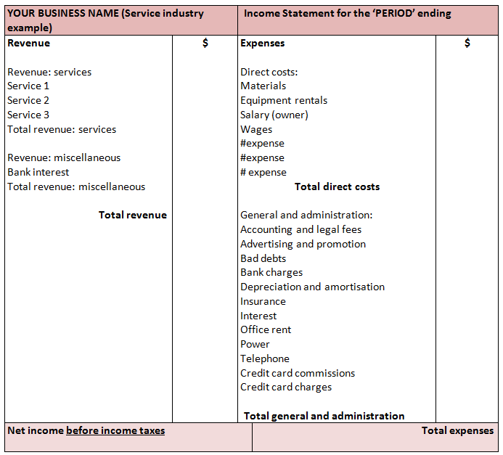
Example – Income Statement

Slide 33
The cash flow projection
The Cash Flow Statement shows how cash has flowed in and out of your business. In other words, it describes the cash flow that has occurred in the past. The Cash Flow Projection shows the cash that is anticipated to be generated or expended over a chosen period of time in the future.

Slide 34
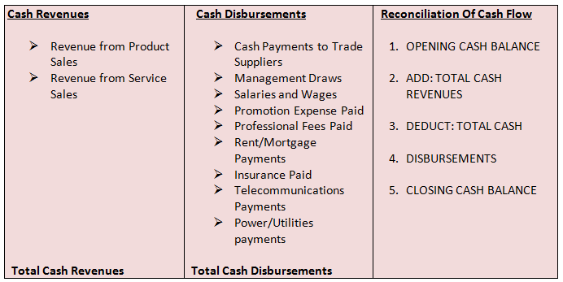
Example - The Cash Flow Projection

Slide 35
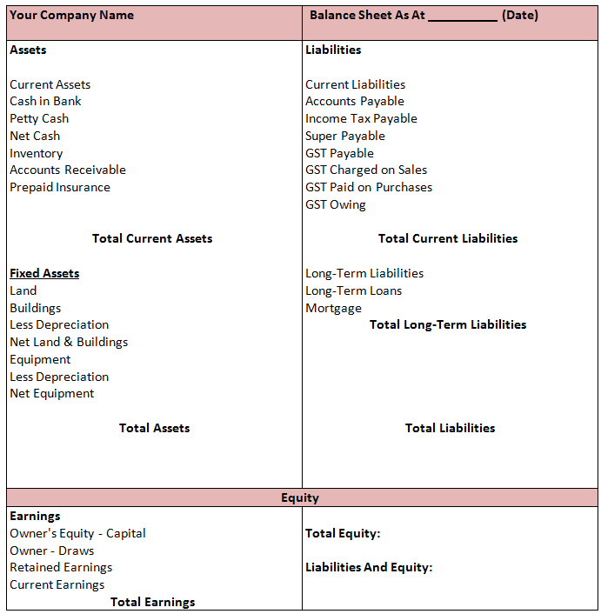
Balance sheet

Slide 36

Sources and costs of finance
Sources and costs of finance is obviously one of the most important parts of a business plan as without funding the business would not exist.

Slide 37
Activity 2C

Slide 38
Develop a business plan
2.4. Identify methods, from marketing strategies, to promote market exposure of the business

Slide 39

Marketing strategies
Marketing strategies may include:
Achieving lower costs of production
Creating a very different product line
Distribution
Product design and packaging
Product range and mix
Promotion and advertising
Pursuing cost leadership

Slide 40

Attendance at trade shows, conferences and other events
Trade shows and product exhibitions can be a sound marketing platform to promote your goods and services.

Slide 41

Using the internet
Along with using media releases and media generally, the internet is equally one of the best ways of promoting your business.

Slide 42
Activity 2D

Slide 43
Develop a business plan
2.5. Identify methods/means of production/operation from production/operations plan to conform with business goals and objectives

Slide 44

Operational Plan
Start within your limits!
Again, assuming you may have already created an operational plan, this will provide as a summary.

Slide 45

Operations in your small business
Demonstrate that you understand the manufacturing process of producing your products in line with business goals and objectives.
You will need to:
Stage of Development
The Production Process section.

Slide 46
Activity 2E

Slide 47
Develop a business plan
2.6. Identify staffing requirements to effectively produce/deliver products/services

Slide 48
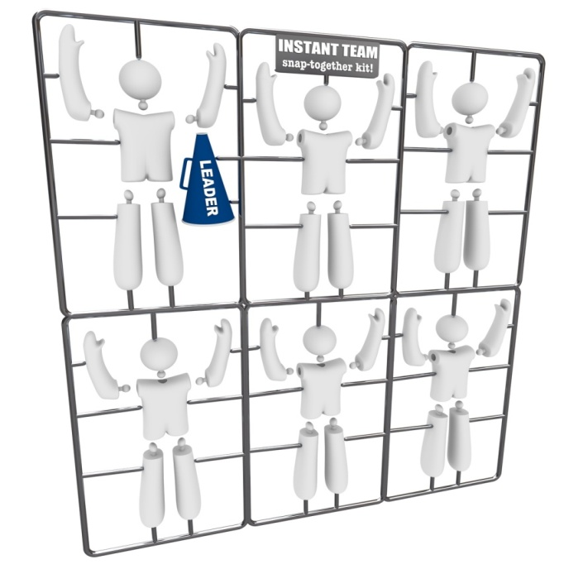
Staffing requirements
Staffing requirements may include:
Full-time, part-time staff, permanent, temporary or casual staff
Owner/operator
Sub-contractors or external advisers/consultants

Slide 49

Staffing requirements
You will need to identify:
Who will be on your management team?
What are the skills of your management and staff?
How will they contribute to the bottom line?

Slide 50

Staffing requirements
You will need to identify:
  Ownership structure
  Internal management team
  External management resources
  Human resources needs.

Slide 51
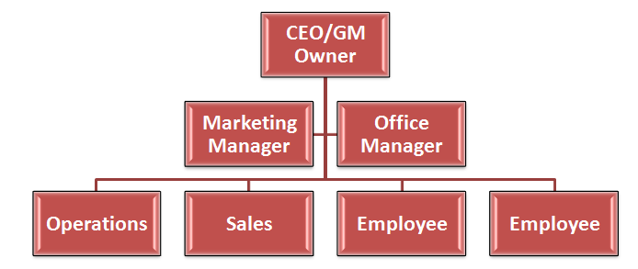
Small Business Organisation Chart

Slide 52
Activity 2F

Slide 53
Develop a business plan
2.7. Identify, assess and prioritise internal and external risks

Slide 54

Internal and external risks
Internal risks are ones that arise due to the organisation’s normal processes. It typically relates to human factors, technology and physical factors.
External risks are ones that imposed on the organisation from without, such as economic changes, natural disasters or political factors.

Slide 55

Assessing risks
You could divide risk probability into categories such as:
Highly unlikely: Could occur in exceptional circumstances, but there is a good chance it never will
Unlikely: Unexpected but there is a slight possibility
Possible: There is a chance of it occurring and similar incidents have occurred in the past
Likely: A strong possibility that it will occur in some form
Certainty: Expected to occur due to past events and is planned around.

Slide 56

Assessing risks
Types of impacts may include:
Damage to reputation
Loss of business from clients
Physical or emotional harm to employees and clients
Damage to equipment, facilities or premises.

Slide 57
Prioritising risks
One method of prioritising risks is a probability-impact matrix (or PIM).
 | Minor (0.2) | Moderate (0.4) | Major (0.6) | Catastrophic (0.8)
Highly likely (0.9) | 0.18 | 0.36 | 0.54 | 0.72
Unlikely (0.7) | 0.14 | 0.28 | 0.42 | 0.56
Possible (0.5) | 0.1 | 0.2 | 0.3 | 0.4
Likely (0.3) | 0.6 | 0.12 | 0.18 | 0.24
Certainly (0.1) | 0.2 | 0.4 | 0.6 | 0.8

Slide 58
Activity 2G

Slide 59
Develop a business plan
2.8. Identify specialist services and sources of advice, where required, and cost in accordance with available resources

Slide 60

Specialist Services
Specialist services may include:
Accountants
Business advisors and consultants
Business brokers
Contractors
Government agencies
Industry/trade associations
Lawyers and providers of legal advice
Mentors.

Slide 61
Activity 2H

Slide 62
Develop strategies for minimising risks
3.1. Identify specific interests and objectives of relevant people and seek and confirm their support of planned business direction

Slide 63

Minimising Risks
You can minimise risks by identifying interests and objectives of relevant people.

Slide 64
Activity 3A

Slide 65
Develop strategies for minimising risks
3.2. Identify and develop risk management strategies according to business goals and objectives, and relevant legal requirements

Slide 66

Risk management strategies
Risk management strategies may include:
Breach of contract
Knowledge management
Measures to manage risk
Security systems
Security of intellectual property.

Slide 67

Risk management strategies
Risk management strategies should be used according to business goals and objectives.

Slide 68

Consequence
Consequence represents the impact that a risk may have and is measured in degrees of severity, should the risk occur.

Slide 69

External/strategic context of Risk
This assessment involves understanding the legal, financial, political, environmental, safety and any other related context of risk.

Slide 70
Activity 3B

Slide 71
Develop strategies for minimising risks
3.3. Develop a contingency plan to address possible areas of non-conformance with the plan

Slide 72

Contingency plan
Contingency plans may include:
Disturbances to cash flow, supply and/or distribution
Sickness or personal considerations.

Slide 73
Activity 3C

Slide 74
Skills and Knowledge Activity

Slide 75
Major Activity
This activity should take anywhere between an 1-2 hours to complete and can be found at the end of your workbook.
Your instructor will let you know whether they wish for you to complete it in session time or your own time.

Slide 76

Summary and Feedback
Did we meet our objectives?
How did you find this session?
Any questions?

Slide 77

Congratulations!
You have now finished the unit…
‘Undertake Small Business Planning’

