Slide 1

BSBITU314
Design and produce spreadsheets

Slide 2

Select and prepare resources
1.1 Identify spreadsheet task purpose and audience

Slide 3

Spreadsheet task purpose
Data storage
Business accounting
Budgeting
Exporting data
Data cleanup
Creating reports and charts.

Slide 4

Audience characteristics:
Age
Location
Gender
Professional status
Attitudes
Behaviour.

Slide 5

Activity 1A

Slide 6
Select and prepare resources
1.2 Identify task requirements in relation to data entry, storage, output, timeline and presentation format

Slide 7
Data entry
It is essential that you ensure the accuracy of data entry within your spreadsheets
You should read any data carefully and ensure that it is transferred correctly into the spreadsheet
The first type of data entry will require you to work on a completely new spreadsheet and use the keyboard to enter data
However, you may also be required to transfer data from existing spreadsheets.

Slide 8

Storage
There are numerous ways of storing your spreadsheets
You may be expected to save them directly to specified computer folders
There will be set file naming procedures which you are expected to follow
It might also be necessary to print paper copies of the spreadsheets
You should ensure that your spreadsheets are stored securely.

Slide 9
Output
It is likely that you will be expected to act in accordance with strict requirements with regards to the output of your spreadsheets
They may be intended for inclusion within textual documents or PowerPoint presentations
They may also be printed in the form of overhead transparencies or attached to emails
You should ensure that the spreadsheets are formatted appropriately.

Slide 10

Presentation
You must consider the ways in which information is presented within your spreadsheets
There may be a need to organise groups of data into specific headings
You might also be expected to use business logos, fonts, and styles within your spreadsheets
Such requirements may well be specified within the spreadsheet design standard.

Slide 11
Activity 1B

Slide 12
Select and prepare resources
1.3 Select most appropriate application to produce spreadsheet, in accordance with available resources and organisational policies

Slide 13

Selecting an appropriate spreadsheet application
You will have to make the decision of whether to opt for an installed program or a cloud-based spreadsheet solution
You may be assured of a relatively good level of developer support if you opt for an installed spreadsheet program
The level of available finance should also have a bearing on the selection of spreadsheet programs.

Slide 14

Microsoft Excel
Microsoft Excel is the most popular spreadsheet application and is fully compatible with Microsoft Windows
It can be used for a wide variety of purposes including the recording of business expenditure, budget planning, and presentation of financial results
Excel is quite user-friendly and can be used for the purpose of carrying out various calculations, using basic formulas
There are also a variety of chart and graph templates which can be used for the visual presentation of data.

Slide 15
Google Sheets
Google sheets is a freely available and popular alternative to Microsoft Excel
You can access the sheets application upon registration for a Gmail account
It comes complete with user-friendly features which allow for real-time collaboration
It is also possible to transfer data from other Google applications such as Google Search and Google services.

Slide 16
iWork Numbers
Numbers is another freely available spreadsheet application for Mac users
It has a relatively clean and user-friendly interface, while still allowing for complex calculations
There is also the option of saving spreadsheet documents to the iCloud, which will save a great deal of time for many users
This allows for the convenience of accessing such documents wherever you are working
There is also the option of real-time collaboration via the iCloud.

Slide 17
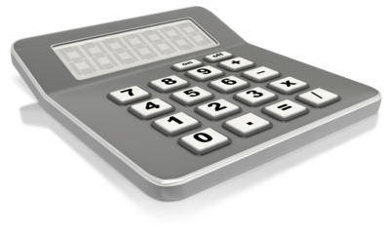
OpenOffice Calc
The final freely available option in OpenOffice calc. This comes as part of the OpenOffice suite and has a wide variety of helpful functions and features
You can transfer spreadsheets in various file formats (including xls) into OpenOffice Calc
There are a range of regular program features, as well as extension and templates which can be used.

Slide 18
Activity 1C

Slide 19
Plan spreadsheet design
2.1 Ensure spreadsheet design suits purpose, audience and information requirements of task

Slide 20

Spreadsheet design may include:
Appropriateness to required tasks
Basic analysis
Charts
Formatting and reformatting
Formulae
Functions
Headers and footers.

Slide 21

Spreadsheet design may include:
Headings
Headings and labels
Identification and parameters
Import and export of data
Labels
Macros
Multi-page documents
Split screen operation.

Slide 22
Activity 2A

Slide 23
Plan spreadsheet design
2.2 Ensure spreadsheet design enhances readability and appearance, and meets organisational and task requirements for style and layout

Slide 24

Different layouts and styles that you may want to consider include:
Paper size and page orientation
Text font, colour, and size
Headings and subheadings
Margins and page breaks
Headings and footers.

Slide 25
Different layouts and styles that you may want to consider include:
Justification
Page numbering
Underlining, italics, and bold
Tables.

Slide 26

Organisational and task requirements may include:
Company colour scheme and logo
Consistent corporate image and content restrictions
Established guidelines and procedures for document production
House styles and templates
Observing copyright legislation
Organisation name, time, date, document title, filename, etc. In header/footer.

Slide 27
Activity 2B

Slide 28
Plan spreadsheet design
2.3 Use available application functions to ensure consistency of design and layout, adhering to organisational and task requirements

Slide 29

Consistency of design and layout may include:
Borders
Bullet/number lists
Captions
Consistency with other business document
Page numbers
Spacings
Typeface styles and point size.

Slide 30

Automatic functions
Auto date
Auto correct
Auto format
Auto text
Default settings
Headers and footers
Page numbering
Styles
Table headings.

Slide 31
Activity 2C

Slide 32
Create spreadsheet
3.1 Enter data, check and amend to maintain consistency of design and layout, in accordance with organisational and task requirements

Slide 33

Entering data
Time and care should be taken when inputting data into spreadsheets
You are advised to organise the layout of your spreadsheets for the effective avoidance of such issues
It would be advisable to use forms for the purpose of quick and accurate data entry
You should also make the most of functions and formulas.

Slide 34

Checking data may include:
Accuracy of data
Accuracy of formulae with calculator
Ensuring instructions with regard to content and format have been followed
Proofreading
Spelling, electronically and manually.

Slide 35
Making amendments
You should also account for any feedback provided by colleagues who have helped you in the review process
You can alter the content by double clicking on a cell, making the necessary corrections, and then clicking enter
It is also possible to make amendments via the formula bar
Alternative use may be made of the Autocorrect feature.

Slide 36
Activity 3A

Slide 37
Create spreadsheet
3.2 Format spreadsheet using application functions to adjust page and cell layout to meet information requirements, in accordance with organisational style and presentation requirements

Slide 38

Formatting the spreadsheet
Alignment on page
Enhancements to format - borders, patterns and colours
Use of absolute and relative cell addresses.

Slide 39

Using software functions
Adding/deleting columns/rows
Formatting cells
Sizing columns/rows
Using macros
Utilising shortcuts.

Slide 40
Activity 3B

Slide 41
Create spreadsheet
3.3 Ensure formulae are tested and used to confirm output meets task requirements, in consultation with appropriate personnel as required

Slide 42

Formulae may include:
Average
Division
Multiplication
Percentage
Subtraction
Sum
Combinations of above.

Slide 43

Follow this procedure in order to evaluate formulae:
Select the cell including the formula
Select the formula tab and click on evaluate formula
Click on the evaluate button in the dialogue box once for each expression that needs evaluating.

Slide 44

Use the error checking tool, as follows:
Select the cell containing the formula
Select the formula tab and click on the error checking button
Choose from options, including:
  help on this error
  show calculation steps
  ignore the error.

Slide 45
Activity 3C

Slide 46
Create spreadsheet
3.4 Use relevant help functions to overcome intermediate-level issues with spreadsheet design and production

Slide 47
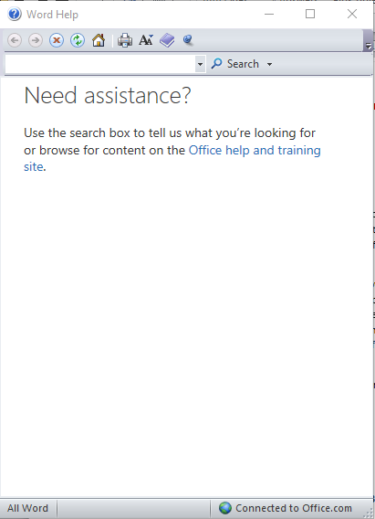
Using relevant help functions
You are advised to use the relevant help functions whenever you have trouble completing set tasks and processes when using spreadsheet applications
Access of the help functions in applications such as Microsoft Excel will allow you to find information on the use of particular commands and functions.

Slide 48

You might have to overcome these problems with design and production:
Difficulty switching between worksheets
Incorrect use of pivot tables
Formula not working properly
Error messages being displayed.

Slide 49
Activity 3D

Slide 50
Produce intermediate-level charts
4.1 Select chart type and design that that offers analysis of numerical data, and meets organisational and task requirements

Slide 51
Produce intermediate-level charts
4.2 Create charts using appropriate data range in spreadsheet

Slide 52
Produce intermediate-level charts
4.3 Modify chart type and layout using formatting features, adhering to organisational and task requirements

Slide 53

Types of charts that you can choose from in Excel:
Column charts
Line charts
Bar charts
Area charts
Scatter charts.

Slide 54

This procedure should be followed for the creation of charts:
Highlight the relevant range of data, including any titles and headings
Select the insert tab and choose from the chart types
If you are unsure of which type of chart to insert then select the drop down chart menu and click on all chart types
Choose the most appropriate chart type and click on ok.

Slide 55

Changes that can be made via the layout tab:
Positioning of the chart table
Use of axis titles
Inclusion of legend
Changing of data labels
Changing of axes and gridlines
Changing of plot area.

Slide 56
Activity 4A

Slide 57
Finalise and present spreadsheets
5.1 Review and edit final spreadsheet and any accompanying charts, and prepare for delivery in accordance with task requirements

Slide 58
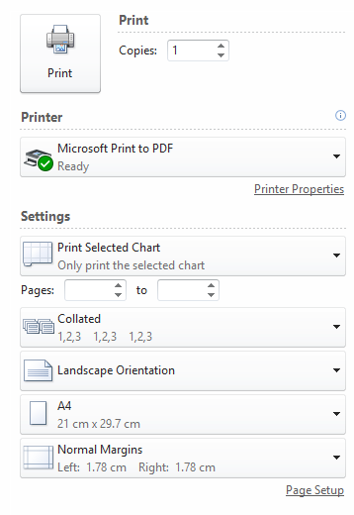
The procedure for previewing a worksheet:
Select the appropriate worksheet tab (it is possible to select multiple worksheets by holding down ctrl while selecting additional sheets)
Click on the file button and select the print option
Cycle through the worksheets as necessary.

Slide 59
Adjusting
If you’d like to change the page margins then click the show margins button and drag them to the appropriate position
You can also change the page orientation, size, and scaling via the drop-down menus
Additional adjustments can be made to the appearance of full-page charts prior to printing.

Slide 60
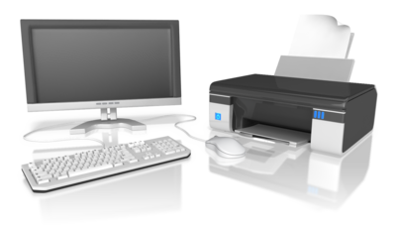
Printing
There are a number of options when it comes to the printing of data and charts included in Excel worksheets
It is possible to print worksheets in their entirety or select and print individual elements
You may choose to print the highlighted selection, a single worksheet, or multiple worksheets in Excel via the settings menu
It is also possible to select and print tables individually.

Slide 61
Activity 5A

Slide 62
Finalise and present spreadsheets
5.2 Deliver document to relevant audience within designated timelines and in accordance with organisational requirements for speed and accuracy

Slide 63
Designated timelines may include:
Organisational timeline, e.g. deadline requirements
Timeline agreed with internal/external client
Timeline agreed with supervisor/person requiring document.

Slide 64

Designated timelines may be:
Within organisational deadline
Within an agreed period
By the end of the month
Daily
As requested.

Slide 65
Consider these data inputting strategies:
Use keyboard and mouse shortcuts
Use the data entry form
Ensure that headings can be seen at all times.

Slide 66

Good time management strategies include:
Recording your deadlines
Prioritising your tasks
Keeping track of your progress
Knowing how to deal with problems that may arise.

Slide 67
Activity 5B

Slide 68
Finalise and present spreadsheets
5.3 Name and store spreadsheet appropriately in accordance with organisational requirements and exit application without data loss/damage

Slide 69

Tips when naming your documents include:
Use keywords
Use your name or initials
Use date
Use alphabetic codes
Use version numbers
Use descriptors
Use underscores
Use common names
Be detailed
Be consistent.

Slide 70

Tips when storing your documents include:
Store similar documents together
Don’t save unnecessary documents
Avoid large folder structures
Use shortcuts rather than having multiple copies
Colour code your folders
Think about storing documents online (e.g. Microsoft SharePoint 2010 or Windows Live SkyDrive)
Make sure that the documents that you use every day can be accessed easily.

Slide 71

Exiting without information loss or damage
To save a document, either:
Press Ctrl and S together
Click the ‘File’ tab and click ‘Save’ or ‘Save as’
Click the save icon across the top of your document (see image).
Once you know that you have saved your document you can then close it. If your document does close without saving you may find that your program recovers the unsaved version.

Slide 72
Activity 5C

Slide 73
Summative Assessments
Summative assessments consist of:
Skills Activity
Knowledge Activity
Performance Activity.
Your assessor will provide you with further guidance on how and where to complete these assessments.

Slide 74

Summary and Feedback
Did we meet our objectives?
How did you find this session?
Any questions?

