Slide 1

HAND AND POWER TOOLS
INCLUDING CONSTRUCTION PLANT
WORK HEALTH AND SAFETY OFFICER

Slide 2
Assessment Criteria
Describe the statutory requirements relating to hand and power tools.
Understand some of the hazards and the risks associated with hand and power tools and other construction plant.
Understand the need for documented training for personnel required to use and/or maintain hand and power tools and other construction plant.
Describe the selection process of effective and appropriate personal protective equipment for personnel required to use and/or maintain hand and power tools and other construction plant.

Slide 3
Hand and Power Tools
There are five basic principles that can help minimise the risk associated with the use of hand and power tools. They are:
Keep all tools in good condition with regular maintenance;
Use the right tool for the job;
Examine each tool for damage before use and do not use damaged tools;
Operate tools according to the manufacturer’s specifications; and
Provide and use properly, the right personal protective equipment.

Slide 4
Hand Tools
Hand tools are tools that are powered manually. They include anything from an axe to a wrench. The greatest risks associated with hand tools result from misuse and improper maintenance.
The PSBU is responsible for the safe condition of tools and equipment used by workers. A PCBU shall not issue or permit the use of unsafe hand tools. Workers should be trained in the proper use and safe handling of all tools and equipment.

Slide 5
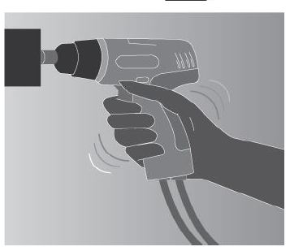
Power Tools
Types of power tools are determined by their power source: electric, pneumatic, liquid fuel, hydraulic and powder actuated.

Slide 6
Power Tools
Minimising the risk:
Never carry a tool by the cord or hose;
Never yank the cord or the hose to disconnect it from the receptacle;
Keep all cords and hoses away from heat, oil and sharp objects;
Disconnect tools when not in use, before servicing and cleaning and when changing accessories such a blades, bits and cutters;
Keep all people who are not involved with the work at a safe distance from the work area;
Secure work with clamps or a vice, freeing both hands to operate the tool;
Avoid accidental starting. Do not hold fingers on the switch button while carrying a plugged-in tool;
Maintain tools with care;
Follow instructions in the user’s manual for lubricating and changing accessories;
Be sure to keep good footing and maintain good balance when operating power tools;
Wear appropriate clothing for the task;
Remove all damaged portable equipment from use and tag them “Do Not Use”. Place lockout devices on all stationery equipment that requires replacement, repair or servicing.

Slide 7
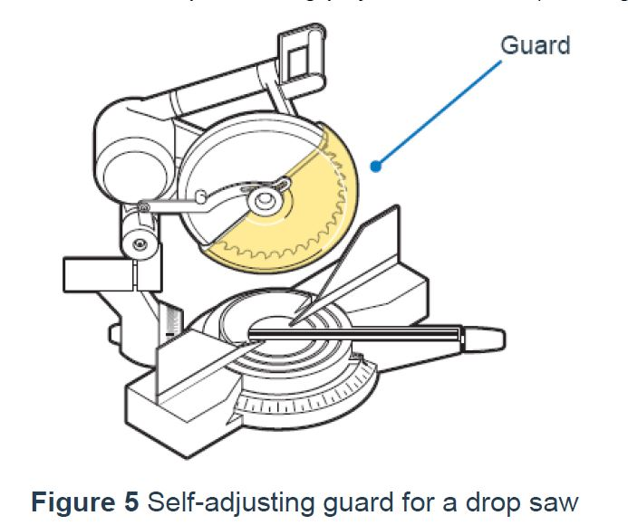
Power Tools
Guarding

Slide 8
Electric Tools
The following general practices should be followed when using electric tools:
Operate electric tools within their design limitations;
Use gloves and appropriate safety footwear when using electric tools;
Store electric tools in a dry place when not in use;
Do not use electric tools in damp or wet locations unless they are approved for that purpose;
Keep work areas well lighted when operating electric tools; and
Ensure that cords from electric tools do not present themselves as a tripping hazard.
Ensure that all specified electrical equipment is tested and tagged in accordance with legislative requirements.

Slide 9
Portable abrasive wheel tools
Portable abrasive grinding, cutting, polishing and wire buffing wheels create special safety problems because they may throw off flying fragments. Abrasive wheel tools must be equipped with guards that:
Cover the spindle end, nut and flange projections;
Maintain proper alignment with the wheel; and
Do not exceed the strength of the fastenings.

Slide 10
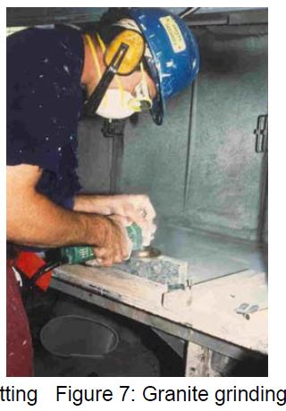
Portable abrasive wheel tools
When using a powered grinder:
Always use eye and/or face protection;
Turn off the power when not in use; and
Never clamp a hand-held grinder in a vice.

Slide 11
Pneumatic tools
Pneumatic tools are powered by compressed air and include chippers, drills, hammers and sanders.
There are several dangers associated with the use of pneumatic tools. First and foremost, is the danger of getting hit by one of the tool’s attachments or by some kind of fastener the worker is using with the tool.

Slide 12
Liquid fuel tools
Fuel-powered tools are usually operated on ULP. The most serious hazard associated with the use of fuel-powered tools comes from fuel vapours that can burn or explode and also give off dangerous exhaust fumes.

Slide 13
Hydraulic power tools
The fluid used in hydraulic power tools must be an approved fire resistant fluid and must retain its operating characteristics at the most extreme temperatures to which it will be exposed.
The manufacturer’s recommended safe operating pressure for hoses, valves, pipes, filters and other fittings must not be exceeded.

Slide 14
Powder-actuated tools
Powder Actuated Tools (PATs) are used to fasten construction materials to concrete, steel or brick and consist of the tool, a fastener and an explosive charge; they are commonly referred to as explosive power tools.
Both high-velocity and low-velocity type PATs can be safely operated when basic safety procedures, outlined below, are observed and the manufacturers’ operational guidelines are followed.

Slide 15
Compressed air nailing tools
Safety procedures:
Review the owner’s manual carefully with all operators.
Always wear safety glasses.
Do not hold the trigger down unless you’re purposefully firing the tool. This is especially important when descending ladders.
Keep people out of range of fire. Exercise extreme caution when using an air tool around another worker.
Never point the tool at anyone. Treat the tool like a firearm. Never assume the tool is empty.
Disconnect the air hose before clearing a jam or making adjustments.
Do not fire the tool unless the nose is firmly pressed against a work piece.

Slide 16
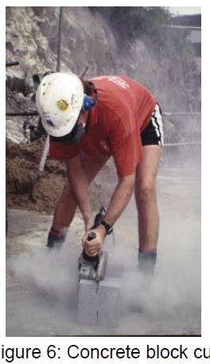
Masonry and concrete cutting

Slide 17


