Slide 1

Managing WHS Compliance of Contractors
Australia Post Contractor Compliance Presentation

Slide 2

Introduction
Importance of WHS compliance for contractors is crucial because it ensures the health and safety of their workers, protects them from legal repercussions, maintains a good reputation and is a requirement to secure contracts by demonstrating their commitment to workplace safety.
They must adhere to the Work Health and Safety Act 2011 (QLD)

Slide 3
WHS Compliance Overview
What is WHS compliance?
Developing Safety Plans, Training and Induction, Incident Reporting, Risk Assessment, Communication and Collaboration
Why is it crucial for contractors?
Legal Obligations, Risk Mitigation, Contract Eligibility, Potential Penalties
A WHS Management Plan must demonstrate compliance with its WHS duties under applicable legislation and satisfies Australia Posts Safety Standards (Aus Post Contract)

Slide 4


Our Contractors
Mail and Parcel Contractor
Services Provided:
  Delivery of mail and parcels
  Vehicle maintenance and insurance
  Use of handheld scanners and sorting frames
  Public liability and personal accident insurance
WHS Compliance:
  Regular safety audits
  Training such as manual handling and communication
  Risk management and mitigation
  Personal Protective Equipment (PPE)
Cleaning Contractor
Services Provided:
  General cleaning and maintenance
  Sanitary bin and sharps container management
  Washroom cleaning and decontamination
  Waste management and recycling
WHS Compliance:
  Personal Protective Equipment
  Safety assessments and regular safety audits
  Training such as risks of hazardous chemicals in the workplace (Code of Practice)

Slide 5
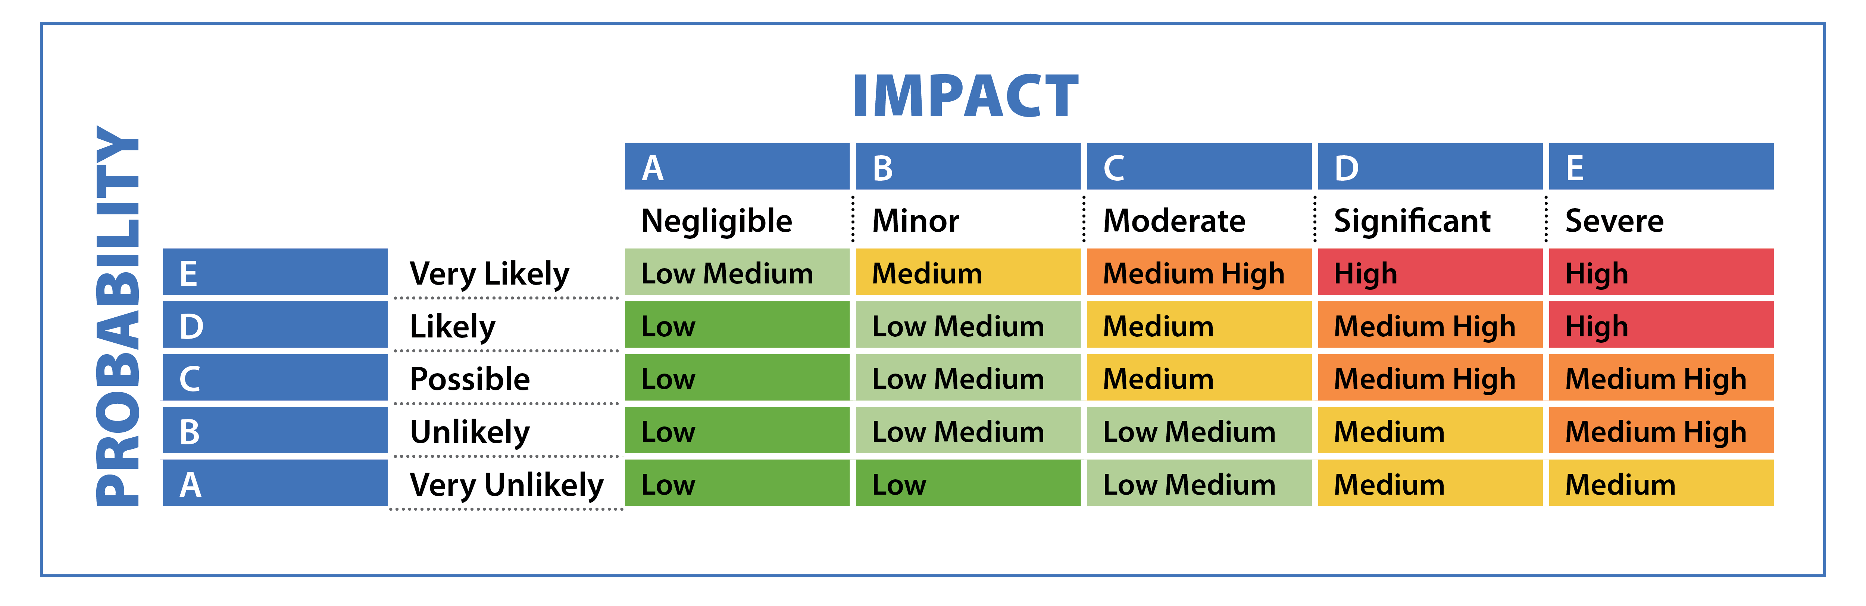
Workplace Requirements
Contractors must have a system for identifying and managing risks. Other requirements include:
Procedures and work instructions.
Personal Protective Equipment.
Health and Safety Audits and Inspections.
Licences and Insurance.
Vehicle Maintenance.
Training such as Manual Handling and Handling Hazardous Chemicals (MSDS)
First Aid Facilities
This Photo by Unknown Author is licensed under CC BY

Slide 6

Inductions
Australia Post has a comprehensive contractor induction program designed to ensure that contractors are well-prepared and aligned with the company's safety and operational standards. This program includes:
Identity Verification: Contractors undergo in-person identity checks and photo capture to ensure accurate and up-to-date records.
Safety Training: Emphasis on safety protocols, hazard awareness, and the importance of maintaining a safe working environment.
Competency and Training Management: Contractors' qualifications and training records are managed and verified to ensure they meet the necessary standards.
Photo Identification Cards: Contractors receive photo ID cards that link all their qualifications, streamlining the verification process.
This program is part of Australia Post's broader commitment to safety and efficiency, aiming to reduce risks and improve overall operational effectiveness
This Photo by Unknown Author is licensed under CC BY-SA

Slide 7
WHS Key Performance Indicators
It is essential to keep records of accidents and incidents to monitor and improve safety measures. These are useful when measuring key performance indicators (KPI’S) against WHS compliance and the following Codes of Practice.
These KPIs can help organisations track their performance and ensure they are meeting the required standards for health and safety.
There are 2 Codes of Practice both contractors have agreed to observe.
How to manage Work Health and Safety Risks
Managing Risks of Hazardous Chemicals in the workplace

Slide 8

Codes of Practice KPI Breakdown Examples
Managing Health and Safety Risks
Incident Rate: Number of workplace incidents (e.g., injuries, accidents) per 100 employees per year.
Near Misses: Number of near-miss incidents reported and investigated.
Safety Training Completion: Percentage of employees who have completed mandatory safety training.
Compliance Audits: Number of safety compliance audits conducted and passed.
Employee Safety Engagement: Employee participation rate in safety programs and initiatives.
Lost Time Injury Frequency Rate (LTIFR): Number of lost-time injuries per million hours worked.
.
This Photo by Unknown Author is licensed under CC BY-SA-NC

Slide 9

Codes of Practice KPI Breakdown Examples
Managing Risks of Hazardous Chemicals
Chemical Inventory Accuracy: Percentage of accurate records in the hazardous chemical inventory.
Safety Data Sheet (SDS) Availability: Percentage of hazardous chemicals with up-to-date SDS available.
Exposure Monitoring: Frequency of monitoring exposure levels to hazardous chemicals.
Personal Protective Equipment (PPE) Usage: Percentage of employees using PPE correctly when handling hazardous chemicals.
Emergency Response Drills: Number of emergency response drills conducted and employee participation rate.
Hazardous Waste Disposal Compliance: Percentage of hazardous waste disposed of according to regulations
This Photo by Unknown Author is licensed under CC BY

Slide 10

Codes of Practice
How to Manage Health and Safety Risks
Managing Risks of Hazardous Chemicals
Identify Hazards
Assess Risks
Control Risks
Review Controls for Effectiveness
Record Keeping
@ www.safeworkaustralia.com.au
Workplace Exposure Standards
Hazardous Chemical Register
Labelling and Safety Data Sheets (SDS)
Health Monitoring
Emergency Plans
Risk Management
@ www.safeworkaustralia.com.au

Slide 11


Non-Compliance
Contractor 1 was involved in a manual handling incident. They were not observing appropriate posture whilst lifting a parcel weighing 20kg. They did not utilise load shifting equipment or ask for assistance for a team lift.
Contractor 2 was undertaking after-hours cleaning tasks and mishandled some cleaning products, causing a chemical burn on their skin. Contractor 2 provided the equipment and chemicals. The Safety Data Sheet (SDS) and gloves were available but were not used
This Photo by Unknown Author is licensed under CC BY-SA

Slide 12
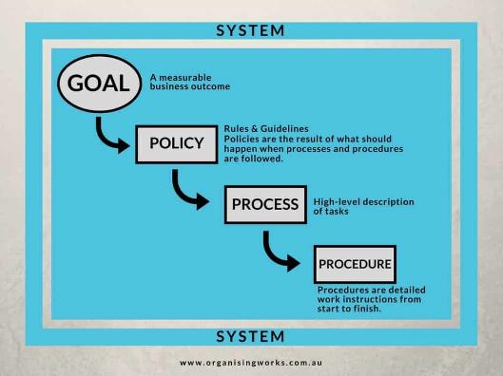
Non-Compliance Follow Up
Improved induction process
Modifying policies, procedures and systems
Provide further training for contract workers
Ensure communication to all involved parties
Monitor changes to ensure they are achieving their goals

Slide 13

PCBU’S Role in Follow Up
PCBUs (Persons Conducting a Business or Undertaking) play a vital role in ensuring contractors comply with health and safety regulations. Their responsibilities include:
Risk Assessment: Identifying and assessing potential hazards associated with contractor work.
Contractor Selection: Choosing contractors with a proven track record of compliance and safety.
Monitoring and Supervision: Regularly checking that contractors adhere to safety protocols and legal requirements.
Incident Reporting: Ensuring contractors report any incidents or near-misses promptly.
Training and Support: Providing necessary training and resources to help contractors meet compliance standards.
By following up on contractors, PCBUs help create a safer workplace for everyone

