Slide 1
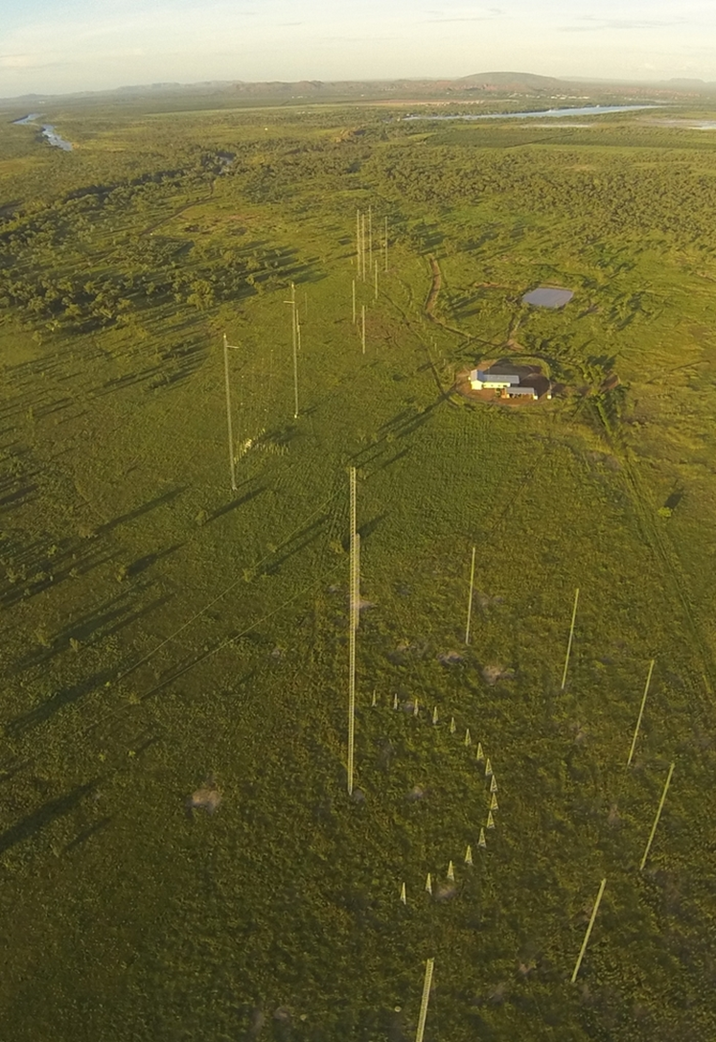
RIICPL401D Apply the principles for the installation of underground service using open excavation

Slide 2
Unit Overview
This unit will cover:
Plan and prepare tasks
Leadership and Supervision
Oversee the execution of tasks
Reporting on the Execution of tasks

Slide 3
Presentation objectives
Section 1: (LG Chapt. 1)
Plan and prepare tasks Slides 04-71
Section 2: (LG Chapt 2)
Leadership and Supervision Slides 72-102
Section 3: (LG Chapt 3)
Oversee the execution of tasks Slides 103-122
Section 4: (LG Chapt 4)
Reporting on the Execution of tasks Slides 123-133

Slide 4

Section 1:
PLAN AND PREPARE TASKS

Slide 5
Section 1 Outline
The following areas are covered in this section:
Legislation
Review the installation and identify required tasks
Access, interpret and clarify the specific task information and requirements
Ensure a job plan is available

Slide 6

Legislation (LG pg. 10-12)
Workplace Health and Safety Act 2011
Workplace Health and Safety regulation 2011
Electrical Safety Act 2002
Electrical Safety Regulation 2013
Excavation work Code of Practice 2013
(can be used to develop Standard Operating Procedure)
Notes:
Test Q1-2

Slide 7
Legislation (LG pg. 10-12)
QLD | www.legislation.qld.gov.au
NSW | www.legislation.nsw.gov.au
VIC | www.legislation.vic.gov.au
SA | www.legislation.sa.gov.au
WA | http://www.slp.wa.gov.au/legislation/statutes.nsf/default.html
TAS | http://www.thelaw.tas.gov.au/
NT | http://dcm.nt.gov.au/strong_service_delivery/supporting_government/current_northern_territory_legislation_database

Slide 8

Review the installation and identify required tasks
(LG pg. 12-17)
The installation of underground services involves a number of specific tasks; these include:
Establishing the work area
Transporting materials to site and unloading
Locate existing underground services
Excavation of the trench
Treatment of the trench with appropriate control to make safe
Placement of services in the trench
Installation of the required markers/locators
Removal of the trench treatments
Backfilling of the trench
Modify existing plans with updated information

Slide 9

Review the installation and identify required tasks
(LG pg. 12-13)
Establishing the work area may include the following:
Communicating with others who may be affected by the work with timeframes and associated risks
Establishing a physical barricade of the area to restrict entry by unauthorised people. This may be a fence, bollards or demarcation/barricading placed around the work area
Installation of signage to warn people of the risks, and the rules or process for entry to the work area
Contact details of the responsible people for the work

Slide 10
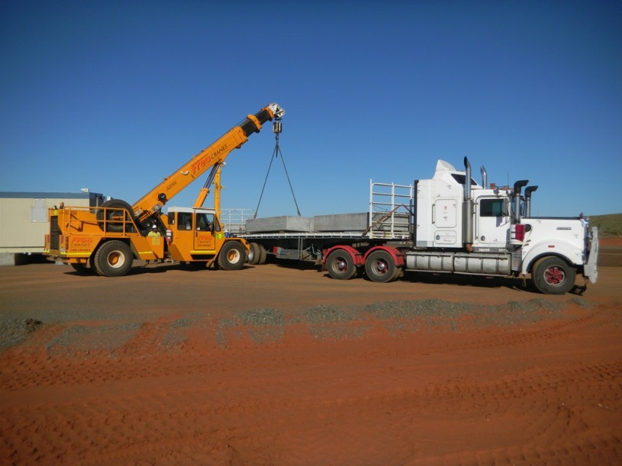
Review the installation and identify required tasks
(LG pg. 14)
Transporting materials to site and unloading may include the following:
Ensuring the area is safe & spotters in place
Unload the vehicle using plan &
Qualified Dogger, if using a crane
Store materials
Install signage
Restrict unauthorised access

Slide 11

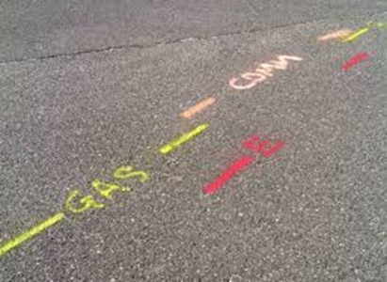
Review the installation and identify required tasks
(LG pg. 14)
Locate existing underground services
Locator equipment
Potholing (manual or vacuum excavation)
Using Ground Penetrating Radar (GPR)
Mark existing services (survey paint or short pegs)
Notes:
Test Q3

Slide 12
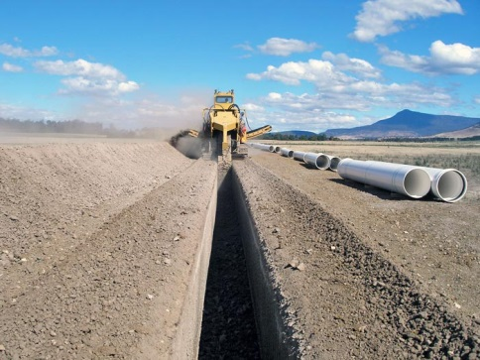
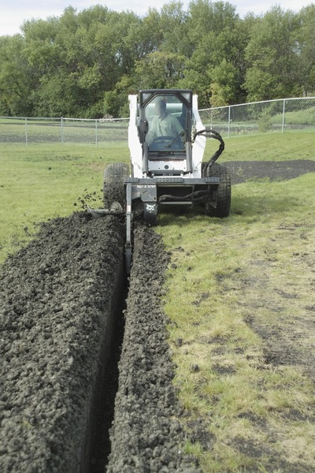
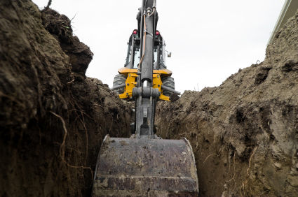
Review the installation and identify required tasks
(LG pg. 14)
Excavation of the trench may involve:
Use suitable plant
Place removed material to the side
Dig/excavate to required depth

Slide 13
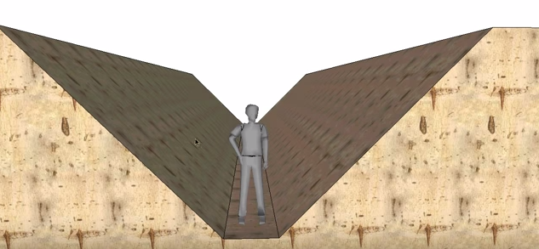
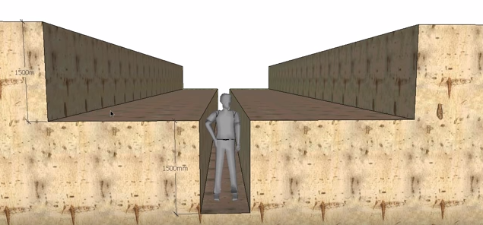
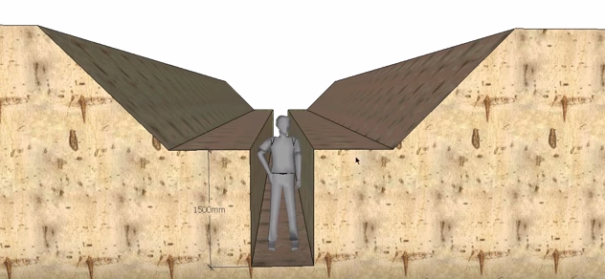
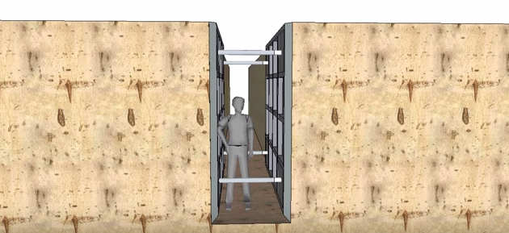
Review the installation and identify required tasks
(LG pg. 15)
Treatment of the trench with appropriate control to make safe may include:
Battering
Benching
A combination of battering and benching
Shoring
13

Slide 14
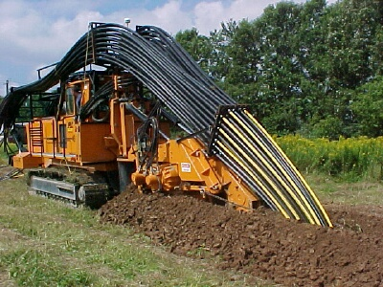
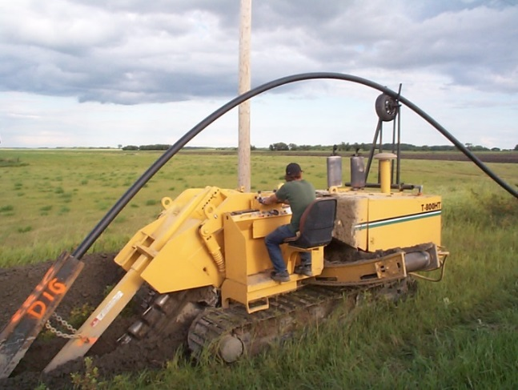
Review the installation and identify required tasks
(LG pg. 16)
Placement of services in the trench
X
This may include:
Installation of the required bedding or supporting sand or gravel in accordance with the clients or manufacturers design or specification
Using an excavator to lift
the services into the trench
Using a dedicated machine to place the services
Source: www.plctrenching.com
Source: www.digallco.com

Slide 15
Review the installation and identify required tasks
(LG pg. 16-17)
Installation of the required markers/locators
Asset Type | Colour | Symbol Examples
Gas | Yellow | HPGM or GM
Sewer | Green | SE
Stormwater | Purple | SS
Telecommunications | Telstra Orange | TE
ETSA | Red | E (H/V & L/V)
Traffic Signals | Red | TS
Street Lighting | Red | SL, SPL
Railways (TransAdelaide) | Orange | TA
Railways (ARTC) | Orange | ARTC
Railways (G&W) | Orange | G&W
Water | Blue | W
Fibre Optic | Orange | TE
Reclaimed Water | Purple | RW
Types:
Non detectable underground warning tapes
Detectable mesh underground warning tape
Detectable wave underground warning tape
AS5488-2013 Classification of Subsurface Utility Information

Slide 16
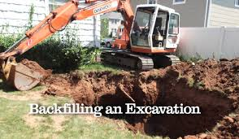
Review the installation and identify required tasks
(LG pg. 17)
Backfilling the trench
Initial ground level has been recorded
A sample of backfilling materials is accepted by Site Engineer
Marking & reference points established for final level
Backfilling completed in sub-grade layers
Watering &compacting completed
Required density tested & achieved
Plans updated & communicated

Slide 17

Access, interpret and clarify the specific task information and requirements (LG pg. 18-27)
Planning:
“Thinking is difficult, as it calls not only for recall but for patient analysis. It means questioning assumptions and considering alternatives.”
(Burns, 2003, p51).

Slide 18


Access, interpret and clarify the specific task information and requirements (LG pg. 19)
Legislation, Codes of Practice
Other compliance documentation
Company policies & procedures
Risk assessments & controls
Plant & equipment specifications
Site plans & processes
Work instructions
Materials suppliers

Slide 19

Access, interpret and clarify the specific task information and requirements (PL pg. 25)
Safe work method statements
The SWMS must:
Type of high risk construction work
Hazards & risks
Controls
How control measures will be implemented, monitored & reviewed
Developed in consultation with workers & those carrying out the high risk construction work

Slide 20

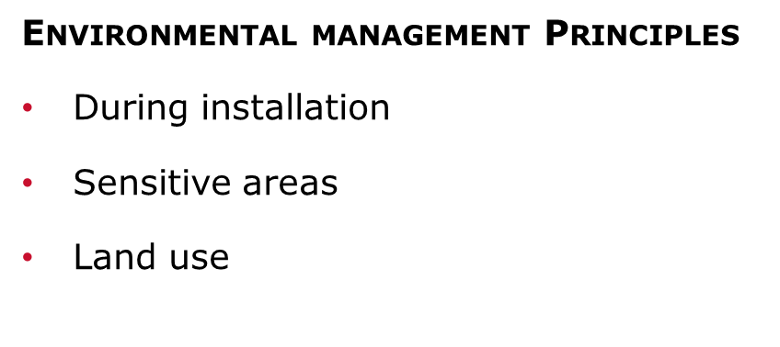
Access, interpret and clarify the specific task information and requirements (PL pg. 26)
Engineering Survey Principles
Providing a framework (providing control)
Planning
Independent checks
Safeguarding
Notes:
Test Q4 & 5

Slide 21
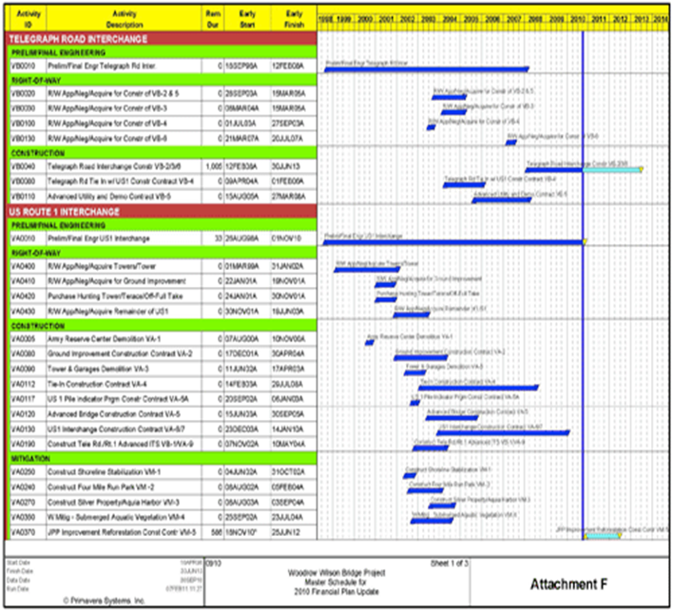
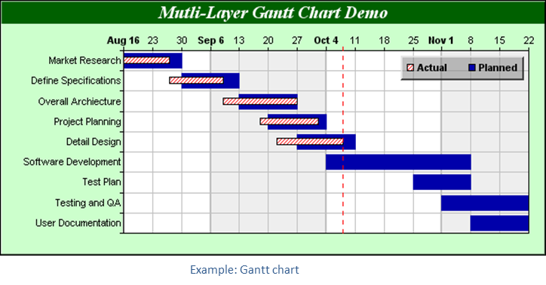
Ensure a job plan is available (LG pg. 27)
Planning
Bar charts
Gantt charts
Work Breakdown Schedule WBS
Interdependencies
Requirements – legislation, compliance, client, site, organisational
Consulting
Communicating

Slide 22
Ensure a job plan is available (LG pg. 29)
Resourcing / Scheduling
Realistic planning and estimating
Clean goal setting and planning
Smart and hard work
Efficient use of ready resources
Creative use of associated/allied resources
Effective management of time

Slide 23

Ensure a job plan is available (LG pg. 29)
Resourcing / Scheduling
List tasks
List actions for each task
Develop timeline/schedule
Allocate resources
Identify possible problems
Develop monitoring strategies
Assign tasks
Estimate costs
Implement plan
Continuously improve
Notes:
Test Q6

Slide 24

Ensure a job plan is available (LG pg. 32)
What goes in a plan?

Slide 25

Ensure a job plan is available (LG pg. 33)
Estimating Costs
Volumes,
Grades,
Percentages,
Areas, and
Resource consumption figures; including required supply rates.
When you calculate costs effectively, you will be able to allocate resources and develop schedules to successfully manage the job.

Slide 26

Ensure a job plan is available (LG pg. 33)
Principles of Cost Estimation
A structured estimating process should produce:
Quality estimates,
Consistency – checks and balances,
Improved accuracy and confidence,
Improved competency and contracting of personnel,
Alignment with all stakeholders,
Reduce uncertainty,
Reduce costs,
Reduce cost over-runs, and
Save time.

Slide 27
Ensure a job plan is available (LG pg. 33)
Principles of Cost Estimation
The Key steps in Estimating:
Overview total estimating process,
Review estimating requirements,
Planning the estimate,
Structuring the estimate,
Developing the estimate,
Analysing cost risk and contingency allocation,
Documenting,
Review and issue estimate, and
Balance estimate against actuals for reconciliation.

Slide 28
Ensure a job plan is available (LG pg. 34)
The Key steps in Estimating:
ESTIMATION PRINCIPLE | DESCRIPTION
What: Scope definition | Equipment required Layout | Material requirements Engineering standards
How: Execution strategy | Project organisation | Contracting requirements Constraints
When: Schedule | Delivery timeline and date | Escalation of costs Currency conversions
Where: Location specifics | Supply sources Import regulations Cost of local sourcing | Productivity Engineering and approvals processes
Notes:
Test Q7

Slide 29
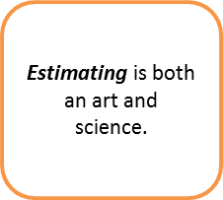
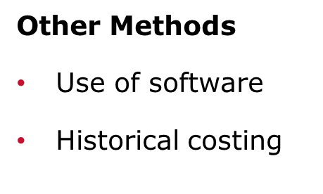
Ensure a job plan is available (LG pg. 34)
Resource Costs
Equipment
Materials
Services
Unit Costs
Building costs
Paving
Brick quantities
Soil quantities
Concrete quantities

Slide 30

Ensure a job plan is available (LG pg. 35)
Common Estimating Mistakes
Misread or misinterpreted specifications, drawing, or any other contract document,
Takeoff omissions or overlaps,
Missing quotes,
Using the percentage method to establish the cost of certain systems,
Crumbling under pressure to procure work,
Cutting prices to meet or beat someone else’s quote,
Underestimating the complexity of a job,
Expecting and excessive amount of favourable changes,
Over emphasising volume purchasing,
Undertaking a project with incomplete bid documents, and
Scaling drawings.

Slide 31

Ensure a job plan is available (LG pg. 35)
Improving your estimating processes
Company labour tables and current material prices should be stored in your database,
Manual estimating is not cost effective and it is subject to more errors and omissions,
Computerised estimating should automate and expedite the manual estimating process,
Establish the company labour units and labour factoring tables,
Maintain current material pricing lists, and
Establish an estimate review procedure.

Slide 32
Section 2:
Leadership and Supervision

Slide 33
Section 2 Outline
The following areas are covered in this section:
Six (6) Principles for Construction Leadership
Confirming resources
Communication

Slide 34

Principles for Construction Leadership(LG pg. 37-39)
Six (6) Principles for Construction Leadership:
The demonstration of safety leadership
Promote the design for safety in all engineering solutions
Communicate safety & project related information
Manage risk
Seek continuous improvement
Embed safety practices
(Other leadership principles – LG 37-39)
Notes:
Test Q8

Slide 35

Principles for Construction Leadership(LG pg. 37-39)
Other leadership skills that provide positive outcomes are:
Keep your people informed
Develop a sense of accountability, ownership and responsibility in your people
Ensure tasks are understood, supervised, and accomplished
Train your people as a team.
Communicate a vision
Think and act strategically
Honour the room
Take charge
Act decisively
Communicate persuasively
Embrace the front lines
Build leadership in others
Manage relations
Identify personal implications
Convey your character
Dampen over-optimism
Build a diverse top team
Place common interest first

Slide 36

Confirming resources (LG pg. 39-42)
Consider contributing factors:
The ground conditions
Proximity to other services
The site area and any restrictions that will impact on equipment movement and the safety of everyone in the locality
The depth and length of the actual installation
The type of installation required or needed
Selecting appropriate resources:
Types of utilities to be installed
The expected duration or life
The installation housing
Availability of the tools, plant, & equipment
The location/environment
Access to qualified/skilled & licenced personnel
Notes:
Test Q9 & 10

Slide 37
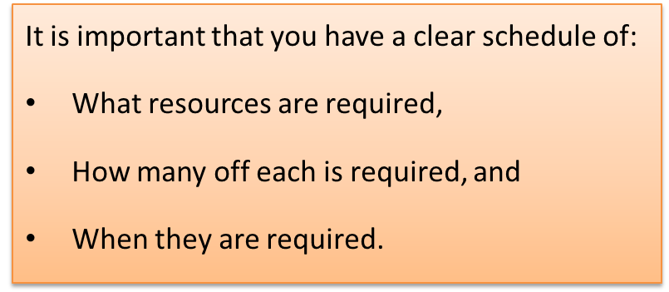

Confirming resources (LG pg. 39-42)
The site & work schedules are determined by any or all of the following factors:
Tasks for the job
Sequence of tasks to get the job
done
Relationship of the tasks to other
site activities
Deliveries and suppliers
Access to site
The risk assessments for the site and the specific job
Timeframes for completion
Availability of resources and equipment
Client/organisational requirements

Slide 38



Communication (LG pg. 43-46)
Verbal/Non-verbal vs. Written
Clear
Concise
Timely
SWI’s
SWMS
Risk Registers
Pre-Start Meetings
Site Induction
Diary Notes

Slide 39
Communication (LG pg. 43-46)
Know who your audience will be. Ask yourself:
Why will they be attending/reading?
Have they worked for this company before?
What job do they do?
What level of experience do they already have?
How much detail of information do they need?
Why do they need to know this information?
Do they have any special needs that you need to consider?
    Do they need to see the plan?
    Do they want a written report to be provided?
    Do they need to be shown where to find the site procedures?

Slide 40

Communication (LG pg. 43-46)
Prepare your presentation:
Where is the best place to conduct your presentation?
Is the location available?
Will attendees be able to easily find the location?
Will attendees be able to easily enter the location?
Are there any OH&S or other workplace requirements?
Effective workplace presentations include:
Identifying the needs of attendees.
Engaging attendees.
Structuring the information clearly & logically

Slide 41

Communication (LG pg. 43-46)
Presenting Information
Purpose and objectives clearly explained
Workplace application (relevance)
Clear language used
Time is allowed for understanding
A safe environment selected
Documents or technology used to assist in communicating key messages
Information and topics delivered in a logical sequence
Key points emphasised & summarised
Attendees encouraged to ask questions & involved in the discussion
Attendees given clear feedback
Attendees given opportunity to provide feedback

Slide 42

Assigning Tasks (LG pg. 47-48)
Delegation
What tasks need to be completed?
Who is able to do the task?
The aim is to find the most appropriate person for each task, so that the desired result will be produced.
Skills Analysis
Skills matrix
Priorities
Notes:
Test Q11 &12

Slide 43
Section 3
Oversee the execution of tasks

Slide 44
Section 3 Outline
The following areas are covered in this presentation:
Monitoring the installation and identifying performance gaps
Continuous improvement processes
Tools, Plant, and Equipment Maintenance

Slide 45


Monitoring the installation and identifying performance gaps(LG pg. 48)
Site inspection
Inventory control
Authorising overtime
Reporting
Coordinating
Consultation
Pre-start meetings
Review previous days reports, progress and incidents
Communicating with authorities & the client

Slide 46

Monitoring the installation and identifying performance gaps(LG pg. 48)
Monitoring activities:
On the job supervision
Formal Quality Assurance inspections against the specification and drawings
Formal general inspection of the work using a checklist
Informal inspection of the work
Types of construction jobs:
Environmental conservation,
Infrastructure development,
Commercial development,
Lifting and carnage,
Road construction and maintenance,
Pipeline construction,
Industrial development, or
Rail construction

Slide 47
Monitoring the installation and identifying performance gaps(LG pg. 49)
Managing the process of installing services, using open excavation include:
Permits are in place before the work commences. Permit requirements may be related to:
    Risk assessments,
    Council by-laws,
    Site requirements,
    Legislation, or
    Organisational requirements
Locate existing services
Using appropriate equipment
Checking and ensuring trench depths are accurate and safely supported
Public safety
Locating spoil dumps
Notes:
Test Q14

Slide 48
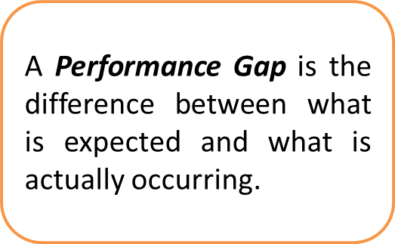

Monitoring the installation and identifying performance gaps(LG pg. 50)
Purpose of monitoring:
Check the quality of design & materials
Check the progress by culture and behaviours
Check completion of in accordance with plans,
drawings & specifications
Check safe work practices
Identify new hazards
Identify issues that may negatively impact the job & cause delay
Track materials usage
Identify performance gaps
Notes:
Test Q15 & 16

Slide 49

Continuous improvement processes(LG pg. 51)
Modifications to the work plan include:
Plant and equipment breakdowns
Personnel being absent from work
Materials not arriving on time
Materials being delivered that don’t meet the specification required by the designs
Any change to the schedule or Job Plan needs to be communicated to those people involved in the work, and possibly suppliers and contractors also involved in the work.

Slide 50

Continuous improvement processes
(LG pg. 51)
STEPS TO IMPROVING PERFORMANCE
Look & listen
Analyse information
Address the problem immediately
Solutions / Recommendations
Follow up

Slide 51


Tools, Plant, and
Equipment Maintenance (LG pg. 52)
The role of the supervisor is to ensure the most appropriate tools, plant, and equipment is used for each task.
Access information
Plant and equipment capabilities
Align to job specifications
Sources of Information
Project plan
OEM
Records management system
Manufacturer’s representatives/trainers
Regular planned inspection and adequate maintenance must be carried out in accordance with the manufacturer’s recommendations to ensure safe operation of mobile plant used on excavation work
Notes:
Test Q17

Slide 52

Tools, Plant, and
Equipment Maintenance(LG pg. 53)
Checks to be carried out:
Daily pre-start checks
Regular inspections by a competent person - defects reported immediately
The purpose of establishing maintenance programs for plant and equipment is to primarily ensure that risks associated with their operation are identified and managed.
Notes:
Test Q18

Slide 53

Tools, Plant, and
Equipment Maintenance(LG pg. 54)
Schedule & record regular maintenance and service checks
Provide historical data of work applied to the machine
Examination of total utilisation
Provide an audit trail in the event of an incident
Track misuse of equipment and identify corrective actions

Slide 54
Section 4 reporting on the execution of tasks

Slide 55
Section 4 Outline
By the end of this chapter you will understand how to:
Complete and submit written reports
Recommend changes to improve safety, efficiency, and effectiveness of task execution

Slide 56

Writing reports (LG pg. 55)
‘If you measure something, then you can control it’
Provide an audit trail
Provide a reference point
Comply with legislation, corporate and client requirements
Enable the Project Manager to maintain effective control of the project

Slide 57
Writing reports (LG pg. 55)
Reporting different types of data:
The measurements used for the ordering of materials
The test results of materials
Photographs of the project under completion
Diary notes of the Project Manager providing insight into daily tasks, events and attainment of milestones
Reports are usually based on common templates and should be completed in a legible, non-emotional based and concise manner – remember, you’re not writing ‘War and Peace’, and the person reading the report needs to get sufficient information from the report to have a clear understanding of the information be relayed.
Notes:
Test Q19

Slide 58

Writing reports (LG pg. 55)
‘Info-graphics’ are graphic visual representations of information, data or knowledge intended to present information quickly and clearly.
Improves understanding by utilising graphics to enhance the reader’s ability to see patterns and trends.

Slide 59
Writing reports (LG pg. 56)
Reports may be submitted to various entities and for different reasons, including (but not limited to):
Incident reports - Corporate Office, Client & Regulators
Budget expenditure reports - finance department
Company Senior Management / Client
Sub-Contractors
Principal Contractor
Suppliers of goods

Slide 60

Writing reports (LG pg. 56)
What information goes into a report?
Executive Summary
Introduction
Project Plan Documentation
Site management activities
Lessons Learned
Conclusions
Summary of Recommendations
Appendices

Slide 61
Recommending changes (LG pg. 57)
The content of reports should be able to assist the Project Manager or other interested Stakeholders in analysing data to identify various aspects, including:
Cost over-runs
Deviation from the plan
Incident causation & contributing factors
Trends in hazards reporting, incident occurrences and control actions
Opportunities for gaining greater efficiency
Opportunities for gaining greater effectiveness
Opportunities for improving the overall project performance

Slide 62

Recommending changes (LG pg. 57)
Recommendations are often included with a report’s conclusion
A conclusion offers you the opportunity to summarise or review your reports main ideas
Recommendations suggest actions to be taken in response to the findings of a report.
You can regard recommendations as a prompt to action for the reader/s.

Slide 63
Recommending changes (LG pg. 57)
Keep emotions out of your recommendations
Base them on fact and research
Effective recommendations:
Describe a suggested course of action to be taken to solve a particular problem
Written as action statements without justification
Stated in clear, specific language
Expressed in order of importance
Based on the case built up in the body of the report
A word of caution about writing recommendations: you should always consider your relationship with the reader first, if you have no authority to make recommendations, the reader may not appreciate them.

