Slide 1
BSBWHS412
PRAC ASSIGNMENT
Happy state high school workplace health and safety policy and perfect painters workplace health and safety policy

Slide 2
Happy state high school whs policy report.
Employer’s Duties:-
DUTY TO ENSURE HEALTH AND SAFETY AT WORK OF ALL EMPLOYEES
Including:
Provide and maintain safe plant and systems of work (s.35)
Healthy and safe plant and substances (s.30(1)b)
Workplace in safe conditions (s.28(1))
Healthy and safe facilities for employees (s.28(1))
Information, training and supervision to employees (s.9(2)(e))
Personal protective equipment (s.36(b))
Ensure health and safety of non-employees and members of the public (s.30(1)b)
Duty of self-employed persons (s.29)
Duty of person “in control” of workplace (s.30)
Duty of owner of specified plant (lifts, etc.) (s.35)
Record injuries, illness and dangerous occurrences (e.g. explosions) for inspection by inspector on request (s.188(2)b)
Notify Director of serious bodily injuries, illness and dangerous occurrences within 3 days (s.188(2)b)

Slide 3
Breaches of safety
STEP FOUR (Repeated Serious Breaches)
Preamble:
The fourth step in the procedure for implementing the enforcement of WHS in the school matches the industrial model of the dismissal or redeployment step. It reflects the seriousness of the events to date. If possible it also allows for the student to return in the future when they have demonstrated a change in behaviour.
Stage One: The student is referred to the Head of Department for a breach of safety after having received written warning.

Slide 4
Safety breaches
The HOD | Verifies the incident/s and records details Sends home letter to parents and phones them Forwards a copy of letter to WHSO and Deputy Principal (DP) Organizes supervision of student until Principal advises otherwise.
The DP | May request a meeting of OHSC to review events and make recommendations to the Principal. May ask the student or the parent to make a submission. Arranges meeting with parents, student and HOD Checks documentation of safety offences provided by HOD Considers seriousness of events and breadth of offences. Make recommendation to the Principal on: Length of time out of practical area (e.g. rest of semester, rest of year, one year) Whether the student should be withdrawn from other subjects. Any other conditions for return to normal class and The approximate date for a review meeting. Send a brief summary of the reasons for the recommendations with them to the Principal.

Slide 5
Safety breaches
The HOD The DP and HOD following the meeting with student, parent and HOD sets the parameters to be used for determining whether a return to practical area/s is warranted (e.g. report from teachers on behaviour in other classes, report on behaviours in playground, report on behaviour in other practical areas).
Stage Two: Restrictions on the Student
Action under the Responsible Behaviour Policy may be taken separately.
Until the student meets the criteria for the return to practical area no subject changes will be allowed.
The behaviour during withdrawal period should be considered by the HOD or DP as per Responsible Behaviour Policy.
OTHER IMPORTANT DOCUMENTS
The Act and Regulations (Workplace health and Safety Act 1995)
Codes of Practice (Now in Regulation [Miscellaneous] part 8) Some revised as Industrial Codes of Practice or Advisory Standards.
  Manual Handling
  Hazardous substances (Now in Regulations parts 9 & 13 and Regulation [Miscellaneous] part 17)
  First Aid in the Workplace
  Use and Selection of Personal Protective Equipment
Electrical Safety Act 2002
Dangerous Goods Management Act 2001

Slide 6
Updated process
Currently the induction process for students does not require them to sign on to any legal documentation, Meaning there is no record of their safety training leaving the PCBU liable to legal action if an in injury was to occur.
To solve this issue, All student and visitor inductions should be filed and kept track of by the pcbu in future.

Slide 7
Recommendations for updating processes and systems with compliance.
Currently the induction process for students does not require them to sign on to any legal documentation, Meaning there is no record of their safety training leaving the PCBU liable to legal action if an in injury was to occur.
To solve this issue, All student and visitor inductions should be filed and kept track of by the pcbu in future.
My recommendation for updating this processes would be to immediately get inductees to sign in with an ipad or similar technological device.

Slide 8
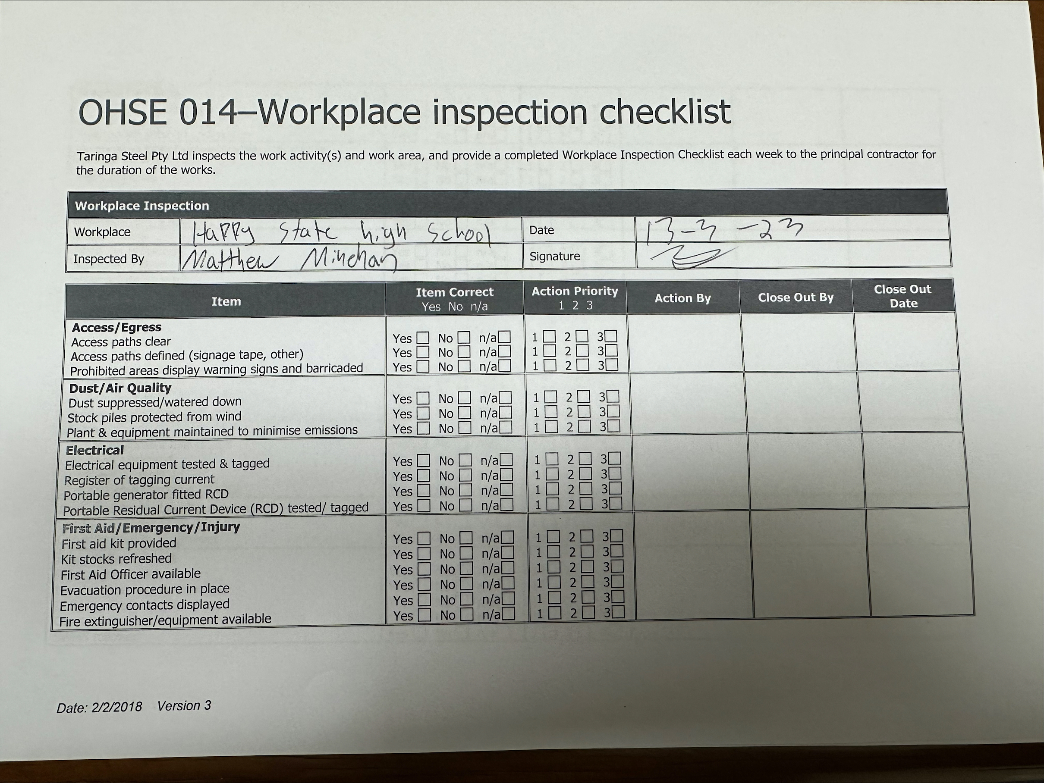
Checklist

Slide 9
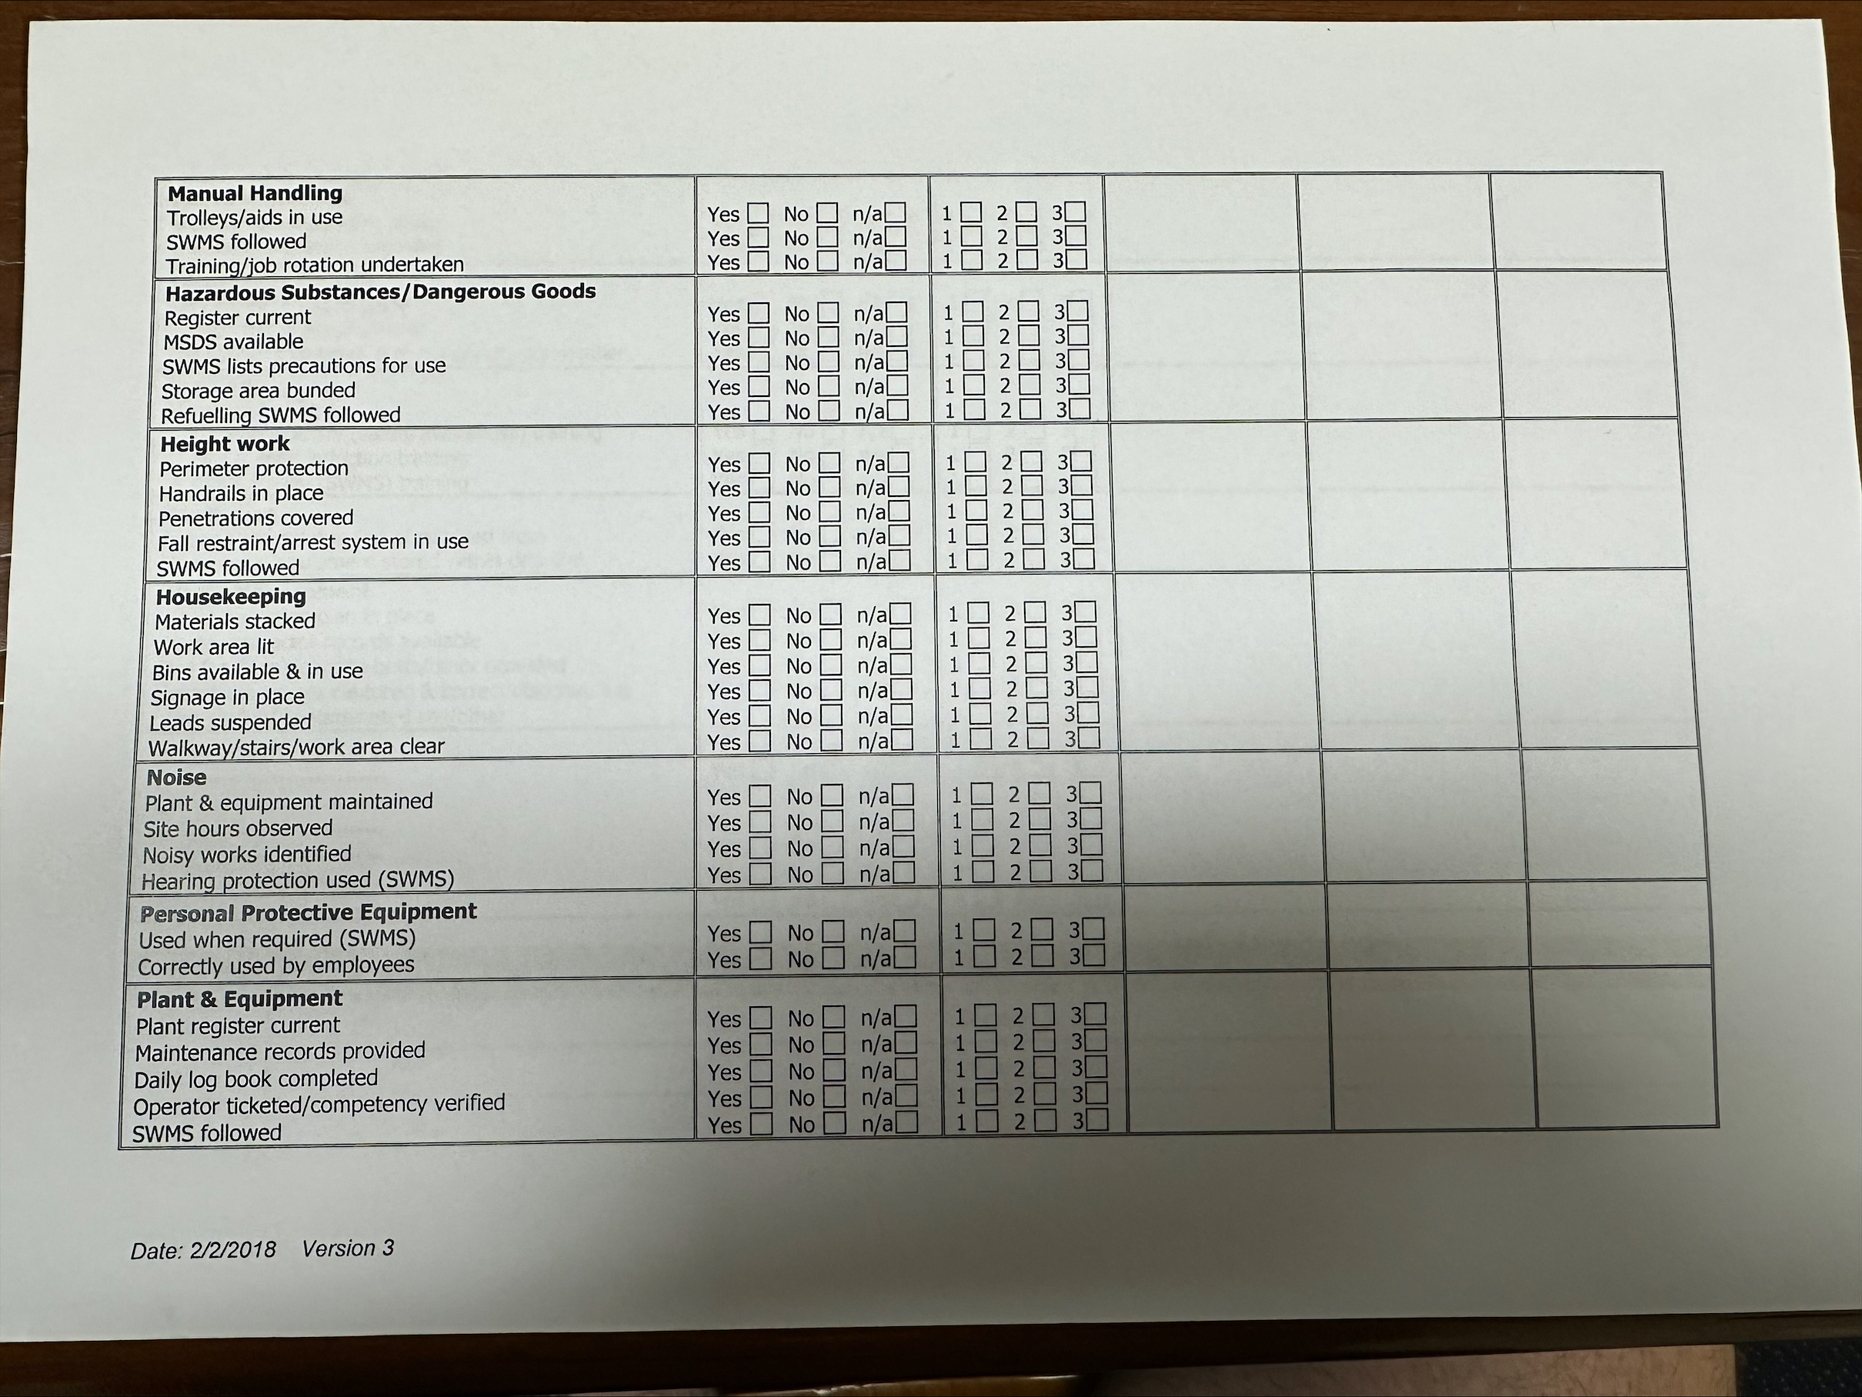
checklist

Slide 10
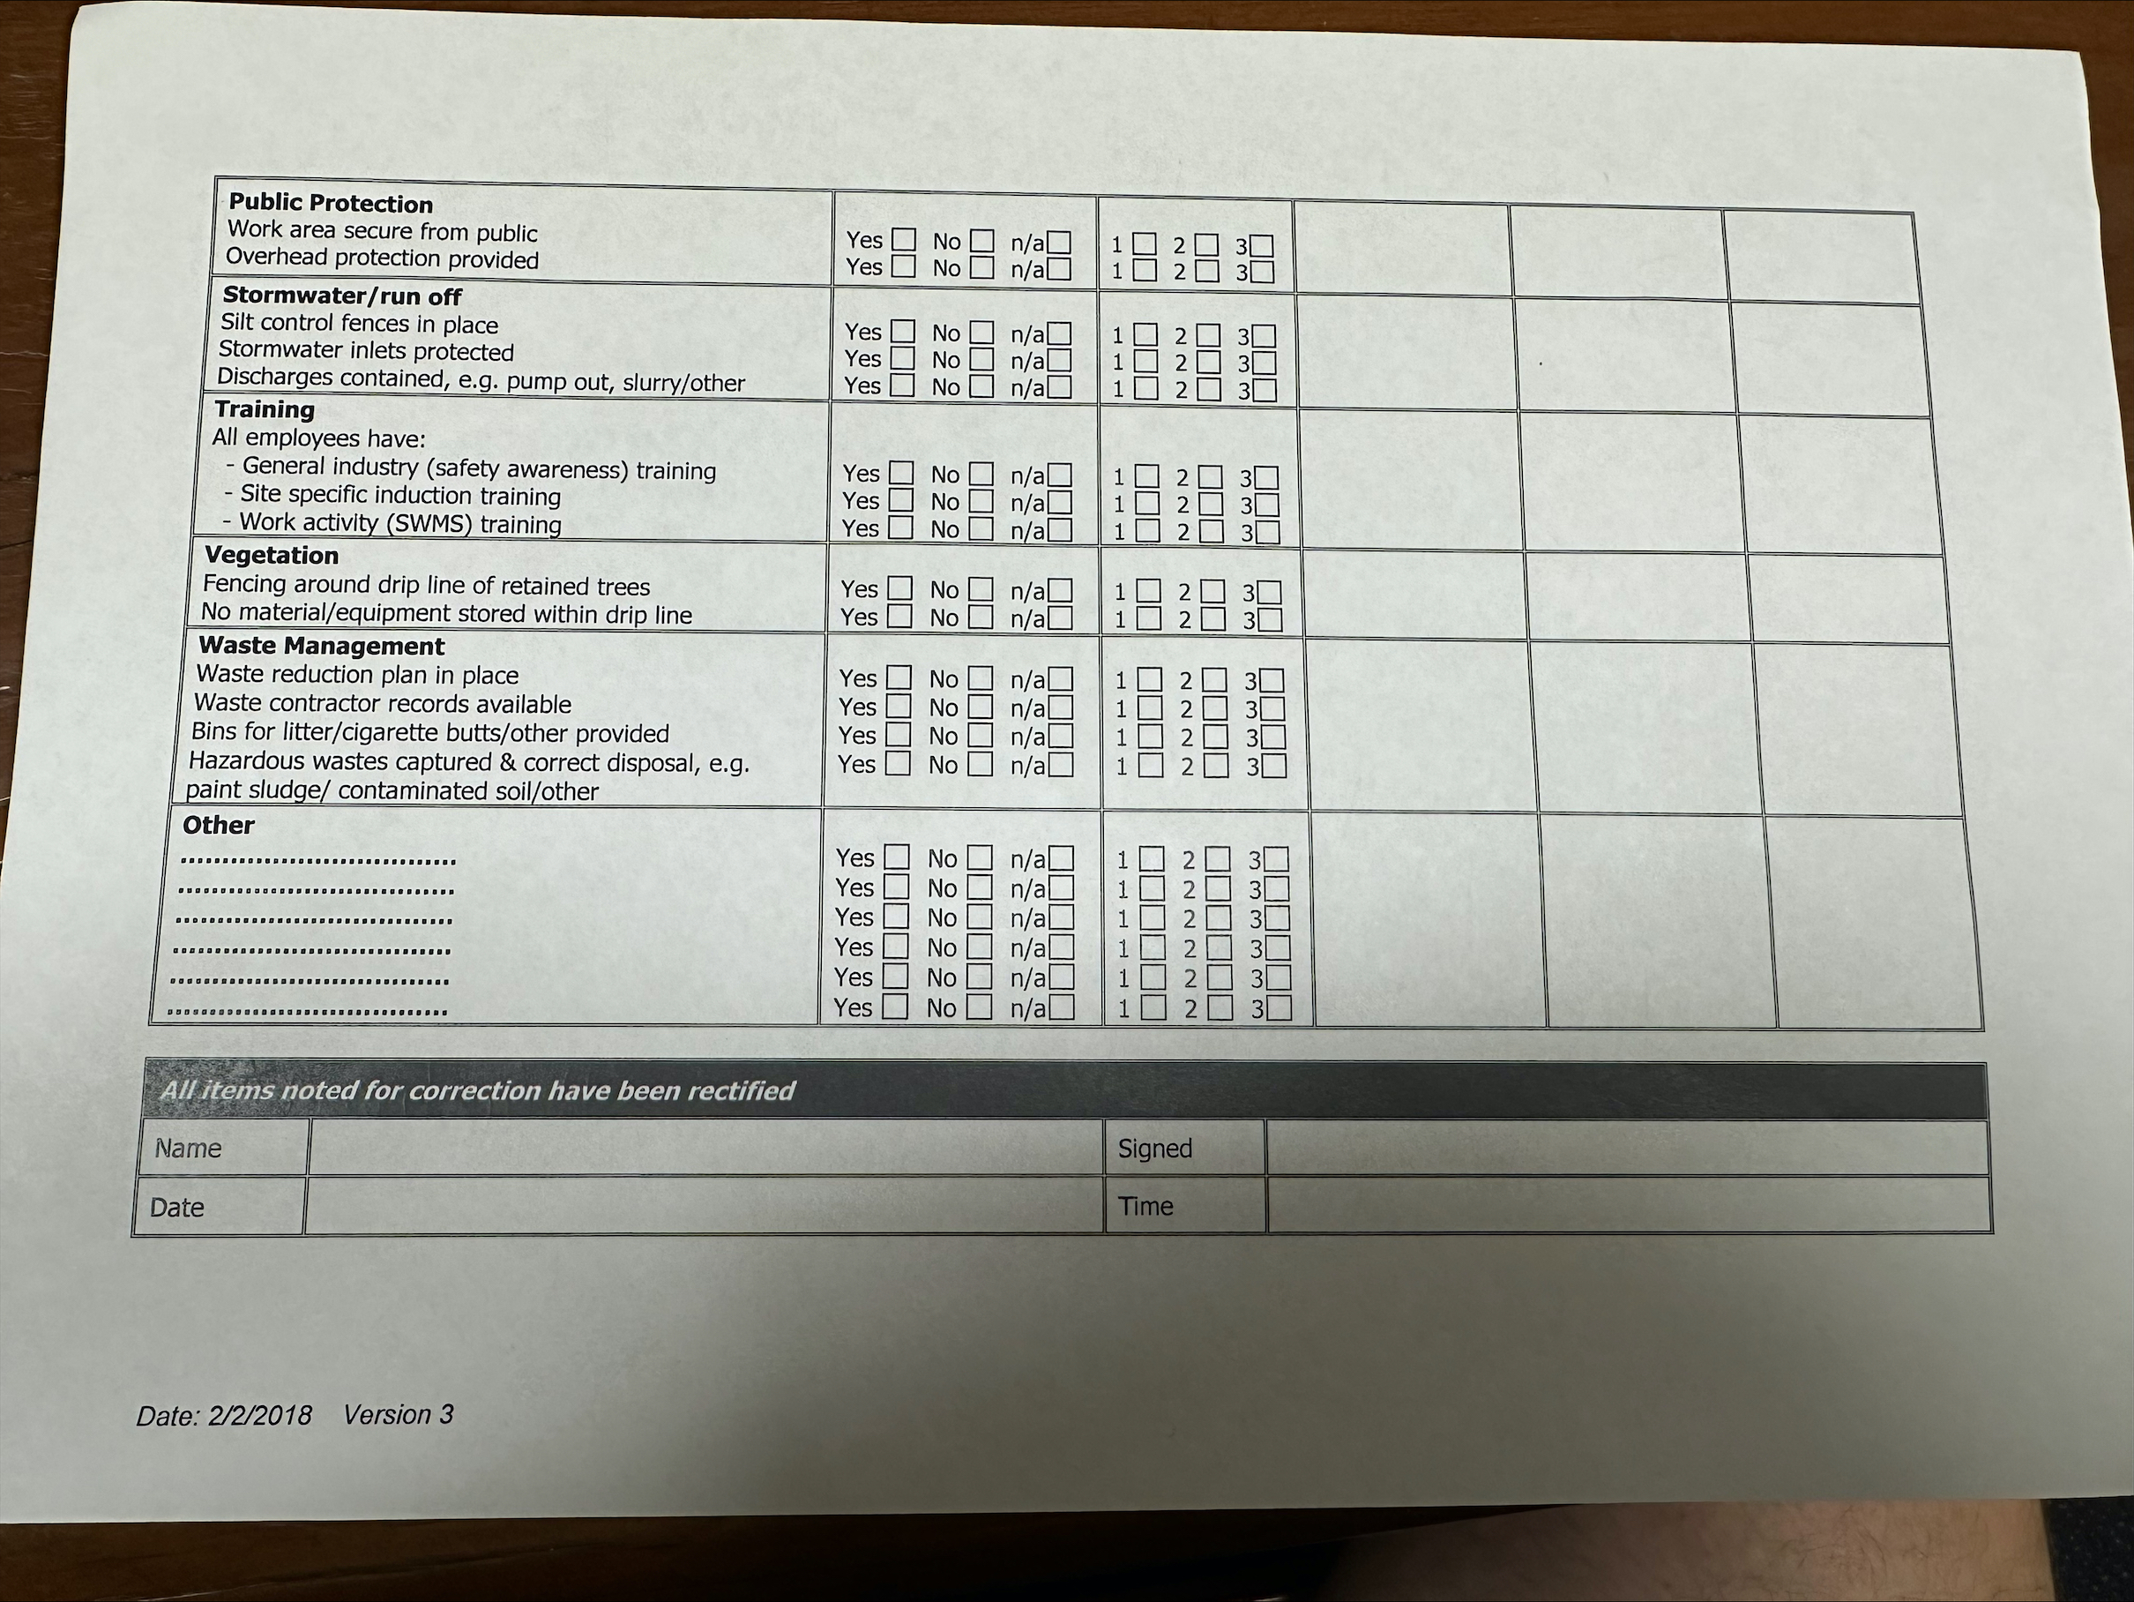
checklist.

