Slide 1

BSBITU313
Design and produce digital text documents

Slide 2

Prepare to produce documents
1.1 Adjust workspace, furniture and equipment to suit user ergonomic environments

Slide 3
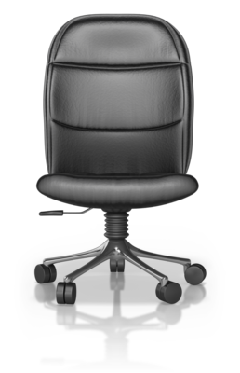
Ergonomic requirements
Ergonomic requirements may include:
Avoiding radiation from computer screens
Chair height, seat and back adjustment
Document holder
Footrest
Keyboard and mouse position
Lighting
Noise minimisation
Posture
Screen position
Workstation height and layout.

Slide 4

Work organisation strategies
Work organisation strategies may include:
Exercise breaks
Mix of repetitive and other activities
Rest periods.

Slide 5

Activity 1A

Slide 6
Prepare to produce documents
1.2 Ensure workspace meets organisational requirements related to work health and safety, and energy and resource conservation, taking into account the type of digital device to be used

Slide 7
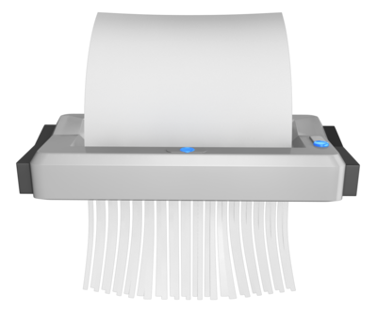
Using energy and resource conservation techniques
Top areas to consider improving include:
Heating
Lighting
Water
Paper use.

Slide 8
Activity 1B

Slide 9
Prepare to produce documents
1.3 Identify document purpose, audience and presentation requirements, and clarify with relevant personnel as required

Slide 10

Purpose
When looking at the purposes of documents, there are four general categories which can be identified:
To give instructions
To persuade the reader
To provide information
To prohibit something.

Slide 11
Audience
Once you know which document you are required to produce, you can determine the tone of the language that you should use. For example, should the document be formal or informal? This will depend on the nature of the document and the audience that it is intended for.

Slide 12

Presentation
The presentation of your promotional materials should always look professional and may include:
Company colours
Different size fonts
Different materials
Company logo
Different backgrounds
Having important points in bold
Contact details.

Slide 13

Clarifying with relevant personnel
Once identified, the purpose, audience and presentation requirements of your document should be clarified by the relevant personnel. This may be your manager or Human Resources manager, for example.

Slide 14
Activity 1C

Slide 15
Prepare to produce documents
1.4 Identify organisational and task requirements for text-based business documents to ensure consistency of style and image

Slide 16

Organisational and task requirements
Organisational requirements may include:
Company colour scheme
Company logo
Consistent corporate image
Content restrictions…

Slide 17

Organisational and task requirements
Established guidelines and procedures for document production
House styles
Observing copyright legislation
Organisation name, time, date, document title, filename, etc. In header/footer
Templates.

Slide 18
Activity 1D

Slide 19
Prepare to produce documents
1.5 Select most appropriate word processing application to produce document, in accordance with available resources and organisational policies

Slide 20

Word processing applications
Some examples of word processing applications include:
Microsoft Word
WordPerfect
Lotus Word Pro
iWork Pages.

Slide 21
Activity 1E

Slide 22
Design documents digitally
2.1 Design document structure and layout to suit purpose, audience and information requirements of task

Slide 23
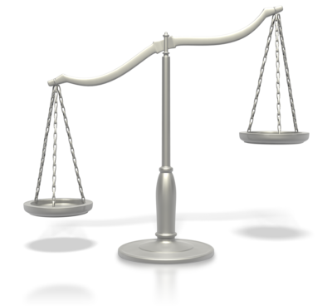
Designing the structure and layout of document
Design may include:
Balance
Diversity
Relative positioning of graphics and headings
Simplicity
Text flow
Typography.

Slide 24
Activity 2A

Slide 25
Design documents digitally
2.2 Design document to enhance readability and appearance, and to meet organisational and task requirements for style and layout

Slide 26

Enhancing readability and appearance
Different layouts and styles that you may want to consider include:
Paper size and page orientation
Text font, colour and size
Headings and subheadings
Paragraphs
Margins and page breaks
Headings and footers…

Slide 27

Enhancing readability and appearance
Justification
Spacing (line and paragraph)
Page numbering
Language
Underlining, italics and bold
Tables.

Slide 28
Activity 2B

Slide 29
Design documents digitally
2.3 Use available application functions to ensure consistency of design and layout, adhering to organisational and task requirements

Slide 30

Consistency of design and layout
Functions used to ensure consistency of design and layout may include:
Annotated references
Borders
Bullet/number lists
Captions
Footnotes/endnotes
Indentations
Page numbers
Spacings
Typeface styles and point size.

Slide 31
Activity 2C

Slide 32
Design documents digitally
2.4 Insert a standard table into document, changing cells, columns, and rows as necessary to meet information requirements

Slide 33
Inserting tables
First, go the taskbar at the top of the page and select ‘Insert’
Then you can select ‘Table’ which is just underneath
Selecting ‘Table’ will bring up your options for the size of the table
Once you have selected the size and clicked to confirm, your table will appear in your document.

Slide 34
Activity 2D

Slide 35
Design documents digitally
2.5 Insert and format visual elements (including, for example, images or icons) to meet organisational and task requirements for style and layout

Slide 36

Visual elements
Visual elements can add a new dimension to your document. Elements such as images, icons and logos can change your plain text document into something more interactive and engaging.

Slide 37
Activity 2E

Slide 38
Produce text documents digitally
3.1 Use intermediate-level application functions to enable efficient production of digital text documents

Slide 39

Using advanced software functions
Advanced software functions may include:
Alternate headers and footers
Drawing tools
Graphics tools
Importing data/objects/pictures
Mail merge
Newspaper columns
Sections
Sort
Styles
Tables
Templates.

Slide 40
Activity 3A

Slide 41
Produce text documents digitally
3.2 Enter or import, and edit text and other data to meet task requirements

Slide 42
Entering and importing text
To insert text from another file into a Word document, follow these steps:
Click in your document where you want to insert the text
Click the ‘Insert’ tab
Click the arrow next to ‘Object’
Select ‘Text from File…’
Locate the file that you wish to insert
Double-click the file.

Slide 43

Editing text
This may involve changing things like the:
Size of the text
Colour of the text
Font of the text
Alignment of the text.

Slide 44

Entering, importing and editing other data
For example, you may need to include:
Watermarks
Images
Clipart
Data from other software applications
Digital photographs
Files
Graphics
Quotes
References
Scanned photographs and logos
Tables, graphs and charts.

Slide 45
Activity 3B

Slide 46
Produce text documents digitally
3.3 Preview, adjust and prepare documents for delivery in accordance with organisational and task requirements

Slide 47
Preview and print
To preview a Microsoft Word document, follow these steps:
Click the ‘File’ tab
Click the ‘Print’ option
Your preview will appear at the right of your screen.

Slide 48

Preview and print
Printing may include:
Print merge
Print to file
With comments
With drawing objects
With field codes
With hidden text.

Slide 49
Activity 3C

Slide 50
Produce text documents digitally
3.4 Name and store document, in accordance with organisational requirements and exit application without information loss/damage

Slide 51

Naming documents
Tips when naming your documents include:
Use keywords
Use your name or initials
Use date
Use alphabetic codes
Use version numbers
Use descriptors
Use underscores
Use common names
Be detailed
Be consistent.

Slide 52
Storing documents
Tips when storing your documents include:
Store similar documents together
Don’t save unnecessary documents
Avoid large folder structures
Use shortcuts rather than having multiple copies
Colour code your folders
Think about storing documents online (e.g. MicrosoftSharePoint 2010 or Windows Live SkyDrive)
Make sure that the documents that you use every day can be accessed easily.

Slide 53

Exiting without information loss or damage
To save a document, either:
Press Ctrl and S together
Click the ‘File’ tab and click ‘Save’ or ‘Save as’
Click the save icon across the top of your document (see image).

Slide 54
Activity 3D

Slide 55
Produce text documents digitally
3.5 Deliver document within designated timelines and organisational requirements for speed and accuracy

Slide 56

Timelines
Designated timelines may include:
Organisational timeline, e.g. Deadline requirements
Timeline agreed with internal/external client
Timeline agreed with supervisor/person requiring document.

Slide 57

Time management
Good time management tips may include:
Recording your deadlines
Prioritising your tasks
Keeping track of your progress
Knowing how to deal with possible problems that may arise.

Slide 58
Activity 3E

Slide 59
Produce text documents digitally
3.6 Use relevant help functions to overcome intermediate issues with document design and production

Slide 60

Manuals
The things that a manual may include are:
A cover page, a title page and a copyright page
Frequently asked questions
Where to find further help, including contact details
Information on how to navigate through manual
A troubleshooting section
A glossary and/or index.

Slide 61

User documentation
User documentation is often divided into categories, for example:
Installation
Reference
Tutorial.

Slide 62

Online help
The advantages of using outsourced technical documentation include:
Time-saving
High quality
Good expertise
Flexible.

Slide 63
Activity 3F

Slide 64
Summative Assessments
Summative assessments consist of:
Skills Activity
Knowledge Activity
Performance Activity.
Your assessor will provide you with further guidance on how and where to complete these assessments.

Slide 65

Summary and Feedback
Did we meet our objectives?
How did you find this session?
Any questions?

