Slide 1

ASBESTOS
WORK HEALTH AND SAFETY OFFICER

Slide 2
Assessment criteria
Identify commons uses and locations of asbestos containing material at commercial and domestic premises.
Identify the legislative requirements for managing asbestos related risk to people and the environment.
Identify the health effects associated with exposure to asbestos fibres.
Identify where guidance on minimising or removing the risks associated with exposure to asbestos can be found.

Slide 3
What is asbestos?
Asbestos is a naturally occurring mineral found in the ground. It contains strong fibres that have excellent durability, fire resistance and insulating properties.
Three types of asbestos:
White (Chrysotile)
Blue (Crocidolite)
Brown (Amosite)

Slide 4
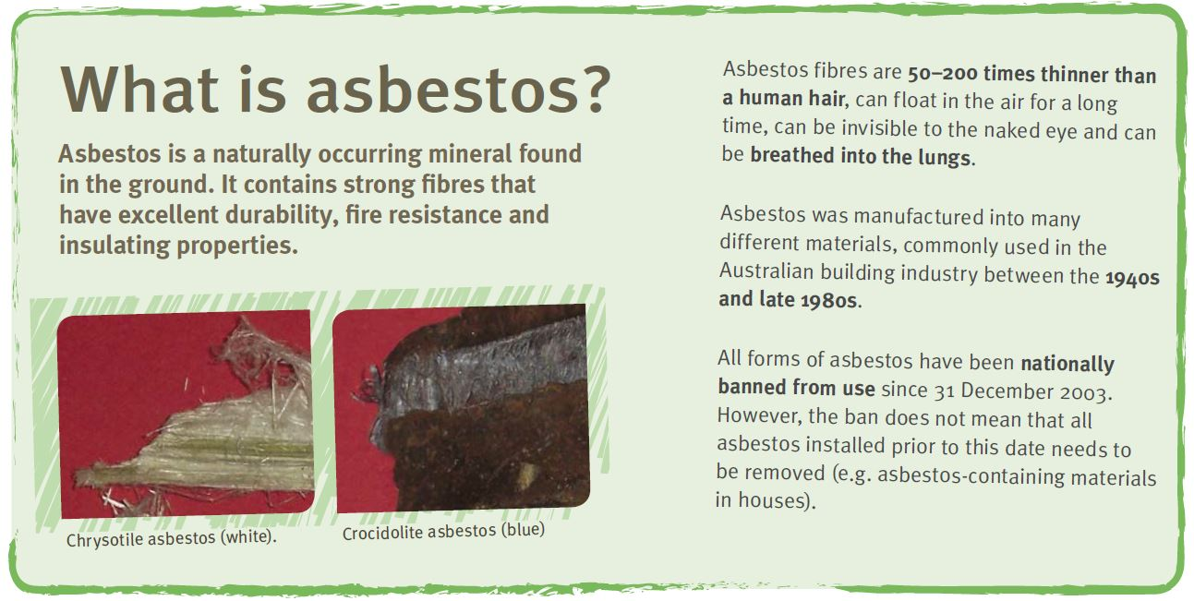

Slide 5
Health hazards
The possible health effects of asbestos are:
asbestosis (progressive and irreversible scarring of lung tissue that impairs breathing)
lung cancer
mesothelioma, a cancer of the linings around the lungs and abdomen
non-cancerous diseases that affect the linings around the lungs and abdomen (commonly called ‘benign pleural diseases’).

Slide 6
Common uses and locations
Asbestos fibres are strong, heat resistant and have insulating properties. Clumps of mined asbestos were broken down into loose fibres or fibre bundles, and mixed with other materials, such as cement, to produce a variety of building products. Up to 90% of the asbestos produced in or imported into Australia was used for the manufacture of building products, especially asbestos cement materials.

Slide 7
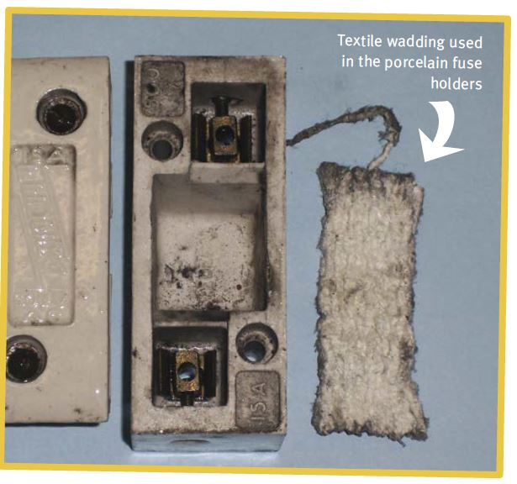
Friable Asbestos
Friable asbestos products are generally quite soft and loose and can be crumbled into fine material or dust with very light pressure, such as crushing with your hand.
Sometimes, small amounts of friable asbestos were used in domestic buildings, including:
in old domestic heaters, stoves, hot water systems and
pipe lagging
in the backing of sheet vinyl floor coverings
inside fireplaces
within fire doors in the main entry doors of units and
stairwells
sprayed on vermiculite insulation material in some common areas of unit blocks.

Slide 8
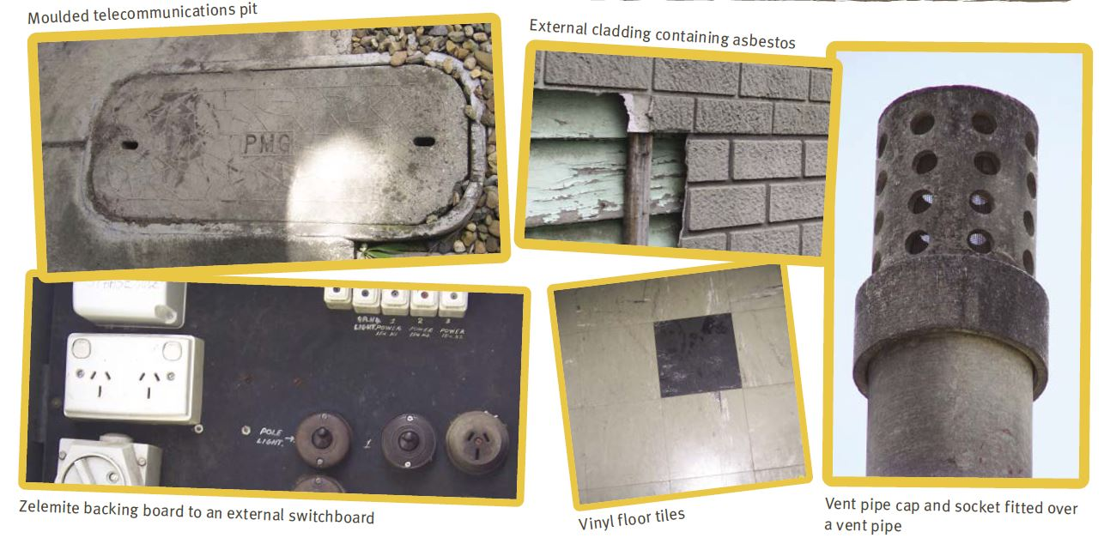
Non-friable Asbestos

Slide 9
Non-friable Asbestos
Bonded asbestos products are made from a bonding compound (such as cement) mixed with a small proportion (range of 5% to 20%) of asbestos. Bonded asbestos products are solid, rigid and non-friable. The asbestos fibres are tightly bound in the product and are not normally released into the air. Common names for such products are ‘fibro’, ‘asbestos cement’ and ‘AC sheeting’.
Non-friable asbestos-containing materials were commonly used, in both domestic and non-domestic buildings for (this is not an exhaustive list):
roof sheeting and capping
guttering
gables, eaves/soffits
water pipes and flues
DT surrounds (disconnector trap surrounds)
wall sheeting (flat or a weatherboard style)
backing boards of electrical switchboards
flexible building boards
imitation brick cladding
fencing
car ports and sheds
waterproofing membranes
telecommunications pits
some window putty
expansion joints
packing under beams
concrete formwork.

Slide 10
Duties
PCBU
PCBU with management or control of a workplace
PCBU carrying out demolition or refurbishment work

Slide 11
Asbestos removal work
If you are a tradesperson or other business operator removing more than 10 m² of non-friable asbestos materials you can only carry out this work under the authority of a class B or class A asbestos removal licence, issued by Workplace Health and Safety Queensland.

Slide 12
Asbestos related work
Asbestos-related work means work involving asbestos other than asbestos removal work, for example, drilling into ACM. Asbestos-related work that is also high risk construction work (i.e. construction work that involves the disturbance of asbestos) requires a documented safe work method statement. For work other than removal (for example preparing a non-friable asbestos wall for painting or drilling a hole for piping or electrical cabling) you do not require a licence or certificate. However safety precautions to minimise asbestos fibres getting into the air must be taken.

Slide 13
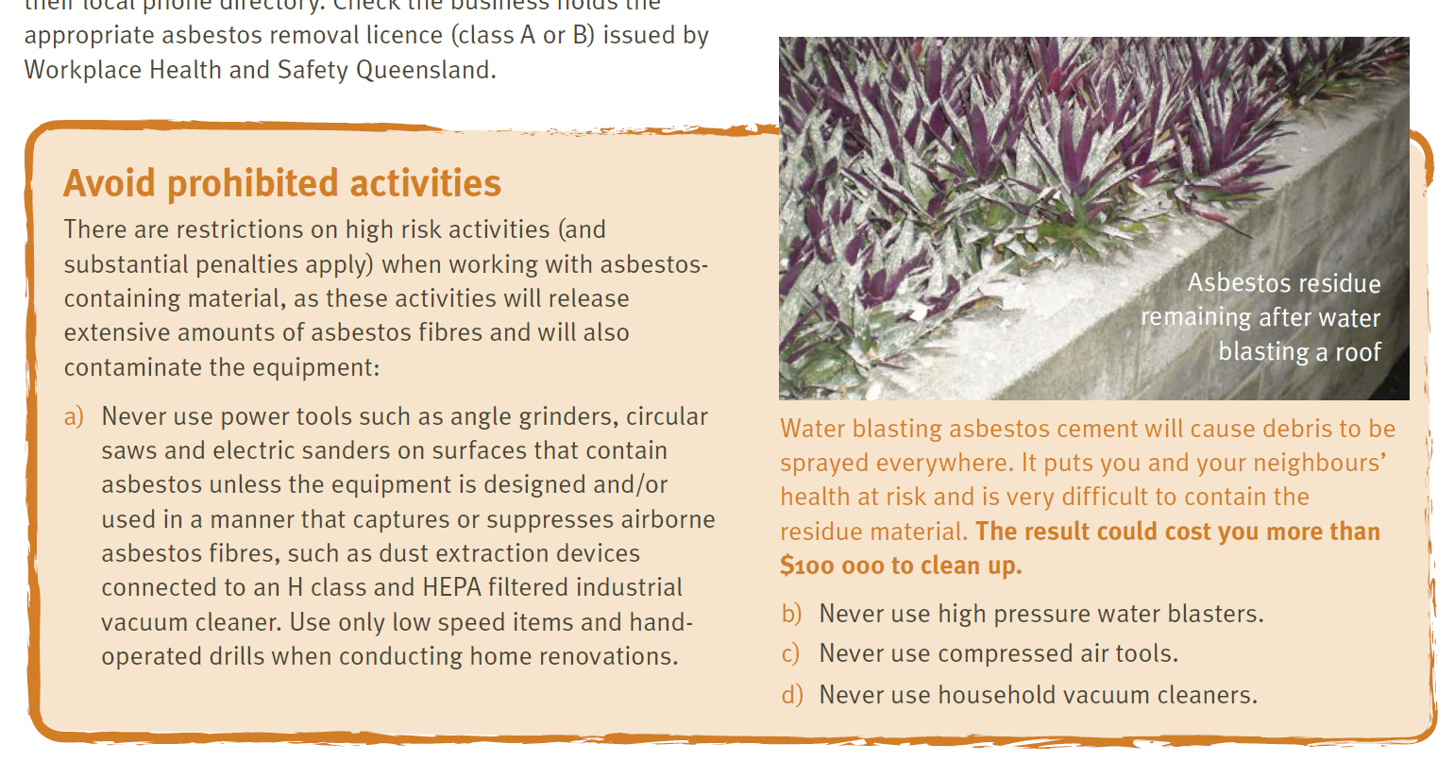
Control on use of particular equipment

Slide 14
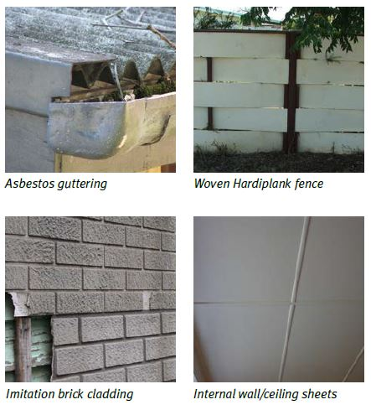
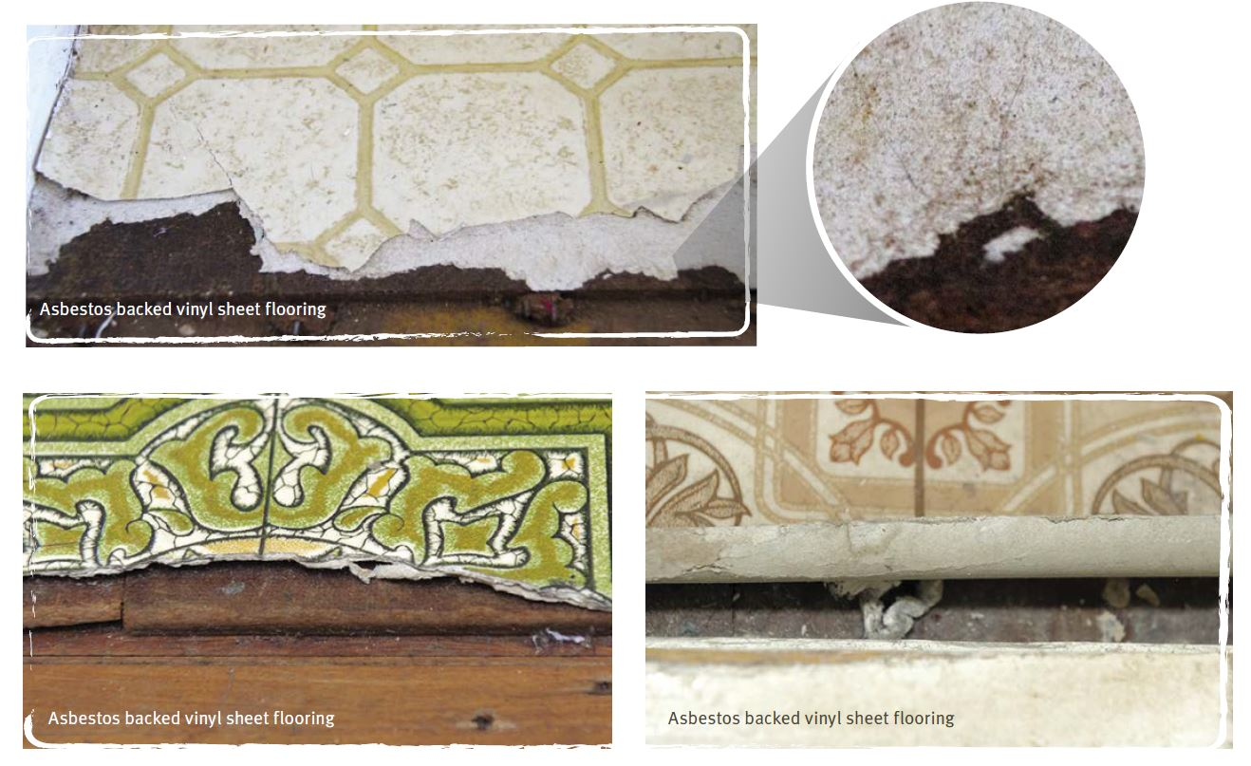
Identifying asbestos or ACM at the workplace

Slide 15
Register of asbestos or ACM at a workplace
A person with management or control of a workplace must ensure an asbestos register is prepared and kept at the workplace. The asbestos register must record any asbestos or ACM identified at the workplace or likely to be present from time to time.
An asbestos register is not required if:
the workplace is a building that was constructed after 31 December 1989, and
no asbestos has been identified at the workplace, and
no asbestos is likely to be present from time to time.

Slide 16
Demolition and refurbishment
A person with management or control of a workplace must ensure the asbestos register is reviewed and revised if it is not adequate before demolition or refurbishment of:
a building constructed before 31 December 1989
a non-building structure constructed or installed before 31 December 2003 if there are reasonable grounds to believe asbestos is installed in the structure
plant constructed or installed before 31 December 2003 if there are reasonable grounds to believe asbestos is installed in the plant.
The asbestos in the structure or plant must be removed, as far as reasonably practicable, before the demolition commences.

Slide 17
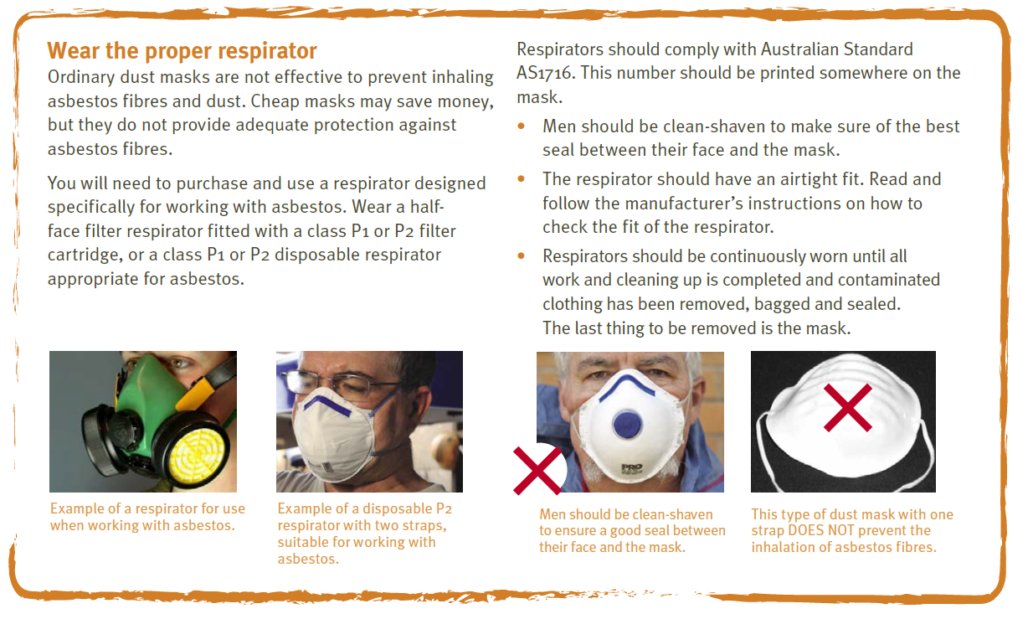
Safe work procedures

Slide 18
Transport and disposal
The Queensland Environmental Protection Regulation 2008
Asbestos waste must be disposed of correctly. There are legal requirements, under the Queensland Environmental Protection Regulation 2008 for transporting regulated waste (asbestos waste), including the requirement to hold an environmental authority for regulated waste transport in certain circumstances.

Slide 19
Transport and Disposal
The regulated waste transport laws apply if you are transporting 250 kg or more of asbestos waste in a vehicle on a non-commercial basis, and you will therefore need to:
engage a commercial contractor to undertake the transport and dispose of the asbestos; or
obtain an environmental authority for regulated waste transport

Slide 20


