Slide 1
BSBMGT402
Implement operational plans
Presentation 3

Slide 2
Presentation objectives
At the end of this lesson you will be able to:
Monitor performance systems and processes to assess progress in achieving profit/productivity plans and targets
Analyse and use budget and actual financial information to monitor profit/productivity performance
Identify unsatisfactory performance and take prompt action to rectify the situation according to organisational policies
Provide mentoring, coaching and supervision to support individuals and teams to use resources effectively, economically and safely
Present recommendations for variation to operational plans to the designated persons/groups and gain approval
Implement systems, procedures and records associated with performance in accordance with organisation’s requirements

Slide 3
  Monitor performance systems and processes
Once an operational plan has been implemented it is important to focus on monitoring its performance
This is essential assess progress in achieving profit/productivity plans and targets
Ensuring that the performance of an operational plan is achieving its targets, is crucially important to ensure that the implementation is effective and, ensuring any negative performance can be corrected, to avoid affecting the business overall

Slide 4
  Monitor performance systems and processes
Performance systems can include:
Informal systems used by frontline managers for the work team in the place of existing organisation-wide systems
Formal processes within the organisation to measure performance, such as:
  Feedback arrangements
  Individual and teamwork plans
  KPIs
  Specified work outcomes

Slide 5
Monitor performance systems and processes
Monitoring these would be conducted on a basis as determined by the organisation
For example, team KPIs may be monitored daily, where as individual KPIs are assessed weekly
You should reference how you will locate the data for your performance systems. What reports will you access?
You will need to ensure these reports are compiled with accurate and valid data
You may seek to utilise:
  Weekly sales reports
  Payroll reports
  Production (volume, quality, and cost) reports
  Income and expenditure reports
  Budget (actual to forecast)

Slide 6
Monitor performance systems and processes
Your performance system may seek to compare results on a month by month basis; or against previous trading periods (comparison against last years –quarterly results’ or seasonal outcomes)
In order for the performance system to be a valuable tool for analysis and evaluation the data source must remain consistent
If there have been reporting variances these must be noted

Slide 7
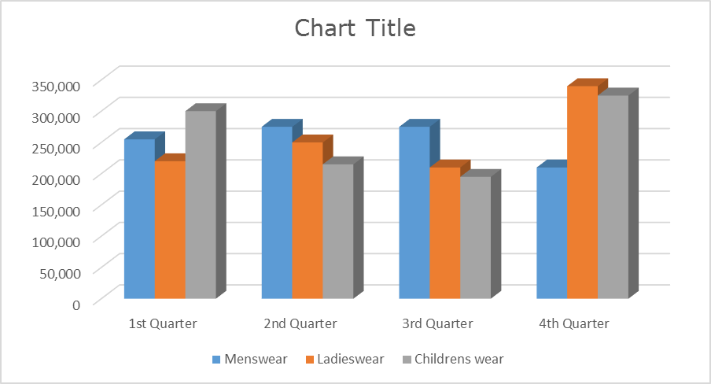
Monitor performance systems and processes
Share details of the progress to towards targets, celebrate success and positive progression
Colourful charts are an effective way to communicate progress, as they are easily and quickly interpreted

Slide 8
monitor profit/productivity performance
There are various ways you can monitor the financial performance of your business using the data you have collected
Using financial ratios may assist in measuring where your business is underperforming
Key financial ratios:
Ratio | Indicator of | Method
Gross profit margin | % of gross profit on sales | (Gross Profit x 100) / sales
Net profit margin | % of net profit on sales | (Net profit before tax x 100) / sales
Material to sales | % of sales dollars spent on materials | (Direct materials x 100) / sales
Labour to sales | % of sales dollars spent on labour | (Direct labour x 100)/s sales
Overhead expenses to sales | % of sales dollars spend on overhead expenses | (Overhead expense x 100) / Sales
Stock turnover | Number of times stock turns over | Cost of goods sold / (0.5 x opening + closing stock)
Debtors turnover | Average time to collect debts | (Debtors x days in period) / credit sales
Working Capital | Liquidity of the business | Current assets / Current liabilities

Slide 9
monitor profit/productivity performance
Profit drivers are factors that have a significant impact on your bottom line result. Profit drivers may be price, fixed costs, variable costs, sales volumes, cost of debt and inventory
Tracking your profit drivers and regularly monitoring performance outcomes are keys to success
To measure your profit drivers you may use the following calculations:
  Earnings to Sales Ratio: This measures how well you are containing your expenses
    Earnings to sales ratio = (net profit ÷ total sales) x 100
You may also choose to measure your staff job satisfaction, a method to do this is referred to as Sick days to total paid days ratio:
  Sick days to total paid days ratio = (total sick days ÷ total days paid) x 100
When you are seeking to measure the quality of your production and evaluate the cost of producing your goods, you can us the Error rate ratio:
  Error rate ratio = (total items rejected ÷ total items produced) x 100

Slide 10
monitor profit/productivity performance
Other non-financial ratios:
There are many other non-financial ratios that are also used in business to monitor and review productivity performance
These may include:
  Product returns ratio: Number of returned, faulty products / total product production
  KPI ratio: Rate at which the KPI’s have been achieved for a department/business
  Days lost to injury ratio: Record of productive hours lost due to injury / overall total hours worked.
  Absenteeism ratio: Number of days an employee absent from work / overall rate of absenteeism.
  Staff turnover: (number of staff who left/ total number of staff) x 100

Slide 11
  Identify unsatisfactory performance and take prompt action to rectify the situation
When monitoring the performance systems it is important to be able to identify unsatisfactory performance and, take steps to rectify these situations
So what could be deemed unsatisfactory performance?
  Deadlines not being met
  Not achieving KPIs
  Overspending budget
  Low productivity levels
  Low profit levels

Slide 12
  Identify unsatisfactory performance and take prompt action to rectify the situation
To determine what action that is required it is often essential to understand the causes of this unsatisfactory performance
  Identify the exact area of non-performance (undertake benchmarking)
  Identify the cause of performance issues
  Check the pattern or usual items/transactions; identify any exceptions to the norm/expected
  What is the exact impact of the cause on overall operation plan
  Is the cause internal or external to the organisation
  Are you able to control the cause, or is it uncontrollable
  Do you have a contingency plan

Slide 13
  Identify unsatisfactory performance and take prompt action to rectify the situation
There needs to be a process of critical analysis undertaken to review areas of underperformance
Once a clear understanding of the unsatisfactory performance has been determined it allows you to implement appropriate action to rectify the issues
Your action plan will, of course, vary depending on the performance issues that need to be addressed, however the plan may include:
  Revision of resources required (human resource and/or physical resources)
  Reorganising/reallocation of resources
  Additional training and support
  Improved systems and processes
  Review of performance measurement and data collected
  Marketing strategies
  Cost saving actions (purchasing at lower cost; bulk purchase; or elimination of waste)
  Enact contingency plans
  Make adjustments to the operational plan

Slide 14
  Identify unsatisfactory performance and take prompt action to rectify the situation
Take action and communicate the plan with your employees; ask for their input and feedback; this way everyone can be involved in rectifying the underperformance as early as possible. To take no action will mean that you will not get your plan back on track for success.

Slide 15
Provide mentoring, coaching and supervision
Your operational plan should include strategies to provide coaching, mentoring and supervision to your teams. These all should address the needs of individuals and teams to develop the skills to effectively, economically and safely use resources.
Coaching
‘A good coach is someone who will get you to do something you don’t want to do; that you have to do; in order to reach your goals.’
Coaching staff in how to use the resources allocated in a safe manner and ensure they are used efficiently and effectively.

Slide 16
Provide mentoring, coaching and supervision
Mentoring
By mentoring in the workplace you can help people increase their effectiveness, advance their careers, and create a more productive organisation. Being a mentor can be very rewarding
Providing mentoring to staff in a one –on one basis with senior staff to provide advice, support, guidance and tips on how to use the resources allocated in a safe manner and ensure they are used efficiently and effectively

Slide 17
Provide mentoring, coaching and supervision
Supervision
Supervising is not about micro-managing, it is about providing a presence for team members to gain support from
The role of the supervisor is to provide leadership in a team
Through leadership team members will follow the example set by the supervisor in all aspects of work, including the effective, economical and safe use of work resources
Another function of the supervisor is to provide feedback and support to teams and individuals to ensure they continue to work towards their objectives, goals and KPIs

Slide 18
Present recommendations for variation to operational plans
Should there be cause for the operational plan to be amended, a consultative process should be undertaken with all key stakeholders that may be impacted by the proposed change
You should prepare a change proposal which will include a justification for the proposed change
This proposal is normally presented in report format and includes cost/benefit calculations
The change proposal should be compiled after consultation with key stakeholder, so that their feedback is considered and included in the report recommendations

Slide 19
Present recommendations for variation to operational plans
The change proposal will need to be presented to all relevant authorities to gain approval for the change
When making a presentation of recommendations, there are a number of factors that need to be considered
These can include:
  What was done previously?
  Why did or did it not work?
  What has worked for others?
  Why did it work?
  What needs to be changed?

Slide 20
Present recommendations for variation to operational plans
Another important consideration is to negotiate your recommendations that you make
When doing this it is important to be prepared
It is always important to be confident and support your recommendations with facts, this will give you a better chance of gaining approval to make variations in the operational plan from designated personnel and groups
Preparation
Information sharing
Bargaining
Closing and committment
Research both your subject and the other party or parties
Ask questions
Most significant
Final adjustments made to arrangements
Trust from each party is important
All decisions are made and compromise is common
Clarify

Slide 21
Present recommendations for variation to operational plans
Designated personnel and groups may be comprised of:
  Other affected work groups or teams and groups designated in workplace policies and procedures
  Those who have the authority to make decisions and/or recommendations about operations such as workplace supervisors, other managers

Slide 22
Implement systems, procedures and records associated with performance
Your operational plan will be supported by organisational policies and procedures which are put into place to ensure compliance with legislative requirements and to meet with organisational needs
There are many Legislations, Acts and Code of Practice that you need to understand in order to ensure that your organisation is not at risk of non-compliance
Refer to your eBook for further information

Slide 23
Implement systems, procedures and records associated with performance
To ensure employees meet with regulatory obligations organisational policies and procedures are created and implemented
Your operation plan should follow policies and procedures for the following:
Recruitment, Selection and Induction Policy and Procedures | Workforce recruitment, selection and induction; including document storage, distribution and accessibility. Policies and procedures are in place to ensure compliance with employment legislation, privacy act and meet with organisational requirements.
Performance Management Policy and Procedures | Following policies and procedures will ensure compliance with employment legislation, privacy act and human rights obligations. In addition to meeting with organisational needs for efficient productive workforce management. Policy and procedures will also govern the storage, distribution and accessibility of performance management documents.
Financial Reporting Policy and Procedures | Financial reporting policies and procedures will be in place to ensure compliance with ATO regulations, ASIC regulations, in addition to organisational needs. Policies and procedures for the storage, distribution and accessibility of financial documents will be implemented to meet with legislative and organisational requirements.

Slide 24
Implement systems, procedures and records associated with performance
Systems may include software or hardware that is used to monitor performance (i.e. record management systems)
Procedures outline the steps to achieve acceptable performance and measuring performance
Records are set up to keep a track of historical performance information

Slide 25
Presentation summary
Now that you have completed this presentation you should be able to:
Monitor performance systems and processes to assess progress in achieving profit/productivity plans and targets
Analyse and use budget and actual financial information to monitor profit/productivity performance
Identify unsatisfactory performance and take prompt action to rectify the situation according to organisational policies
Provide mentoring, coaching and supervision to support individuals and teams to use resources effectively, economically and safely
Present recommendations for variation to operational plans to the designated persons/groups and gain approval
Implement systems, procedures and records associated with performance in accordance with organisation’s requirements

