Slide 1
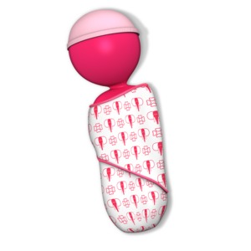
CHCECE005
Provide care for babies and toddlers

Slide 2

Promote safe sleep
1.1 Reach agreement with families on how sleep and rest will occur

Slide 3
Reaching agreements with families
Developing and maintaining a good relationship with the family of a child will enable you to share information and make decisions based on a mutual agreement and with the child’s best interests at the centre.
Deciding on when and where children will sleep is an example of a decision that should be made alongside the family of the child. Sleep should be based on the habits which the child is accustomed to at home.

Slide 4

Reaching agreements with families
Whilst it may seem like a relatively consistent activity, people all over the world have completely different habits when it comes to sleeping.
You should respect the individual practices of children and their families and try to focus your work around the preferred customs.

Slide 5

Sleep and rest
It may not be possible to maintain the exact same environment within the workspace as the child is given at home.
When making arrangements for sleep, it might a good idea to try to focus on the key factors for sleep, rather than being held up on smaller issues which can be overcome by the child over time.

Slide 6
Sleep and rest
The key things to consider are likely to include:
Where to sleep
When to sleep
How long to sleep for
General sleeping conditions – consider any environmental factor that may affect or prevent sleep, for example, noise or temperature.

Slide 7
Sudden Infant Death Syndrome (SIDS)
Sudden Infant Death Syndrome refers to the sudden and unexpected death of a baby.
SIDS most commonly occurs during the first three months of a baby’s life, during the time when the child is asleep.

Slide 8
Sudden Infant Death Syndrome (SIDS)
There are some things that you can do to help reduce the risk of SIDS or other fatal sleep accidents:
Place the child on their back to sleep. The safest place for them to sleep is in a cot in a room with someone present for the first 6 to 12 months
Prevent anyone from smoking in the same room or within close proximity of the baby
Never set the baby to sleep on a sofa or an armchair
Do not let the baby get too hot
Keep the baby’s head uncovered. Their blanket should be tucked in no higher than their shoulders.

Slide 9

Activity 1A

Slide 10
Promote safe sleep
1.2 Check that cots, bedding and equipment meet approved standards

Slide 11

Approved standards
All sleeping equipment which you utilise within your working vicinity will have to abide by the relevant regulations. In Australia, cots will need to follow the mandatory requirements outlined by the Australian and New Zealand AS/NZS 2127:2003 Cots for household use – safety requirements.

Slide 12

Checking equipment
Before you utilise any equipment within your workplace, you have a responsibility to ensure that it is safe for use and meets the standards mentioned.
A good visual check should be enough to allow you to identify any faults or issues should they be there.

Slide 13
Checking equipment
You may look to identify:
The bars or panels are spaced between 50 mm and 95 mm apart – bigger gaps can trap a baby’s head, arms or legs
There are no spaces between 30 mm and 50 mm that could trap the child’s arms or legs
There are no small holes or openings between 5 mm and 12 mm that could trap the child’s fingers
There are no loose nuts or bolts
The side drop is functioning correctly
The cot is placed in a safe spot and locking brakes are in place.

Slide 14
Activity 1B

Slide 15
Promote safe sleep
1.3 Implement safe sleep practices and explore and implement quality sleeping environments

Slide 16
Safe sleep practices
To ensure that you are promoting safe sleep practices you will need to consider the relevant safety procedures.
For example, some general safety procedures include:
Avoid soft bedding in a cot
Try to judge what layers are needed and adjust case by case
Ensure that there is nothing around the cot/bed which poses a danger.

Slide 17

Quality sleeping environments
The general environment in which sleep occurs can have a detrimental effect on whether or not a child gets the sleep which it needs. Ideally, it is best practice to try to replicate the home environment of the child so that they are comfortable and familiar with the idea of ‘sleep time’.

Slide 18

Quality sleeping environments
The key factors to creating a quality environment include:
Lighting
Temperature
Noise.

Slide 19
Activity 1C

Slide 20
Promote safe sleep
1.4 Ensure bedding is clean, using appropriate hygiene practices

Slide 21

Bed cleaning
All cots, beds, and equipment which are utilised within your workplace will need to be in a clean and sanitary condition.
Your organisation is likely to have specific guidelines and systems in place for cleaning beds and bedding, such as labelling to indicate when a bed has been cleaned or changed.

Slide 22

Hygiene practices
As you are likely already aware infection can be spread in a number of ways, including physical contact as well as through the air, i.e. airborne infections such as coughing or sneezing.
Incorporating simple practices into your daily routine can help to reduce the chances of cross-infection for yourself, your colleagues and the children who you care for.

Slide 23
Hygiene practices
On top of ensuring that beds are cleaned and changed regularly, there are some general practices which you can follow to promote a safe environment:
Encourage children to follow simple hygiene practices such as washing their hands and brushing their teeth
Ensure that key facilities are cleaned sufficiently – this should include the sleeping area as well as bathrooms, kitchens/eating areas and playing areas
Use hygienic nappy changing methods/areas.

Slide 24
Activity 1D

Slide 25
Provide positive nappy-changing and toileting experiences
2.1 Change nappies using appropriate hygiene practices

Slide 26
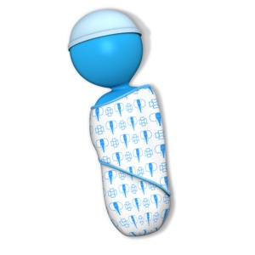
Changing nappies
A large part of caring for babies and toddlers will include changing nappies whenever necessary. Nappies should be changed regularly to avoid a build-up of bacteria or sores caused by leaving them on for too long.

Slide 27
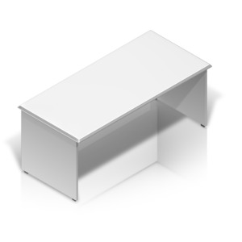
Changing nappies
Nappy changing should always occur in a designated place whenever possible. This will help to ensure that the germs are contained to one area. Having a designated area will also allow you to keep all necessary equipment nearby and make the process as efficient as possible.

Slide 28
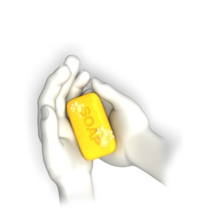
Changing nappies
Generally speaking, for each nappy change you will need:
A clean nappy – this may be a cloth or a disposable nappy depending on your organisation/the baby’s preferences (any allergies, for example)
A nappy bucket to store the dirty nappy or a bag to throw it away
Nappy wipes or cotton wool and warm water
Barrier cream/nappy cream.

Slide 29
Practicing good hygiene during nappy changes
There are techniques that you can adopt to prevent spreading germs during the nappy changing process.
For example:
Wash your hands
Place paper on the change table
Always wear gloves when changing a nappy
Remove the child’s nappy and put it in a ‘hands-free’ lidded bin
Remove any clothes with urine or faeces on them.

Slide 30
Practicing good hygiene during nappy changes
Clean the child’s bottom
Remove the paper and put it in a ‘hands-free’ lidded bin
Remove your gloves by peeling them back from your wrists, turning them inside out as you go. Put the gloves in the bin
Wash and dry the child’s hands
Take the child away from the change table
Clean the change table with detergent and warm water
Wash your hands.

Slide 31
Activity 2A

Slide 32
Provide positive nappy-changing and toileting experiences
2.2 Adapt experiences to meet the individual child’s routines

Slide 33

Individual child’s routine
Throughout all of your work, you will need to adopt strategies which aim to support positive nappy changing and toileting experiences for a range of children. As with all people, children are all different. They will respond differently to your work practices and will require individualised treatment during sensitive practices.

Slide 34
Adapting the care which you give
You will be required to adapt your working practices to ensure that all children get the care which they need.
Practices to help you adapt your care include:
Discuss children’s individual needs with families to ensure practices are reflective of the home environment and are culturally sensitive
Provide information to families regarding children’s nappy change patterns…

Slide 35
Adapting the care which you give
Utilise nappy change times to interact with children on an individual basis
Organise the nappy change area to promote positive interactions and promote positive learning experiences, e.g. place pictures or mobiles to stimulate children’s interactions and to encourage learning.
(Community Child Care Co-Operative, Nappy change: http://ccccnsw.org.au/wp-content/uploads/nappy-change.pdf)

Slide 36
Activity 2B

Slide 37
Provide positive nappy-changing and toileting experiences
2.3 Support children sensitively and positively when they are learning to use the toilet

Slide 38
Supporting children throughout toileting
Toilet training is a huge part of a child’s development and a major milestone in their lives. A negative experience can have a long-lasting effect on the self-esteem of a child, so it is important that you are a positive influence on this activity.

Slide 39
Supporting children throughout toileting
The age when toilet training begins can differ dramatically from child to child and there is essentially no ‘right’ age for when this should occur.
Generally speaking, you should look for the following signs when judging whether a child is ready for toilet training:
An awareness of their toileting habits
Showing discomfort when a nappy is wet or soiled
Waking from a daytime sleep with a dry nappy
Showing an interest in a potty or the toilet.

Slide 40

Supportive practices
To ensure that toilet training is a positive experience for all children in your care, you should adopt a range of supportive practices which aim to encourage the child and promote their independence in the most positive way.

Slide 41
Activity 2C

Slide 42
Provide positive nappy-changing and toileting experiences
2.4 Work with families to support children’s toilet learning

Slide 43
Working together to support toilet learning
You should work in partnership with the families to keep them updated with anything that you become aware of and any plans that you intend to put into motion. For example, if you are caring for children throughout a large portion of the day, you may begin to see signs that the child is becoming ready for toilet training before the families do.

Slide 44

Working together to support toilet learning
Throughout toilet learning, it is a good idea to try to replicate the home environment. This should include you mirroring the steps taken by the parents/family members throughout the toilet training procedure. Creating a similar process will encourage the child to feel comfortable by providing a familiar situation for them.

Slide 45

Working together to support toilet learning
Spending some time with the family of the child will enable you to find out how they want to deal with the process on the whole and what you can do to help support any preferences or requirements which they may have.

Slide 46
Activity 2D

Slide 47
Promote quality mealtime environments
3.1 Promote positive mealtime environments that are adapted to meet the individual child’s routines and needs

Slide 48

Positive mealtime environments
Creating a positive mealtime environment can significantly help children to learn good eating habits and develop a positive attitude towards food. All children should develop an understanding of the importance of eating healthily and maintaining positive lifestyles.

Slide 49
Positive mealtime environments
There are some simple tips which you can follow to help to ensure that children gain a positive experience from their mealtimes:
Use child-sized furniture
Supply easy-to-use cutlery
Consider finger foods
Incorporate new foods
Encourage cooperation when cleaning spillages
Engage with children whilst they eat.

Slide 50
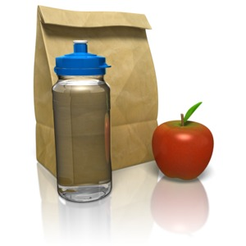
Ensuring that mealtimes are healthy and nutritious
Standard 2.2.3 of the National Quality Standards covers healthy eating and requires that food/drinks provided are nutritious and appropriate for each child.
Your workplace should be aiming to serve meals at set times each day so that children engage with the routine of eating healthily.

Slide 51

Ensuring that mealtimes are healthy and nutritious
The foods that are served should be as nutritious as possible to enable the children’s mental and physical development.
It is important to think about the environments in which meals are served also. You can increase the sense of enjoyment by incorporating a range of colours and pictures which will encourage children to think positively about food.

Slide 52

Adapting mealtime environments to meet individual routines and needs
When you are responsible for a large number of children, ensuring that all their different needs are catered for can be a difficult task, particularly when they are different ages and require different levels of care.

Slide 53
Adapting mealtime environments to meet individual routines and needs
You may need to consider a range of factors when catering for a number of different children:
The different ages of children
Any allergies children may have
Sleep times
Any cultural or religious preferences/requirements.

Slide 54
Activity 3A

Slide 55
Promote quality mealtime environments
3.2 Ensure babies are fed individually

Slide 56

Feeding babies individually
All babies will have different needs and requirements when it comes to feeding, and it is important that you do all that you can to meet their needs whilst they are in your care.
Babies, especially new born, will be hungry at varying times throughout the day and night, so it may be almost impossible to stick to a feeding schedule.

Slide 57

Feeding babies individually
The best thing to do is to simply respond to the baby’s cues.
Cues may include specific behaviours such as sucking on their hands or grabbing for breast/bottle. Responding to behavioural cues will help to ensure that babies are being fed when they are actually hungry as well as promoting natural behaviours with food.

Slide 58
Feeding babies individually
The benefits of feeding babies individually include:
Avoids undereating/overeating by responding to natural cues rather than working on a feeding routine
Allowing the baby to feed when it desires will ensure that their energy levels are as they should be and promotes healthy development
Enables you to spend time bonding with the baby
Encourages a natural relationship with food.

Slide 59

How often to feed babies
When you have decided to feed babies individually, it can be a scary prospect to make sure that they are eating enough and as often as they should be without referring to a schedule or routine.
Generally speaking, formula-fed babies should be fed around 6-10 times per day, whereas breast-fed babies between 8-12 times per day.

Slide 60
Activity 3B

Slide 61
Promote quality mealtime environments
3.3 Follow approved standards for safe storage and heating of formula and breast milk and for cleaning equipment and utensils

Slide 62
Safe storage and heating of formula
Families may choose to feed their baby using formula and you will be responsible for preparing and storing this correctly.
Some tips for heating and storing powder formula include:
If not used immediately when made up infant formula must be stored in a sterilised bottle or container at the back of the fridge, in the centre where it is coldest
Discard unused infant formula after 24 hours if refrigerated. Re-warming stored, made-up formula
Remove the prepared formula just before it is needed…

Slide 63
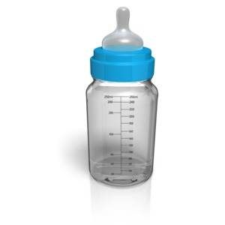
Safe storage and heating of formula
Re-warm by placing the container in heated, shallow water for no more than 15 minutes or use a commercial bottle warmer
Microwaves are not recommended to rewarm formula as they heat unevenly and overheated parts of formula can burn the baby’s mouth
Discard unused infant formula after two hours at room temperature.

Slide 64
Safe storage of breast milk
Families may prefer babies to continue to be fed on breastmilk rather than formula whilst they are in your care.
Store expressed breast milk in:
The fridge (in the back where it is coldest) for no more than 72 hours
The freezer compartment inside a fridge (-15°C) for up to 2 weeks
In the freezer section of a fridge with a separate door (-18°C) for 3 months.

Slide 65

Safe heating of breast milk
The best way to heat breast milk is to place the bottle into a bowl of warm water and leave it until it has reached room temperature. You should then shake the bottle to ensure that the milk has a consistent temperature throughout. Overheating or boiling the breast milk can cause a loss of nutrients and could also potentially burn the baby’s mouth.

Slide 66
Safe heating for utensils and equipment
Any equipment which you use to serve or prepare babies food will need to be thoroughly cleaned and sterilised before use.
There a number of ways that you can ensure that equipment is sterilised and safe for contact with baby:
Boiling
Chemicals
Steam sterilisers/microwave steam sterilisers.

Slide 67

Storing utensils and equipment
All utensils and equipment should be stored in a clean environment; this will prevent recontamination prior to the next use. Ensure that equipment is stored on a clean surface away from contact with food or dirty surfaces. It is a good idea to utilise cupboards/shelves where equipment can be stored separately from anything else which is used.

Slide 68
Activity 3C

Slide 69
Promote quality mealtime environments
3.4 Assist in providing a supportive environment for mothers to breastfeed

Slide 70
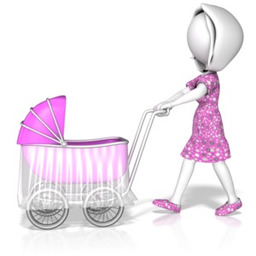
Providing a supportive environment for breastfeeding
Breastfeeding is a huge part of providing the right nutrients for babies and ensuring that they are given the best chance of a healthy and positive development.
If mothers choose to breastfeed in or around your working area, it is important that you make them feel comfortable and provide them with an environment which supports the process.

Slide 71
Providing a supportive environment for breastfeeding
There are some tips that you can adopt to ensure that mothers feel comfortable and confident to breastfeed in your working environment:
Be understanding
Create a quiet and comfortable place to breastfeed
Do not be judgemental.

Slide 72
Activity 3D

Slide 73
Promote quality mealtime environments
3.5 Prepare formula and other food according to recommended food safety standards

Slide 74

Preparing formula
Formula milk is an alternative way (to breastfeeding) to provide a baby with the nutrients which they need.
Powder formula is usually made with water and liquid is ready-to-feed. Each requires a different preparation process which you will need to be aware of.

Slide 75
Preparing powdered formula
Wash hands thoroughly with soap and warm water and dry with a disposable paper towel
Whenever possible, make a fresh batch of infant formula before each feed
Prepare infant formula exactly according to manufacturer’s instructions
Check the temperature of infant formula before feeding the baby by placing a drop of liquid on the inside of your wrist. It should feel warm
Avoid preparing infant formula if caregivers are suffering illnesses with vomiting or diarrhoea, and take extra care with hygiene.

Slide 76
Preparing liquid formula
Once opened, if the liquid infant formula is not to feed to the baby immediately pour into a sterile container
Store immediately in the coldest part of the fridge: at the back, in the centre
Re-warm by placing the container in heated, shallow water for no more than 15 minutes or use a commercial bottle warmer
Microwaves are not recommended to rewarm formula as they heat unevenly and overheated parts of formula can burn the baby’s mouth…

Slide 77

Preparing liquid formula
Discard unused infant formula after two hours out of the fridge
Discard after 24 hours in the fridge.

Slide 78
Preparing other food
Throughout preparation, you should follow these steps to ensure the hygiene and safety of food:
Wash your hands often with soap and water during food preparation
Wash and sanitize work counters and surfaces before and after use
Wash and sanitize cutting boards and utensils before using and after each use
Use separate cutting boards and utensils for raw meats than the ones you use for fruits, vegetables, and other foods…

Slide 79
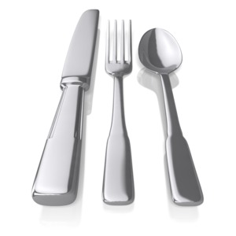
Preparing other food
Wash and sanitize can openers after each use
Put frozen meats into a pan before placing them in the refrigerator to thaw
Never thaw meats on the kitchen counter
Cook meats thoroughly, and use a food thermometer to be sure they are fully cooked to the correct temperatures
Do not change diapers in areas where you prepare, store, and serve foods.

Slide 80
Activity 3E

Slide 81
Create a healthy and safe supporting environment
4.1 Communicate with families daily about the child’s intake and experiences with food and drink

Slide 82

Communicating with families
Keeping families alert as to how their children are getting on when they are in your care should be a huge part of your role, particularly when it comes to food.
Families will be interested to know that their child is displaying healthy and normal eating behaviours whilst away from them.

Slide 83
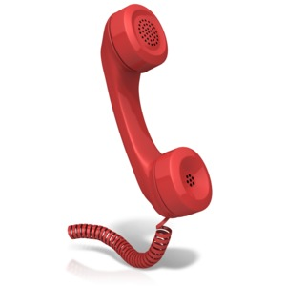
Communicating with families
The different ways that you can communicate include:
Face to face
Telephone
Text message
Email
Social media.

Slide 84

Children’s intake and experience with food
It is not expected of you to relay in grand detail the eating behaviours of every child you care for.
However, if you do notice differences, or you plan to make any changes, you should be looking to communicate in more detail with the family.
The main focus for children’s intake and experience of food is that they are engaging with a healthy and nutritious diet.

Slide 85
Activity 4A

Slide 86
Create a healthy and safe supporting environment
4.2 Ensure safe areas and encouragement is provided for babies to practise rolling over, sitting, crawling and walking

Slide 87

Providing safe areas and encouragement for physical activity
The first stages of physical development are detrimental to babies, and you will want to encourage their natural movements as much as possible.
Whatever stage the babies are at with their development, you will need to ensure that they are provided with a safe and encouraging environment in which they can fully explore and continue to develop.

Slide 88

Providing safe areas and encouragement for physical activity
Ways to ensure that an area is safe include:
Remove any furniture which babies could bang into or pull over
Use a rug or a blanket on the floor
Stay with the baby.

Slide 89

Providing safe areas and encouragement for physical activity
Ways to provide encouragement include:
Provide opportunities to play on their back, belly and both sides
Give them the opportunity to belly crawl
Allow them to explore in a completely free zone
Verbally praise them.

Slide 90
Activity 4B

Slide 91
Create a healthy and safe supporting environment
4.3 Supervise closely when babies and toddlers are in situations that present a higher risk of injury

Slide 92

The importance of supervision
Children of all ages are naturally curious and this behaviour should be encouraged throughout their development. However, due to their lack of ability to understand the concept of danger, children need a second pair of eyes to prevent them from getting into dangerous situations.

Slide 93
The importance of supervision
Supervision also has a number of benefits aside from preventing danger:
Allows you time to bond with the children and understand their personalities better
Allows you to see their capabilities
Puts you in an effective position to be there immediately should something go wrong or the child find themselves in any compromising situation.

Slide 94

High-risk situations
You should be on top of safety procedures at all times during your working practice, but there are some particular situations that will require more intense awareness due to the heightened risk of injury or harm.
For example, particular high-risk situations may include:
Being around water
Being outside
During eating
Being around household objects.

Slide 95
Activity 4C

Slide 96
Create a healthy and safe supporting environment
4.4 Ensure babies and toddlers can safely explore their environment with their hands, mouths and bodies

Slide 97
Exploring the environment safely
You will need to ensure that your working space is a safe and clean environment for children to put their curiosity in to practice.
A good way to make sure that the area is safe and clean is to look at it from a child’s eye view. Get yourself to their height and walk/crawl around this space.
Some toys which children play with may also become an issue. It is common behaviour for children to express their curiosity by putting things into their mouths. Whilst this is entirely natural, certain objects have the potential to become a choking hazard.

Slide 98

Infection control
To ensure that the area is safe for babies and toddlers to explore with their hands and mouths, you should be practicing effective infection control.
Effective infection control should allow for children to touch and taste things during their explorations without being vulnerable to infections caused by bacteria or germs.

Slide 99
Activity 4D

Slide 100
Create a healthy and safe supporting environment
4.5 Keep up-to-date with children’s immunisation status and recommended immunisation schedule

Slide 101
Immunisation status
Immunisation is an important part of minimising the spread of infections among babies and toddlers, particularly in a care setting when children are in regular contact with each other.
Working with children of a variety of ages means that they will be at different stages of their immunisation journey. You will need to be aware of what infections and illnesses children are still vulnerable to so that you can take the relevant steps to protect their safety as well as your own.

Slide 102

Record keeping
The best way to keep on top of each child’s immunisation status is to maintain effective records which provide up-to-date details of the injections each child has had.

Slide 103

Immunisation schedule
You can help families to keep on top of immunisation by becoming familiar with the ages when specific injections are due, and providing prompts to encourage them to visit a recognised immunisation provider.
Be aware that specific immunisation schedules may differ depending on the jurisdiction which you are based in.

Slide 104
Activity 4E

Slide 105
Provide predictable personal care routines that are rich and enjoyable
5.1 Provide predictable personal care routines that are rich and enjoyable

Slide 106

Personal care routines
Whilst children are in your care, you are likely to be required to carry out personal care tasks such as bathing and brushing teeth sleeping and toileting
Throughout these tasks, you should be aiming to ensure that the child feels comfortable and safe; the best way to do this is to create a routine.

Slide 107
Making routines rich and enjoyable
Making routines enjoyable for children will increase their engagement and participation in the task, as well as make their time with you valuable and positive. For each of the four personal care tasks mentioned (bathing, brushing teeth, sleeping, and toileting) there are a range of ways to make them more enjoyable.

Slide 108
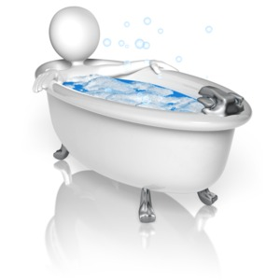
Bathing
Provide distractions
Use a bath pillow
Engage
Keep the water warm!

Slide 109

Brushing teeth
Set specific times for when brushing teeth should occur and stick to this – this is usually morning and night time
Use a fun toothbrush
Provide rewards – for example, stickers.

Slide 110

Sleeping
Bring in home comforts
Play soft music and/or provide soft lighting
Give a warning.

Slide 111
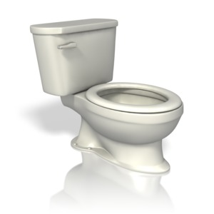
Toileting
Encourage toilet trained children to go to the toilet at specific set times during the day
Provide distractions for nappy changes
Let toddlers hold toys or books whilst they use the toilet
Repeat the same process each time a child uses the toilet.

Slide 112
Activity 5A

Slide 113
Provide predictable personal care routines that are rich and enjoyable
5.2 Respond to babies and toddlers when they practice language by repeating words, sounds and gestures that children use
5.3 Describe objects or events and talk about routine activities with babies and toddlers

Slide 114

Responding to babies and toddlers practicing language
Language development is a continuing process from birth, throughout the child’s early years, and throughout the rest of their lives. During the early stages of a child’s life, they are able to understand a lot more than what they are able to say.

Slide 115
Talking to the child
You should be trying to communicate with the child as though they are a talker themselves. This will promote natural communication techniques by encouraging them to respond to you and will also begin to familiarise them with certain words and phrases as they develop their language skills.
When babies respond to your talking in babbling sounds and noises – respond in the same way!

Slide 116

Responding to the child
Responding to babies and toddlers when they are communicating with you should include language but also gestures too. For example, if a child shakes their head, respond to them as if they have said the word ‘no’. This will show the child that their gesture has meaning and will encourage them to continue to communicate in any way they can.

Slide 117
Describing objects and routine activities
A good way to promote conversation and language development with babies and toddlers is to describe the things around them and the things they do.
Try to focus on things that they are often in contact with or routine activities which form a large part of their day. Focusing on these things will allow you to repeat words often and the baby will hopefully become familiar with these.

Slide 118
Activity 5B

Slide 119
Provide predictable personal care routines that are rich and enjoyable
5.4 Initiate one-to-one interactions with babies and toddlers during daily routines and add to interactions initiated by babies and toddlers

Slide 120

Initiate one-to-one interaction
In order to establish and maintain a positive relationship, you should be looking to engage in one-to-one interactions on a regular basis. One-to-one interactions will include spending time alone with a child.

Slide 121

Initiate one-to-one interaction
Some ways to initiate one-to-one interaction throughout daily tasks include:
Asking questions
Eye contact
Physical contact.

Slide 122

Add to interactions initiated by babies and toddlers
Once you have established a relationship with a child, it is likely that you will find them taking the first step to interacting with you.
You should ensure that your reactions are always positive, and that you invest time in responding to them.

Slide 123
Add to interactions initiated by babies and toddlers
There are a few things that you can do to ensure that you are adding to interactions:
Answer any questions
Allow children to join in with your activities
Respond to baby talk
Practice baby signing.

Slide 124
Activity 5C

Slide 125
Provide predictable personal care routines that are rich and enjoyable
5.5 Use a favourite toy or comfort item brought from home to assist babies and toddlers

Slide 126
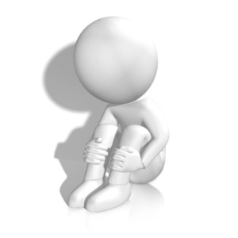
The importance of comfort items
A good way to help children who may be feeling sad, frightened or anxious is to provide them with an object which they associate with home. Objects may include toys, blankets or an item of clothing, for example.

Slide 127

Disagreement with comfort items
Some families may be against the idea of their child having a comfort item. It can build an unnecessary attachment and whilst most children will grow of this, families may fear that it will be an ongoing situation.

Slide 128
Attachment theory
Attachment theory refers to the individual’s ability to form a strong emotional and physical attachment to another person. This attachment is relied on to produce a sense of stability and security and will form as a ‘safety net’ through which the person will build and develop themselves.

Slide 129

Attachment theory
There are steps which you can take to increase the child’s sense of stability and security away from the significant person.
For example:
Try to strengthen the relationship between yourself and the child –
Provide distractions
Talk to the child
Talk to the families.

Slide 130
Activity 5D

Slide 131
Provide predictable personal care routines that are rich and enjoyable
5.6 Provide babies and toddlers with many opportunities to experience relaxed and physical contact

Slide 132
Providing opportunities for relaxed and physical contact
To provide a quality childcare environment, children should be provided with regular opportunities to experience physical contact with their caregiver. The best way to do this is to try and incorporate relaxed and physical contact into routine activities.

Slide 133

Providing opportunities for relaxed and physical contact
Physical contact with babies and toddlers may be encouraged:
By holding babies whilst feeding
During nappy changes
During bathing
Interaction during playtime
Holding hands throughout tasks.

Slide 134
Activity 5E

Slide 135
Provide predictable personal care routines that are rich and enjoyable
5.7 Respond positively to babies’ and toddlers’ exploratory behaviour

Slide 136

Responding positively to exploratory behaviour
It is really important that you respond positively to explorative behaviour and show enthusiasm towards their curiosity.
You can encourage exploration by:
Providing mirrors
Providing tactile toys
Allow climbing

Slide 137
Ensuring a positive response
When you are supervising babies and toddlers as they roam and explore their surroundings, it can be easy to respond negatively when they get themselves into danger or do something which they shouldn’t. However, responding in a negative way may cause children to feel less inclined to carry out their instinctual explorations and could potentially affect their development in the long run.

Slide 138
Activity 5F

Slide 139
Provide predictable personal care routines that are rich and enjoyable
5.8 Closely monitor babies and toddlers for signs of hunger, distress, pain and tiredness, and provide physical comfort as appropriate

Slide 140

Monitoring babies and toddlers
Throughout your role, you should be looking for signs that the children in your care require your assistance in some way. The main things to look for are hunger, distress, pain and tiredness.
In order to monitor children successfully, you should try to become familiar with their normal behaviours, attitudes, and personalities.

Slide 141
Monitoring babies and toddlers
You may be able to identify signs of hunger, distress, pain and tiredness through behaviours such as:
Crying
A loss of interest in activity
Rubbing eyes
Squirming
Change in sleeping/eating patterns
Increased emotions.

Slide 142
Activity 5G

Slide 143
Gather information from the family to assist in the transition from home to care
6.1 Gather information from the family to assist in the transition from home to care
6.2 Assist in the transition from home to care

Slide 144

Gather information from families
The family of the child will always be the best source of information for you; they know their child better than anyone. Therefore, their knowledge, skills, expertise and aspects of family life and culture are beneficial to you as a service provider.

Slide 145
Gaining relevant information
Families may not always be aware of the information that you need; it is your responsibility to find out what you need to know.
Respectfully ask them about their child and the family as a whole. Families should be encouraged to share any details that can help you to give their child a better experience as they transition between the care setting and their home lives.

Slide 146

Gaining relevant information
Families should be encouraged to share information right from the start and throughout the use of your service. Think about holding an initial meeting for the children’s families. This will allow you to discover information about the child’s home life and incorporate relevant techniques to ease the transition from the offset.

Slide 147

Assisting in the transition from home to care
Once you have gathered the relevant information, you will need to put strategies in place which aim to encourage children to feel safe and comfortable in their transition to care.

Slide 148

Assisting in the transition from home to care
For example, strategies might include:
Develop your relationship with the child
Assist in their understanding of the transition
Provide them with distractions on arrival
Make the day more interesting
Ensure that you are providing consistent, positive care.

Slide 149
Activity 6A

Slide 150
Gather information from the family to assist in the transition from home to care
6.3 Communicate daily with families about their child

Slide 151

The importance of regular communication
Throughout your role, it is important that you keep the families up-to-date on their child’s progress within your care. Daily contact will lead to better outcomes for the children and will also enable you and the family to work together to provide the best possible care for the child in a manner which is appropriate for them specifically.

Slide 152

Two-way communication
As well as sharing information with families, you will want them to share the things that are happening at home too. You need to know what’s going on at home and what the child is achieving outside your service.

Slide 153

Appropriate methods of communication
When communicating on a daily basis, you will need to consider which methods of communication are appropriate.
Whilst all methods of communication are valuable, some will not be the best option for daily contact. For example, email may not be sufficient if this is not checked on a regular basis by the family member.

Slide 154
Activity 6B

Slide 155
Summative Assessments
Summative assessments consist of:
Skills Activity
Knowledge Activity
Performance Activity.
Your assessor will provide you with further guidance on how and where to complete these assessments.

Slide 156

Summary and Feedback
Did we meet our objectives?
How did you find this session?
Any questions?

