Slide 1
BSBWHS412
PRAC ASSIGNMENT 2
Perfect painters workplace health and safety policy statement.

Slide 2
laws
Perfect Painters is committed to providing a safe and healthy working environment for our employees and for contractors and visitors to the workplace. Adopting and promoting the provisions of the Workplace Health and Safety Act 1995 and its associated Regulation, Codes and Standards, together with significant importance placed in the areas of hazard / risk management and injury prevention strategies, will achieve our WH&S Objectives.

Slide 3
Responsibilities
Specific responsibilities for the development and approval of the WH&S Policy Statement are delegated to relevant executive management. Communication of the WH&S Policy Statement is delegated to relevant Managers, Supervisors, WHSOs, WHSRs and selected staff as identified.

Slide 4
Policy review
Not once on the safety review for a painting company does it mention dealing with hazardous paint.
A redo of this policy needs to add a section for working with hazardous chemicals and how to manage them.

Slide 5
Recommendations
Not once on the safety review for a painting company does it mention dealing with hazardous paint.
My recommendation for this policy would be a complete rewrite to mention the hazardous chemicals that will undoubtably used, Possibly even registers for those exposed to LED paints.
Also outlining specific duties and responsibilities of workers and PCBU needs to be added, its to generelised.

Slide 6
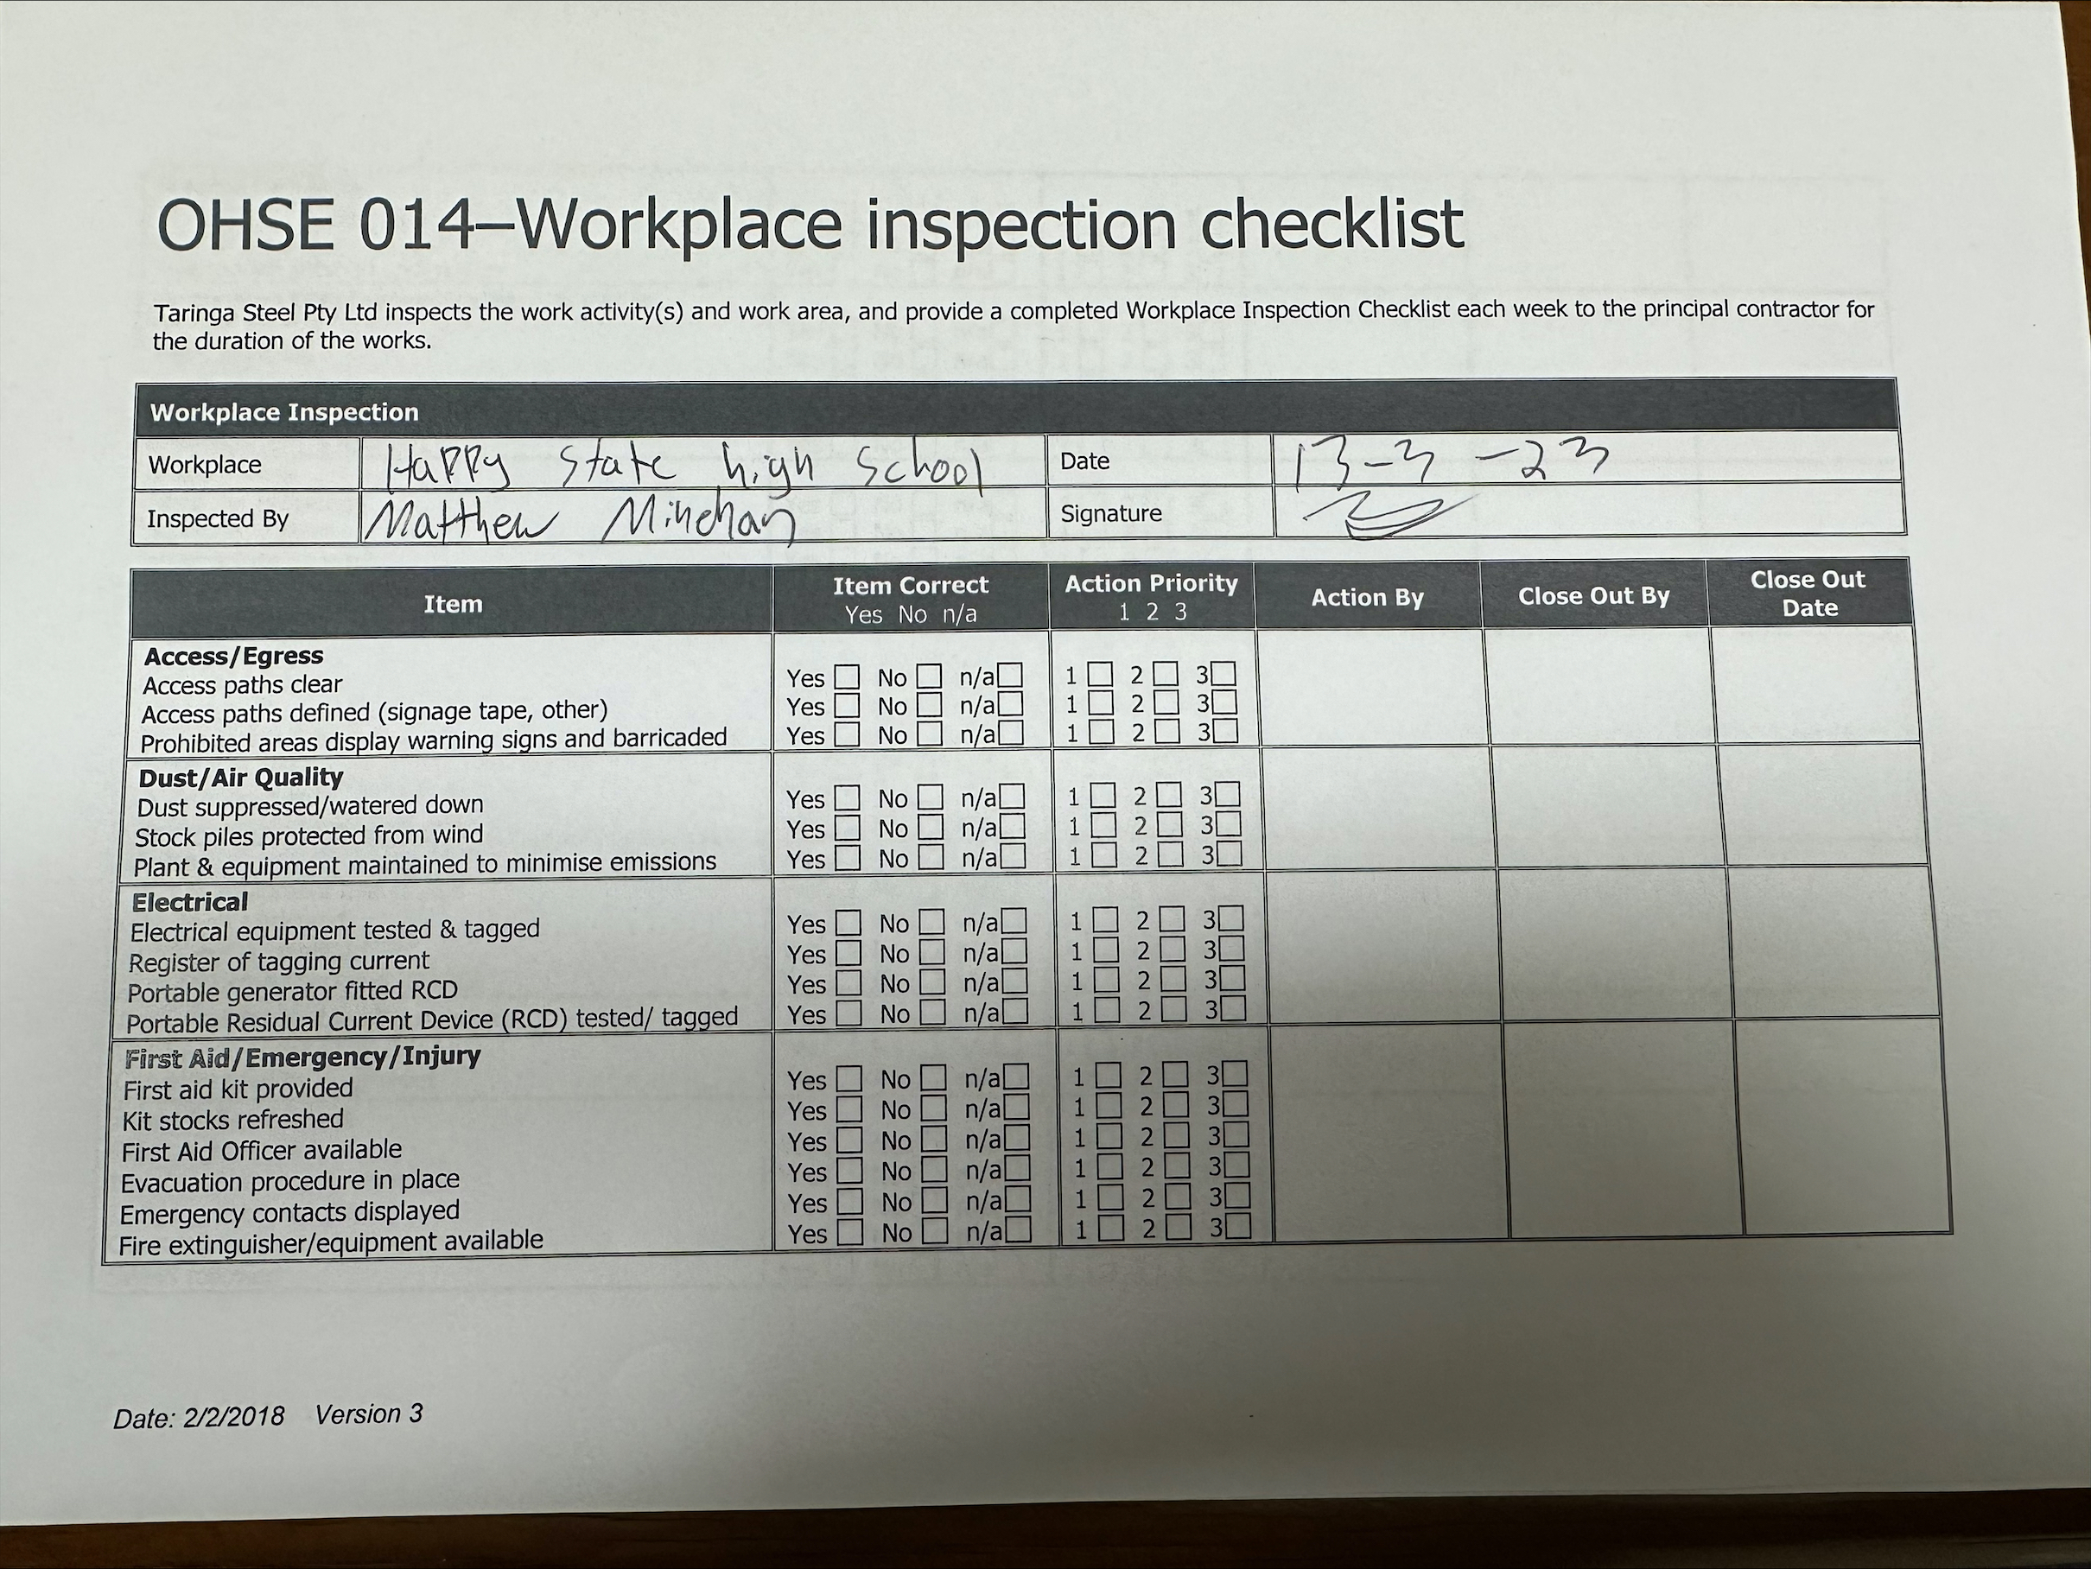
Safety checklist

Slide 7
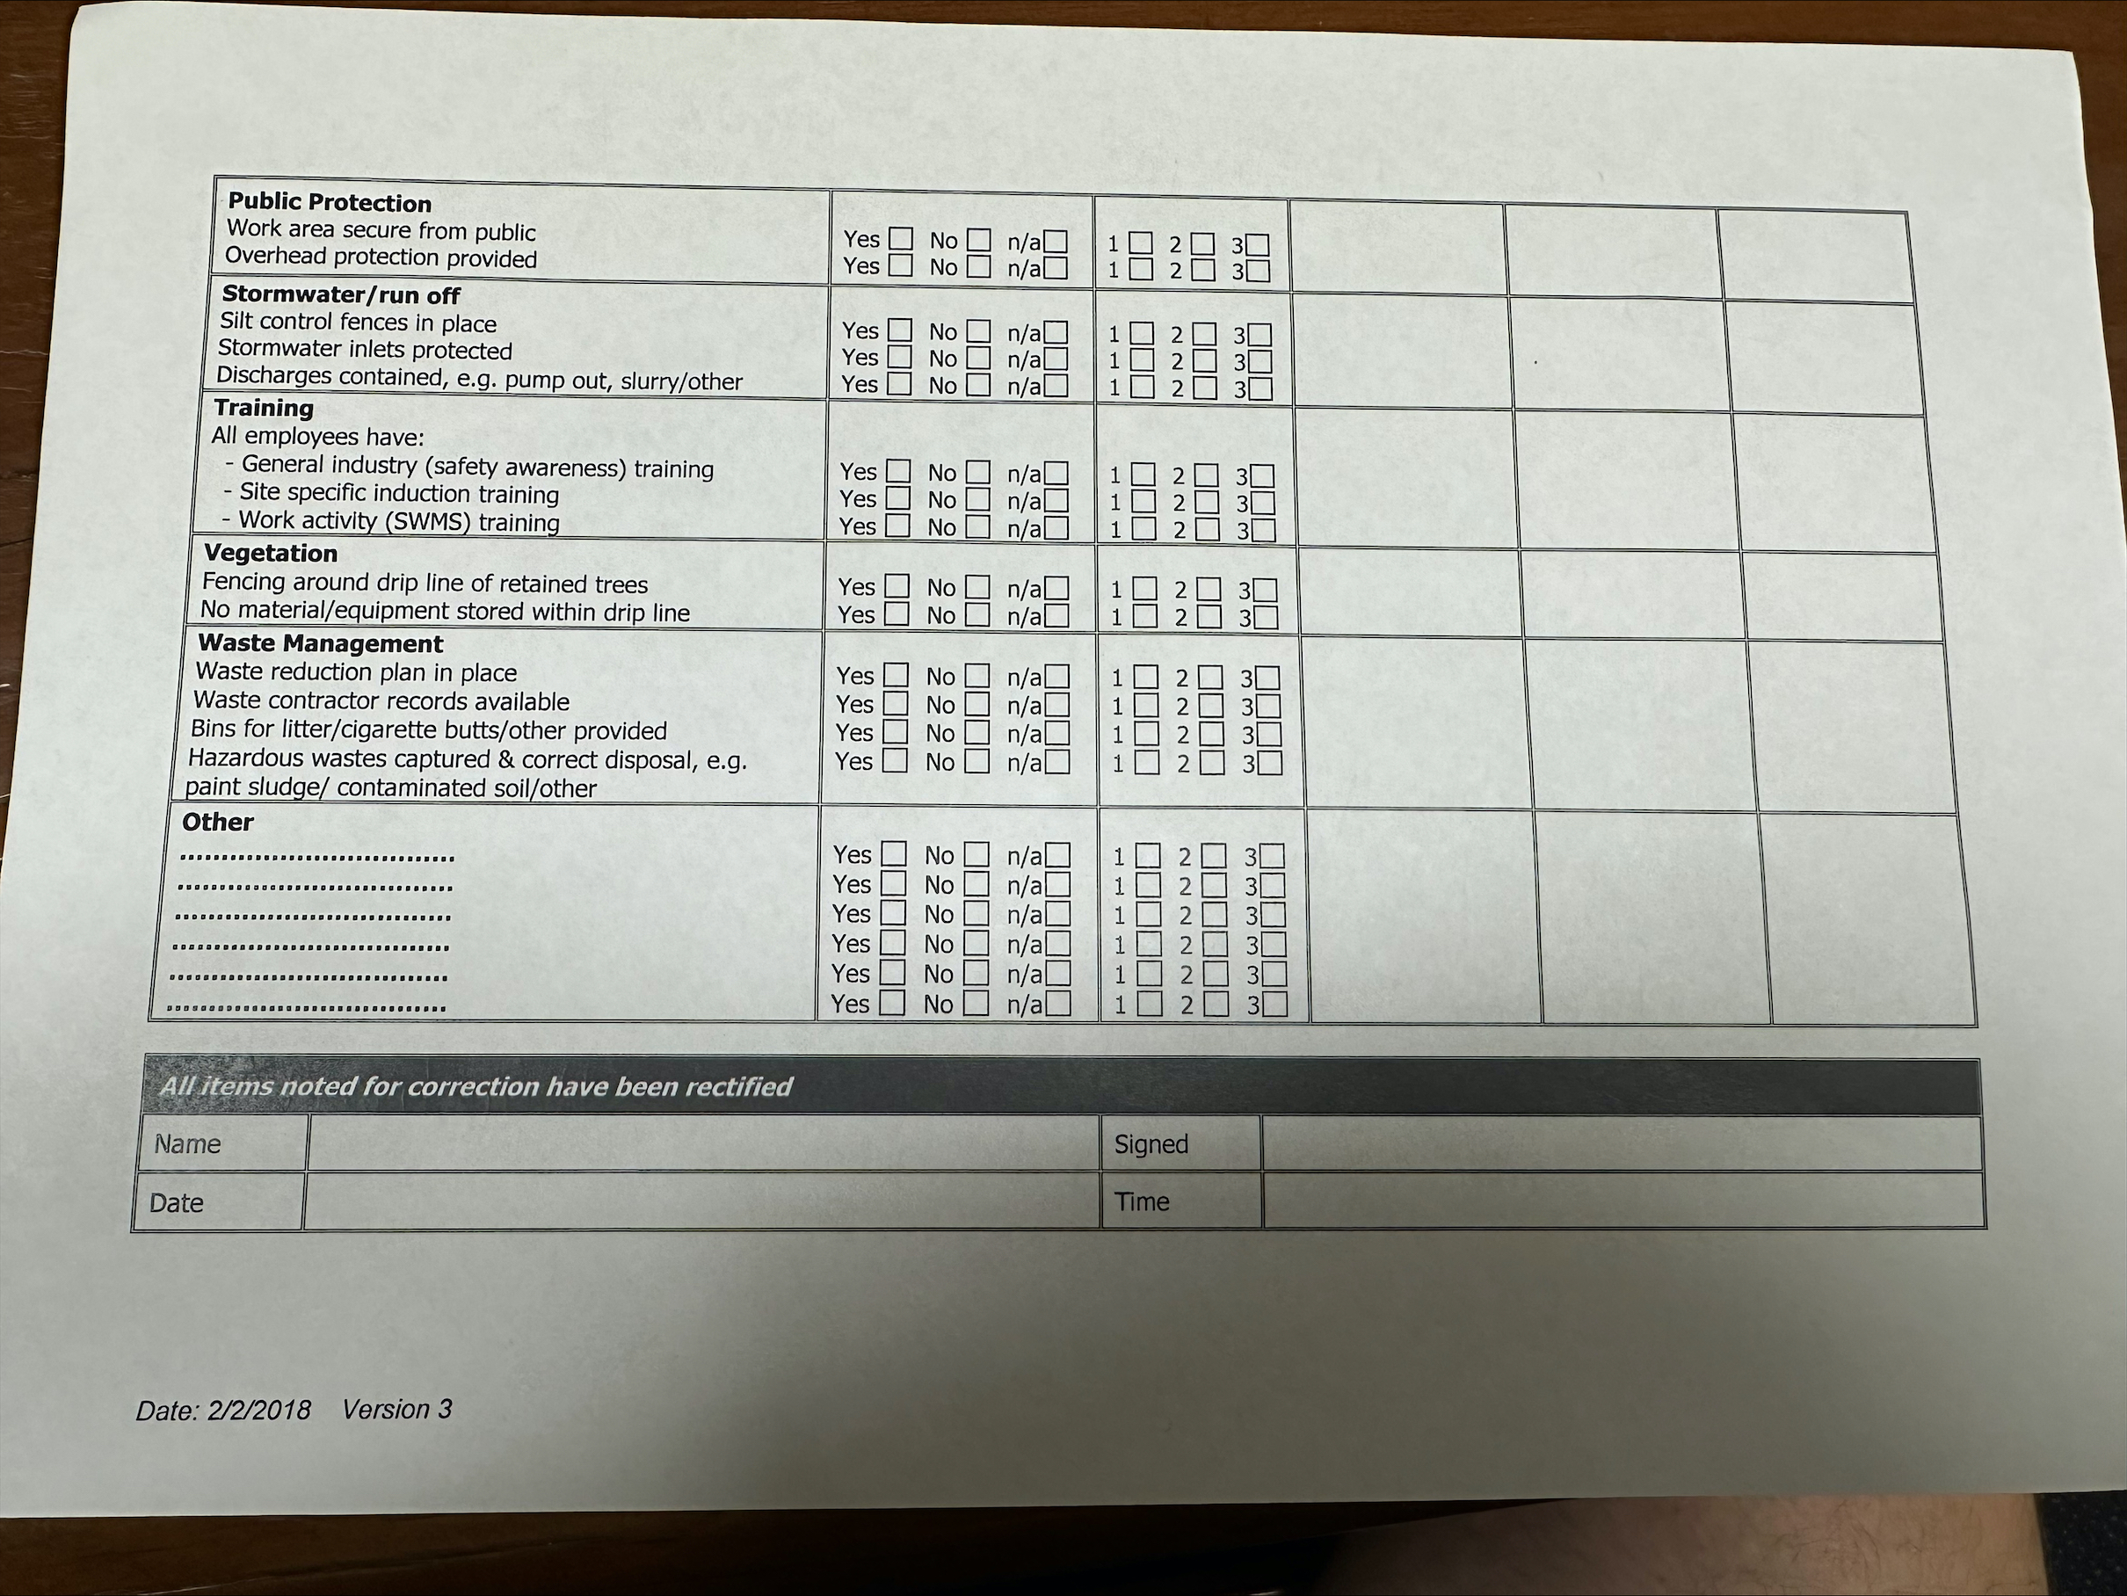
Safety checklist

Slide 8
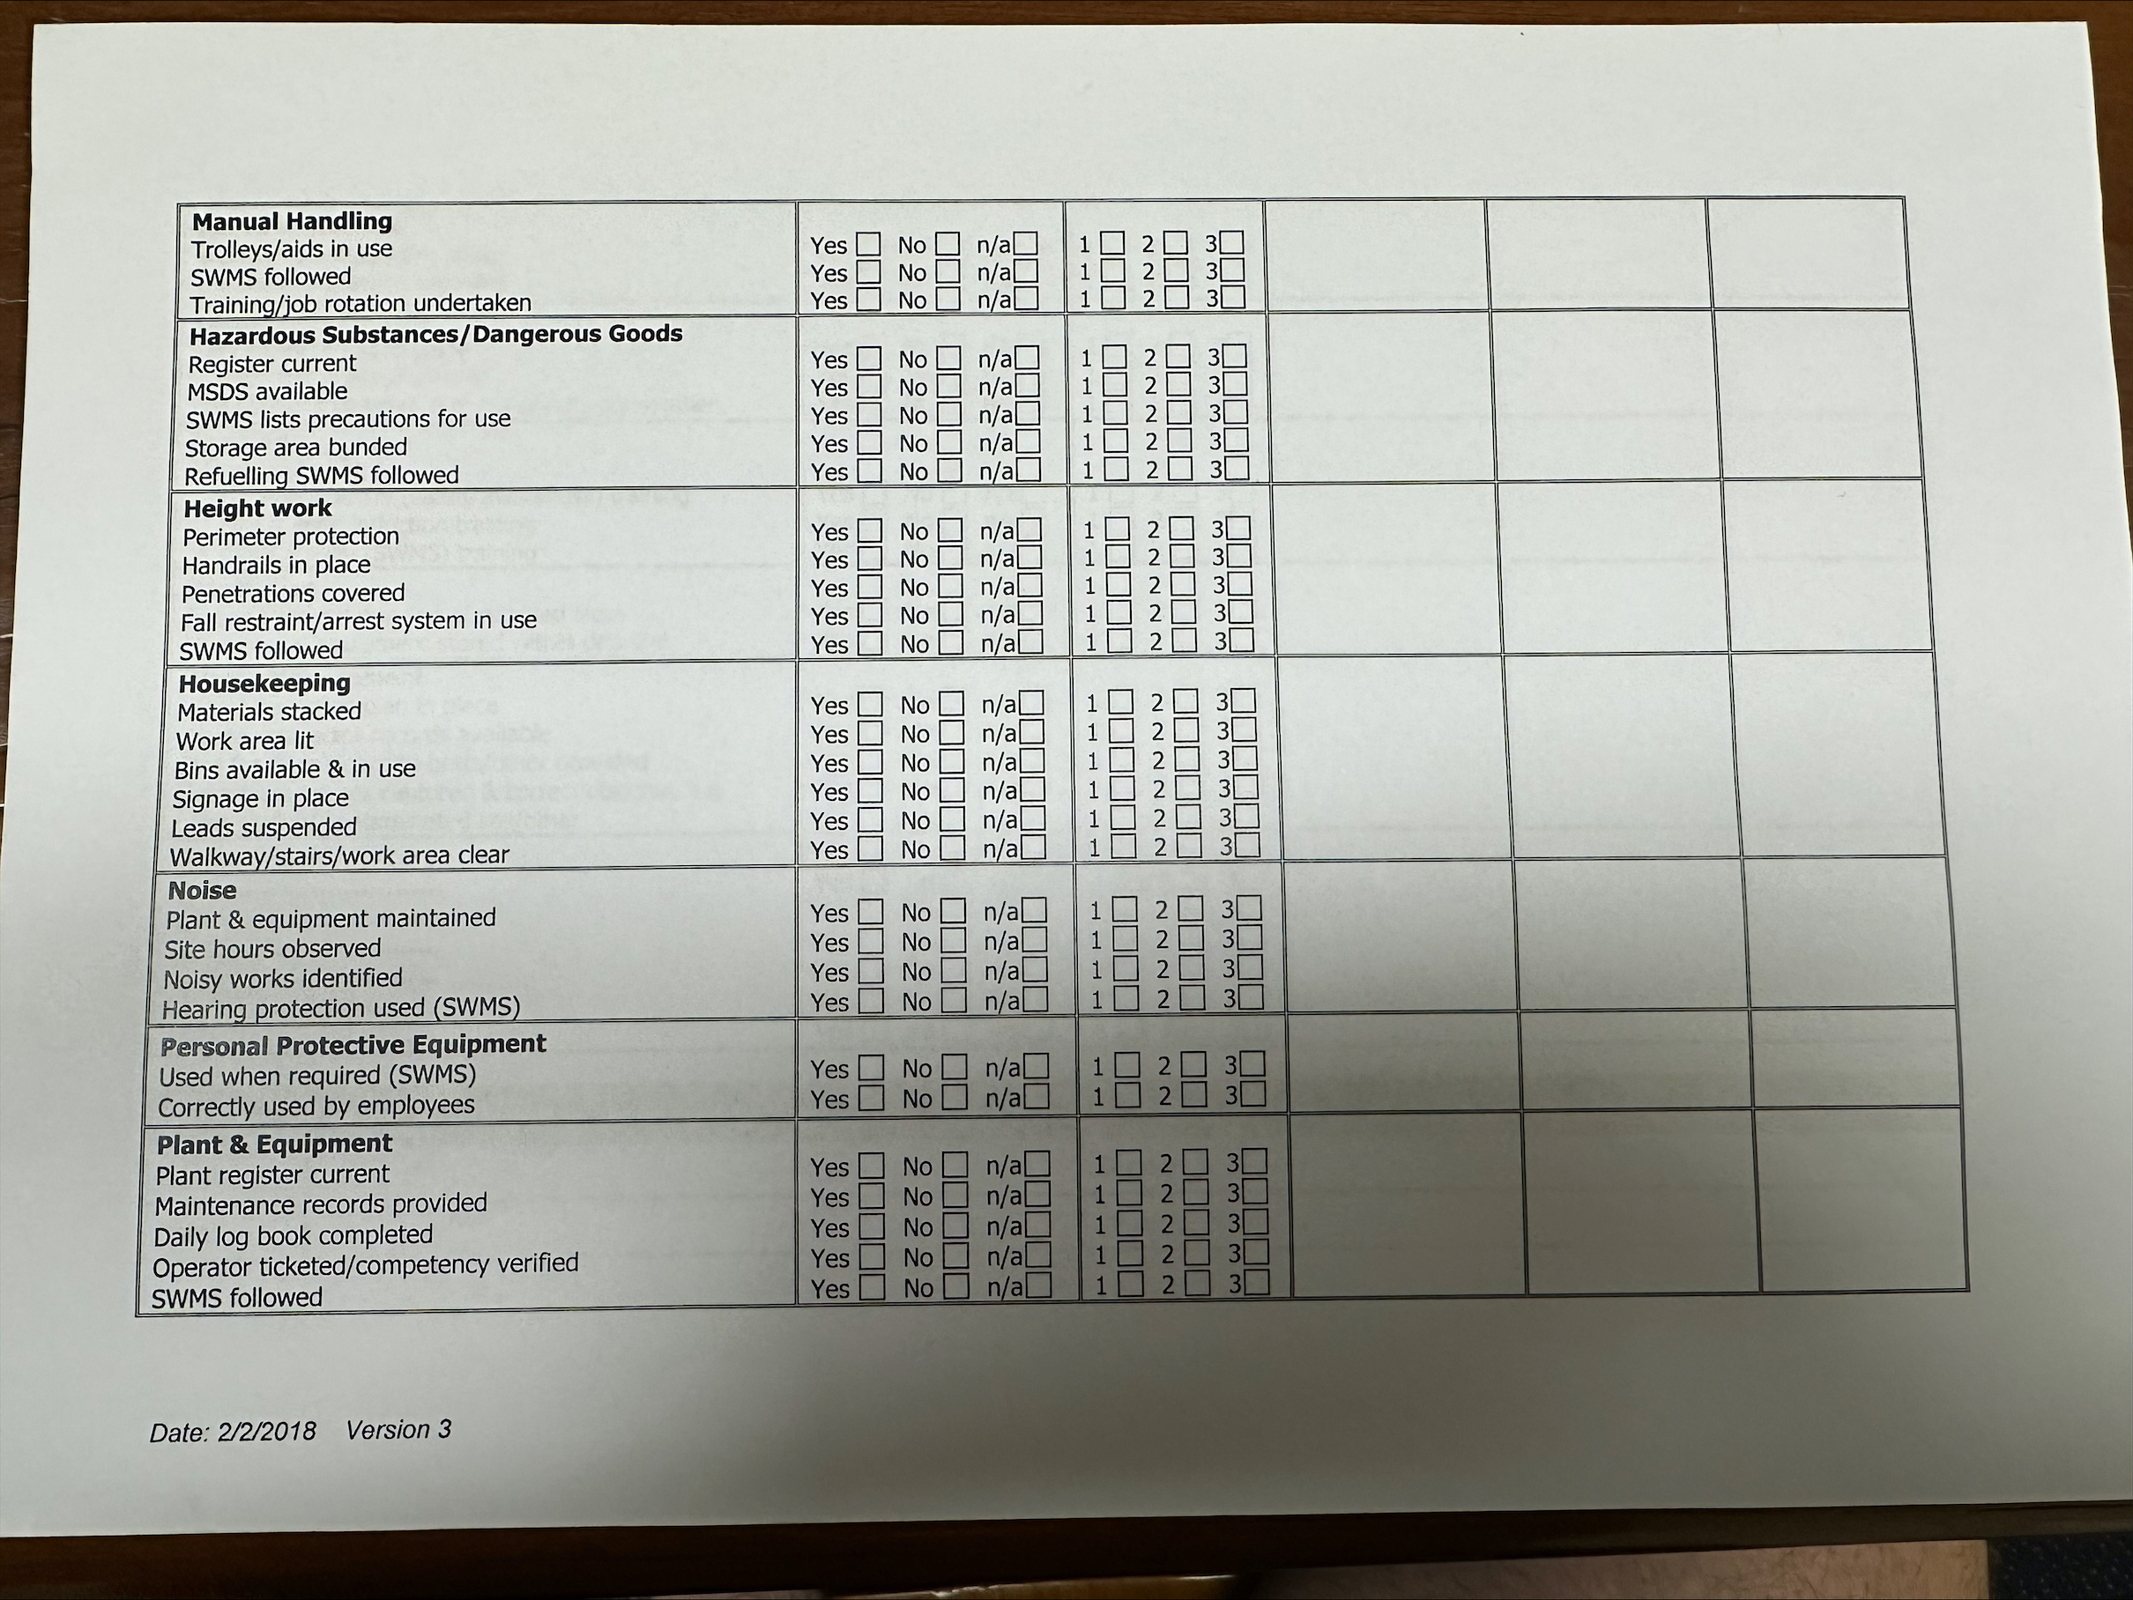
Safety checklist

