Slide 1


Hazards addressed
Presented by
Kira-Lee Gibson

Slide 2
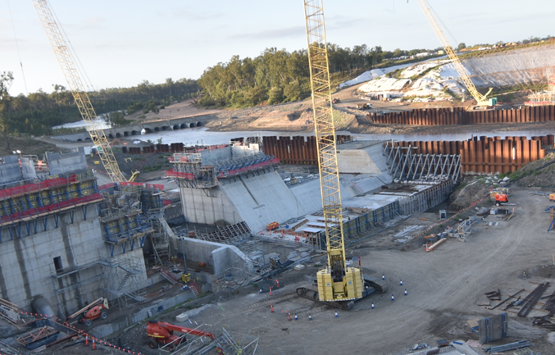
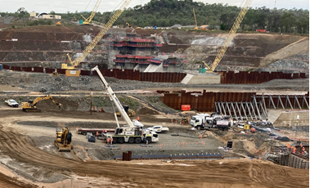
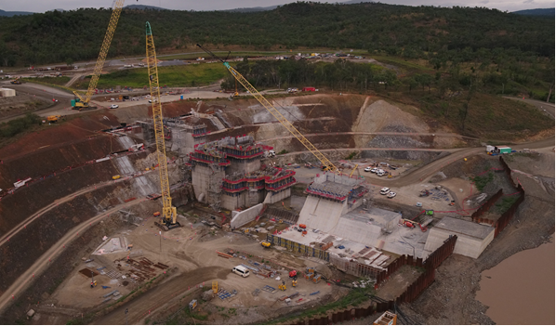
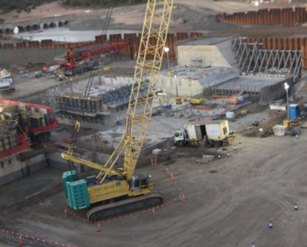
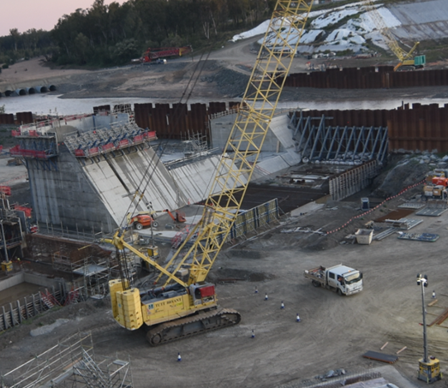
Cranage

Slide 3
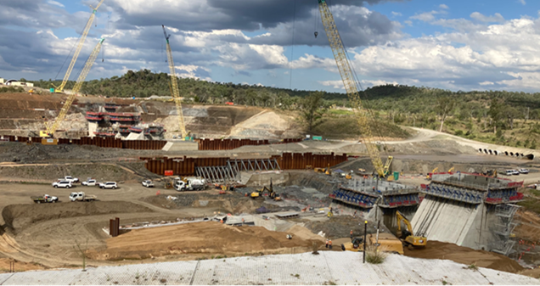
Controls Identified
Specific Hazard / Issue
Crane Roll Over
Dropped loads
Rigging Failure
Sim Ops
Training and Qualifications
Acciona online induction
RWP site induction
General Construction induction
HRWL
System Controls
RWP Workplace Health and Safety Management Plan
LLE618 Cranes & Lifting
LLE621 Working In and Around Plant
LLE626 Chain of Responsibility
LLE901 Plant & Equipment Risk Management
LLE902 Plant & Equipment
LLE601C JHA
LLE601B Safe Work Method Statement
Lift Plans and Studies
LLE 902 plant pack
OME Manuals
VoC
RWP LLE1006A Approval to operate
Physical Controls
Rigging at predetermined lift points
Rigging configuration as per lift plan;
Exclusion zones / drop zones established
Qualified dogman, crane operator.
Edge protection or pre-slung loads
Inspected and tagged equipment
Equipment registers
Positive Communication
Approved crane pads for crawlers cranes

Slide 4
How are the controls being monitored?
Who is responsible?
Quarterly equipment inspections and tagging
Inspections
Plant Inductions stickers
Observations
Construction meetings
HSR Meetings
Engineered certification
SWMS Reviews
Superintendent
Engineers
Supervisors
Safety Team
Notes:
Discuss and question successfulness of controls. What areas can be improved? What areas are working well?

Slide 5
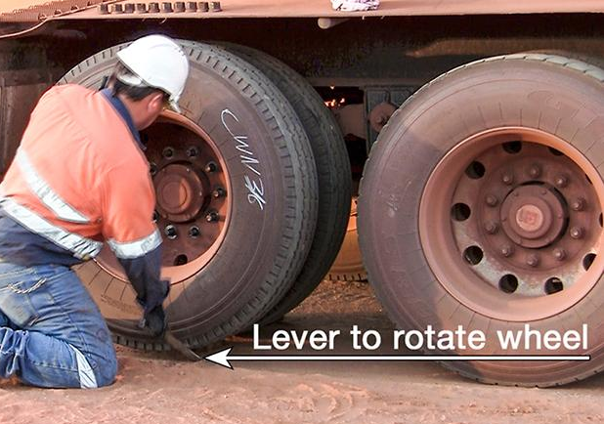
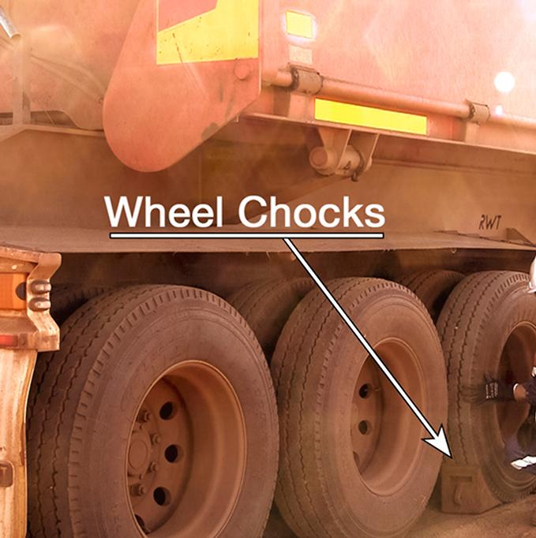
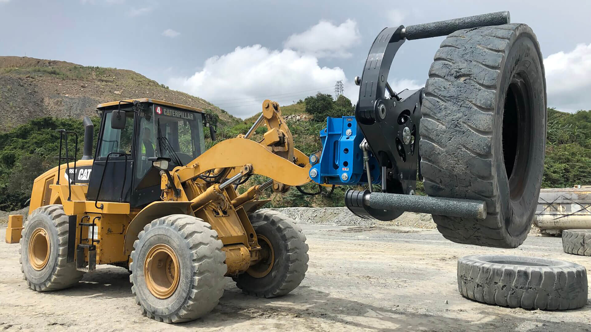
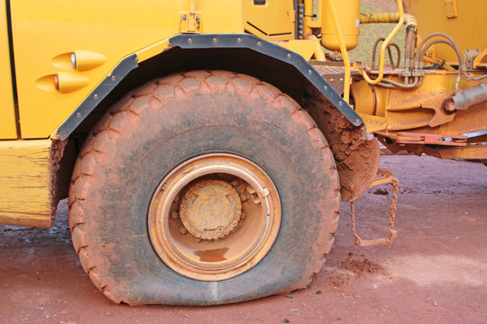
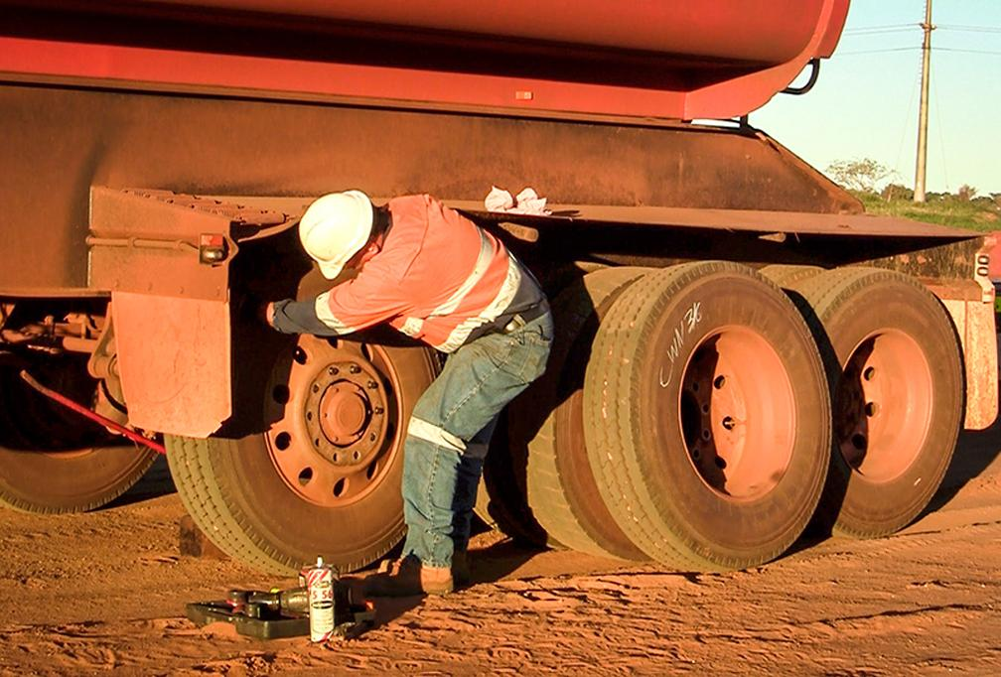
Tyre Changing
Notes:
Image Referencing :
Allan Whiting, 2019. Advice: Changing truck tyres safely [online]. Place of publication: trucksales.com.au Available https://www.trucksales.com.au/editorial/details/advice-changing-truck-tyres-safely-122219/ (1/12). Accessed 03/12/2022
Allan Whiting, 2019. Advice: Changing truck tyres safely [online]. Place of publication: trucksales.com.au Available https://www.trucksales.com.au/editorial/details/advice-changing-truck-tyres-safely-122219/ (2/12). Accessed 03/12/2022
Allan Whiting, 2019. Advice: Changing truck tyres safely [online]. Place of publication: trucksales.com.au Available https://www.trucksales.com.au/editorial/details/advice-changing-truck-tyres-safely-122219/ (10/12). Accessed 03/12/2022
Jenny Thompson, 2022. Dump truck with a flat tyre [online]. Place of publication: stock.adobe.com. Available from https://stock.adobe.com/search?k=flat+tyre&asset_id=264358706. Accessed 03/12/2022
Just Easy Tools, 2022. Mining – Easy Gripper – Efficient and safe tyre handling [online]. Place of publication: justeasytools.com. Available from https://justeasytools.com/tyrehandlers/industry-mining. Accessed 03/12/2022

Slide 6
Controls Identified
Specific Hazard / Issue
Manual Handling
Mobile plant operation
Incorrect isolation
Uncontrolled movement
Release of uncontrolled energy
Crush Injuries
Training and Qualifications
Acciona online induction
RWP site induction
General Construction induction
Applicable RII certification
RWP LLE1006A Approval to operate
Trade Qualification
System Controls
LLE618 Cranes & Lifting
LLE621 Working In and Around Plant
LLE901 Plant & Equipment Risk Management
LLE902 Plant & Equipment
LLE620 Isolation and Lock out
LLE620A Isolation Permit
LLE601C JHA
LLE601B Safe Work Method Statement
Physical Controls
IT loader with tyre handler
Exclusion zones

Slide 7
How are the controls being monitored?
Who is responsible?
Site Inspections
Construction Meetings
SLT Meetings
HSR Meetings
Risk Reviews
Audits
Superintendent
Engineers
Supervisors
Safety Team
Notes:
Discuss and question successfulness of controls. What areas can be improved? What areas are working well?

