Slide 1
BSBMGT402
Implement operational plans
Presentation 1

Slide 2
Presentation objectives
At the end of this lesson you will be able to:
Collate, analyse and organise details of resource requirements in consultation with relevant personnel, colleagues and specialist resource managers
Implement operational plans to contribute to the achievement of organisation’s performance/business plan
Identify and use key performance indicators (KPIs) to monitor operational performance
Manage contingencies by adjusting the implementation of the operational plan in consultation with others
Provide assistance in the development and presentation of proposals for resource requirements in line with operational planning processes

Slide 3
Collate, analyse and organise details of resource requirements
When preparing to implement an operational plan, it is important to collect details of the resources required to effectively implement the plan.
Resources that may be required can include:
  People (human resources)
  Plant and equipment
  Finances (money)
  Raw materials
  Goods and services

Slide 4
Collate, analyse and organise details of resource requirements
To know exactly what is required, consultation with relevant personnel is required, these people generally have some significant input into the operational plan as it will directly affect them in the workplace.
These people may include:
  Colleagues and specialist resource managers
  Managers
  Occupational health and safety committees and other people with specialist responsibilities
  Other employees
  People from a wide range of social, cultural and ethnic backgrounds, and people with a range of physical and mental abilities
  Supervisors

Slide 5
Collate, analyse and organise details of resource requirements
A lack of consultation may result in insufficient knowledge and expertise being contributed to the operational plan
If key stakeholders are not involved in the consultation process then they are less likely to be engaged in the implementation process
Once this the requirements have been determined they need to analysed and organised properly to determine the needs and the accessibility to those needs
This is the process of collation
Analysing the requirements can be conducted by determining, the need for the resource, for instance, if an operational plan is to be effective it requires the creation of a department that deals with specific functions as outlined in the plan
  Therefore it can be considered the need for resources to be high.

Slide 6
Collate, analyse and organise details of resource requirements
Organising of the requirements that have been identified, can be done by breaking them down into categories of resource type and level of importance
Below is an example of how this can be conducted
 | Human | Physical | Virtual
High | 3 new staff to work in the operations
Medium | Further training of existing staff |  | Upgrade of customer service system
Low |  | Purchase of new POS units

Slide 7
Implement operational plans to Achievement of business plan
Organisational plans are crucial to the success of the business, therefore plans must be implemented in a manner that contribute to the achievement of performance and business plans
It is very important to ensure that any operational plan has been aligned to the business plan and strategic goals of a business
It would be pointless to implement an operational plan that goes against
strategic directions have been established in the operation plan of the business as the operational objectives in which activities and strategies alongside operational resources, responsibilities have been factored in to ensure that the operational plan achieves to the future direction and goals of the organisation what the company wants to achieve

Slide 8
Implement operational plans to Achievement of business plan
Organisational plans are crucial to the success of the business, therefore plans must be implemented in a manner that contribute to the achievement of performance and business plans
It is very important to ensure that any operational plan has been aligned to the business plan and strategic goals of a business
It would be pointless to implement an operational plan that goes against
Strategic directions are established in the operation plan of the business as the operational objectives

Slide 9
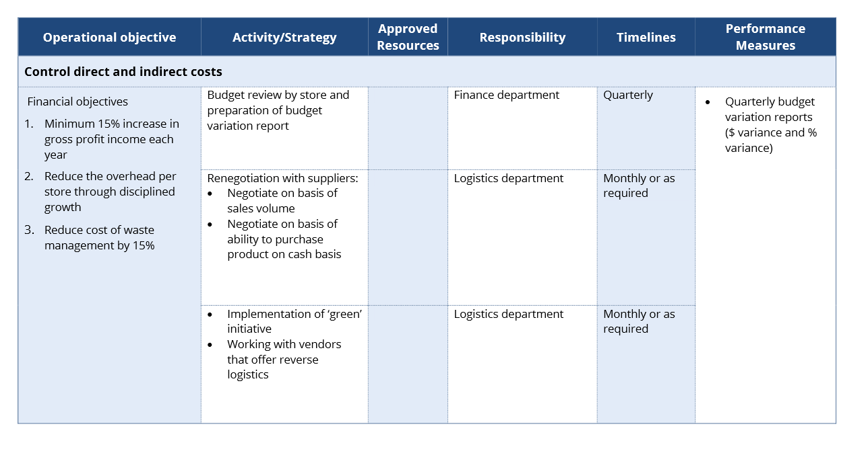
Implement operational plans to Achievement of business plan
Activities and strategies alongside operational resources, responsibilities have been factored in to ensure that the operational plan achieves to the future direction and goals of the organisation what the company wants to achieve

Slide 10
Identify and use KPIs to monitor operational performance
There are many applications for KPI’s (Key Performance Indicators) in business
These are essentially a measure of success
KPIs commonly cover five key areas of performance:
Cost
Quality
Quantity
Time
Safety

Slide 11
Identify and use KPIs to monitor operational performance
Business objectives, goals, key performance indicators (KPI)….What is the difference?
Business Objectives
The main reason for doing what you do
Desirable outcome for your business
Goals
Specific steps or strategies to achieve business objectives
What you need to do to achieve your objective
Tasks, Actions, Activities
Breaking the goals down
Measurements of performance (success or otherwise)
Key Performance Indicators (KPI)
highest or over arching aim
The next step in achieving goals and business objectives
Detailed

Slide 12
Identify and use KPIs to monitor operational performance
Your business objective might be to:
  Increase sales during the early breakfast period through a targeted marketing campaign
A relevant goal could be to:
Give out 10 vouchers a day over the next month for early bird discounts. The vouchers must be redeemed the day after issue
Tasks, actions, activities could be to create an advertisement for your promotion, decide who your target is, create a social media campaign and hand out vouchers
Key personnel to complete these tasks within timeframes can be outlined at this stage

Slide 13
Manage contingencies by adjusting the implementation
A Contingency plan is a set of pre-planned steps to take if an original plan defaults, or a crisis or emergency occurs
Contingency plans are commonly referred to as ‘Plan B’
There are many reasons why your operational plan may steer off course
For example:
  Change to the economy
  A major weather event
  Change of government
  Change to funding arrangements
  Unexpected high staff turnover

Slide 14
Manage contingencies by adjusting the implementation
You will of course be invested in your plan A; as this is your favoured approach, but you should put time and effort in identifying you plan B, just in case
Some examples of contingencies include:
  Contracting out or outsourcing human resources and other functions or tasks
  Diversification of outcomes
  Finding cheaper or lower quality raw materials and consumables
  Increasing sales or production
  Recycling and re-use
  Rental, hire purchase or alternative means of procurement of required materials, equipment and stock
  Restructuring of organisation to reduce labour costs
  Risk identification, assessment and management processes
  Seeking further funding
  Strategies for reducing costs, wastage, stock or consumables
  Succession planning

Slide 15
Manage contingencies by adjusting the implementation
Relevant personnel may include:
Colleagues and specialist resource managers
Managers
Occupational health and safety committees and other people with specialist responsibilities
Other employees
People from a wide range of social, cultural and ethnic backgrounds, and people with a range of physical and mental abilities
Supervisors

Slide 16
Manage contingencies by adjusting the implementation
A tactical risk analysis is the assessment of a companies tactical plan to set in motion short term actions and plans from the organisations strategic plan
Identification of Risks is conducted in a similar manner to WHS risks, though it evaluates financial, reputation and resource based risks
Reporting requirements of a tactical risk assessment is the submission of a viability report with proposed contingencies to fall back on to avoid serious impact to the company

Slide 17
  Provide assistance in proposals for resource requirements
Many operational plans fail to be implemented satisfactorily due to lack of resources, typically money, people or both
Therefore it is important to make a strong case for proposals to acquire resources for the operational plan, to ensure it is implemented effectively
This must be conducted in line with the organisation’s planning process, this is a series of steps and requirements outlined by the organisation for its employees to follow to ensure consistency and accuracy of planning

Slide 18
  Provide assistance in proposals for resource requirements
Things that need to be taken into consideration are:
  Budget
  Consultation
  Strategic objectives
  Resources
  Risk

Slide 19
  Provide assistance in proposals for resource requirements
Budget
When presenting a proposal for resources, the budget must be considered. You must be able to claim with factual information that the resource required are able to be purchased within the designated budget
Consultation
There has been overwhelming support from the relevant personnel involved in the implementation for the acquisition of the resources, with the benefits of the acquisition clearly outlined
Strategic objectives
How will acquiring the resources assist in the achievement of the operational objectives aligned with the operational plan? Through the social media campaign strategy in the CA City Retail Groups operational plan, a social media coordinator will need to be hired in the marketing department, therefore placing emphasis on the resource as vital to the achievement of the strategic goal
Resources
This is an analysis question, what resources do we currently have? Will they be as effective to use? What is the need to get new resources?
Risk
What are the risks of not acquiring this resource? What will need to be done to ensure that risks are minimised by gaining this resource?

Slide 20
  Provide assistance in proposals for resource requirements
Some organisational requirements you would need to follow when making a proposal for resources
Resource acquisitions policy
Resource acquisitions procedure
Resource acquisitions practices

Slide 21
Presentation summary
Now that you have completed this presentation you should be able to:
Collate, analyse and organise details of resource requirements in consultation with relevant personnel, colleagues and specialist resource managers
Implement operational plans to contribute to the achievement of organisation’s performance/business plan
Identify and use key performance indicators (KPIs) to monitor operational performance
Manage contingencies by adjusting the implementation of the operational plan in consultation with others
Provide assistance in the development and presentation of proposals for resource requirements in line with operational planning processes

