Slide 1

POTENTIALLY HAZARDOUS PROCESSES
WORK HEALTH AND SAFETY OFFICER

Slide 2
Assessment Criteria
Describe the statutory and minimum requirements relating to spray painting and abrasive blasting
Describe control strategies required for hazards associated with spray painting and abrasive blasting

Slide 3
Spray Painting
Spray painting including electrostatic spray painting, is a process by which liquid paint is applied under pressure to an object.
Spray painting may be carried out by hand or automatically.

Slide 4
Spray Painting methods
Using a conventional air compressor – air is driven across the mouth of a small outlet under pressure to draw liquid paint out of the container and produce an air-paint mist from the nozzle of the spray-gun.
Airless spray painting – the paint container is pressurised pushing the paint to the nozzle where it is atomised by the spray gun; or
electrostatic spray painting – an electric pump drives the electrostatically charged liquid paint out of the nozzle which is then applied to the object which is earthed.

Slide 5
Hazards associated with Spray Painting
Hazardous chemicals
Operating plant, such as spray painting guns, ventilation systems, hoses, compressors and booths;
Fire and explosion;
Electricity;
Noise;
Manual tasks;
Confined spaces;
Heat;
The workplace environment.

Slide 6
Hazardous chemicals
Spray painting processes involving hazardous chemicals include:
Preparation (including preparing surfaces, tinting, mixing and pouring paints);
Spray painting;
Storage, clean-up and disposal.

Slide 7
Health effects of hazardous chemicals
Serious health effects include:
Occupational asthma
Allergic contact dermatitis
Lung cancer
Painter’s syndrome – from long-term exposure to organic solvents, it affects the brain
Damage to the reproductive system
Kidney or liver damage.
Shorter-term effects can include:
Irritant contact dermatitis
Burns to the skin or eyes
Vomiting and diarrhoea
Irritation to the nose, throat and lungs
Headaches, dizziness, nausea and fatigue.

Slide 8
Spray Booths
Spray booths are enclosed or partially enclosed structures designed to prevent or reduce exposure to hazardous chemicals or vapours.
Types of spray booths include:
Open-faced spray booths
Enclosed type batched booth
Tunnel or production spray booths
Full downdraft spray booths
Semi downdraft booths

Slide 9
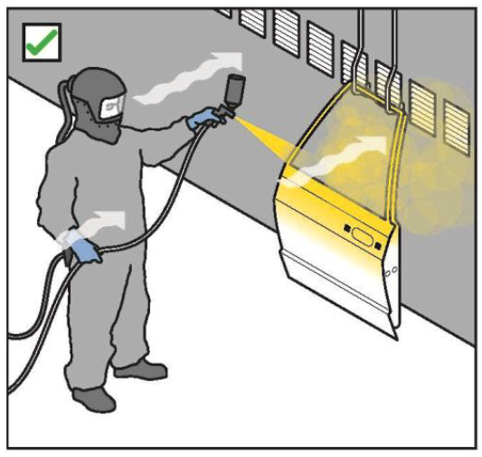
Ventilation

Slide 10
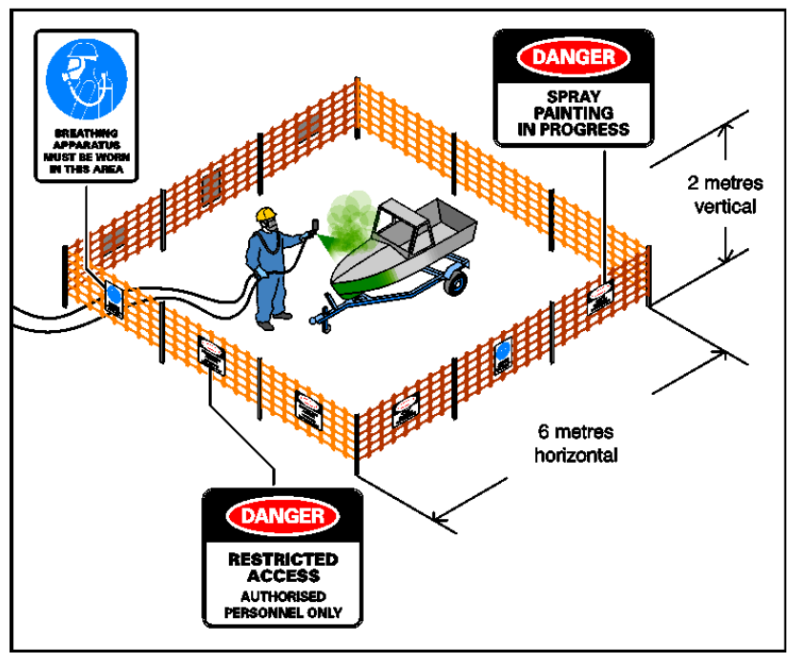
Spray Painting outside a booth
When spray painting outside a spray booth or outdoors, a spray painting exclusion zone should be designated around the area where the spray painting is carried out.

Slide 11
Administrative Controls
Store solvents in covered containers with taps to avoid the need for pouring
With surface preparation:-
- Use wet sanding or rubbing where possible
- Avoid dry sanding unless dust extraction equipment is used
- Do not clean surfaces with rust/corrosion treatments unless there is adequate ventilation.
Mix and pour in a room clearly designated and used exclusively for it with good mechanical or natural ventilation and no ignition sources.

Slide 12
Training
Workers who are involved in spray painting or powder coating activities require relevant information, training, instruction or supervision to enable them to carry out their work safely. For example, this must include information on:
the proper use, wearing, storage and maintenance of personal protective equipment (PPE)
working in hazardous environments such as confined spaces
first aid and emergency procedures
how to access SDSs for workers using, handling or storing hazardous chemicals
the nature of, and reasons for, any health monitoring if required.

Slide 13
Supplied air
To ensure that supplied air is free contaminates, compressors used to provide breathing air must:
Be designed to provide clean breathing air
Have a pressure regulator and filtration system, located as close as practicable to the worker
Have records of regular air quality testing
Be located well away from sources of contaminant, particularly exhaust gases from operating plant, equipment of vehicles, or where exhaust fumes may accumulate
Supplied air hoses must be protected from risk of damage and kinks

Slide 14
Abrasive Blasting
Abrasive blasting is used in a wide range of industries for many different purposes, including the removal of rust, scale, paint, graffiti, mildew, and various forms of surface preparation. Abrasive material is propelled onto the surface at a high speed using air pressure, water pressure or centrifugal force.

Slide 15
Hazards associated with Abrasive Blasting
The major hazards that have been identified as being associated with the activity of abrasive blasting are:
Crystalline silica
Noise
Particulate matter
Lead

Slide 16
Control of dust
Elimination
Using a less hazardous abrasive material
Substitution
Wet abrasive blasting
High pressure water jetting
Centrifugal wheel blasting
Vacuum blasting
Other removal methods

Slide 17
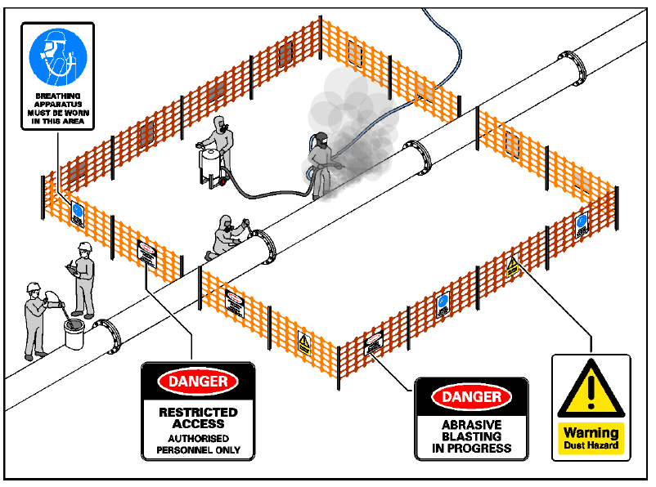
Isolation and Engineering controls

Slide 18
Particulate matter
Particulate matter includes small particles of the object being blasted, or of the abrasive material. Particulate matter can also include water. Particulate matter can strike workers carrying out abrasive blasting.

Slide 19
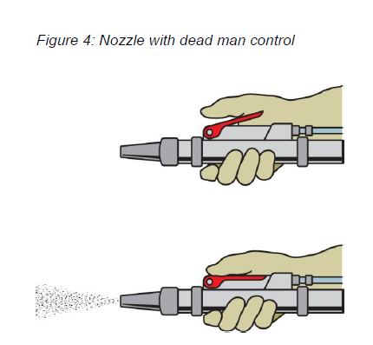
Plant and Equipment
Nozzle
Deadman controls
Blast hoses, Hose whips and couplings
Blasting cabinets
Blasting chambers
Temporary enclosures

Slide 20


