Slide 1
Organising Workplace Information
Leilah Chadburne

Slide 2
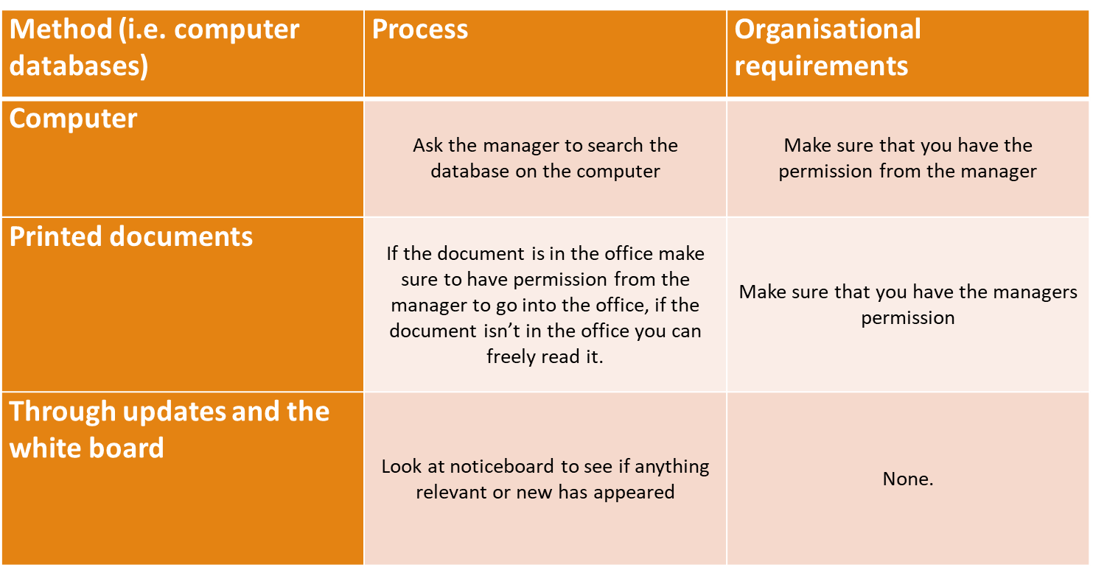
Common Ways You Can Access Information

Slide 3
Collected Information
Once you have collected all information ensure that the information is clear and accurate and relevant to the task that is being done. For example the information needs to be clear and in an ordered way so that someone out of the workplace can read and understand it correctly.

Slide 4
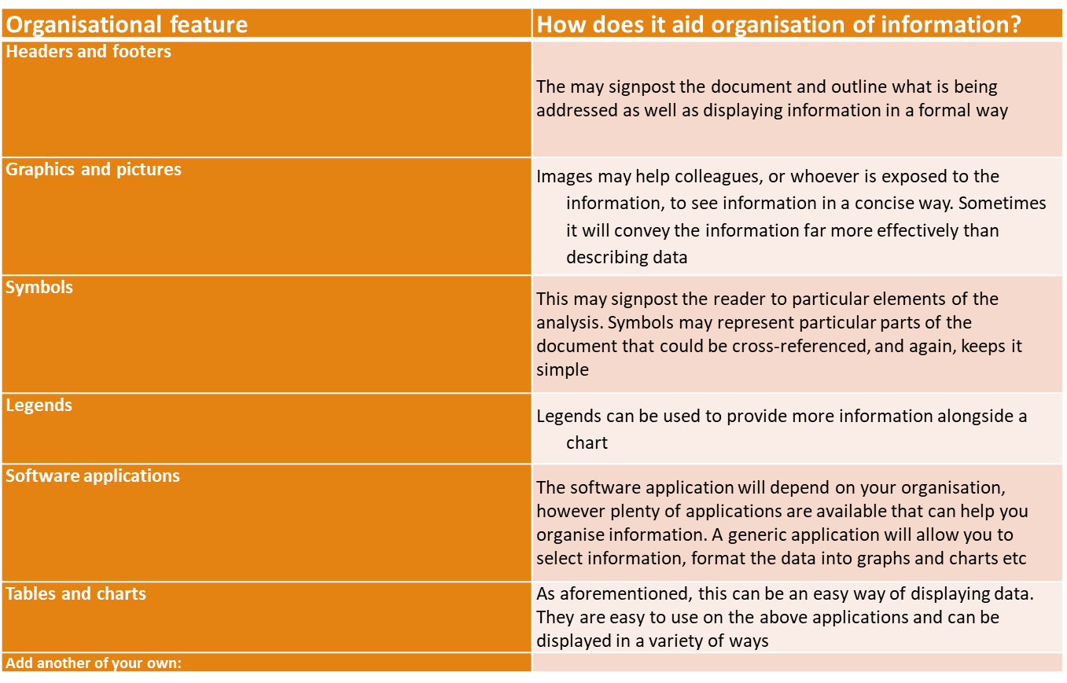
Example of Effective Formats

Slide 5
What is The Purpose of Collating Information
Collating information, in the context of business, is when you bring all sorts of documents and files from all sources and compare, arrange and organise the documents.

Slide 6
Legislation and Regulations
Legislation is synonymous with statutory law; the laws that have been enacted by the legislature as well as those still in the process of being enacted. Self-regulation is when an individual or a business has control over the particulars of how it meets the minimum legislative requirements.

Slide 7
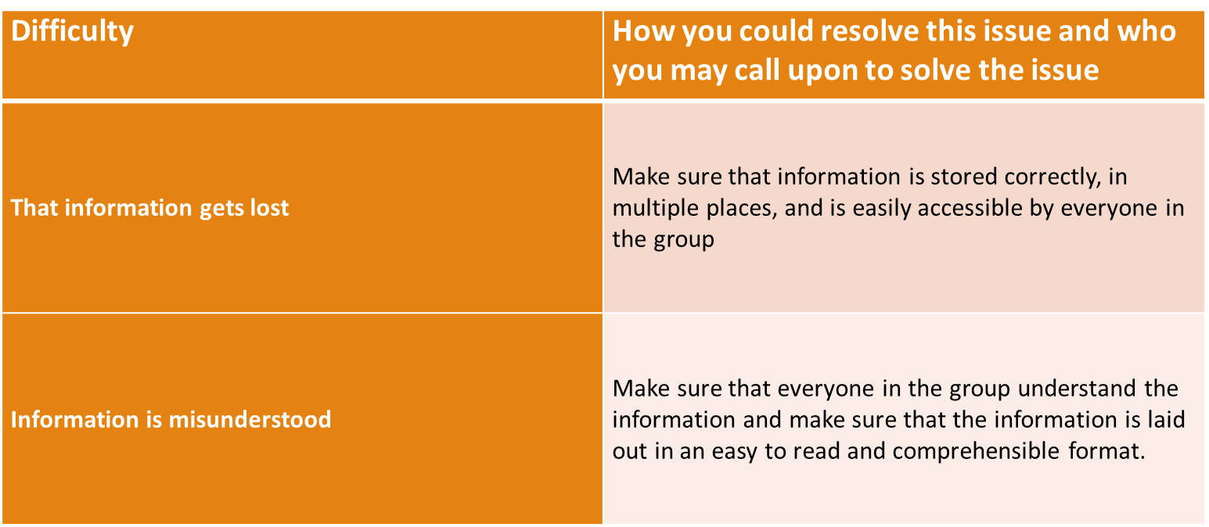
Example Of Possible Difficulties

Slide 8
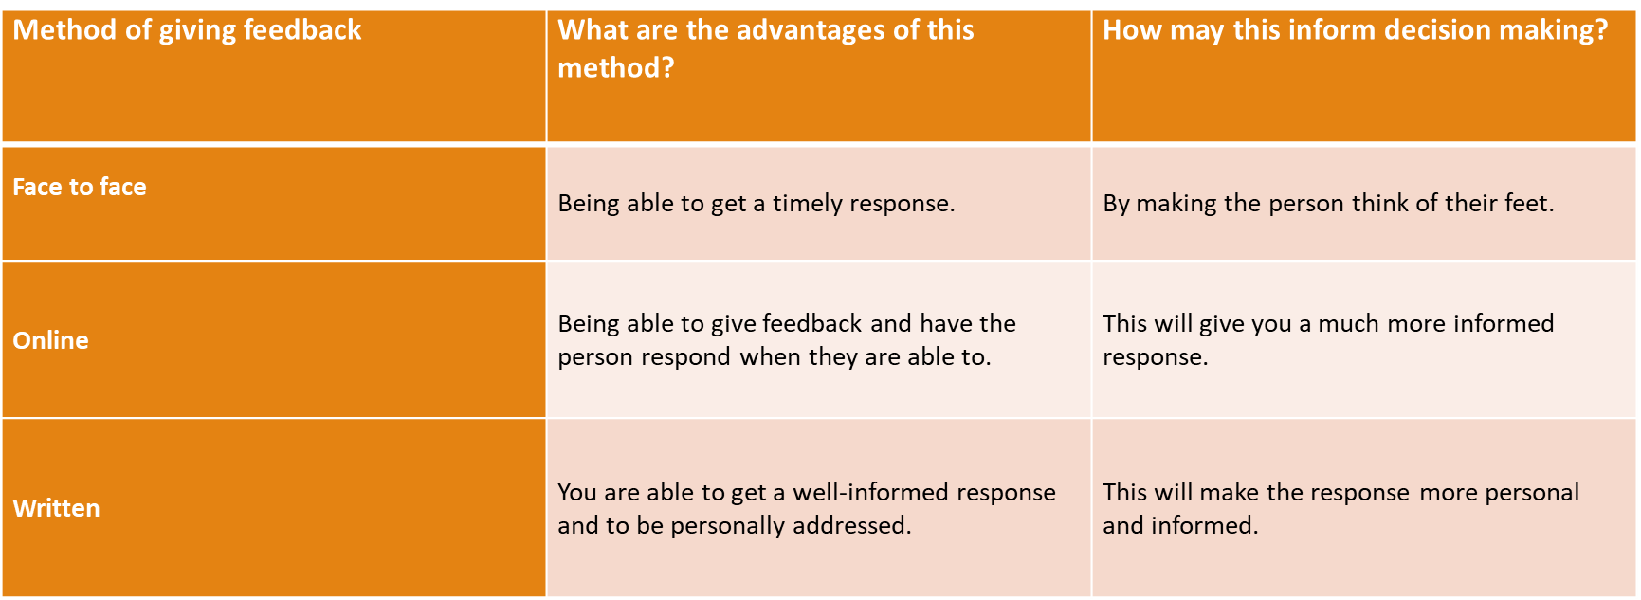
Feedback Opportunities

