Slide 1

CHCECE024
Design and implement the curriculum to foster children’s learning and development

Slide 2

Develop appropriate settings and environments
1.1 Evaluate and modify the learning environment and materials to support all aspects of children’s learning, and promote opportunities for sustained shared thinking and collaborative learning

Slide 3

Learning environment
Combination of social and physical qualities
A learning environment should be:
  safe
  challenging
  stimulating
  interesting
  reflect each child’s needs, interests
  and capabilities.

Slide 4

Learning materials
Should encourage children to investigate and explore
May include:
  rattles
  books
  puzzles
  art materials
  building blocks
  play dough
  dress-up clothes.

Slide 5

Supporting aspects of learning
Aspects of early learning include:
Social and emotional development
  encouraging participation and interaction
Physical development
  using senses, body and muscles
Intellectual development
  language and cognitive development
Spiritual development
  learning about natural world.

Slide 6

Shared thinking
Continually finding a shared interest to find out more
This can be between you and a child or between the children themselves
Promote opportunities for sustained shared thinking by:
  adult modelling/offering your own experiences
  asking open-ended questions
  asking children to elaborate
  making suggestions
  showing genuine interest
  re-capping and clarifying.

Slide 7

Activity 1A

Slide 8
Develop appropriate settings and environments
1.2 Assess and modify the learning environment and materials to ensure that families and the community are respected

Slide 9

Respecting families and communities
Value every person regardless of their background
Reflect the diverse world we live in
Look at each child with interest and openness
Never judge
Build a level of respect for culture and communities
Environment and resources should be relevant to a child’s family, culture and community
Learn about each child.

Slide 10

Materials and activities that can reflect diversity
A dress-up box with a diverse range of options
A variety of musical instruments
A range of foods from around the world
A selection of artwork
Cultural trips and visits
Singing a wide range of songs
Different cooking and eating utensils
A selection of puzzles and books
Recognising appropriate celebrations.

Slide 11

Avoiding stereotypes
Environment/materials should represent diversity within:
Family structures
Gender roles
Cultures
Daily routines
Communities
Body types
Abilities.

Slide 12
Activity 1B

Slide 13
Develop appropriate settings and environments
1.3 Implement learning environment modifications

Slide 14

Questions to ask yourself
Does the environment have resources that will interest each child? Are these accessible?
Does the environment have defined areas?
Does the environment have the necessities?
Do the children have appropriate toilet facilities?
Do you have somewhere for them to eat?
Have you got the space for them to take a nap?
Do you have both active and quiet play areas?
Do any of the children have additional needs?

Slide 15
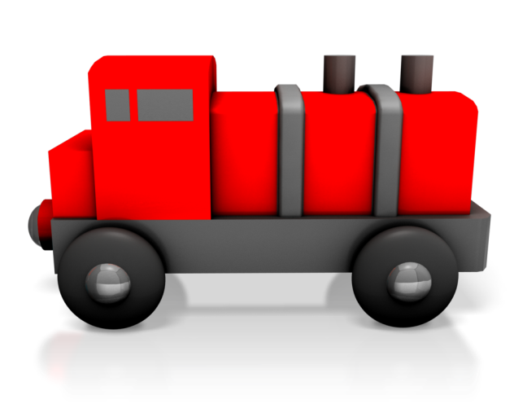
How can you modify the learning environment?
A child has developed an interest in trains – you can get books about trains and a train set to play with
A child is a wheelchair user – you may need to add a ramp or rearrange the layout of environment
A child with a visual impairment – you may need books that are printed in large letters or braille
A child is being breastfed – you may need a private area for the mother to come in and
feed their child.

Slide 16

General tips
Have clear, defined areas for different activities (e.g. play/work/eat/sleep)
Allocate places for different materials and toys within the correct areas
Ensure that these resources are accessible by everyone
Consistently return materials to proper space
Arrange furniture safely (e.g. not placed haphazardly)
Avoid clutter
Use curtains and blinds to control light.

Slide 17
Activity 1C

Slide 18
Develop appropriate settings and environments
1.4 Promote an appreciation of the natural environment

Slide 19

The natural environment
Children will benefit from a stimulating outdoor environment
Supports spiritual aspect of learning
Provides children with range of sensory experiences
Children want to learn about the world
When outdoors, children can observe, touch, smell and hear a variety of new things.

Slide 20

Incorporating natural environment
Incorporate things into outdoor area, including:
  plants and flowers
  water
  sand
  dirt
Incorporate nature into trips:
  an interest in sand could inspire a trip to the beach
  an interest in trees could inspire a trip to nearby woodlands.

Slide 21

Bringing natural environment indoors
Aspects of natural environment that can create possibilities for learning include:
Rainbows/clouds
Puddles/shadows
Water
Plants and flowers
Animals, insects and birds
Fruits and vegetables.

Slide 22
Activity 1D

Slide 23
Design and implement curriculum in consultation with others
2.1 Consult with children and families to assist in reflecting on the current curriculum and learning environments and identify current strengths and goals

Slide 24

Reflecting on current curriculum and learning environment
Need to reflect on current curriculum before developing a new one
What works?
What doesn’t?
May need to consult with children and their families
Make it clear you welcome opinions/suggestions
Encourage families to work with
you to provide best possible
learning environment.

Slide 25

Gaining feedback
From families:
  monthly meetings (one-to-one or as a group)
  having a suggestions box
  sending out forms
  making phone calls/sending out emails
From the children:
  smiley/sad faces to indicate if they enjoyed activity
  monthly meeting asking them what they want to learn about next.

Slide 26

Strengths and goals
Identify what’s working and what isn’t
Good starting point for designing new curriculum
Build on strengths
Turn weaknesses into goals
E.g. families may be concerned that their children spend too much time indoors – think
about how you can create a curriculum
that facilitates outdoor play and learning.

Slide 27
Activity 2A

Slide 28
Design and implement curriculum in consultation with others
2.2 Design and implement curriculum that reflect the philosophy of the service

Slide 29

Curriculum must…
Be based on children’s needs and interests
Promote health and safety of children
Encourage equality of opportunity
Cover all aspects of a child’s learning and development
Involve parents, visitors and other professionals
Refer to the early learning goals
Support needs (e.g. special educational needs)
Be appropriate, enjoyable and varied.

Slide 30

Approaches to planning curriculum
The different approaches to planning curriculum include:
Structured
Unstructured
Experiential
Thematic.

Slide 31

Framework for designing curriculum
This framework includes:
Key components
Interactive processes for curriculum decision making
Contexts for learning
Early learning areas
Phases that describe children’s learning
and development.

Slide 32

Example activities
Here are some example activities that you can incorporate into the curriculum:
Simple bingo
Name game
My favourites
The alphabet song
Treasure hunting.
Think about some of your examples.

Slide 33
Activity 2B

Slide 34
Design learning experiences to foster children’s learning and development
3.1 Collect data on each child

Slide 35

Information you may want to find out about each child
What they do and don’t enjoy learning about
The new things that they would like to learn about
What toys they like do and don’t playing with
The new toys that they would like to play with
What they are good at/what they struggle with
How they learn best
How they interact with the other children
What their family life is like
Any particular interests.

Slide 36

Key reference points for data collection
Early Years Learning Framework’s five learning outcomes:
Children have a strong sense of identity
Children are connected with and contribute to their world
Children have a strong sense of wellbeing
Children are confident and involved learners
Children are effective communicators.

Slide 37

Data collection
Many ways to collection information
Combination of quantitative and qualitative methods
For example:
    discussing with families
    asking children themselves
    observing children.

Slide 38

Ethical issues
Ensure confidentiality
Ensure privacy
Consider the perspective of each child
Gain written consent from families
Gain consent of child (age dependent).

Slide 39
Activity 3A

Slide 40
Design learning experiences to foster children’s learning and development
3.2 Analyse data collected to identify each child’s interests, strengths and goals in conjunction with the approved learning framework

Slide 41

Analysing data
Information needs to be manageable
Could create a portfolio for each child
Gathering information is not enough
Needs to be used correctly
Should reflect on what you found and what you can change
Examine what you have found and
ask yourself a range of questions.

Slide 42

Identifying interests, strengths and goals
After analysing information you should be able to identify each child’s interests, strengths and weaknesses (turned into goals)
Information can help design and implement curriculum to reflect these interests, abilities and strengths
Help generate new ideas and improvements
Elsie’s example – how could you improve
her learning experience?

Slide 43
Activity 3B

Slide 44
Design learning experiences to foster children’s learning and development
3.3 Clarify specific objectives, learning environment, role of the educator and assessment/evaluation methods and evidence using the approved framework’s learning outcomes, principles and practices

Slide 45

Early Years Learning Framework
Provides you with a framework you can use to make decisions and build your own curriculum
Learning outcomes aim to capture complex learning and development of all children
Principles and practices have a dynamic
relationship
Principles underpin the practices
Need to clarify objectives, learning
environment, role of educator and assessment/evaluation methods.

Slide 46

Objectives
How can you incorporate framework into objectives?
Common objectives include developing:
  reading and writing skills
  language and communication
  social skills
  attention skills
  well-being
  positive attitudes.

Slide 47

Learning environment
How can you incorporate framework into learning environment?
Important influence on achievement
Sum of emotional, indoor and outdoor environment
It should:
  cater for different learning styles and capacities
  be safe and welcoming
  enable exploration
  encourage play-based learning.

Slide 48
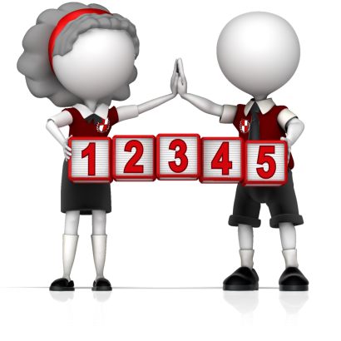
Role of educator
Use framework to think about role of educator
What does it involve?
An educator will need to:
  develop partnerships with families
  be responsive to strengths, abilities and interests
  build on existing knowledge and skills
  be culturally competent.

Slide 49

Assessment and evaluation
How well is each child doing?
What can they do?
What do they know?
A combination of observing them, asking them questions and consulting with their family should provide you with an overview of how they are getting on.

Slide 50
Activity 3C

Slide 51
Design learning experiences to foster children’s learning and development
3.4 Design learning experiences to foster holistic learning and to provide continuity of learning and transitions

Slide 52

Holistic learning
Process enabling children to learn more effectively
Doesn’t force learning
Goal is to create webs of information that link together
Constructs an underlying understanding
Focuses on complete well-being of child, rather than traditional milestones of academic development
Recognises connectedness of mind, body
and spirit.

Slide 53

Holistic learning pays attention to:
Cognitive aspects of learning
Spiritual wellbeing
Personal wellbeing
Social wellbeing
Physical wellbeing
Emotional wellbeing.

Slide 54

Designing learning experiences
Children learn best through hands-on experiences
Need opportunities to explore, discover and investigate world around them
Should be based on children’s interests
Many ways to design learning experiences to foster holistic learning, for example:
  art activities
  imaginative play
  physical play.

Slide 55

Continuity of learning
Uninterrupted flow of learning
Provides sense of stability for children
Need to provide children with connected learning
Routine shouldn’t be too rigid
Repetition it key – more meaningful learning
Not too much change
Allow children to decide when they
are finished.

Slide 56

Continuity of transitions
Examples of transitions:
Between home and the service
Between the baby area, the toddler area, the kindergarten area and school
Between different home settings
A new addition or loss in the family
Between everyday routines (e.g. play time,
to lunch time, to reading time).

Slide 57
Activity 3D

Slide 58
Design learning experiences to foster children’s learning and development
3.5 Plan for ways to monitor and assess children’s learning, consistent with the principles and practices of the approved framework, ensuring that both planned and unplanned experiences are considered for assessment

Slide 59

Monitoring and assessing children’s learning
Assessment can improve outcomes for children
It can help educators to:
  plan effective future learning
  identify children who may need additional support
  determine how children are progressing
  identify anything that may be impeding progress
  evaluate the effectiveness of learning opportunities and environment.

Slide 60

Categories of assessment
There are three different categories when it comes to assessment in a learning environment.
They are:
  assessment for learning
  assessment of learning
  assessment as learning.

Slide 61

Planned and unplanned experiences
Planned experiences:
  experiences you plan in order to manage learning process
  usually goal-directed or outcome-directed
  you have idea about how children can achieve the particular outcome
Unplanned experiences:
  usually a by-product of other experiences
  can take place without specific learning
  goals or outcomes.

Slide 62
Activity 3E

Slide 63
Implement learning experiences to foster children’s learning and development
4.1 Ensure that required materials are identified and available at time of implementation
4.2 Set up the physical learning environment

Slide 64

Required materials
Need to ensure that the materials you require are available at the time you need them
Plan your daily activities and list any materials that you will need
For example, what materials will be needed for an art project?
  paper
  glitter
  glue
  paint.

Slide 65
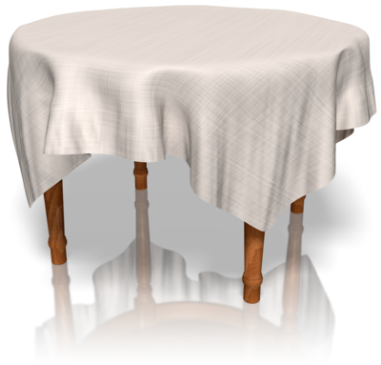
Setting up learning environment
How would you need to alter the physical learning environment to allow for your planned daily activities?
For example, puppet making:
  need sufficient space
  joining tables
  arranging baskets of materials
  creating a makeshift stage area.

Slide 66
Activity 4A

Slide 67
Implement learning experiences to foster children’s learning and development
4.3 Co-construct meaning with children and ensure there are sustained interactions

Slide 68

Co-construction
Children construct their learning by actively engaging in and shaping their experiences and environments
You need to interact with children
Co-construction is the process of educator and child working in partnership to develop learning experiences and their meaning.

Slide 69

Aims of co-construction
To break down traditional roles, creating an environment in which the teaching and learning process merge
To ensure that prior learning is the starting point for further learning
To allow children to take risks with their learning
To get children to use communication and learning modes in a way they don’t normally
To develop skills needed to become an
independent learner and to take ownership
of their own learning.

Slide 70
Activity 4B

Slide 71
Implement learning experiences to foster children’s learning and development
4.4 Model and promote enabling learning dispositions

Slide 72

Learning dispositions
Combination of learning inclinations, specific behaviours, interests, values and attitudes that will enable and support a child’s learning
Develop these positive enabling learning dispositions through interactive experiences with the learning environment
As an educator, it is your role to model
and promote them.

Slide 73

Examples of learning dispositions
Persistence
Curiosity
Playfulness
Collaboration
Concentration
Resilience
Creativity
Being brave
Reciprocity.

Slide 74

Modelling and promoting learning dispositions
Example: persistence
In order to foster and promote persistence, you should promote the children’s self-confidence by supporting and encouraging their achievements
You should use sustained shared thinking in order to support any questions the children may
have along with asking meaningful
questions of your own.

Slide 75
Activity 4C

Slide 76
Implement learning experiences to foster children’s learning and development
4.5 Monitor and reflect on children’s learning and own pedagogical practices and continuously refine

Slide 77

Monitoring and reflect on children’s learning
Process of monitoring and reflecting on children’s learning is important in ensuring their learning experiences are the best they can be
When reflecting on the children’s learning you should identify the areas that have proved successful and those that haven’t
You can highlight any necessary
changes that are needed in order
to improve the children’s learning.

Slide 78

Gathering information
Many different ways to gather information, including:
Making observations
Taking notes
Rating scales
Capturing images
Collecting samples of work
Recording interviews.

Slide 79

Pedagogical practices
Pedagogy isn’t just about teaching
It is the process of accompanying learners, caring for and about them and bringing learning into life
Pedagogical practices are the activities that you design and carry out that will enhance overall learning experiences
Practices should be directed at needs of the children
Practices should be based on strong
evidence and research.

Slide 80
Activity 4D

Slide 81
Assess and evaluate planned and unplanned teaching and learning
5.1 Use or establish opportunities to gather feedback from families and children

Slide 82

Gathering feedback
The key sources of evidence will come from those that are closely linked with the service; i.e. the children and their families
Use opportunities that arise to ask for feedback
If opportunities do not arise, establish them.

Slide 83

Gathering feedback from families
In order to gather feedback from the children’s families you could:
Organise family events
Encourage informal daily contacts
Send out periodic questionnaires
Draw on their responses in a
time of concern.

Slide 84

Gathering feedback from children
There are many ways to gather feedback from children, including:
Watching and listening to them play
Talking in small groups
One-to-one discussions whilst you are working with them.

Slide 85
Activity 5A

Slide 86
Assess and evaluate planned and unplanned teaching and learning
5.2 Collect data using a range of methods in order to assess and evaluate teaching and learning, both planned and unplanned, using approved frameworks
5.3 Ensure assessment and evaluation of the curriculum and learning experiences are regular and in accordance with service guidelines

Slide 87

Assessing and evaluating teaching and learning
Key stages of curriculum development
Can help you identify how effective the teaching/learning process has been
Teaching and learning occur in a variety of ways so assessment and evaluation will also need to be varied
Don’t just focus on end points; what about the journey?
Recognise small steps of achievement.

Slide 88

Collecting data
Ongoing process
Interpret children’s learning against learning outcomes
Methods should match curriculum and can include:
  interviews/questionnaires
  discussions
  self-assessment/reflection
  observations
  feedback.

Slide 89

Assessing and evaluating the curriculum and learning experiences
Regularly assess and evaluate the curriculum as a whole
Draw on all the other assessments you have made
Does it produce the desired outcomes?
How can it be improved?

Slide 90
Activity 5B

Slide 91
Assess and evaluate planned and unplanned teaching and learning
5.4 Use assessment and evaluation to influence the design of future curriculum and learning experiences

Slide 92

Future design
Developing a curriculum is a continuous process in which reflection is key
After assessing and evaluating all aspects of your service, you will be able to identify areas that need improvement
This can help to design the future curriculum and learning experiences.

Slide 93

Ask yourself:
What’s working?
What’s not working?
What could be improved?
Is there anything that is being over-used?
Is there anything that is being overlooked?

Slide 94
Activity 5C

Slide 95
Summative Assessments
Summative assessments consist of:
Skills Activity
Knowledge Activity
Performance Activity.
Your assessor will provide you with further guidance on how and where to complete these assessments.

Slide 96

Summary and Feedback
Did we meet our objectives?
How did you find this session?
Any questions?

