Slide 1

BSBREL401
Establish networks

Slide 2

Housekeeping
Emergency procedures
Mobiles, security issues
Break times / smoking policy
This course is “interactive” – ask questions
Respect, confidentiality, practice
Ground rules

Slide 3
Housekeeping
Emergency procedures
Mobiles and security issues
Break times and smoking policy
This course is interactive – ask questions
Practise respect and confidentiality
Ground rules

Slide 4
Objectives
Identify how to develop and maintain business networks
Determine how to establish and maintain business relationships
Demonstrate how to promote the relationship
Gain the skills and knowledge required for the unit

Slide 5

Develop and maintain business networks
1.1 Use appropriate network strategies to establish and maintain relationships that promote the development of business opportunities

Slide 6

Network strategies
Association memberships
Conference participation
Distributing materials
Individual marketing
Maintaining regular contact
Seminar attendance.

Slide 7

Develop and maintain business networks
Series of activities...
Identify your networking purpose
Identify your networking goals
Determine the most appropriate network.

Slide 8

Method of contact
Letter
Email
Online, e.g., LinkedIn or other professional forums
Face to face meeting
Telephone call
Social gathering.

Slide 9
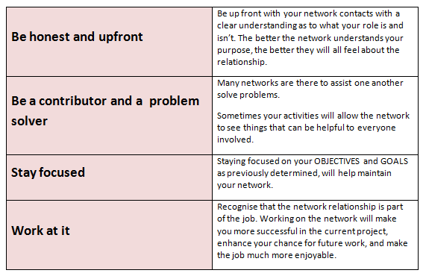
Choose your approach

Slide 10
Activity 1A

Slide 11
Develop and maintain business networks
1.2 Identify and pursue network opportunities to maximise a range of contacts

Slide 12

What are networking opportunities?
Who runs them?
How do I get to attend these events?
What are the key benefits of these events?
How to get the most out of networking events?

Slide 13
Develop and maintain business networks
1.3 Communicate information regarding new networks to inform individuals, colleagues and clients of potential benefits

Slide 14

Determine who to communicate to
Individuals
Colleagues
Clients.
Customers
Users
managers
And various stakeholders.

Slide 15

Communication needs of each stakeholder
For each of the individuals or stakeholders identified previously, you will need to establish what their communication needs are.

Slide 16

How to fulfil the communication needs of each stakeholder
Communicating the potential benefits of the network
Some of the networking activities might be relatively easy
Estimate the time involvement over a one month period.
Some networking activities provide more value than others.

Slide 17
Activity 1B

Slide 18
Develop and maintain business networks
1.4 Participate in professional networks and associations to obtain and maintain personal knowledge and skills

Slide 19

Professional networks and associations
Advisory committees
Colleagues
Committees
Government agencies
Internal / external customers
Lobby groups
Local inter-agency groups.

Slide 20
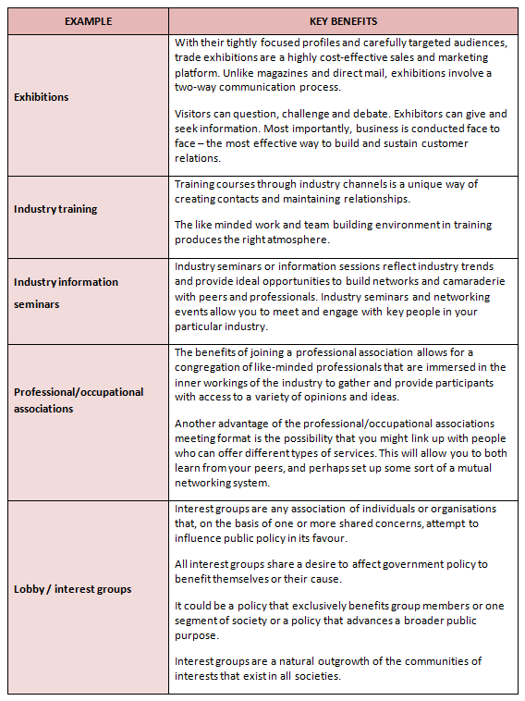

Slide 21
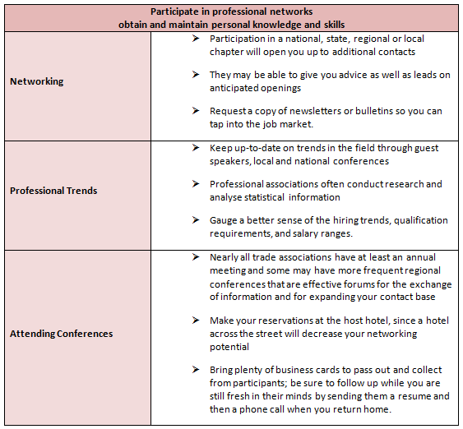
Being selective

Slide 22
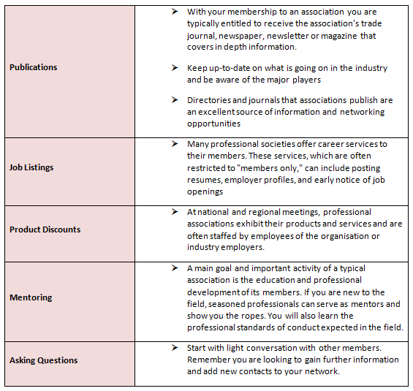
Being selective

Slide 23
Activity 1C

Slide 24
Establish and maintain business relationships
2.1 Develop and maintain relationships to promote benefits consistent with organisational/client requirements
2.2 Gain and maintain trust and confidence of contacts through demonstration of high standards of business practices

Slide 25

Organisational / client requirements
Access and equity principles and practices
Defined resource parameters
Ethical standards
Goals, objectives, plans, systems and processes.

Slide 26

Organisational / client requirements
Legal and organisational policies
Marketing plan
Occupational health and safety policies
Quality and continuous improvement
Quality assurance and / or procedures manuals.

Slide 27

Develop and maintain relationships
Two objectives are present here:
  Develop and maintain relationships
  Promote benefits.

Slide 28

Business relationship skills
It begins with your initial contact with clients and customers.

Slide 29

Communication styles
By understanding a person's communication style can lead to respect not conflict. This is after all what you are trying to achieve in maintaining relationships. All people do not communicate in the same manner.

Slide 30

The best business relationships
The best business relationships usually come from repeat business
Once you have established a relationship with a customer or client, don’t let the relationship end
Take it to the next level.

Slide 31

Establish and maintain business relationships
Learning styles
Values
Boundaries
Company culture
Culture of the country.

Slide 32
Activity 2B

Slide 33
Establish and maintain business relationships
2.3 Use a high level of negotiation skills to encourage positive outcomes
2.4 Identify difficult situations and negotiate solutions using collaborative problem-solving techniques

Slide 34

Why negotiate?
If we all got what we wanted, when we wanted it and how we wanted it there would be no need for us to negotiate. However, that is not the way it works in life or business.

Slide 35

Active listening
This is a key skill that helps you to understand the other party’s needs, explore ideas, identify possible options for agreement, test your understanding to avoid confusion and achieve a genuine and workable agreement.

Slide 36

Gain the power of negotiation
If you enter negotiations with arguments intended to persuade the other party of the legitimacy of your position you give away your power.

Slide 37

Being well prepared
Explore and understand your needs and motivations
Consider all elements and views on an issue
Predict others points.

Slide 38

Getting started
One of the first steps is to use a negotiation preparation worksheet. This is much a responsibility of the organisation as well as the person or group responsible for the negotiation.

Slide 39

Maximise your leverage
How much do you want or need the deal, how much does your counterpart want or need the deal?
What are the alternatives for each party if you don’t reach an agreement?
How can you strengthen your leverage and weaken your counterpart’s leverage?
Are you using your leverage appropriately?

Slide 40

Know what you want and focus on goals
Instead of focusing on your position in a negotiation it may be more useful to focus on what you want to achieve from the relationship. By doing this you open up an opportunity for other possible solutions to resolve the issue.

Slide 41

Employ fair and objective criteria
Fairness is a key element of negotiating. Fairness boils down to objective standards like market value, precedent, efficiency, costs/profits, or expert opinion. Standards help customers objectively determine the value you provide.

Slide 42

Negotiating
Remember win / win outcomes are the best outcomes as they take relationships forward by achieving agreements that meet the interests of both parties.

Slide 43

Recognise exceptions
When you are in this situation, it is important to maintain your self control.

Slide 44

Establish and maintain business relationships
Some common mistakes
Identifying dirty tricks
Examples of dirty tactics
Dealing with dirty tricks

Slide 45

In all organisations negotiation skills are required at every level
Between you and your customers
Between you and your staff
Between you and your CEO
Between you and various departments.

Slide 46
Establish and maintain business relationships
2.5 Seek specialist advice in the development of contacts where appropriate

Slide 47

The specialist
Are experts in their speciality
Easier time selling their services
Can charge more
Have no “filler” services to pick up the slack when work slows down
They limit their ability to expand their business.

Slide 48

Doing it yourself?
This involves doing the ground work yourself or just using associates as described earlier... but not engaging a specialist in the sense of a consultant.

Slide 49

Using an agent for specialist advice on contacts
Agents can be particularly useful
Businesses usually appoint agents
Many businesses use agents to access domestic and overseas markets
This may play a realistic role in the development of contacts.

Slide 50

The specialist in social media contacts
Outsourcing or using some form of specialisation for your development of contacts in social media marketing can be a wise decision.

Slide 51

Specialist areas of technology in the development of contacts
There are a few major areas in which technology now is able to help provide key advantages to businesses in engendering customer loyalty by improving customer service and/or the development of contacts.

Slide 52
Activity 2C

Slide 53
Promote the relationship
3.1 Develop strategies to represent and promote the interests and requirements of the relationship

Slide 54

Being informed
Email messages, newsletter and surveys
Provide product / service updates
Promote goods and services
Communicate news / events.

Slide 55

Being informed
Feedback
Insight
Customer loyalty
Relationship building
Be accessible
Customer satisfaction
Involvement
Anticipate customer needs
Become an indispensable resource
Help lines

Slide 56
Promote the relationship
3.2 Use appropriate presentation skills to communicate the goals and objectives of the relationship
3.3 Effectively communicate issues, policies and practices of the relationship to a range of audiences, in writing and verbally

Slide 57

Formal and appropriate presentation skills
The starting point in planning any form of presentation is to formulate a precise objective
It is far more productive to achieve one goal from your presentation
Consider the audience profile of your ‘relationship’.

Slide 58

All presentations should have a clear structure or format
If you do not place your thoughts in order for presenting them the audience will not be able to follow,
Having established the order of your presentation you should choose the most appropriate structure to achieve it.

Slide 59

Sequential argument
‘Sequential Argument’, which simply means a series of linked or sequential statements leading to a conclusion.
However, the ‘simplicity’ can only be achieved by careful and deliberate connection between each section.
Give the audience reminders of the main point as each new section is linked.

Slide 60

Get their attention
Too often in a presentation of any format, the first few minutes are lost while people adjust their coats, drift in with coffee and finish the conversation they were having with the person next to them.

Slide 61

Establish your theme
Be quick and to the point on the subject matter of your presentation.
This can be done by a statement of your main objective, unless for some reason you wish to keep some surprise element of it a secret.
Most professional business audiences will have some experience or opinions on relationships.

Slide 62

Present a structure
Explain the structure briefly at the beginning, then the audience will know what to expect.
This can help to establish the theme and also provide something concrete to hold their attention.
Ultimately, it provides a sense of security in the promise that this speech too will end.

Slide 63

Create a rapport
Just like communicating the goals and objectives of a relationship you must win the audience over in the first minute as well.
Plan exactly how you wish to appear to them and use the beginning to establish that relationship.
You may be presenting yourself as their friend, as an expert, perhaps even as a judge.

Slide 64

Administration
When planning your presentation you should make a note to find out if there are any administrative details
This is not simply to make yourself popular with the people organising the session but also because if these details are over looked.

Slide 65

Using visual aids
Should you choose to use a form of visual aid presentation, like PowerPoint or similar, there are some fundamental guides to this as well.

Slide 66

Presentation Styles
Appearance
Stance

Slide 67

The Ending
The final impression you make on the audience is the one they will remember.
As with the beginning, it is necessary first to get their attention, which will have wandered.
One of the greatest mistakes is to tell the audience that this is going to be a summary because at that moment they simply switch off.
The ending can be a flourish.

Slide 68
Activity 3A

Slide 69
Promote the relationship
3.4 Obtain feedback to identify and develop ways to improve promotional activities within available opportunities

Slide 70

Feedback
Ask for, capture and act on your customer’s feedback.

Slide 71
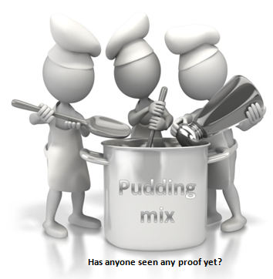
Promote the relationship
Guidelines to effective business feedback...
Ultimately, the proof is always in the pudding.

Slide 72
Activity 3B

Slide 73

Skills and Knowledge Activity

Slide 74
Major Activity
This activity should take 1-2 hours to complete and can be found at the end of your workbook.
Your instructor will let you know whether they wish for you to complete it in session time or your own time.

Slide 75

Summary and Feedback
Did we meet our objectives?
How did you find this session?
Any questions?

Slide 76

Congratulations!
You have now finished the unit…
‘Establish networks’

