Slide 1

SCAFFOLDING
WORK HEALTH AND SAFETY OFFICER

Slide 2
Assessment criteria
Describe the requirements under the Work Health and Safety legislation for scaffolding used within the workplace.
List the hazards that are associated with the erection, use and dismantling of scaffolding.
Describe the control measures that could be implemented to eliminate or minimise the risks associated with these hazards.

Slide 3
Definition
WHS Regulation 2011 schedule 19:
scaffolding means a temporary structure specifically erected to support access or working platforms.
A ‘temporary structure’ refers to scaffolding that can be assembled and disassembled, for example, modular scaffolds, hanging bracket scaffolds, tube and coupler scaffolds and mobile scaffolds.

Slide 4
Types of Scaffold
Independent
An independent scaffold consists of two or more rows of standards connected longitudinally and transversely.
Bird Cage
A birdcage scaffold is an independent scaffold that consists of more than two rows of standards in both directions and is connected by ledgers and transoms.
It is mainly used for work that is to be carried out on a single level, such as ceilings.

Slide 5
Types of Scaffold
Tower
A tower scaffold is an independent scaffold consisting of four vertical members connected longitudinally and transversely.
Mobile
A mobile scaffold is an independent scaffold that is freestanding and mounted on castors.

Slide 6
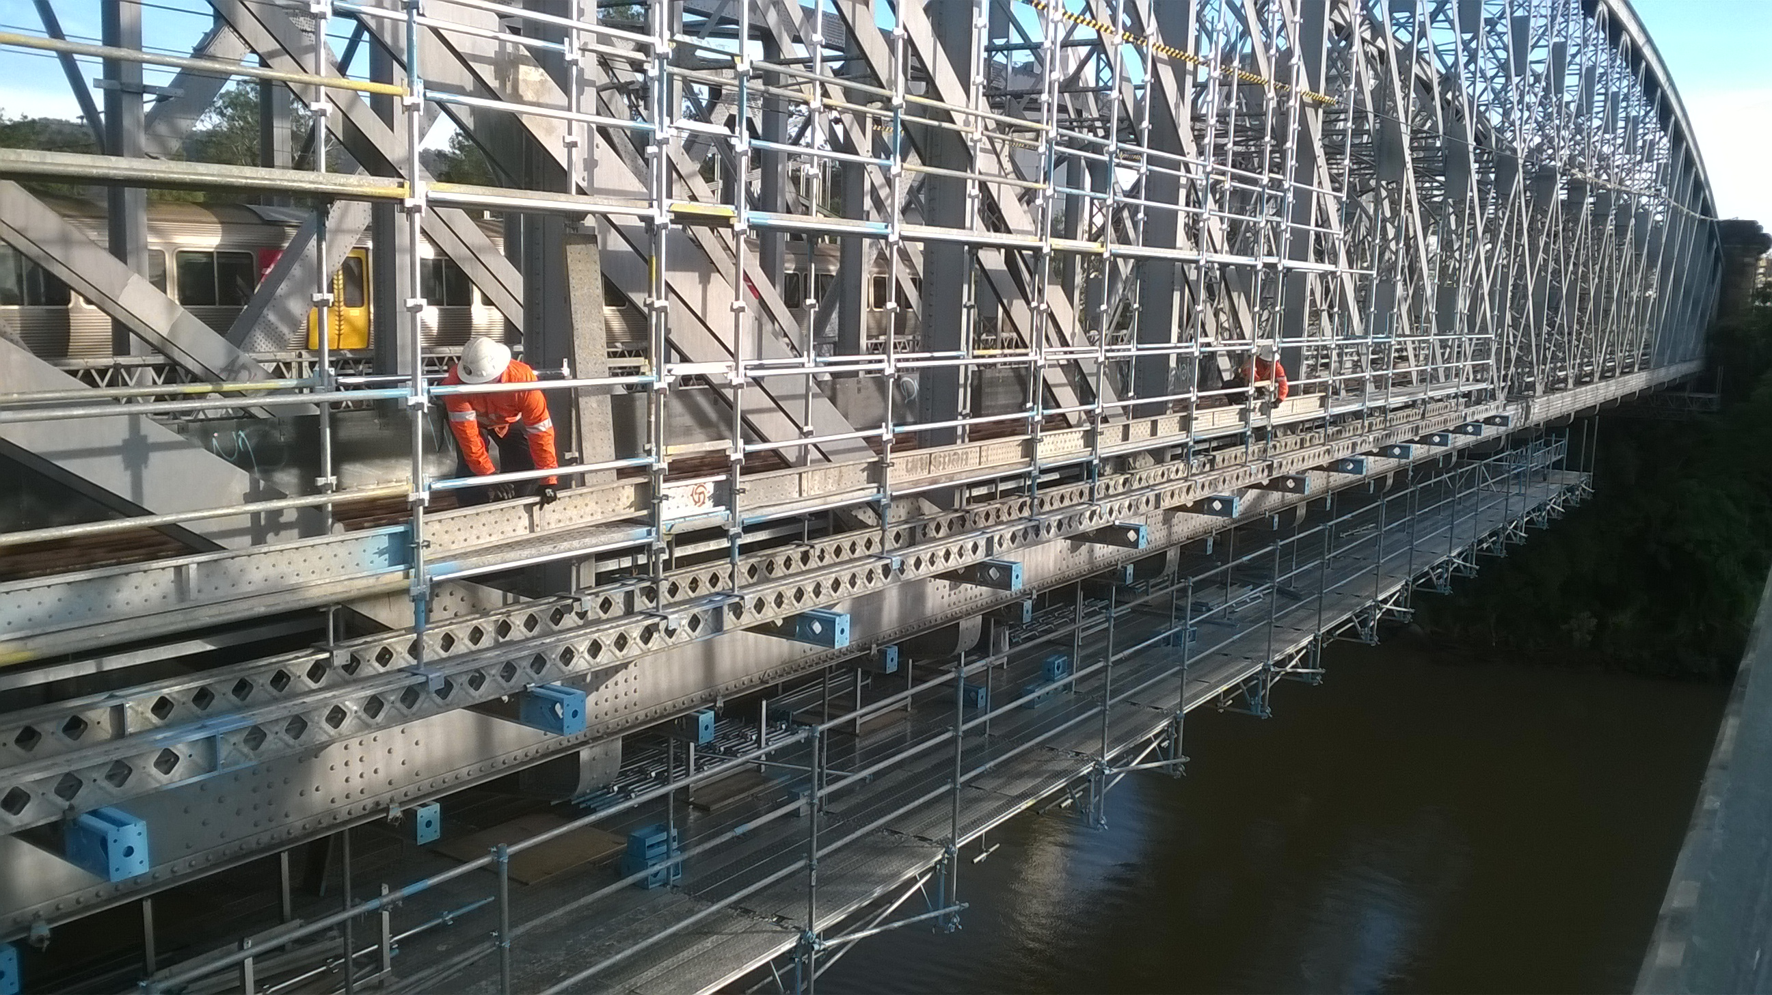
Types of Scaffold
Hung
A hung scaffold is an independent scaffold that hangs from another structure, but is not capable of being raised or lowered when in use.

Slide 7
Legislation
High risk work licence
Safe work method statements
Written confirmation from competent person before scaffold erected
Inspection by a competent person
Unauthorised access
Erecting scaffolding
Dismantling scaffolding
Notifiable incidents

Slide 8
Definitions
Scaffolding means a temporary structure specifically erected to support access or working platforms.
Scaffolding Work means erecting, altering or dismantling a temporary structure that is or has been erected to support a platform and from which a person or object could fall more than 4m from the platform or the structure.

Slide 9
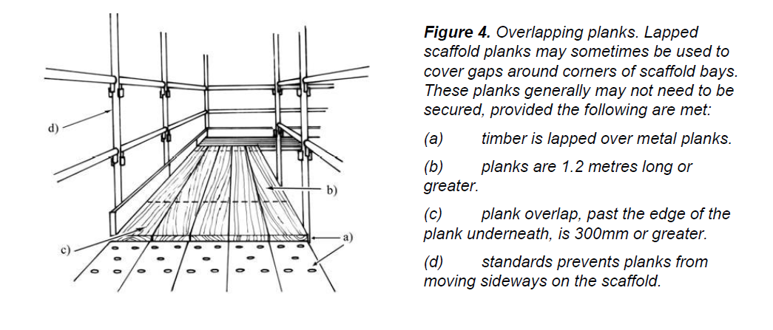
Planks

Slide 10
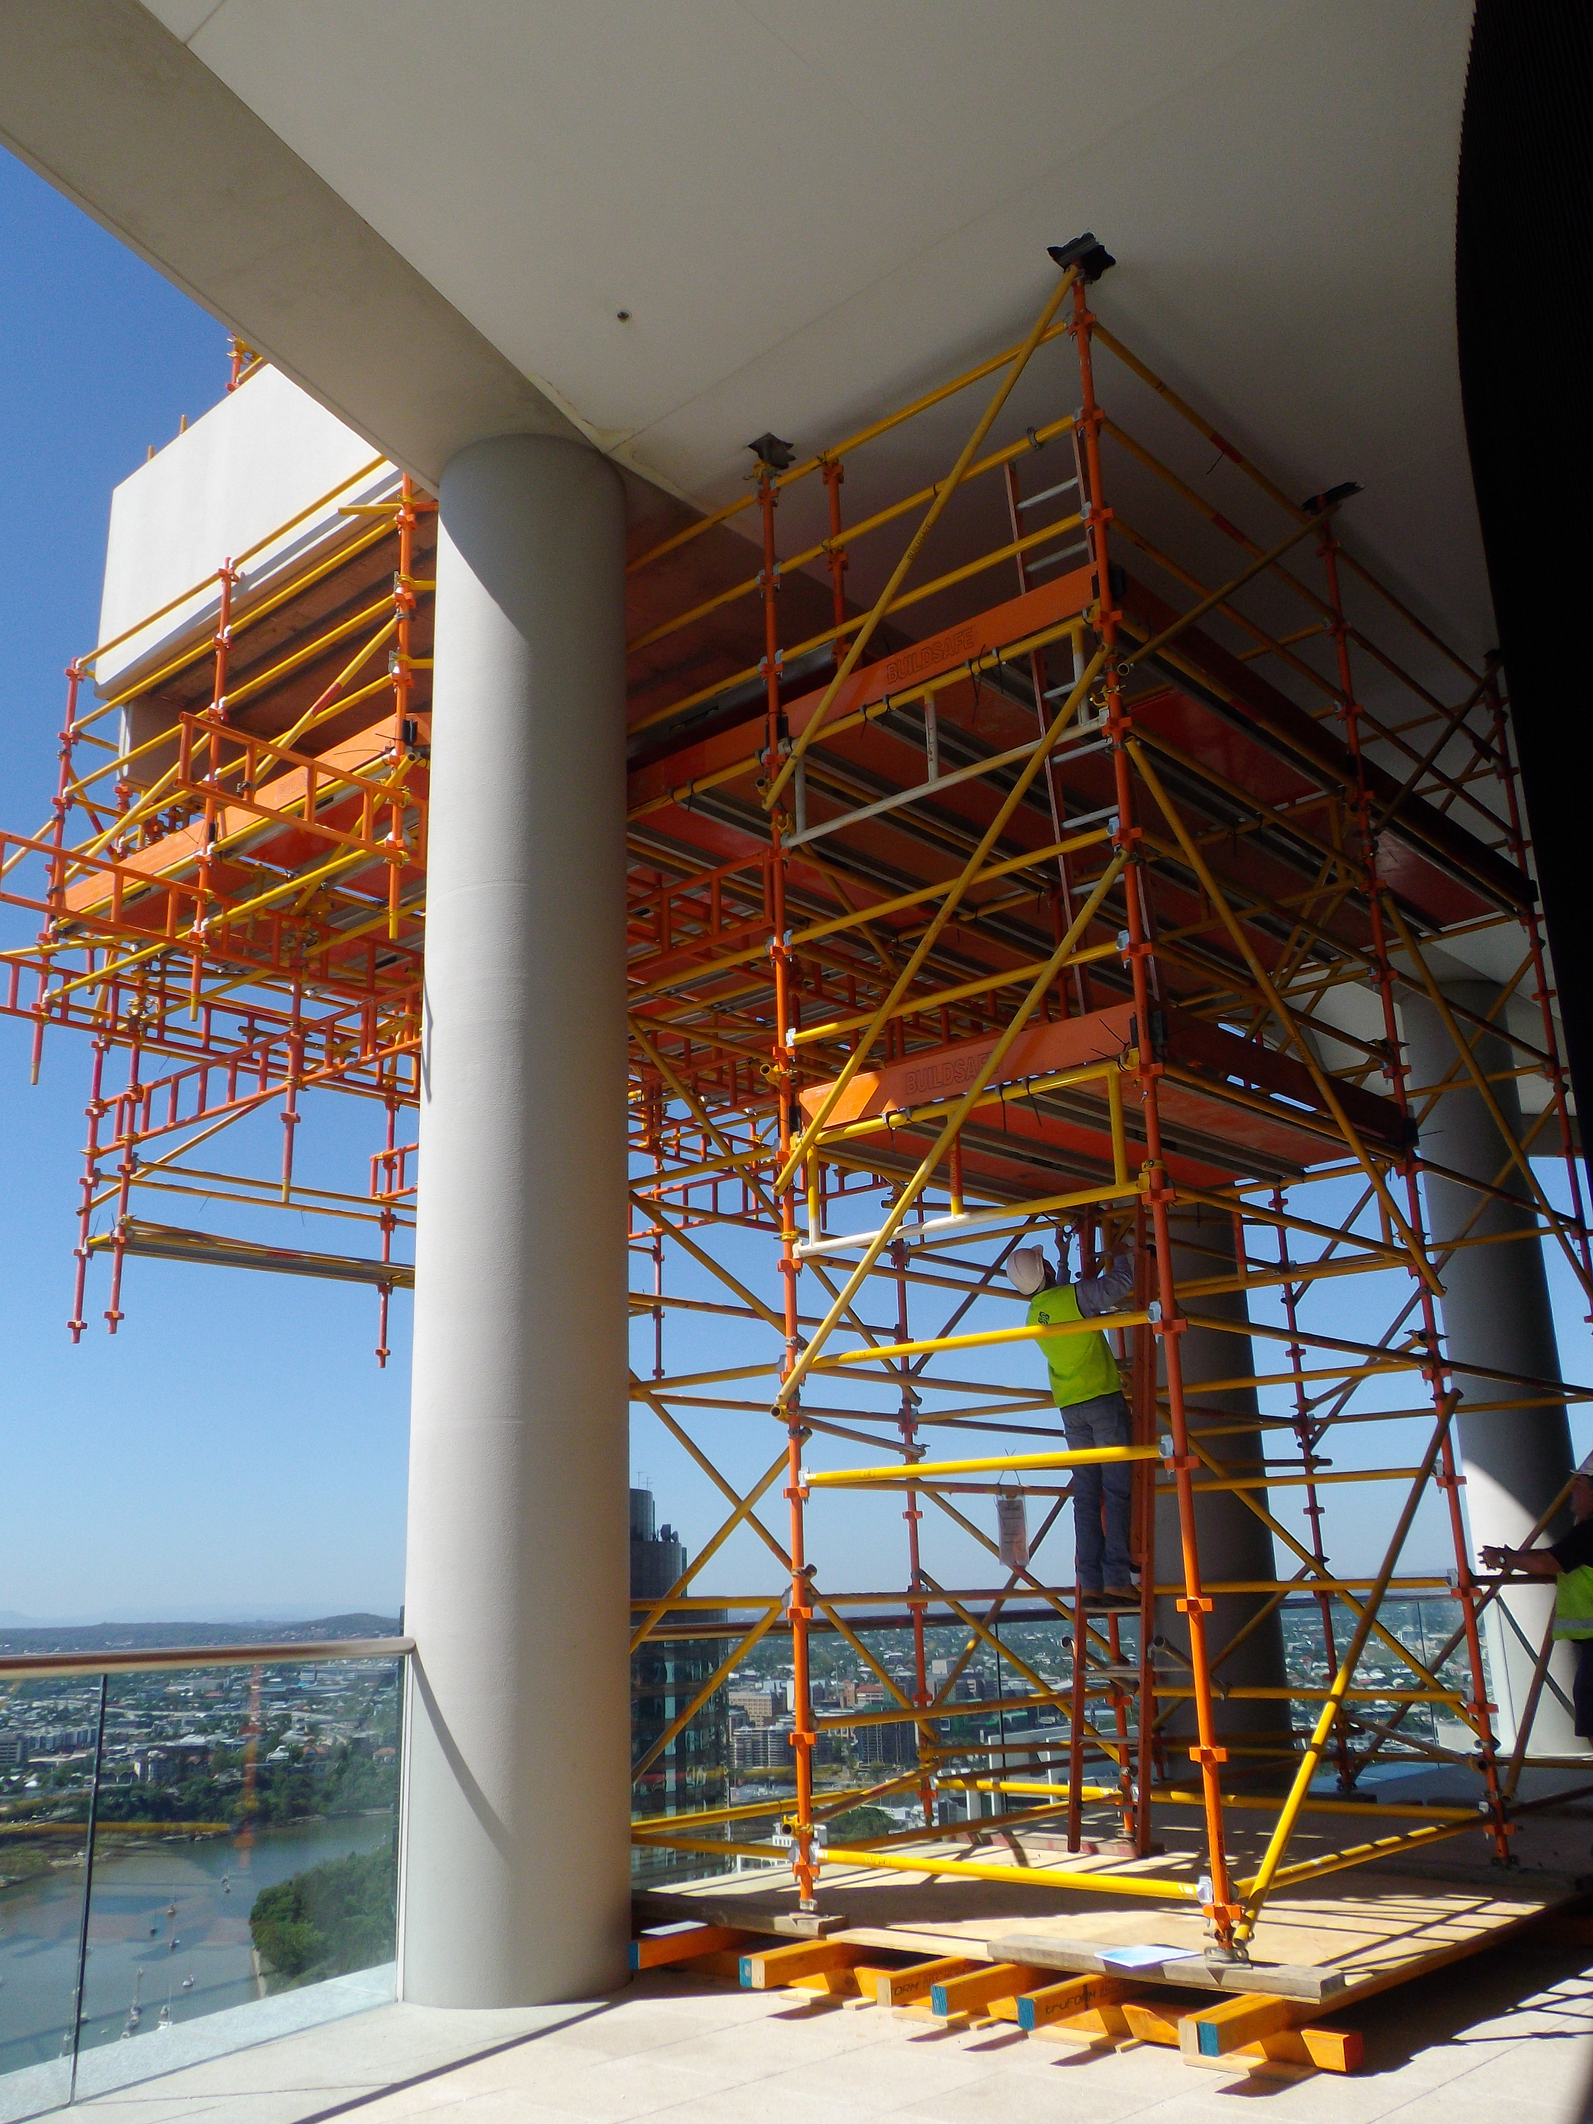
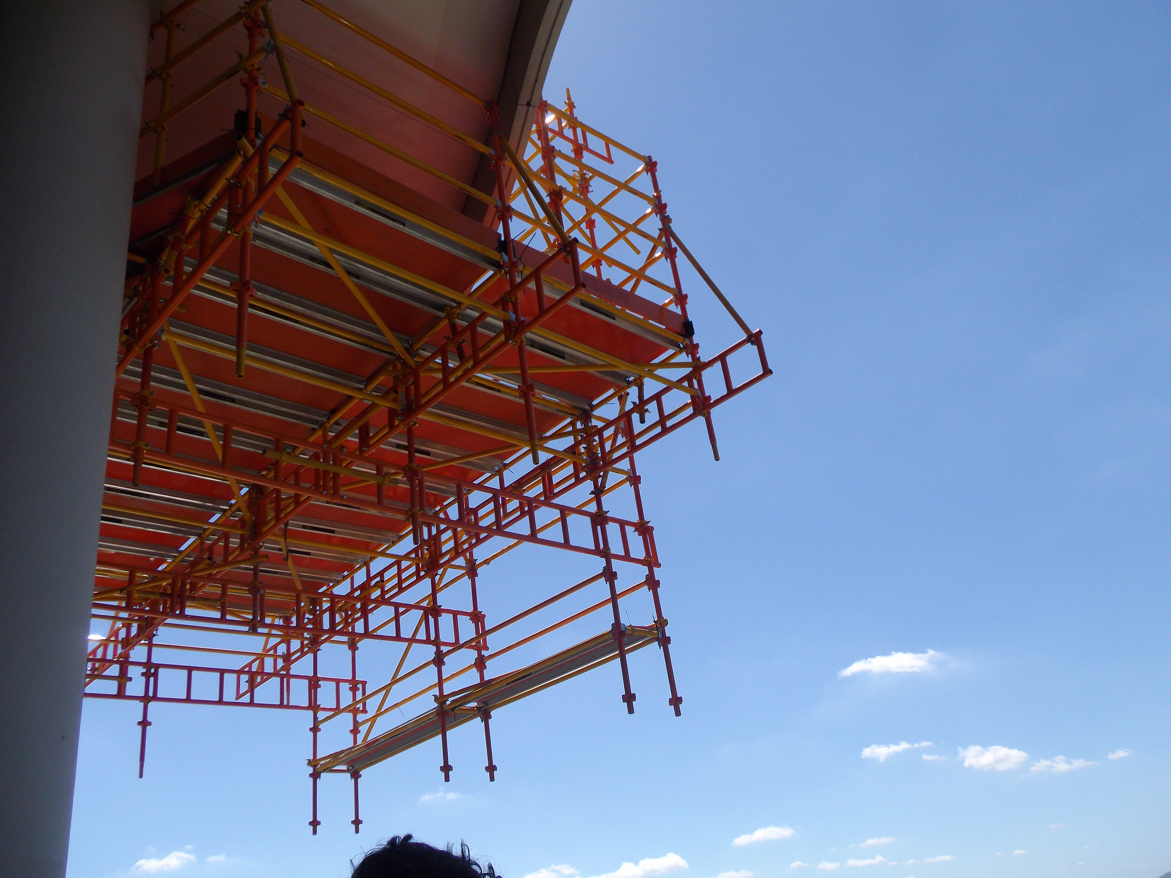
Basic rules
Drop cantilevered scaffolding

Slide 11
Hazards
Work near powerlines
Mobile plant and traffic
Mixing and matching scaffold components
Falls from heights
Falling objects
Scaffold collapse
Manual tasks

Slide 12
Mobile plant and traffic
Re-route motor vehicles and mobile plant away from the location of the scaffold, for example, by using traffic controllers to redirect traffic.
Use barricades, signs, posts, buffer rails, guards, or concrete or timber kerbs to prevent mobile plant and traffic from coming into contact with scaffolding.
Ensure scaffolding does not have any unnecessary protrusions, such as over-length transoms, putlogs, tie tubes or over-height standards.

Slide 13
Inspection
WHS Regulation 2011 s225 (3):
The person with management or control of a scaffold at a workplace must ensure that the scaffold and its supporting structure are inspected by a competent person—
before the scaffold is used; and
(b) before use of the scaffold is resumed after an incident occurs that may reasonably be expected to affect the stability of the scaffold; and
(c) before use of the scaffold is resumed after repairs; and
(d) at least every 30 days.
Inspection records should be kept on site and include the location, comments, date and time of inspections, relevant design or specification reference and the person who conducted the inspection.
The person responsible for the erection of the scaffold should provide the PCBU or principal contractor with a handover certificate which is kept on site until the scaffold has been dismantled.

Slide 14


