Slide 1
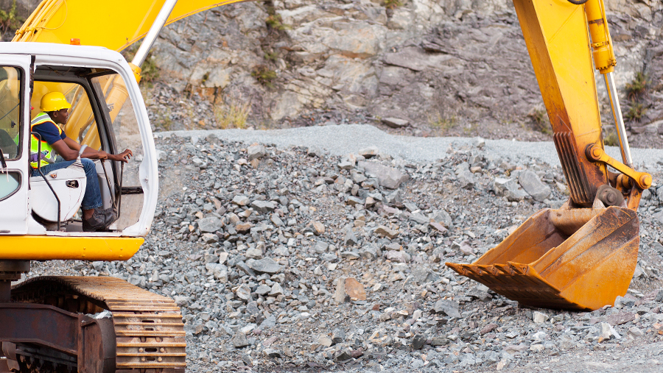
Working In Around Mobile Plant

Slide 2
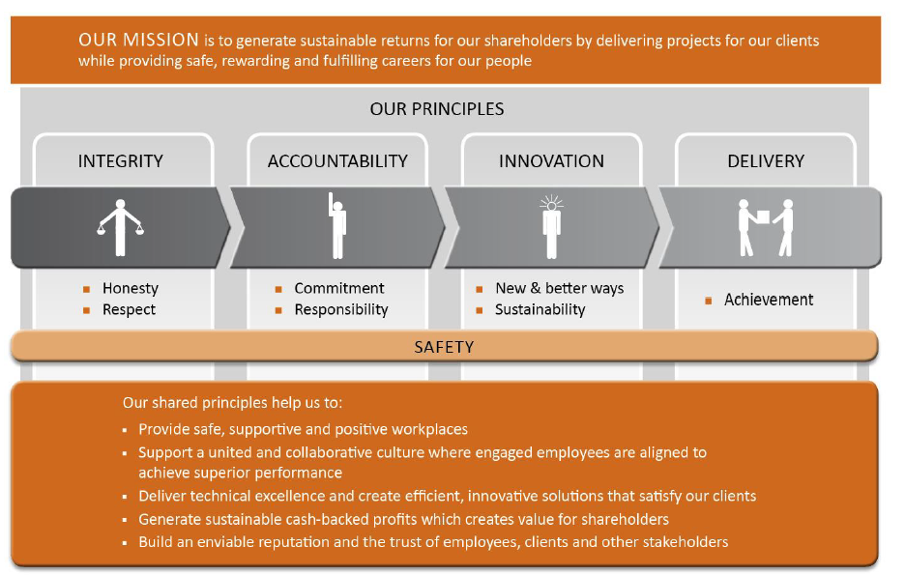
Our Mission and Principles

Slide 3
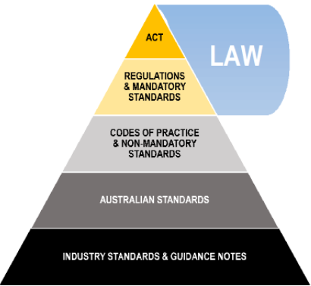
Legislative Framework

Slide 4
References
Work Health and Safety Act 2011: https://www.legislation.gov.au/
Work Health and Safety Regulations 2011: https://www.legislation.gov.au/
WorkSafe Qld: Home | WorkSafe.qld.gov.au
CPB Contractors CMS internal policies and procedures: internal home intranet

Slide 5
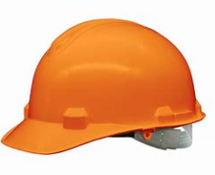
Workers Duties & Rights – Where to find them
Workers Duties:
Take reasonable care for their own safety and health, take steps to ensure their actions or omissions do not harm the health and safety of others
Comply, if able, with any reasonable instruction from the person conducting business
Cooperate with any policy or procedure that is reasonable, from the person conducting business regarding health or safety that the worker/s has been told about.
Work Health and Safety Regulation 2011, section 28; Work Health and Safety (Construction work) Code of Practice 2015, Section 2.3 & 2.4; Work Health and Safety Act 2011, Section 84
Workers Rights:
A worker may refuse to carry out or cease work if the worker has a genuine concern that the work could expose them to serious risk or the workers’ health and safety, from contact with an immediate hazard
The right to a safe and healthy workplace, include safe machinery and structures
Workers’ compensation
Be given training
Consultation about safety in the workplace.
Worksafe Qld; Work Health and Safety Regulation 2011, section 83-89

Slide 6
Workers Obligations - Where to find them
Workers Obligations:
Take reasonable care of yourself and others
Follow WHS instructions
Follow workplace WHS polices and procedures
Work safely
Use personal protective equipment (PPE) as correctly trained and not mistreat anything provided for your health and safety at work.
Report injuries and unsafe situations to a supervisor or health and safety representative
Construction card induction training card must be available for inspection
Worksafe Qld; Work Health and Safety (Construction work) Code of Practice 2015, Section 2.3

Slide 7
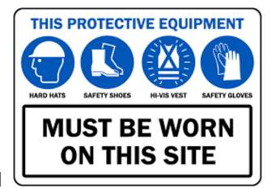
Personal Protective Equipment (PPE)
Mandatory
Reflective high visibility long sleeved shirt
Long Trousers / jeans
Lace-up Steel Cap Boots
Industrial Safety helmet – white
Hard Hat and (Brims available)
Safety Glasses, prescription if necessary
Gloves must be carried on the persons at all times and used as required for suitable activities, FINGERLESS GLOVES ARE NOT PERMITED.

Slide 8
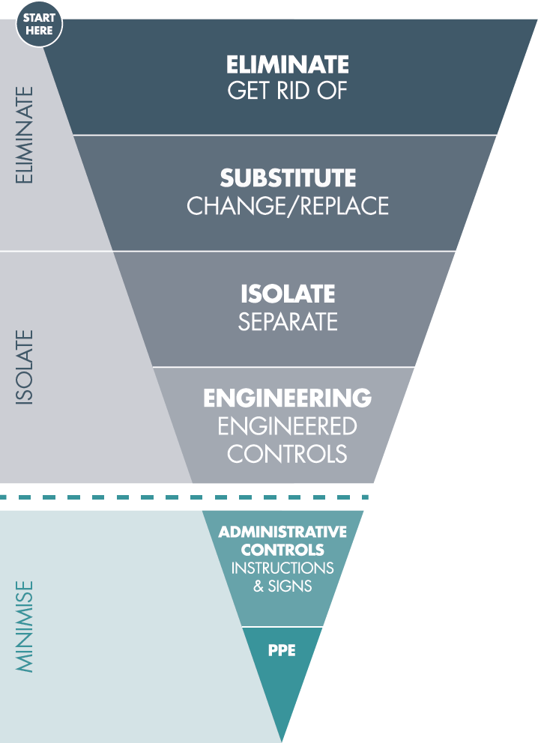
Hierarchy of Controls
Above the Line:
Whenever worker/s are performing a high risk task, everyone MUST have an Above the Line Control as the main control.
If you do not have that, you must have a Safety Essentials Exception signed by the Business Unit (BU) General Manager.

Slide 9
Safety Essential Exceptions
A Safety Essentials Exception is required for any activity that requires a worker to enter a Plant Operating Zone (POZ):
  While plant is working
  An appropriate vehicle barrier is not used to separate the worker from the mobile plant.

Slide 10
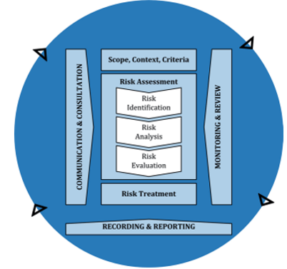
Working In and Around Mobile Plant
Risk Management Process
Communicate and consult
Establish scope, context and criteria
Assess risk:
  Identify risk
  Analyse risk
  Evaluate risk
  Treat risk
  Monitor and review
Reference: Work Health and Safety Act 2011, Section 20-26 & Section 27-29 & Section 30-34 & Section 35-39: https://www.legislation.gov.au/

Slide 11
Plan – Exclusion and/or Restricted Access Zones
When planning any high risk activity in construction, a risk assessment must be completed which will consider the following risk control measures;
Hierarchy of Risk Control Measures
Eliminate | Design the work so that hazards no longer exist; Schedule the activity at a time where opportunity for interaction with hazards can be eliminated;
Substitute | Have aspects of the construction methodology substituted for a less hazardous process to mitigate the risk of interaction with hazards;
Isolate | Undertake the activity at a location where the hazard is situated away from other works/workers; Install a physical barrier to create an Exclusion Zone between the hazard and workers;
Engineer | Consider using technology devices to mitigate unplanned contact between people and hazards;
Administrative | Establish signage to ensure hazards and restrictions are communicated to people (public or workers). Train project teams and workers in the planning, establishment and management of Exclusion Zones and/or Restricted Access Zones requirements.
PPE | Have workers fitted with high visibility clothing to AS/NZS 4602.1:201 and other equipment to increase awareness of their proximity.

Slide 12
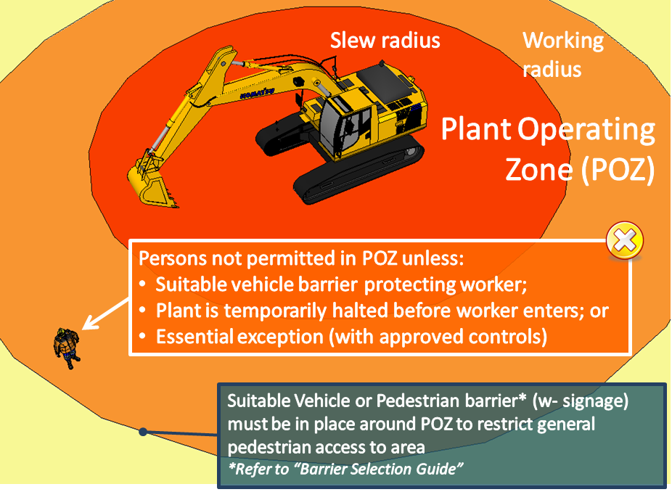
Working In and Around Mobile Plant
What is a Plant Operating Zone
An area around mobile plant (or multiple plant), where workers (and the public) may be exposed to:
Normal or uncontrolled movement of the plant or moving parts (i.e. boom, jib, counterweights)
By other plant hazards (i.e. projectiles ejected from the plant).
Eliminate the activity that potentially exposes workers (and the public) to the Plant Operating Zone (POZ); and reduce the risk of serious injury or fatality to workers (and the public) as a result of being struck by:
    operating mobile plant
    exposed to mobile plant hazards

Slide 13
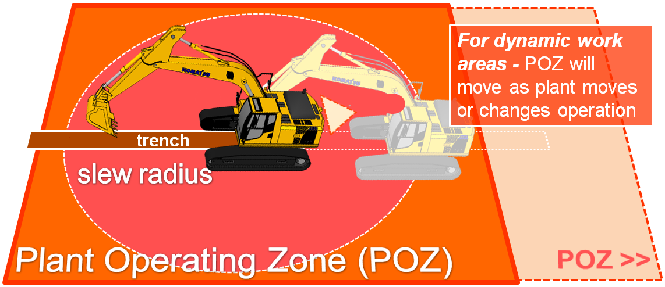
Plant Operating Zone (POZ)
A suitable barrier must be in place around the POZ to either:
Prevent the mobile plant from moving outside of its operating zone
Prevent workers (and the public) from accessing the POZ

Slide 14
Barrier Selection
CPB Contractors requires the following barrier categories to be installed for each zone:
 | Exclusion Zone | Restricted Access Zone
Barrier Category | Hard | Soft
Description | A barrier constructed of interconnecting rigid materials intended to prevent people from entering the zone. | A barrier constructed of interconnecting flexible materials suspended from stands or fixed to structures intended to delineate the perimeter of the zone
Barricade Material Examples | Concrete Barriers; Water-Filled Barriers; Permanent Fencing/ Hoarding; Temporary Fencing; Crowd Control Barriers. | Para-webbing; Rope Flagging; Plastic Chains; Extendable Plastic Bollards.

Slide 15
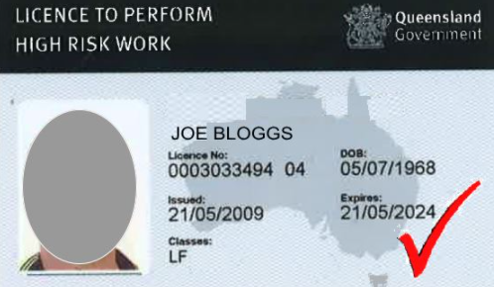
Training & Operator Competence
All mobile plant operators must hold the applicable regulatory High Risk Work License and have completed all relevant training components. All operators must also be validated by a CPB Contractors supervisor as being competent.

Slide 16
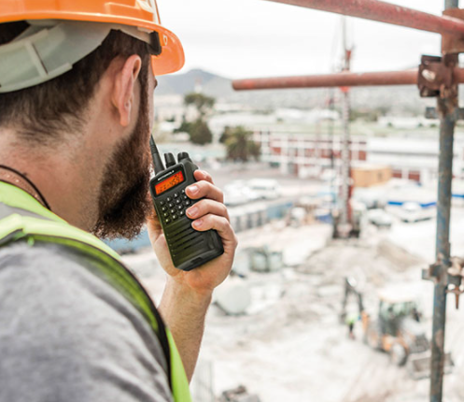
Communication
Lines of communication must stay open between all workers, before work commences and while the work is carried out. The minimum requirements include, but are not limited to:
UHF radios available to all mobile plant and light vehicles
All supervisors, leading hands and spotters to have hand held radios
Test all areas of the project that radio coverage is working or make alternative arrangements if there are dead zones. These areas must be marked clearly on the site map.
All documents from the Work Packs must be kept at the designated zone and available for all workers to review. These document include but are not limited to:
  Work Packs
  Safe Work Method Statements (SWMS)
  Permits
  Pre-Start Briefing cards

Slide 17

Control Measures
Using the Hierarchy of Controls is the easiest way to make sure we keep our workers safe.
Have you checked?
Elimination – What hazards can be eliminated?
Substitution – Can you substitute plant for workers?
Isolation – Can you separate plant from workers (and the public)?
Engineering – Have plant been fit with limiting devices such as mechanical stops?
Administration – Are signs and spotters in place?
Do you understand all the control measures that are in place? Have you read and signed the SWMS?
Remember, speak up and ask questions if you are unsure, and cease work if it is unsafe!

Slide 18

Monitoring All Workers and Works
Supervisors, leading hands and engineers are required to undertake regular monitoring of all work tasks including the use of Exclusion Zones and/or Restricted Access Zones to ensure that each zone is effectively established and controlled.
Task observations are required to be conducted to meet compliance and ensure all control measures are effective. If a change occurs during works (e.g., a new hazard), a review must be completed by the responsible Supervisor to ensure the safety of workers and that CPB Contractors requirements and compliance are met.
Monitoring requirements (not limited to):
Monitoring and documentation
Leadership visits
Task observations
Plant and equipment inspected

Slide 19
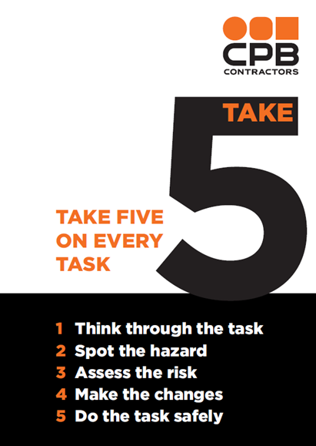
Take 5
Monitoring is not just the responsibility of the supervisor, leading hands and engineers. We must all monitor and “take 5” to assess our personal safety.
Take 5 allows you to look around and take into account your work environment, identify hazards before you start work, manage any hazards and make changes to any control measure.
Why?
It will help protect you and your workmates from harm and potential injury.
We want you to get home safe to the things you love and enjoy!

Slide 20
Incident Reporting
Reporting
All incidents, near misses and hazards must be reported to your supervisor, no matter how minor
Non- Disturbance
In some instance it is an offence to disturb an incident scene before regulators have given the all clear – on this site, incident scenes must be preserved until cleared by the safety department
Investigations
Incident investigations will be undertaken in accordance with CPB Contractors requirements
What if you injure yourself outside of work?
You must contact your supervisor prior to leaving and returning to work
You must NOT return to work until you are “fit for duty” or for ‘suitable duties’
For medical conditions a clearance from a doctor will be required
Approval must be obtained by the Project Manager if you return to work with a non-work related injury

Slide 21

Removing an Exclusion or Restricted Access Zone
Once the supervisor has approved, the exclusion and or restricted access zone can be removed, and all signage must be removed immediately. This can only take place after the completion of the work or when the hazard no longer exists.

Slide 22
Questions

