Slide 1
SUBCONTRACOR NON COMPLIANCE ISSUES HS418HS418
UNIT 9 CERT 4 PRAC POWERPOINT.

Slide 2
NON COMPLIANCES
COMPANY 1 GLOSSKING PAINTERS
COMPANY 2 SHINYFLOOR CLEANERS

Slide 3
Contractor legal requirements
Contractors have work health and safety duties under the legislation. They are responsible for ensuring the health and safety of themselves, their workers and others affected by their work. This includes following safety guidelines, providing necessary training and cooperating with the principal contractor and other parties to maintain a safe work environment
Work Health and Safety Act 2011
Section 29 (a), (b), (c)
As a contractor, you have work health and safety obligations including taking reasonable care to ensure the health and safety of yourself and others, complying with relevant safety laws and regulations, and cooperating with the principal contractor and other parties to maintain a safe work environment.
Work Health and Safety Act 2011
Division 2 Section 19 (1) (2) (3) (5)

Slide 4
Induction process.
Both parties were given an induction by the workshop foreman greg before starting work, this included signing onto the workshop swms and a full walk around of emergency exits and amenities. They were also present at the daily pre start in which their works were brought to the the attention of all workers. The workers also briefed the contractors of their daily activities and how their work could cause hazard.
TARINGA STEEL INDUCTION RECORD
SIGN ON-
-JAMES M
-JOHN T
-MATT G
-GREG A
-OWNE C
-JAMES H (PAINTER)
-RICHARD S (CLEANER)

Slide 5
Codes of practice
Being a construction workshop, the codes of practice followed are the safe work Australia legislative codes of practice as found here https://www.safeworkaustralia.gov.au/sites/default/files/2022-10/Model%20Code%20of%20Practice%20-%20Construction%20Work%20-%2021102022%20.pdf
5.1. What is a WHS management plan? A WHS management plan is a written plan that sets out the arrangements for managing some site health and safety matters. The intention of a WHS management plan is to ensure the required processes are in place to manage the risks associated with a complex construction project, as there are usually many contractors and subcontractors involved and circumstances can change quickly from day to day. The WHS management plan must be in writing and must be prepared by the principal contractor before a project starts. It should be easily understood by workers including contractors and subcontractors.
Section 5.1 was reviewed with both subcontractors prior to starting, as it outlines the management plan we expect them to follow

Slide 6
Non compliances.
COMPANY 1 PAINTERS – On the 09/09/2023 the workshop foreman pulled up the painting subcontractors for the application of flammable paint near explosive and welding tools, creating a dangerous fire hazard. – Works was immediately stopped and an incident report form was completed. This will require further follow up from both pcbu parties involved.
COMPANY 2 CLEANER – On the 09/09/2023 a worker brought to the attention of management that the cleaners had left slippery cleaning products on the tiled crib room floor without a wet surface sign, creating a slip dangerous slip hazard. - – Works was immediately stopped and an incident report form was completed. This will require follow up from both pcbu parties involved.

Slide 7
Consultation identification.
Both contractors were immediately stopped from works and taken into the office to file the incident report. A verbal face to face meeting was had with all workers involved. The incident report was then sent to the contractors employers via email after a phone call was ha regarding the incident.

Slide 8
PCBU follow up
After the incident report was filed, the contractors returned to work and were re inducted into the swims. There was also a toolbox talk with all workers to notify workers of how the hazard and risk has been removed. The pcbu issued a written warning to both contractors for breaching company policies and protocalls.

Slide 9
Meeting scheduled.
A follow up meeting has been scheduled with Owen, the boss to discuss and close out both incidents. Conversations will be had with contractors and workers to make sure the hazards are completely removed and delt with.

Slide 10
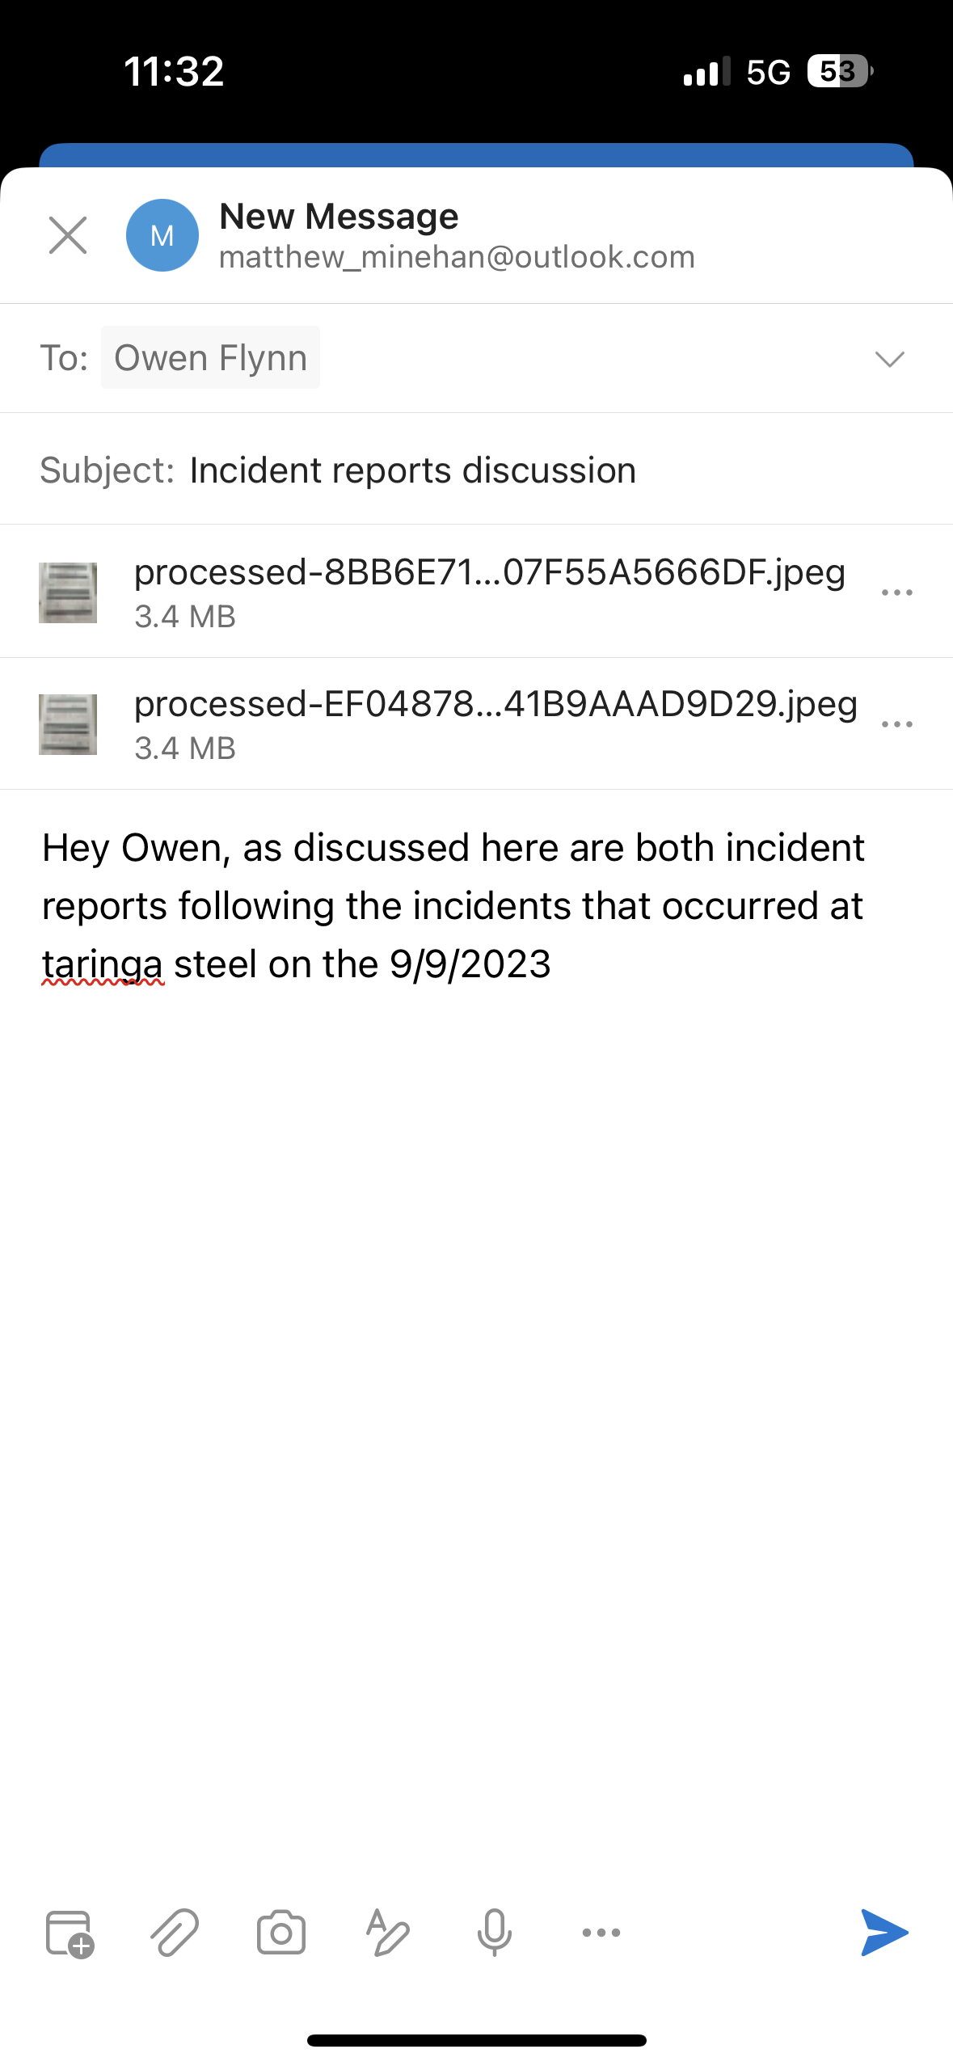
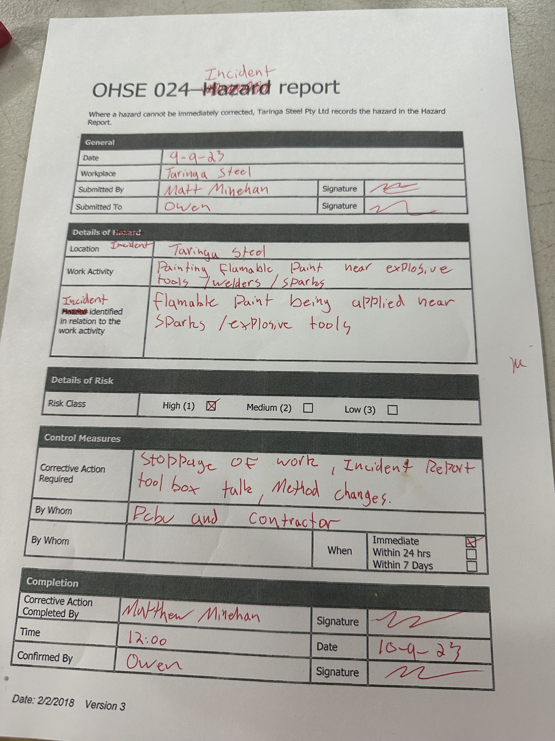
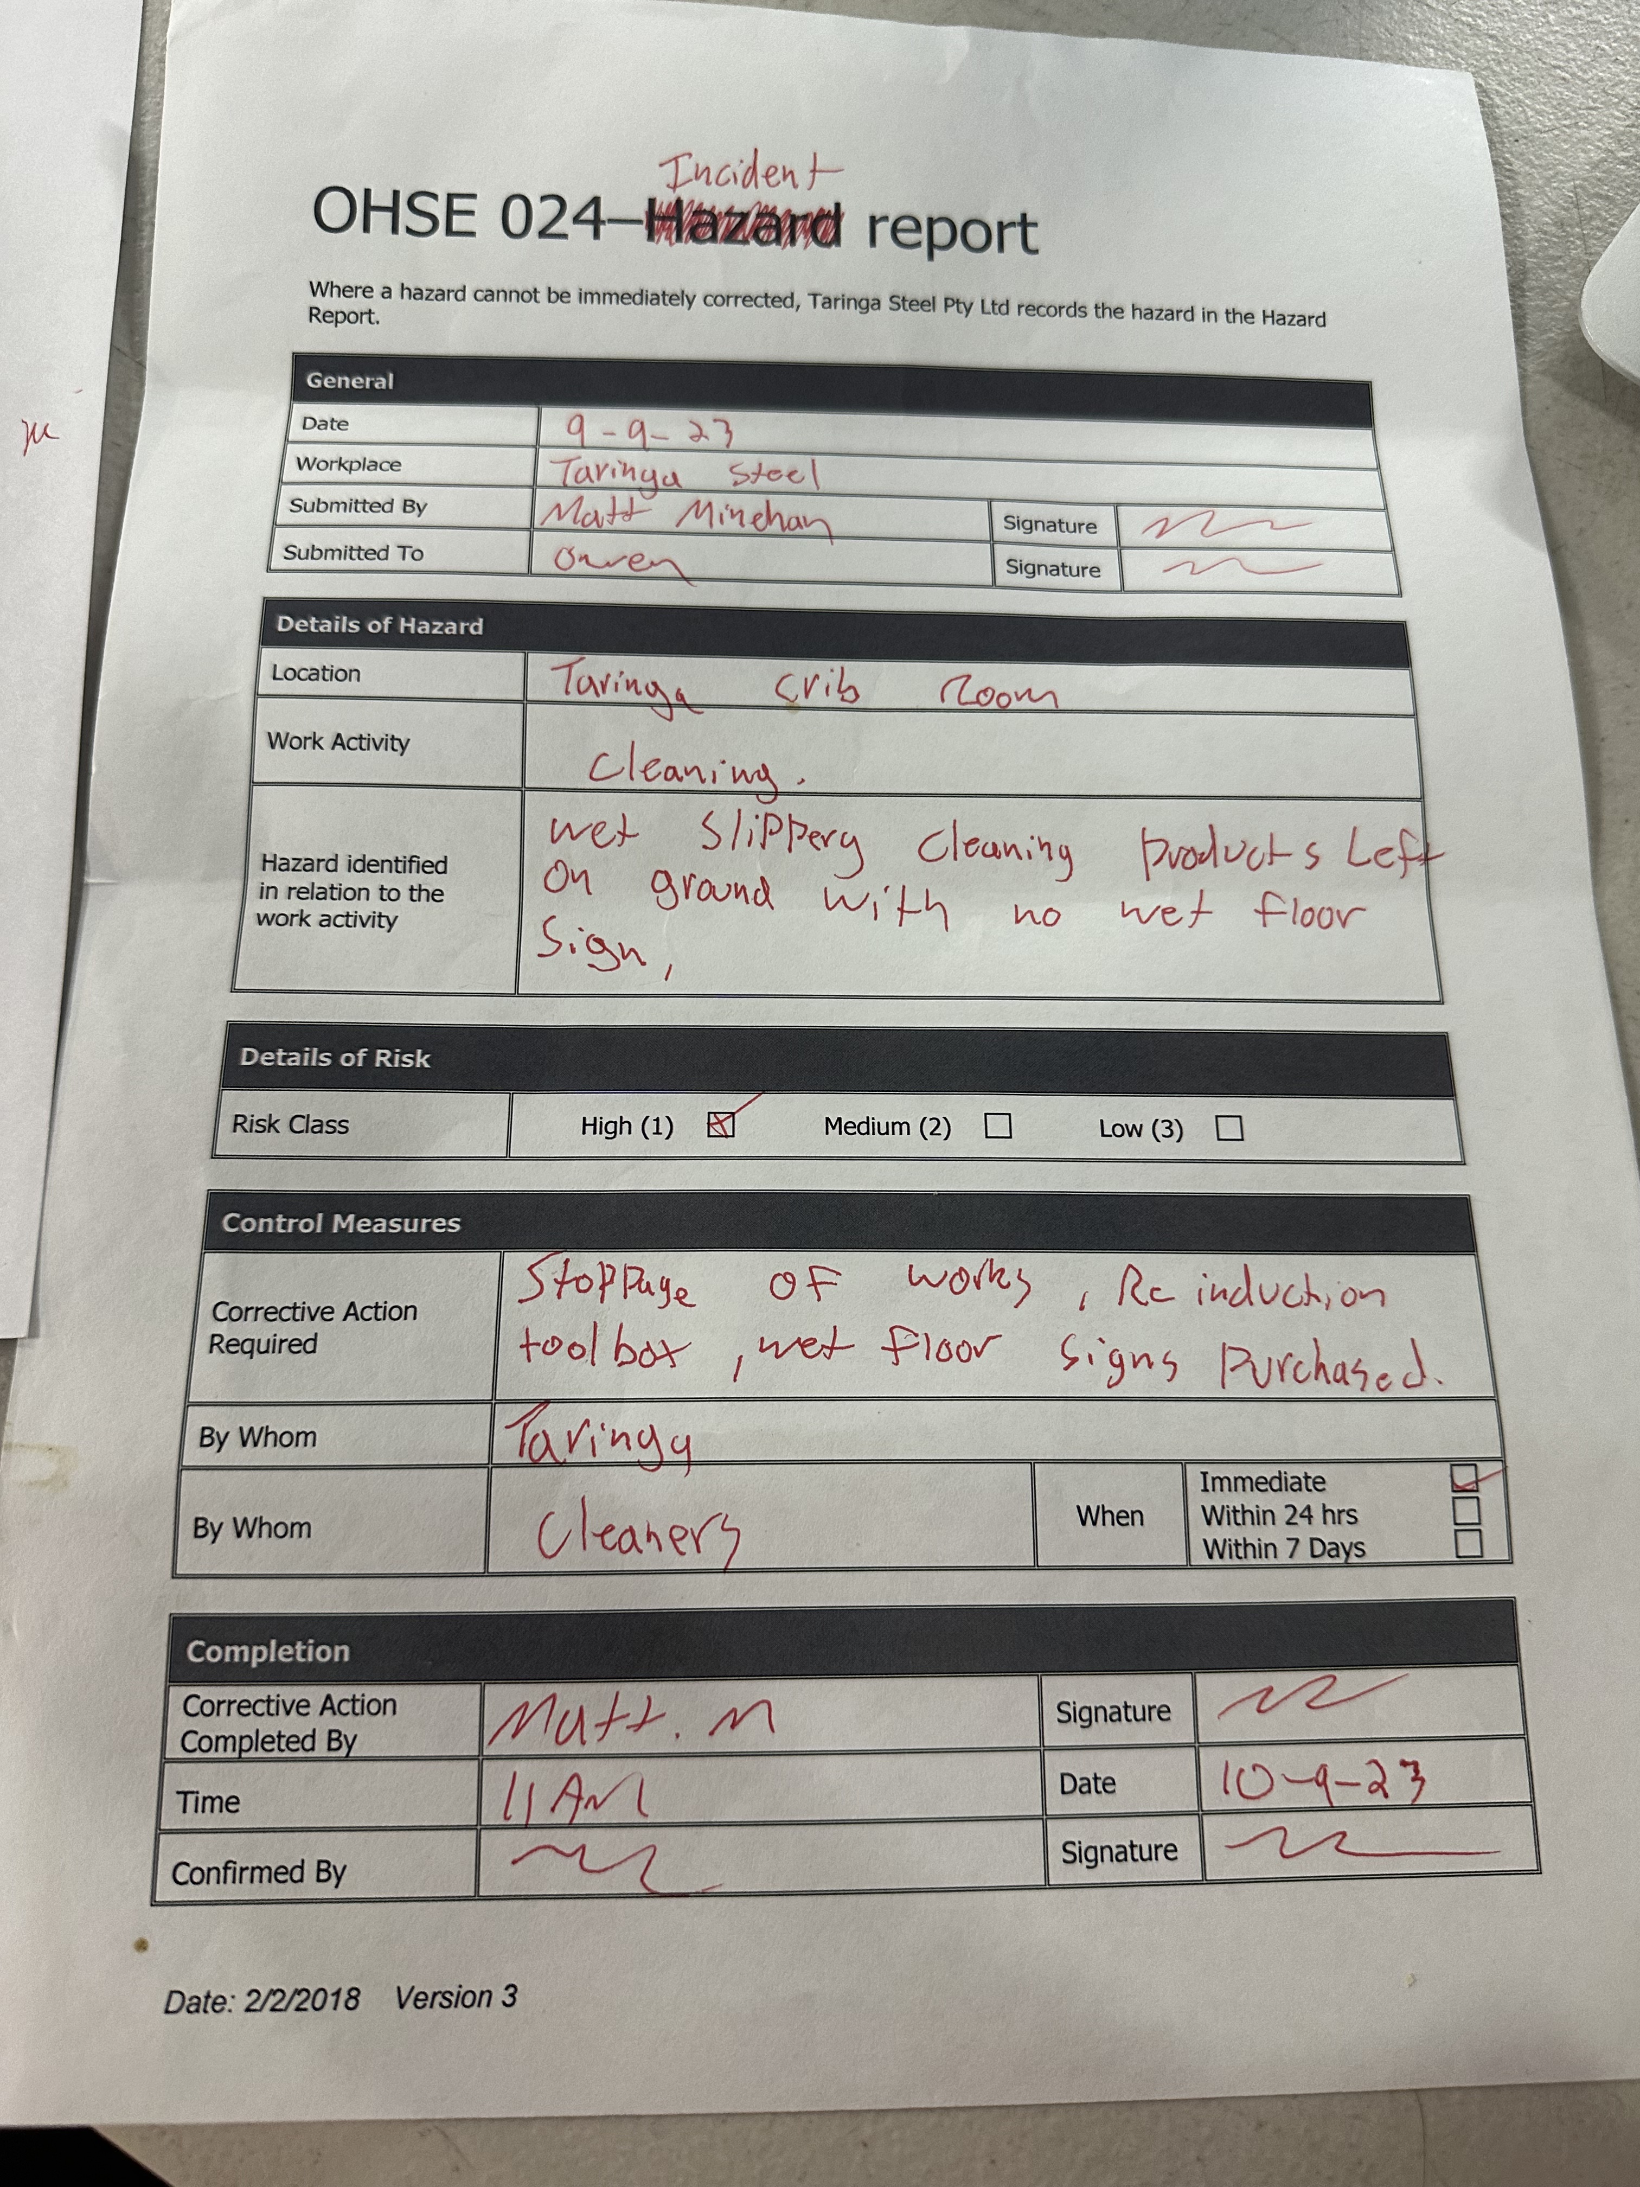
Incident reports.

