Slide 1

HLTWHS002
Follow safe work practices for direct client care

Slide 2

Housekeeping
Emergency procedures
Mobiles and security issues
Break times and smoking policy
This course is interactive – ask questions
Practise respect and confidentiality
Ground rules

Slide 3
Objectives
Discover how to follow safe work practices for direct client care
Know how to follow safe work practices for manual handling
Learn how to follow safe work practices for infection control
Understand how to contribute to safe work practices in the workplace
Comprehend how to reflect on own safe work practices
Gain the skills and knowledge required for this unit

Slide 4

Follow safe work practices for direct client care
1.1 Follow workplace policies and procedures for safe work practices

Slide 5
Your organisational policies should clarify:
Objectives for the achievement of health and safety standards
Details of the steps that should be taken to meet health and safety aims
Schedules for the completion of health and safety objectives
Details of how the policies should be reviewed
The specific responsibilities of managers and other staff members.

Slide 6

You may have organisational procedures for:
Dealing with aggressive and potentially dangerous behaviour
Organising evacuations
Inspecting and monitoring the workplace
Training and reviewing the knowledge of employees.

Slide 7
Legal responsibilities
Thorough research should be undertaken, to ensure that you are fully aware of the relevant laws and practices
The aim of your policies and procedures should be to eliminate or minimise the potential impact of hazards in the work place
Safe work practices may include the substitution of chemicals with less harmful alternatives and the isolation of areas where employees are at considerable risk.

Slide 8

Employers must provide their staff with:
Safe premises
Safe machinery and materials
Safe systems of work
Information, instruction, training and supervision
A suitable working environment and facilities.

Slide 9
Infection control
When you have identified infection risks, you must respond to them according to infection control policies that are based and State legislation, National Standards and local regulations
Think about how you can eliminate hazards, where reasonable – this could involve changing certain work methods
Take time to read through your organisation's policies and procedures in relation to immunisation and infection control.

Slide 10

Activity 1A

Slide 11
Follow safe work practices for direct client care
1.2 Identify existing and potential hazards in the workplace, report them to designated persons, and record them according to workplace procedures

Slide 12
Identifying hazards and risks
Health and safety hazards may be apparent in numerous areas of the work environment.
There will different levels of risk associated with each of these hazards
You are advised to carry out regular inspections and identify signs of danger
Some hazards and long term risks may not be immediately obvious
However, research can be undertaken and employees asked for details of any concerns.

Slide 13

You may arrange the following consultations:
Tool box talks
Production meetings
Team meetings
Regular informal discussions.

Slide 14
Sources of risk to personal safety can include:
Alcohol and/or drug use
Behaviours of concern
There are risks associated with access to work (car parking would be an example), access to private homes, and the performance of work
Incident reports may be used to identify situations with a higher risk of threat and client related. They may include information regarding care plans and case management meetings
Working new, isolated, and/or potentially unstable environments.

Slide 15
Workplace hazards:
Biological hazards, including body fluids, contaminated food, soiled clothing and linen, clinical waste, syringes, and other 'sharps'
Chemicals, such as toxic or hazardous substances, gases and liquids under pressure, and certain cleaning chemicals
Electrical hazards related to use of equipment and faulty wiring
Equipment including suitability for purpose and fitness for use

Slide 16

Workplace hazards:
Personal threat, such as through behaviours of concern of clients and/or visitors
Work organisation issues such as shift work or irregular hours/on call
Work-related environment, such as underfoot, lighting, space, noise, air quality, furniture/fittings, and car parking
Work-related stress

Slide 17
Different types of risk:
Environmental: these are caused by threats in the physical environment, such as trip hazards, fire hazards, contamination and other accidents. Potential hazards should be identified and minimised whenever possible.
Client-based: this can range from clients becoming violent, or threats which may be made by someone in your care. There may be an infection risk, or injury sustained while moving/helping a client.

Slide 18

Different types of risk:
Staff-based: this can range from other staff being violent, unfit for work, or negligent. Staff should be monitored and trained in preparation for such events
People-based: this involves other people and can range from clients’ families to the general public. This can cause numerous risks, from infection, to a person’s dog being out of control.

Slide 19

Communication methods:
Written:
  notes
  memos
  emails
  report forms
Verbal:
  face-to-face
  phone call
  voicemail.

Slide 20
Activity 1B

Slide 21
Follow safe work practices for direct client care
1.3 Identify any client-related risk factors or behaviours of concern, report them to designated persons, and record them according to workplace procedures

Slide 22
These factors should be taken into consideration:
The times at which there is a significant risk of challenging behaviour
The environments in which employees and customers are at the greatest risk
The arrangement and allocation of resources to help employees deal with aggressive behaviour
Opportunities for training staff in the different ways of minimising risk and overcoming challenging behaviour.

Slide 23

Employees should know how to:
Identify signs of behavioural change and aggression
Monitor and deal with various challenging scenarios in the workplace
Negotiate and establish reasonable limits in response to concerning behaviours
Decide which actions to take as a consequence of challenging behaviour.

Slide 24

Deal with distressed and angry customers in the following ways:
Apologise
Sympathise
Accept responsibility
Identify means of assistance.

Slide 25
Organisational procedures for managing risks include:
Client assessment documents and care plans
Communication, consultation, and issue resolution procedures
Hazard management documents
Hazard and incident reporting and investigation
Hazard management policies and procedures
Human resources management procedures, such as harassment and grievance procedures
Job procedures and work instructions; including medications policy and procedures.

Slide 26
Organisational procedures for managing risks include:
Other related procedures; including waste management and security
Post incident/injury management; such as first aid, critical incident debriefing, compensation, and return to work
Strategies for reducing the amount of manual handling required and manual handling risk
Supporting people with behaviours of concern.

Slide 27

Incidents or suspicions:
Abuse:
  assault
  negligence
  neglect
Staff that are unfit for work:
  through drink
  through drugs
  through tiredness
  through lack of training

Slide 28

Incidents or suspicions
Sexual misconduct:
  inappropriate relationships with clients
  sexual misconduct with clients
Missing residents.

Slide 29

You can report workplace hazards:
Verbally:
  face to face
  telephone call
Written:
  memo
  notes
  report forms.

Slide 30
Activity 1C

Slide 31
Follow safe work practices for direct client care
1.4 Follow workplace policies and procedures to minimise risk

Slide 32

Health and safety policies
Health and safety policies may be created specific to your entire organisation and the work carried out within separate departments
You should include details of how to manage the different working environments for optimum safety
There should also be details of the responsibilities designated to different members of the workforce.

Slide 33
Health and safety policies
Employees with knowledge of various health and safety issues should contribute to the policies
Health and safety policies should apply to various types of work and be written in accordance with the WHS Act
Methods should be established for the identification and removal of hazards in the workplace
It is also important to produce response documentation, highlighting details of incident investigation, notification and ways of dealing with emergencies.

Slide 34

You may identify the following means of minimising risk:
Ensuring that employees/customers aren’t exposed to hazards
Developing low risk work practices
Providing protective equipment
Integrating care and treatment facilities within the workplace
Discussing risks with employees.

Slide 35
Hierarchy of risk control:
Level One controls:
  eliminate hazards
Level Two controls:
  substitute the hazard with something safer
  isolate the hazard from people
  Use engineering controls
Level Three controls:
  use administrative controls
  use Personal Protective Equipment (PPE).

Slide 36
Activity 1D

Slide 37
Follow safe work practices for direct client care
1.5 Identify and report incidents and injuries to designated persons according to workplace procedures

Slide 38

You should be aware of the following causes:
Fatigue
Stress
Slips
Trips
Unsecured objects
Lifting
Aggressive behaviour
Unexpected collisions.

Slide 39
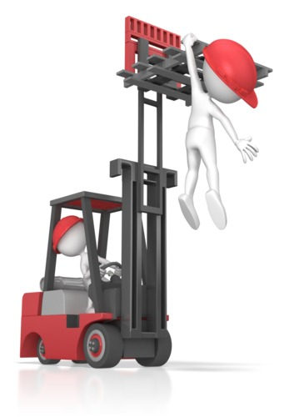
Dealing with incidents
You should never attempt to deal with a serious issue, unless you’ve been provided the necessary authorisation, or training
You should complete the tasks that you are trained for, in accordance with your moral and legal responsibilities.

Slide 40
Reporting incidents and injuries
It is important to take details of the incident date, time, and location
You should also record the names of witnesses who may be able to provide helpful information
It is also important to comply with legislation regarding the report of serious incidents and injuries
There will be different levels of investigation based upon the likelihood of recurrence and the potential impact of similar events in the future.

Slide 41
Activity 1E

Slide 42
Follow safe work practices for manual handling
2.1 Follow manual handling procedures and work instructions for minimising manual handling risk

Slide 43

Work instructions may be:
In a community language
In English
Provided visually e.g. video, WHS signs, symbols, and other pictorial presentations
Verbal
Including care plans associated with risk management
Written.

Slide 44

Lifting a heavy object:
Plan the lift
Hold the item close to you
Stand properly
Hold/support the weight properly
Don’t bend your back
Don’t twist.

Slide 45
Activity 2A

Slide 46
Follow safe work practices for manual handling
2.2 Identify manual handling hazards and report in line with workplace procedures

Slide 47
Manual handling
Manual handling may be an unavoidable part your job
You will be expected to account for heavy lifting risks and hazards
It is essential to provide appropriate training for lifting and carrying items in the workplace
Workers must take responsibility for following instructions and guidance, for the purpose of avoiding injuries and accidents.

Slide 48

Different types of manual handling:
Moving people
Carrying manageable items
Moving heavy or bulky items
Postural movements.

Slide 49

Preventing injury and using assistive aids
You should be aware that there are many dangers associated with manual handling
There are also a wide variety of injuries and accidents that occur as a result of poor handling techniques
However, there is a good selection of equipment available for workers are required to lift and move heavy goods.

Slide 50

Suitable equipment in the care industry:
Client hoists
Slide sheets
Standing lifters
Riser/recliner beds
Bath hoists
Slings
Transfer boards.

Slide 51
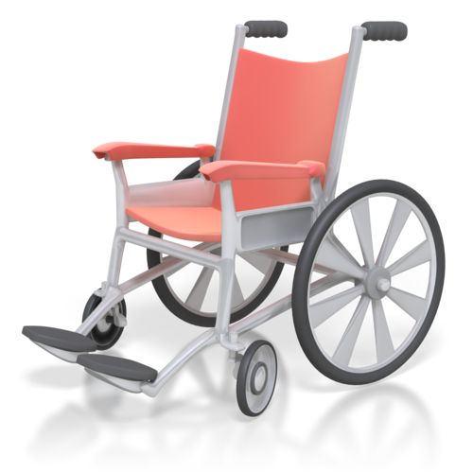
Suitable equipment in the care industry:
Turntables
Wheelchairs
Lifting cushions
Other manual handling assistive devices.

Slide 52

Control measures may entail:
Changes to the load, or client
Changes to work organisation, or practices
Changes to workplace layout
Minimising amount of handling
Provision of equipment
Task-specific training.

Slide 53
Activity 2B

Slide 54
Follow safe work practices for manual handling
2.3 Apply control measures for minimising manual handling risk

Slide 55

The risk factor of manual handling activities can be influenced by:
Duration and frequency of the task
Environmental conditions
Forces exerted
Movement undertaken
Postures adopted.

Slide 56
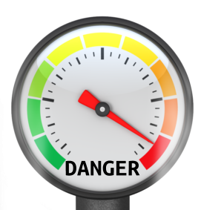
Risk assessment tools:
Charts
Checklists
Scales of danger
Questionnaires
And similar.

Slide 57
Activity 2C

Slide 58
Follow safe work practices for infection control
3.1 Follow standard precautions as part of own work routine to prevent the spread of infection

Slide 59

Preventing the spread of infection
Preventing the spread of infection should be a priority for all care providers and health care professionals
Preventative practices should be maintained at all times
Good habits and routines will become second nature.

Slide 60

Standard precautions can include:
Appropriate reprocessing and storage of reusable instruments
Aseptic technique
Personal hygiene practices, especially washing and drying hands, such as before and after client contact
Safe disposal of sharps and other clinical waste.

Slide 61

Standard precautions can include:
Safe handling of sharps
Surface cleaning and management of blood and body fluid spills
Techniques to limit contamination
Use of Personal Protective Equipment.

Slide 62
Activity 3A

Slide 63
Follow safe work practices for infection control
3.2 Recognise situations when additional infection control procedures are required
3.3 Apply additional precautions when standard precautions alone may not be sufficient to prevent transmission of infection

Slide 64

Additional infection control measures may be required if:
A staff member is sick
A client is sick
There is an outbreak of a particular virus, or similar
A service user is known to have a serious infectious condition, such as HIV
You are treating a client for a particular illness.

Slide 65

Additional infection control measures may be required if:
Your immune system is compromised for some reason
A condition has spread amongst the residents
There is an outbreak of parasites in the building
There is a particularly vulnerable client.

Slide 66
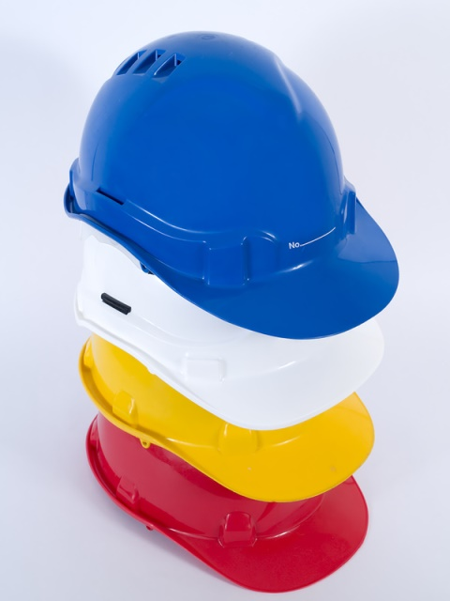
Additional precautions may include:
Additional use of Personal Protective Equipment
Dedicated equipment for each client, or as appropriate to work function
Special ventilation requirements.

Slide 67
Activity 3B

Slide 68
Activity 3C

Slide 69
Follow safe work practices for infection control
3.4 Identify risks of infection and report them according to workplace procedures

Slide 70

You may be exposed to the following types of infection:
Bacteria/germs
Viruses
Skin rashes
Contagious diseases
Lice/parasites
Food poisoning
Campylobacter.

Slide 71

Infections typically happen in one of several ways, such as:
Airborne
Through skin contact
Through shared surfaces
Through bodily fluids
Through wounds.

Slide 72

Good practice:
Sterilising surfaces and equipment
Wearing Personal Protective Equipment (PPE), such as gloves
Covering your mouth when sneezing or coughing
Separating contagious people
Being aware of those who are sick
Washing hands.

Slide 73

Infection may result from contact with the following sources:
Food poisoning
Animals
Family members/friends/associates
Poor housing
Poor sanitation.

Slide 74
Activity 3D

Slide 75
Contribute to safe work practices in the workplace
4.1 Raise WHS issues with designated persons according to organisational procedures

Slide 76
Rights and responsibilities for WHS:
Employers and employees are subject to rights and responsibilities in the workplace
This is to ensure the safety of all people affected and to establish mutually beneficial working arrangements
If employers provide a safe and supportive environment then employees can work in greater comfort
The employer will benefit, as people will spend less time away from work.

Slide 77
Employers must:
Provide a safe workplace
Provide safe equipment
Provide:
  training
  information
  Supervision
Provide adequate and suitable facilities, where required
Check and maintain WHS systems and procedures
Provide PPE, where required.

Slide 78
Employees must:
Work safely
Wear PPE, where required
Follow safety procedures and requirements
Not destroy or compromise equipment and resources
Not interfere with safety equipment
Not act in a way that compromises their own safety, or that of colleagues, clients, and the public
Report any WHS.

Slide 79

Workplace issues and concerns can be discussed with:
Colleagues
Supervisors
Managers/team leaders.

Slide 80

Legislative requirements relating to WHS consultation and participation:
National Work Health and Safety Model
Current relevant State/territory WHS legislation
Relevant state/territory Manual Handling Code of Conduct.

Slide 81
Activity 4A

Slide 82
Participate in workplace safety meetings, inspections and consultative activities
4.2 Participate in workplace safety meetings, inspections and consultative activities

Slide 83

Employees may participate in the following:
Informal chats in the workplace
Discussions during tours of the workplace
Conversations about health and safety issues during general meetings
Toolbox talks
Focus groups.

Slide 84

Workplace inspections
Routine inspections should be carried out for the identification of hazards and associated risks in the workplace
It is also important to assess the work of employees and ensure that they are fulfilling their duties
The inspections should be carried out by employees with considerable knowledge of health and safety issues relevant to the areas that they are assessing.

Slide 85
These inspections may be carried out:
Safety tours – Involving general evaluation of the workplace
Safety sampling – Conducting sampling of potentially dangerous areas and practices
Safety surveys – Asking employees for perspectives on health and safety
Incident inspections – Assessing the workplace after a serious injury/illness or near miss caused by lack of care and concern for health and safety.

Slide 86
Follow up
There should be an opportunity to discuss the findings of workplace inspections
The inspectors may agree to go away and draw up plans for follow up action
You may lack the time or resources to implement all of the suggested improvements
However, you should keep a record of the findings and produce reports for circulation among the workforce.

Slide 87
Consultations may include:
Health and safety representatives – Designating personnel with responsibility for consulting on the behalf of employees. They may highlight areas of concern, training requirements and demanded improvements
Health and safety committees – Employees and managers who come together for the analysis and improvement of WHS measures. Workers may enlist the support of union representatives for these consultations.

Slide 88

You may use these forms of communication:
Intranet bulletins
Email
Team briefings
Regular newsletters
Video-conferencing.

Slide 89
Activity 4B

Slide 90
Contribute to safe work practices in the workplace
4.3 Contribute to the development and implementation of safe workplace policies and procedures in own work area

Slide 91

Participative arrangements can be:
Documented issue resolution processes
Easy access to relevant written workplace information
Formal and informal WHS meetings
Health and safety committees
Meetings called by Health and Safety Representatives.

Slide 92
Participative arrangements can be:
Other committees, such as consultative planning, and purchasing
Other means and processes for raising requests and concerns as well as contributing suggestions and reports to management
Regular information sessions (using clear and understandable language) on existing or new WHS issues
Team meeting and case management meetings.

Slide 93

Contribution in each instance may refer to:
Attendance at meetings
Behaviour that contributes to a safe working environment which includes following WHS procedures
Identifying and reporting risks and hazards
Input to care plans
Listening to the ideas and opinions of others in the team.

Slide 94

Contribution in each instance may refer to:
Recommendations on changes to work processes, equipment or practices
Sharing opinions, views, knowledge and skills
Using equipment according to guidelines and operating manuals.

Slide 95

Your organisation may use these prompts for information:
Moral and ethical obligation
Legal obligation
Mandatory notification
Organisation policy
Consideration
Request.

Slide 96

Your organisation may have the following systems and procedures:
Training staff
Having a report/feedback system
Following the law
Manual Handling Code of Practice
Providing lifting equipment
Providing PPE
Taking steps to prevent infection.

Slide 97
Your organisation may have the following systems and procedures:
Abiding by the law
Meeting restrictions and legislations
Working compliantly
Many more.

Slide 98
Activity 4C

Slide 99
Reflect on own safe work practices
5.1 Identify ways to maintain currency of safe work practices in regards to workplace systems, equipment and processes in own work role

Slide 100
Monitoring and evaluating health and safety
It is important to establish means of monitoring health and safety and reviewing the effectiveness of measures over time
You should consider the changing health and safety standards of your organisation in relation to the objectives that have been set out in your policies
Questions should be asked if you are not making the expected level of progress
There should be numerous categories related to health and safety within your organisation.

Slide 101
You should create checklists specific to:
The use of personal protective equipment
The safety of different types of machinery
The storage of chemicals and other hazardous business items
Levels of cleanliness and tidiness in the working environment
The accumulation and removal of waste
The safety of procedures carried out in the workplace.

Slide 102
Safety audits
It may be deemed necessary to carry out a safety audit to ensure that your organisation is meeting the required standards
This may be carried out by a group of suitably knowledge staff members or an external agency
It will involve an analysis of your health and safety policies, work practices and applicable legislation
A report will be compiled detailing any areas of non-compliance and the recommended steps for improved health and safety.

Slide 103

Equipment assessments should be based on:
Manufacturer’s instructions
The extent to which employees rely on equipment
Environmental impacts (accounting for the effects of temperature, corrosion and weathering)
Understanding and skill shown when using the equipment
The potential impact of breakdown and malfunctioning.

Slide 104

Measures include:
Installing temporary guarding
Ensuring safe access
Providing suitable protective clothing and accessories
Using equipment under supervision
Arranging comprehensive training.

Slide 105
Ensuring the safety of work processes
Employees should be consulted for their perspectives on health and safety issues
Your organisation should keep a record of any injuries or near misses that occur as a result of dangerous activity in the workplace
It will be necessary to identify the need for improvement and carry out essential corrective action.

Slide 106
Ensuring the safety of work processes
You should provide guidelines for the completion of high risk processes in the workplace
Employees should be aware of the hazards and steps that should be taken for the assurance of safety
These instructions should be updated in accordance with the update and introduction of new work practices
You may include details of appropriate PPE, essential process steps and risk control methods.

Slide 107
Activity 5A

Slide 108
Reflect on own safe work practices
5.2 Reflect on own levels of stress and fatigue, and report to designated persons according to workplace procedures

Slide 109

Causes of stress and fatigue include:
Workers placing themselves under undue amounts of pressure to meet high standards
The breakdown of relationships inside and outside the workplace
The exertion of considerable physical effort over sustained periods of time
The level of mental effort required to complete work tasks
Environmental factors.

Slide 110

Employees may experience these symptoms of stress and fatigue:
Increased blood pressure
Chest pains
Palpitations
Stomach aches
Headaches
Sleep problems
Fatigue
Unusual behaviour.

Slide 111

Employees may experience these symptoms of stress and fatigue:
Lack of concentration
Depression
Anxiety
Irritability
Lack of confidence.

Slide 112
Negative impacts in the workplace
It is an unfortunate truth that stress and fatigue can have overwhelmingly negative impacts in the workplace
Employees who feel great pressure on a regular basis are unlikely to be as productive as their colleagues
Stress and fatigue may also result in failure to turn up for work, diminished standards, increased risks of injuries and illnesses, and poor morale
Stressed employees are likely to feel guilty and place increasing amounts of pressure on themselves.

Slide 113
Reporting procedures
It is important for employees to be able to report instance of stress and fatigue at the earliest opportunity
If such problems are rapidly identified then there will be a good chance of developing effective solutions
There shouldn’t be any considerable fear regarding the consequences of reporting stress and fatigue
Employees should be treated fairly, with the appropriate level of respect and dignity.

Slide 114
Organisational responsibilities
Some employees may be reluctant to provide details of stress and fatigue due to concerns about job security and follow up action
However, employers should make it clear that such personal characteristics may have significant impacts in the workplace
Appropriate means of support should be established, so that employees are able to overcome problems and continue performing their duties.

Slide 115
Activity 5B

Slide 116
Reflect on own safe work practices
5.3 Participate in workplace debriefing to address individual needs

Slide 117

Debriefing in response to workplace incidents
The risk of workplace incidents varies, depending on the nature of the organisations and the level of care taken by employees
Such events are bound to have a considerable impact on employees
Meetings and necessary support should be arranged for the benefit of the workforce.

Slide 118

These measures may be agreed:
Allowing time away from the workplace for recovery
Counselling within and outside the workplace
Thorough assessment of the working environment, to avoid any recurrences.

Slide 119
Your organisation may adopt these strategies:
Draw upon employee experiences to draw up a detailed account of events
Address any questions and concerns
Encourage open discussions about the incidents
Identify immediate requirements
Provide information on the different means of support
Organise further meetings for the purpose of assessing and evaluating responses.

Slide 120
Structure of incident debriefing
There should be general agreement regarding attendance at workplace debriefings
Such sessions may begin with details of the agreed measures implemented subsequent to a negative event
Employees should be encouraged to air their views, without fear of recrimination
It will also be important to consider the results of follow up action in light of agreed recovery objectives.

Slide 121

Other forms of debriefing
Debriefing sessions aren’t always organised in response to workplace incidents
Many businesses organise regular debriefings for the purpose of assessing the risk and progression of projects
Employees may be praised and rewarded for setting positive examples in the workplace.

Slide 122
Activity 5C

Slide 123
Skills and Knowledge Activity

Slide 124
Major Activity
This activity should take anywhere between an 1-2 hours to complete and can be found at the end of your workbook.
Your instructor will let you know whether they wish for you to complete it in session time or your own time.

Slide 125

Summary and Feedback
Did we meet our objectives?
How did you find this session?
Any questions?

Slide 126

Congratulations!
You have now finished the unit…
‘Follow safe work practices for direct client care’

