Slide 1
Unit 7 prac powerpoint.
Legality and workplace requirements for incident response.

Slide 2
Legal responsibilities of workers with reporting incidents.
You as a worker have a legal obligation under the workplace health and safety act (2011)(qld) to report incidents to management.
• Section 28 of the Work Health and Safety Act 2011 (Qld) provides that workers: • Comply, so far as they are reasonably able, with any reasonable instruction given by the PCBU to allow the PCBU to comply with WHS laws, and • Cooperate with any reasonable policy or procedure of the PCBU relating to health or safety at the workplace that has been notified to workers (e.g. implement risk controls as specified by the PCBU). • This would extend to responding to incidents (e.g. providing first aid and responding to emergencies), investigations and implementation of risk control measures.

Slide 3
Legal responsibilities of your management
Your Employer also has a legal duty under the work health an safety act (2011) (qld) to report workplace incidents.
• Section 19 of the Work Health and Safety Act 2011 (Qld) provides that in holding the primary duty of care the PCBU should ensure, so far as is reasonably practicable, the health and safety of workers affected by the business or undertaking. • This would extend to responding to incidents (e.g. providing first aid and responding to emergencies), investigations and implementation of risk control measures
Section 35-37 • Identifies and explains incidents that require notification:
• Death of a person
• Serious injury or illness of a person
• Dangerous incident 36
• Duty on PCBU to notify regulator of notifiable incidents 39
• Duty on those who manage or control a workplace to preserve sites where incidents occur

Slide 4
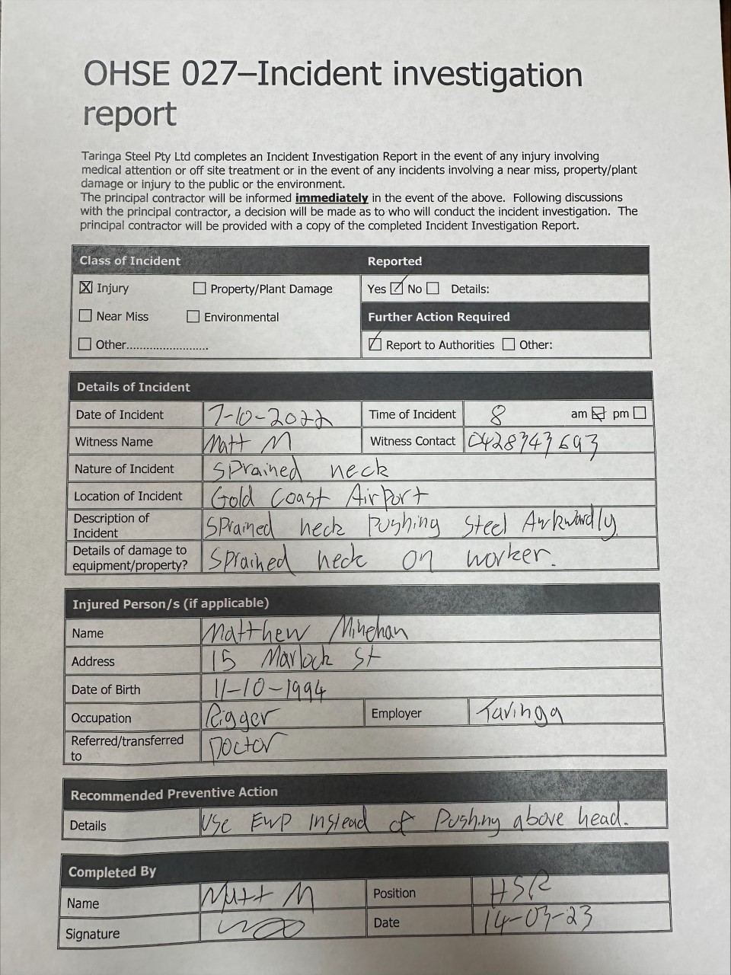
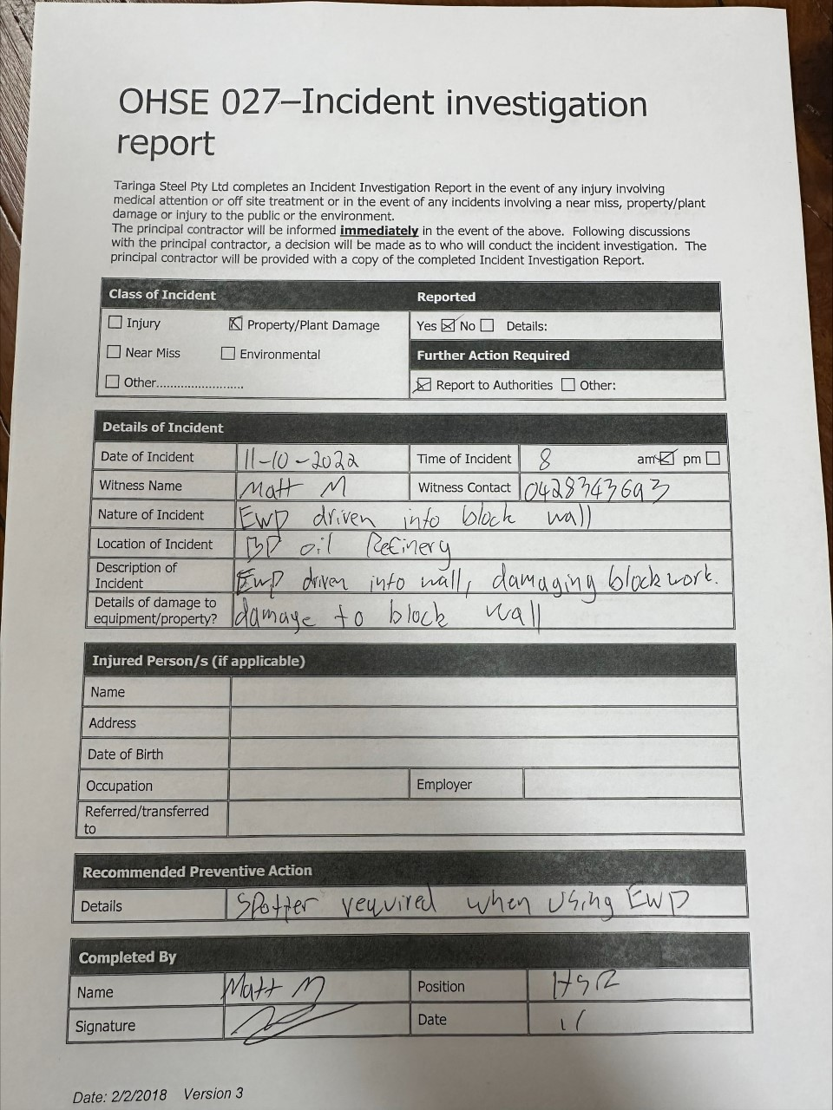
Two completed incident reports

Slide 5
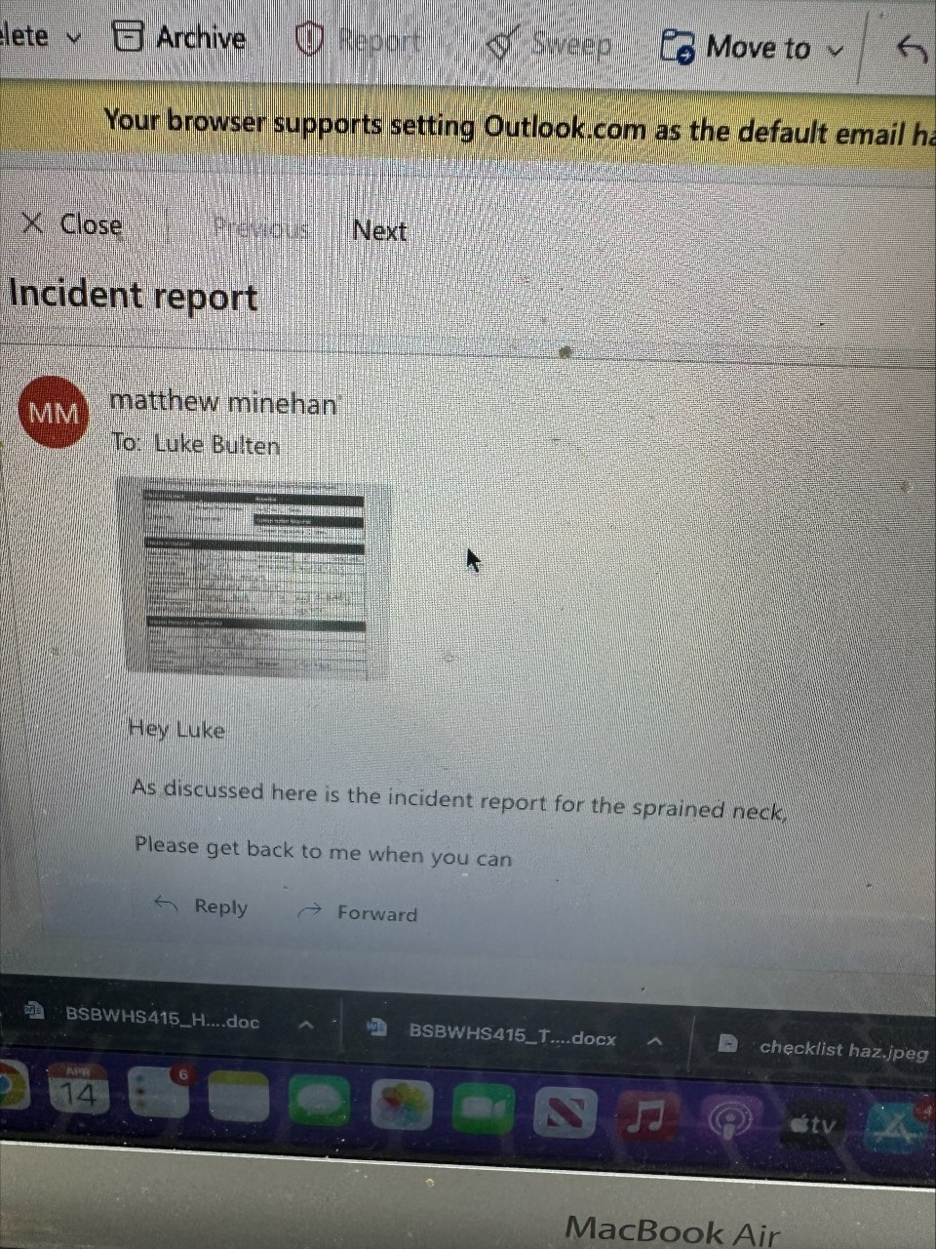
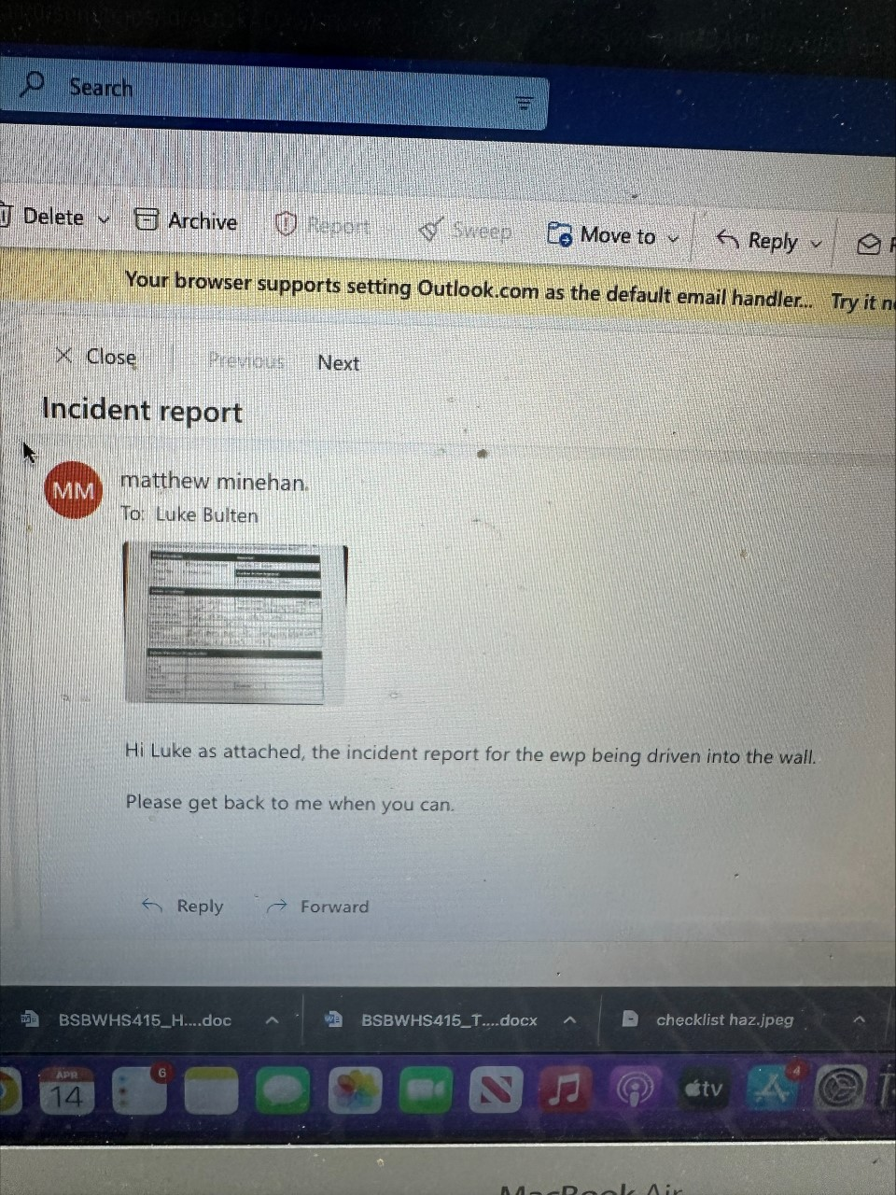
Email communication about incident reports

