Slide 1

FORKLIFT TRUCKS
WORK HEALTH AND SAFETY OFFICER

Slide 2
Assessment criteria
Describe the licence requirements for the operators of forklift trucks.
Describe the safe operating procedures required for forklift trucks within a workplace.
Discuss basic risk management principles applied to the operation of forklift trucks.

Slide 3
Definition
WHS Regulation 2011 s19:
Forklift truck means a powered industrial
truck equipped with lifting media made up of a mast and an elevating load carriage to which is attached a pair of fork arms or other arms that can be raised 900mm or more above the ground, but does not include a pedestrian-operated truck or a pallet truck.

Slide 4
Duties
The person with management or control of powered mobile plant at a workplace must manage the associated risks to health and safety, as far as reasonably practicable.

Slide 5
Hazards
The operation of powered mobile plant exposes workers to a range of risks to health and safety, including the risks of:
the plant overturning
things falling on the operator of the plant
the operator being ejected from the plant
the plant colliding or coming into contact with any person or thing (e.g. workers, other vehicles or plant, energised powerlines)
mechanical or other failures (e.g. hydraulic failures, release of hazardous substances).
Coming in contact with other persons.

Slide 6
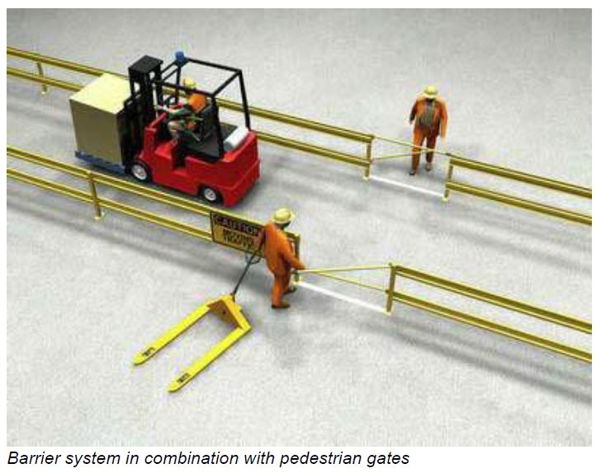
Specific hazards
Confined Spaces
Overhead Electrical Powerlines
Flammable atmospheres and handling flammable materials
Hazardous areas
Working around forklifts

Slide 7
Safety Procedures
Training and information
Personal protective equipment
Pre-start inspection
Procedures for fuel handling and storage, battery changing and charging
Determining weight of loads
Ensure work areas are safe

Slide 8
High risk work licence
Forklift truck – LF
Order-picking forklift truck – LO
order-picking forklift truck means a forklift
truck where the operator’s controls are incorporated with the lifting media and elevate with the lifting media.

Slide 9
Safe Operation
Forklift trucks should be used only for the purpose for which they are designed.
Forklift trucks should only be operated in a manner that is safe, within design parameters and in areas for which it has been designed.

Slide 10
Pre-Operating Safety Check
Operators should inspect the forklift truck and any attachments prior to commencement of each working day shift.
Arrangements for this should be clear especially where more than one operator will use the forklift during the course of each working day or shift.

Slide 11
Inspection and maintenance
PSBU should develop and implement an inspection and maintenance program which addresses the following:
Standards against which the forklift truck should be inspected and maintained;
Frequency of inspection and maintenance;

Slide 12
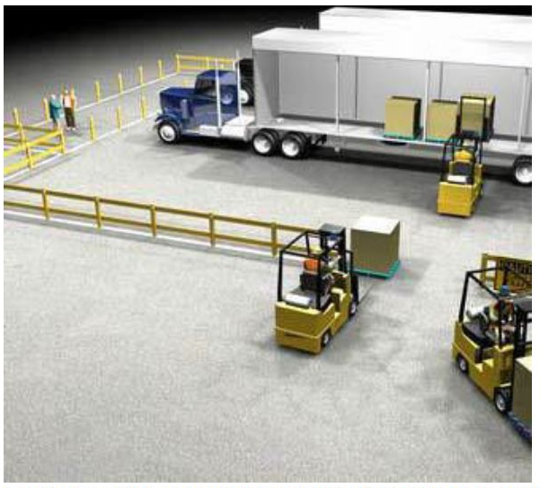
Loading and Unloading
Pallets
Steel racking/
adjustable pallet
racking

Slide 13
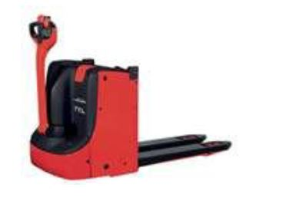
Pedestrian Operated Forklifts
Pedestrian operated forklifts (POFs) differ from forklift trucks because they are not intended to be controlled by an operator riding on the vehicle. While similar safe operating and maintenance procedures apply to all types of forklifts, the following control measures relate specifically to POFs.
A licence/certificate is not
required to operate POFs.

Slide 14


