Slide 1

WORK HEALTH AND SAFETY LAW - OVERVIEW
WORK HEALTH AND SAFETY OFFICER

Slide 2
Learning Outcome
Understand the legislative framework that applies to ensure the health and safety of workers and others in Queensland.

Slide 3
Work-related deaths, injury and illness have a significant impact on workers, the community and businesses.
The purpose of work health and safety (WHS) laws is to reduce the serious economic and social impact on individuals, businesses and the Australian community of work-related incidents.

Slide 4
Queensland Health and Safety Laws
Work Health and Safety Act 2011
(WHS Act),
Work Health and Safety Regulation 2011
(WHS Regulation).

Slide 5
Queensland Health and Safety Laws
This legislation, which took effect on 1 January 2012
Based on the national model WHS legislation developed by Safe Work Australia in consultation with the states and territories.

Slide 6
The nationally uniform laws provide
greater certainty for employers (particularly those operating across state borders)
ensure workers in Australia have the same standard of health and safety protection, regardless of where they work

Slide 7
Adoption of model laws
All Australian jurisdictions, except Victoria and Western Australia, have adopted the model laws

Slide 8
Application of the WHS Act 2011
The WHS Act applies in all Queensland workplaces, except mines, prescribed railway operations and aviation safety, and where the Electrical Safety Act 2002 applies.

Slide 9

Individuals protected under the WHS Act
employees
contractors
subcontractors
outworkers
volunteers
apprentices and trainees
work experience students
employers who perform work.

Slide 10
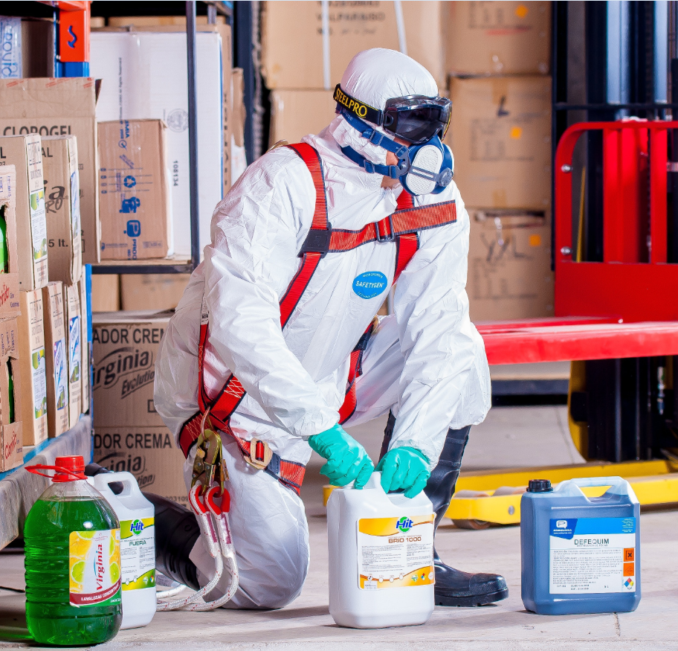
Individuals protected under the WHS Act
The WHS Act also provides protection for the general public so that
their health and
safety is not placed
at risk by work
activities.

Slide 11
The WHS Act aims to:
protect the health and safety of workers and other people by eliminating or reducing workplace risks
ensure effective representation, consultation and cooperation to address health and safety issues in the workplace
encourage unions and employers to take a constructive role in improving health and safety practices
promote information, education and training on health and safety
provide effective compliance and enforcement measures
deliver continuous improvement and progressively higher standards of health and safety.

Slide 12
Section 19 Duties of the PCBU
providing and maintaining a working environment that is safe and without risks to health, including the entering and exiting of the workplace
providing and maintaining plant, structure and systems of work that are safe and do not pose health risks (e.g. providing effective guards on machines and regulating the pace and frequency of work)
ensuring the safe use, handling, storage and transport of plant, structure and substances (e.g. toxic chemicals, dusts and fibres)
providing adequate facilities for the welfare of workers at workplaces under their management and control (e.g. washrooms, lockers and dining areas)
providing workers with information, instruction, training or supervision needed for them to work safely and without risks to their health
monitoring the health of their workers and the conditions of the workplace under their management and control to prevent injury or illness
maintaining any accommodation owned or under their management and control to ensure the health and safety of workers occupying the premises.

Slide 13
Duties of officers, workers and other persons
Division 4 WHS Act outlines the duties of these persons.
A person may have more than 1 duty at the same time

Slide 14
Section 27 Duties of officers
An ‘officer’ of a company is ‘a person who makes or participates in making decisions that affect the whole or a substantial part of the business or undertaking’
An Officer has a positive duty to exercise due diligence in ensuring the organisation complies with the law.

Slide 15
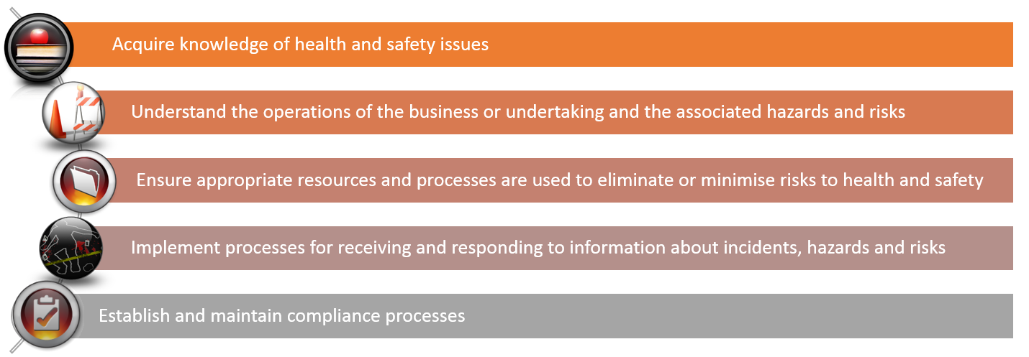
Due Diligence

Slide 16
Section 28 Duties of workers
take reasonable care for their own health and safety and electrical safety
take reasonable care that their conduct, acts or omissions does not adversely affect the health and safety of others or adversely affect the electrical safety of other persons or property
comply, so far as they are reasonably able with instructions
co-operate with reasonable health and safety and electrical safety policies or procedures that have been notified to workers.

Slide 17
Division 3 - Further duties of persons conducting a business or undertaking
persons with management or control of a workplace or in control of electrical equipment
persons with management or control of fixtures, fittings or plant at a workplace
designers of plant, substances, structures, electrical equipment or an electrical installation
manufacturers of plant, substances, structures or electrical equipment
importers of plant, substances, structures or electrical equipment
suppliers of plant, substances, structures or electrical equipment
persons who install, construct or commission plant or structures, or install electrical equipment or an electrical installation
repairers of electrical equipment or electrical Installation
persons conducting a recognised external certification scheme.

Slide 18
Meaning of ‘Reasonably Practicable’
the likelihood of a hazard or risk occurring (i.e. the probability of a person being exposed to harm)
the degree of harm that would result if the hazard or risk occurred (i.e. the potential seriousness of injury or harm)
what the person concerned knows, or ought to reasonably know, about the hazard or risk and ways of eliminating or minimising it
the availability of suitable ways to eliminate or minimise the hazard or risk
the cost of eliminating or minimising the hazard or risk.

Slide 19
ADDITIONAL REQUIREMENTS OF THE WHS ACT
Risk management
Incident notification
Representation and consultation with workers
Issue resolution

Slide 20
Work Health and Safety Officer
notify the PCBU about work health and safety matters
identify hazards and risks to health and safety arising from the work
report in writing to the PCBU any hazards and risks identified arising from the work
immediately notify the PCBU about —
  any incident the WHSO is aware has occurred at the business or undertaking; or
  any immediate or imminent risk to health and safety at the business or undertaking
investigate, or assist in the investigation of, any incidents that occurred at the business or undertaking
accompany and assist an inspector during an inspection of the business or undertaking
establish educational and training programs on matters relating to work health and safety.

Slide 21
Inspector powers and functions
to provide information and advice about how to comply with the law
to help resolve work health and safety issues
to help resolve right of entry disputes
to review a disputed PIN
to issue notices to require compliance with the law
to investigate contraventions and assist to prosecute offences.

Slide 22
Offences and penalties
on-the-spot fines
improvement or prohibition notices
prosecutions
heavy fines
imprisonment
enforceable undertakings and other non-monetary sanctions.

Slide 23
Industrial manslaughter
The Industrial Manslaughter provisions make it an offence for a PCBU, or a senior officer, to negligently cause the death of a worker.
In particular, the offence applies if:
A worker dies, or is injured and later dies, in the course of carrying out work for the business or undertaking (including during a work break); and
The PCBU’s, or senior officer’s, conduct cause the death of the worker (i.e. the action or inaction of the PCBU, or senior officer, substantially contributes to the death) and;
The PCBU, or senior officer, is negligent about causing the death of the worker (i.e. the person’s action or inaction departs so far from the standard of care required).

Slide 24
WHS Regulation
The WHS Regulation covers a wide range of matters including:
representation and participation (Chapter 2)
managing risks to health and safety and general workplace management (Chapter 3)
hazardous work involving noise, hazardous manual tasks, confined spaces, falls, demolition work, electrical safety and energised electrical work, diving work and licensing of high risk work and accreditation of assessors of competency (Chapter 4)
plant and structures (Chapter 5)
construction work (Chapter 6)
hazardous chemicals including lead (Chapter 7)
asbestos (Chapter 8)
major hazard facilities (Chapter 9); and
review of decisions, exemptions, and prescribed serious illnesses (Chapter 11).

Slide 25
Codes of Practice
A code of practice provides practical guidance for people who have work health and safety duties.
Codes give guidance on:
how to achieve the standards required under the Act
effective ways to identify and manage risks.
The WHS Act and WHS Regulation are supported by 38 codes of practice. 20 of these are based on national model codes, and 18 are Queensland specific.

Slide 26
Australian standards
Published documents that set out specifications, procedures and guidelines that aim to ensure products, services and systems are safe, consistent and reliable.
A standard may also be considered information that a duty holder knows, or ought reasonably to know, about a hazard or risk and about the ways to eliminate or minimise the risk.

Slide 27
Australian standards
Standards are not laws, so there is no general requirement to conform to a standard. However, where the WHS laws require conformance with a standard, a failure to do so may result in a breach of the WHS laws.

Slide 28
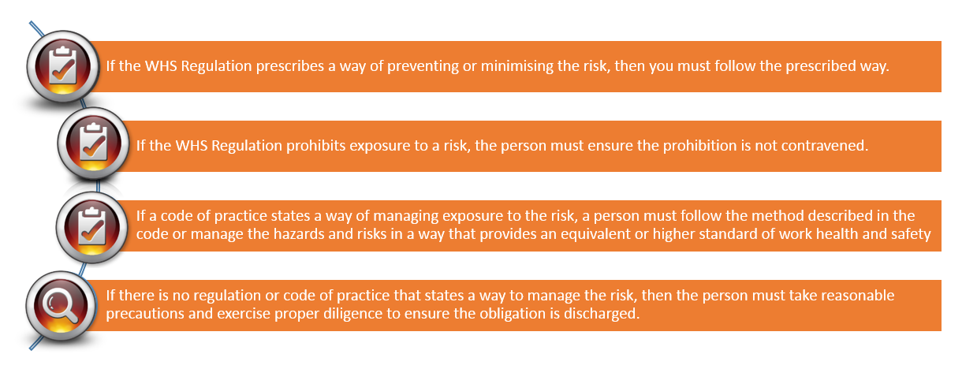
How to meet your WHS obligations

Slide 29

How to meet your WHS obligations

Slide 30
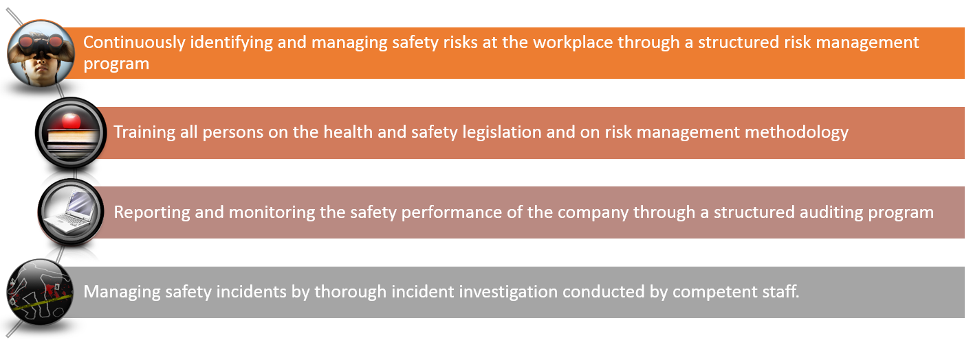
Due Diligence

Slide 31
Amendments to the legislation
Keep update with updates to legislation through:
Queensland Legislation - Office of the Parliamentary Council
Worksafe Queensland
eNEWS
Safework Australia

Slide 32


