Slide 1
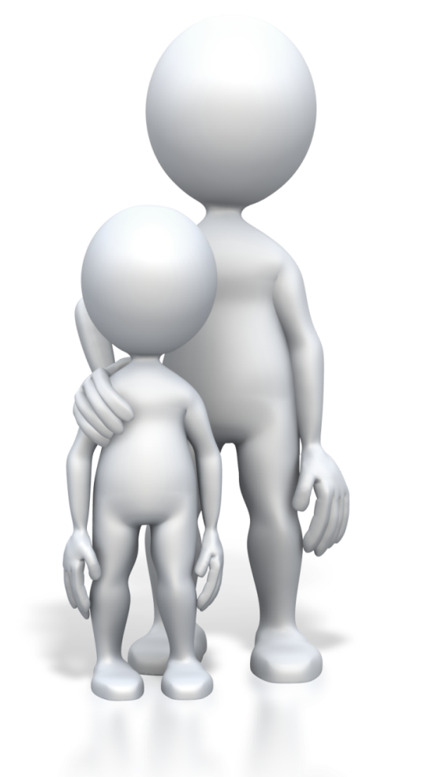
CHCECE002
Ensure the health and safety of children

Slide 2

An introduction on the National Quality Framework (NQF)
The National Quality Framework (NQF) was established in 2012 by the government as a measure to raise the quality and standards of early childhood education and care
This is overseen by the Australian Children’s Education and Care Quality Authority (ACECQA), in conjunction with the individual state and territory regulatory bodies.

Slide 3

The NQF includes:
The National Law and National Regulations
The National Quality Standard (NQS)
National learning frameworks
Assessment and quality rating process.

Slide 4

Support each child’s health needs
1.1 Communicate with families about children’s health needs

Slide 5

Knowledge of children’s health needs
The essential factors are:
To determine if the child has a health condition or concern
To clarify any specific health care needs
To take all possible steps to enable full participation of the child.

Slide 6

Communicating with families
To communicate with families, you will need to have an understanding of how to interact professionally and with consideration to the different types of people you will meet
Never presume all people are alike; take the time to get to know the types of families in your community and at your service
Build a rapport so you can understand family needs.

Slide 7

Questions to ask families when confirming children’s health needs
Is there a diagnosis?
Is medication taken, if so, how much and when should it be administered during service hours?
Are there specific requirements for providing care?
Are there specific requirements for inclusion in activities?
Etc.

Slide 8

The National Quality Standard (NQS)
The seven quality areas under the NQS are:
Educational program and practice
Children’s health and safety
Physical Environment
Staffing arrangements
Relationships with children
Collaborative partnerships with families and communities
Governance and leadership.

Slide 9

Quality area 6 includes:
Standard 6.1 – Supportive relationships with families
Standard 6.2 – Collaborative partnerships.

Slide 10

Activity 1A

Slide 11
Support each child’s health needs
1.2 Maintain confidentiality in relation to children’s individual health needs

Slide 12

Confidentiality requirements
Maintaining confidentiality means:
Not disclosing information to those who should not have this
Discussing health and personal matters away from others so you are not overheard
Storing information safely and securely.

Slide 13

Confidentiality in law
Records and information collected by your organisation will need to be kept for conducting service activities; this is also required by law for your organisation’s reporting requirements
Confidentiality and privacy of information is governed by the Privacy Act 1988, which regulates the handling of personal information.

Slide 14

Health plans
This type of plan is used to provide information to others on the healthcare needs of a child
This should be created by the relevant health professional in conjunction with the parent(s)
or carer(s)
This should contain details of the
requirements for every-day health
and care needs, and also for handling
a situation of emergency.

Slide 15

Medication management plans (MMPs)
This type of plan is used by health professionals as a way to standardise how information on medications is presented within the health profession
From the perspective of a medication management plan as may be used in children’s education and care service environments, this will contain information on the current medications being taken by a child.

Slide 16
Activity 1B

Slide 17
Support each child’s health needs
1.3 Assist others to implement appropriate practices when administering medication

Slide 18

Persons authorised to administer medication
This can include:
Service staff authorised to administer medication
Self-administration
Parents/carers and medical practioners administering medication.

Slide 19

Service requirements for administration of medication
Your service should follow clear practices and procedures for staff administering medication.
This will include:
Accessing the correct health plan/medication record
Obtaining the medication and dispensing equipment
Taking the appropriate child to a safe area for administering medication
Requesting another member of
staff to witness administration
Etc.

Slide 20

Duty of care
Duty of care is a legal duty that you have as a worker to take all reasonable care to avoid others from being harmed when in your care and supervision. You also have an obligation to make sure that your colleagues (and other workers) provide a good standard of care, with due attention.

Slide 21

NQS, quality area 2 – Children’s health and safety, includes:
Standard 2.1 – Each child’s health is promoted:
element 2.1.1 – Each child’s wellbeing and comfort is provided for, including appropriate opportunities to meet each child’s need for sleep, rest and relaxation
element 2.1.4 – Effective illness and injury management and hygiene practices are promoted and implemented.

Slide 22
Activity 1C

Slide 23
Support each child’s health needs
1.4 Check the written authorisation form to administer medication from the parent or guardian

Slide 24

Making appropriate checks with administering medication
Before medication can be administered to a child, a written authorisation must be obtained from the parent or person legally responsible for the child
This must state each medication that the child needs to take and should include any non-prescription drugs.

Slide 25

An authorisation form should contain information such as:
The name of the child
The medication that the child is authorised to be given
The dosage and frequency of administering
Signature of the parent or guardian and the date this was given.

Slide 26
Support each child’s health needs
1.5 Check the medication does not exceed the use-by date, is supplied in its original packaging and displays the child’s name

Slide 27

Medication checks
Medication should:
Be in its original packaging and container
Have the original label with the prescription clearly legible, including the name of the child this is for
Have authorised instructions for administering
Not be used after the expiry date shown
on the packaging/container.

Slide 28

Interpreting medication packaging and information
Expiry (or use-by) dates should be clearly indicated on the outer product box/container or on the primary medication packaging; it may also be given on the prescription label
Do not use medications after the expiry date as these may become unsafe to use or diminish in product quality and purpose.

Slide 29

Following dosage instructions
Some medications may require technical expertise to prepare and administer
All medications should state the measurement of the active ingredients/dosage
Measuring cups and syringes will clearly state the measures with moulded or visible markings and should be provided by the parent/guardian alongside their child’s medication.

Slide 30
Activity 1D

Slide 31
Support each child’s health needs
1.6 Store medication appropriately

Slide 32

Storing children’s medication
Medication should always be stored in a designated safe area away from children and under lock and key.
Factors that can affect the quality of medications include exposure to:
Heat
Air
Light
Moisture.
As a general rule, these conditions should be avoided.

Slide 33

Keep medicine records
Clear records of all medications held in the premises should be made, this ensures that items can be monitored and accounted for, and parents/carers are given medications back at the end of each service day/period.

Slide 34
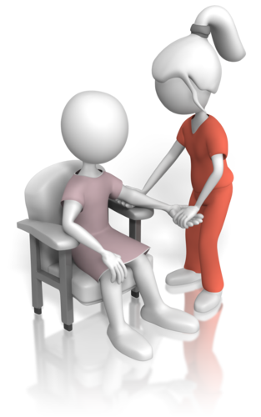
A service medical/first aid room
If your service premises allow, it is a good idea to establish a dedicated medical/first aid room or area which has storage space for children’s medications and also a quiet area for the administration
of these
This room/area should be made secure,
and doors or cupboards locked when
not in use.

Slide 35
Activity 1E

Slide 36
Provide opportunities to meet each child’s need for sleep, rest and relaxation
2.1 Ensure sleep and rest practices are consistent with approved standards and meet children’s individual needs

Slide 37

Requirements for sleep and rest
Children’s requirements for sleep and rest will vary depending on their age, temperament, needs and home life routines
Establishing clear routines with different service activities will help children to respond in more appropriate ways to sleep and rest time.

Slide 38

Environments that promote sleep and rest
Dimming lights, or closing blinds or curtains to reduce light levels
Providing clean bedding and appropriate beds and cots for comfortable sleep
Speaking in quieter and softer tones to indicate the sleep/rest period has begun
Reducing noise levels by closing windows/doors and partitioning space
Etc.

Slide 39
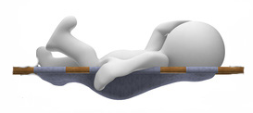
SIDS and Kids safe sleeping
The recommendations include the following:
Place babies and young children on their back for sleeping
Not covering babies faces (and not using soft toys or pillows)
Not exposing babies to cigarette smoke
Providing a safe sleep environment, including cots, beds, mattresses and bedding.

Slide 40
Activity 2A

Slide 41
Provide opportunities to meet each child’s need for sleep, rest and relaxation
2.2 Provide appropriate quiet play activities for children who do not sleep or rest

Slide 42

Quiet play
Children who do not want to sleep or stay at rest should be allowed to make that decision themselves and decide on their own needs. They should be allowed to engage in appropriate quiet activities.

Slide 43

The Early Years Learning Framework
Learning outcome 3: Children have a strong sense of wellbeing:
Children become strong in their social and emotional wellbeing
Children take increasing responsibility for their own health and physical wellbeing.

Slide 44

Quiet play activities
Quiet play will include:
Completing or solving simple puzzles
Using colouring-in books
Playing with sticker activity books
Playing with building blocks or soft toys
Reading or looking at picture books
Simple crafts, such as making a collage.

Slide 45
Activity 2B

Slide 46
Provide opportunities to meet each child’s need for sleep, rest and relaxation
2.3 Respect children’s needs for privacy during any toileting and dressing and undressing times

Slide 47

Addressing personal care needs of children
Children should be supported to learn the skills that they need in life, such as how to wash their hands, brush their teeth, use the toilet and dress themselves
It can take time for children to learn such skills and this will be linked to their abilities and own particular stage of development.

Slide 48

Supporting children may include:
Showing them what to do
Helping them directly to do the activity
Explaining they need to do
Answering questions or giving advice
Providing them with a safe place or the right environment to do the activity
Giving encouragement to the child
Taking time to allow the child to try out the activity on their own (under supervision)
Not rushing the child into doing something they are not ready to do.

Slide 49

Privacy
Privacy is an important aspect within a social environment. It is about respecting the individual child’s privacy so that each child feels comfortable and safe in the routines and activities that they do;
it is also about teaching privacy so children are aware that others have personal boundaries
which may be different to their own.

Slide 50
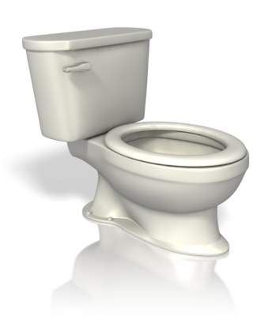
Toileting
Toileting requirements will include:
Training young children to transition from nappies to potty and toilet
Assisting with undressing/dressing needs
Helping children to sit on/access toilets safely
Assisting with toilet flushing
Attending to personal hygiene (i.e., helping children to wipe themselves and washing of hands).

Slide 51
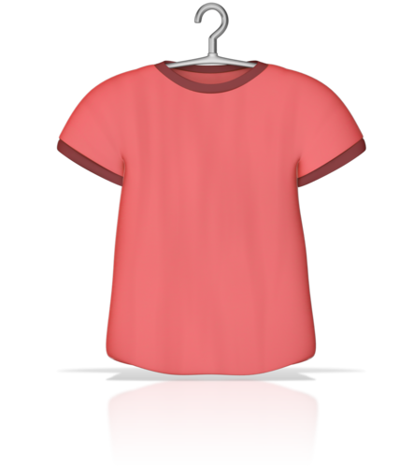
Dressing and undressing
Dressing and undressing will include:
Unbuttoning/buttoning clothing
Using fasteners, such as Velcro, zips and press studs
Removal of clothing items
Putting on clothing items (checking these are positioned correctly)
Putting on shoes and fastening these (e.g., tying laces and using Velcro strips).

Slide 52
Activity 2C

Slide 53
Provide opportunities to meet each child’s need for sleep, rest and relaxation
2.4 Ensure children’s and families’ individual clothing needs and preferences are met, to promote children’s comfort, safety and protection within the scope of the service requirements for children’s health and safety

Slide 54

Children’s comfort and safety in clothes
Clothing for activities should include outfits for:
Active indoor play
Active outdoor play
Outdoor recreation
Indoor sleep and rest periods.

Slide 55

Clothing to avoid:
Decorations on clothing which may catch
Long strings or necklaces that may cause a child to choke
Delicate fabrics and best clothes which may spoil
Long skirts and higher heeled shoes that
my cause girls to trip
Difficult or multiple fastenings which
are difficult for a child to use.

Slide 56
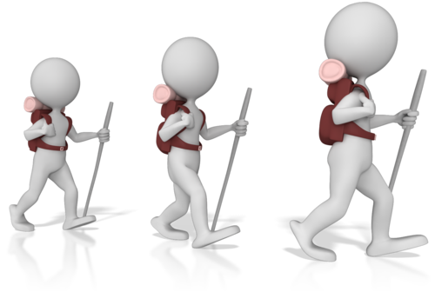
Clothing that should be encouraged:
Shoes that cover and protect the foot, with flat/small heels that support healthy foot development
Shorts or trousers for active play which are practical and safe for girls as well as boys
Long sleeved tops to protect from sun exposure
(as well as sun hats and use of sun cream)
Elasticated waistbands that pull-up and
which support children to learn
how to dress
Etc.

Slide 57
Activity 2D

Slide 58
Provide opportunities to meet each child’s need for sleep, rest and relaxation
2.5 Share information about individual children’s rest and sleep with families as appropriate

Slide 59

Sharing information with the child’s family
The Early Years Learning Framework supports working together with families to provide knowledge between both home and care environments. This enables a consistent approach in development and learning so both parent/carer and the service can work towards achieving the same goals in the same ways.

Slide 60

Information you should share on sleep and rest includes:
How well the child sleeps or rests at the service
How long they sleep for
Whether they prefer to engage in quiet play
Their sleep routines at the service
What strategies work best to help encourage sleep or rest
If there are any problems or issues involving sleep and rest.

Slide 61
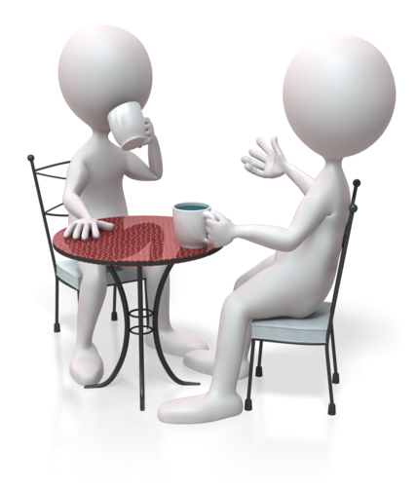
Meeting with families
Sharing information is about:
Giving details and facts that are relevant
to the needs of the child
Providing opinions and viewpoints
Listening to families as they provide their own information in return
Listening and responding to what you have heard in constructive and positive ways
Etc.

Slide 62
Activity 2E

Slide 63
Implement effective hygiene and health practices
3.1 Consistently implement hygiene practices that reflect advice from relevant health authorities

Slide 64

Assess service hygiene practices
Your service should use approved hygiene practices to maintain cleanliness and safety throughout its environments.
As mentioned in section 1.3 of this unit, the NQS quality area 2 has the following stipulation:
Element 2.1.2 – Effective illness and injury management and hygiene practices are promoted and implemented.

Slide 65

Service environments include:
Toilet facilities
Kitchen and eating area
Outdoor play area
Indoor play area
Sleep and rest area
Quiet play area
Reception area for parents/carers
Administrative office
Medical/first aid area.

Slide 66

Cleaning at the service
Cleaning includes:
Cleaning away debris
Mopping floors and disinfecting surfaces
Wiping down/sanitising equipment and toys
Tidying service areas
Spot cleaning
Washing hands before and after activities
Using personal protective equipment (PPE).

Slide 67
Implement effective hygiene and health practices
3.2 Support children to learn personal hygiene practices

Slide 68

Personal hygiene learning for children
Personal hygiene is an important requirement for healthy development, this includes:
Washing hands after using the toilet and before eating food
Throwing own items of rubbish into the bin
Washing faces and cleaning teeth
Hair hygiene.

Slide 69

The importance of oral hygiene
As children develop their fine motor skills, they can learn the essential techniques for brushing teeth
It is important to educate parents/carers and children on the importance of oral hygiene and the need to reduce intake of sugary foods and drinks.

Slide 70
Activity 3A

Slide 71
Implement effective hygiene and health practices
3.3 Implement the service health and hygiene policy and procedures consistently

Slide 72

Service health and hygiene policy
Policy may cover things such as:
Health authority guidance
The aims of health and hygiene
Legal requirements for health and hygiene,
e.g., immunisation records for children
Routine hygiene
Minimising risks of illness
Managing situations of sickness and infection outbreaks
Etc.

Slide 73
Implement effective hygiene and health practices
3.4 Ensure that service cleanliness is consistently maintained

Slide 74

Maintain service cleanliness
No matter how busy the day is, it is essential that service cleanliness is maintained
Ensure that time is given to health and hygiene, such as monitoring children as they interact in service environments, and providing suitable learning activities to help educate children
Staff should work supportively with
each other to manage health
and hygiene.

Slide 75
Activity 3B

Slide 76
Implement effective hygiene and health practices
3.5 Observe and respond to signs of illness and injury in children and systematically record and share this information with families

Slide 77

Signs of illness in children
Signs of sickness may include:
Feeling or being sick
Having a stomach ache or stomach cramps
Having a headache
Having an upset stomach or diarrhoea
Having a high temperature
Displaying signs of a fever
A sore throat
A runny or blocked nose
Etc.

Slide 78

Signs of injury in children
Signs of injury may include:
Bruises, cuts and scratches
Swollen or inflamed areas
A child who is in pain, crying or showing signs of distress
A child is holding a part of their body awkwardly or protectively
A child tells you they have hurt themselves.

Slide 79

Reporting requirements under the National Law
Under the Education and Care Services National Regulations, an incident, injury, trauma and illness record must be kept. This record should be accurate, confidential and stored for each child until they reach 25 years of age, any incident should be recorded within 24 hours of the occurrence.
Parents/carers should also be notified as soon as possible and within 24 hours of any incident, injury, trauma or illness relating to their child.

Slide 80

A serious incident
Under the Education and Care Services National Law, regulatory authorities in each jurisdiction must be notified of any serious incident at an approved service
A serious incident must be documented
as an incident, injury, trauma and illness
record as soon as possible and within
24 hours of the event.

Slide 81
Activity 3C

Slide 82
Implement effective hygiene and health practices
3.6 Consistently implement the service policies for the exclusion of ill children

Slide 83
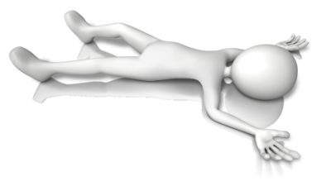
Excluding sick children
The priority is to maintain the health and safety of all children and service staff, and this will mean containing any source of infection/illness as soon as this is made known. It also means ensuring the child is well-looked after and is given access to the right care.

Slide 84

Consistently implementing policies for exclusion of ill children
Being vigilant to how children are feeling and behaving
Observing and acting on any symptoms or signs of illness
Making sure the health and safety of other
children and staff are not put at risk
Isolating ill children in case there is risk
of infection
Following service procedures and
protocols to maintain children’s health and safety.

Slide 85
Activity 3D

Slide 86
Implement effective hygiene and health practices
3.7 Discuss health and hygiene issues with children

Slide 87

Learning opportunities with health and hygiene
Topics for discussion will need to be chosen for their relevancy to the children and the ages and stages of development they are at. Any topic that is chosen will need to be discussed in ways that children can understand and relate to.

Slide 88
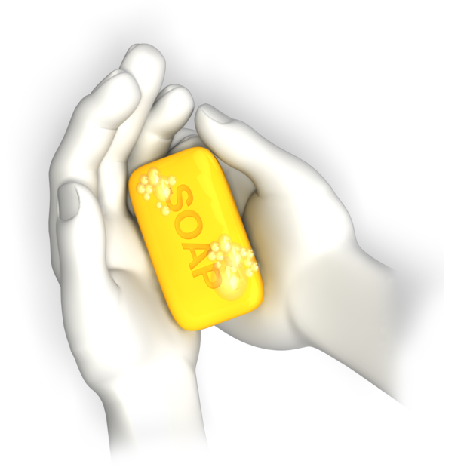
Washing hands
It is important to educate children on the need for clean and hygienic hands to prevent the risk of germs and illness; it also is important to prevent spreading risk of infection to others
This includes washing in between fingers and where the hand meets the wrist; it is also about cleaning nails as dirt can become easily embedded.

Slide 89

Personal hygiene topics also include:
Oral hygiene
Hair care
Blowing noses
Coughing and sneezing
Food hygiene
Toileting.

Slide 90
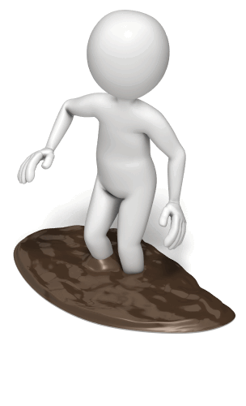
Situations for personal hygiene discussion may include:
When learning about the human body
When engaged in personal hygiene routines at the service
Before or after messy play
Before eating
In personal hygiene learning activities
When reading stories that involve personal hygiene learning.

Slide 91
Activity 3E

Slide 92
Supervise children to ensure safety
4.1 Supervise children by ensuring all are in sight or hearing distance at all times

Slide 93

Supervising children
Supervising is required for the following reasons:
To ensure children do not have an accident
To direct planned activities
To watch unplanned activities
To help children participate in activities
To facilitate development and learning
To attend to care needs
To ensure children do not wander off, get
lost or taken from the premises without
prior arrangement and consent.

Slide 94
Supervise children to ensure safety
4.2 Adjust levels of supervision depending upon the area of the service and the skill, age mix, dynamics and size of the group of children, and the level of risk involved in activities

Slide 95

Levels of supervision
With different ages and types of children, comes the need for adjustment to supervision. Factors that may impact on the level of supervision include the size of the group, age-ranges, development issues, group dynamics and the activity itself.

Slide 96

Size of the group
How many children you have in the group will affect the number of educators that are required for supervision
ACECQA educator-to-child ratios exist as part of the NQF.

Slide 97

Development needs of the group
The development and ability of the child will influence supervision needs in activities; all children should be given the chance to participate in age and development-appropriate activities.

Slide 98

Group dynamics
How your group behaves can have a direct influence on the group itself and how well they participate in activities
When children interact with each other, group dynamics will come into play and children may change their behaviours depending on who they are with.

Slide 99
Activity 4A

Slide 100
Supervise children to ensure safety
4.3 Exchange information about supervision with colleagues to ensure adequate supervision at all times

Slide 101

Maintaining supervision
Supervision should be maintained at all times – if another colleague is due to take over supervision, you must ensure they are present before you leave the children unattended.

Slide 102

Information exchange
Your service may have specific handover requirements for information exchanges, for example:
How many children in attendance
What occurred during your period of supervision
Any concerns you may have had with the children
Any requirements that need to be met with
the children.

Slide 103

Discussions with colleagues
Working alongside your colleagues will require you to develop good working relationships which are supportive.
Communications may include:
Staff meetings
Progress updates
Handover discussions
Activity planning
Assessments.

Slide 104
Activity 4B

Slide 105
Minimise risks
5.1 Assist in the implementation of safety checks and the monitoring of buildings, equipment and the general environment

Slide 106

Managing risks in and around the service
Your service should conduct risk management activities to ensure all risks to health and safety are identified and controlled. This will include conducting safety checks to determine exactly where risks and hazards are and how these may impact on those at the service.

Slide 107

Fire safety
Your service needs to comply with health and safety standards for fire in your state/territory
This includes ensuring buildings comply with fire safety standards, use of smoke alarms, and regular safety checks on electrical and
gas equipment
A fire blanket should be located near
to cooking equipment
Fire extinguishers should be placed
in easy to reach areas, for example,
in corridors.

Slide 108

Conducting safety checks
Safety checks should be carried out regularly, for example, checking outdoor areas each day before they are used
Viewing areas from the perspective of a child can help you to identify the risks more quickly
This is also known as a risk assessment or hazard check.

Slide 109

Risk assessment tools
Risk checklists and questions
Risk matrix
Risk management strategies.

Slide 110
Activity 5A

Slide 111
Minimise risks
5.2 Consistently implement policy and procedures regarding the use and storage and labelling of dangerous products

Slide 112

Using dangerous products
Dangerous products include:
Cleaners and cleaning solutions
Paints
Glues
Igniters
Matches or lighters
Aerosols
Batteries.

Slide 113

Using dangerous products
Products which are considered dangerous should be used carefully and in accordance to service guidelines
These products can be varied, and product instructions/equipment manuals should be read and followed
Chemicals will also have own safety data sheets to provide you with in-depth instructions for use and safe handling.

Slide 114

Storing dangerous products
Items should be kept in a designated storage area which is designed to hold the items in the correct conditions as per instructions
Products should be placed in the same area each time so they are easily located and can be documented in stock and safety checks
Always be aware of how items should or should not be stored together.

Slide 115

Labelling of dangerous products
Labels should be retained on products so information is clearly displayed
Storage areas should also be clearly labelled and signed to maintain health and safety within the service
The globally harmonised system of classification and labelling of chemicals (GHS) provides standard information and pictograms for businesses to use.

Slide 116
Activity 5B

Slide 117
Minimise risks
5.3 Follow service procedures for the safe collection of each child, ensuring they are released to authorised people

Slide 118

Procedures for releasing children from the service
Procedures should include the following factors:
A verification of identity
Checking unauthorised persons who come to collect and not allowing them to take the named child
Not allowing a child to leave with a parent
or authorised person when they are
under the influence of alcohol or drugs
Etc.

Slide 119
Activity 5C

Slide 120
Minimise risks
5.4 Assist in the supervision of every person who enters the service premises where children are present

Slide 121
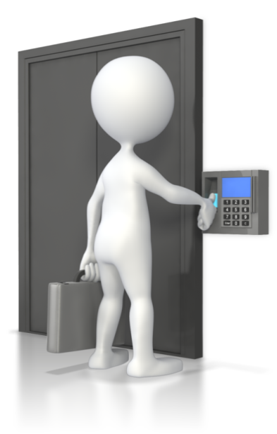
Security of premises
Your service should ensure procedures are in place for checking visiting persons
These should enable service staff to identify who people are and why they are visiting
Each member of staff should be fully
trained in how to manage and supervise
persons entering service premises.

Slide 122

Procedures may include:
Meeting visitors at the gate or when
opening a secured entrance door
Checking the identity and reason for
persons visiting
Checking forms of identification of
work persons/tradespeople
Signing in visitors at the entrance
Assisting the visitor in the purpose of their visit
Supervising the visitor for the duration of
their visit.

Slide 123

Risks to children
Children are less aware of the risks that may threaten their safety and are not able to react or respond to situations as quickly as an adult can. As well as threats from persons visiting, there are also threats to safety if a child wanders away from the service premises through an open door or gate.

Slide 124
Activity 5D

Slide 125
Minimise risks
5.5 Discuss sun safety with children and implement appropriate measures to protect children from over-exposure to ultraviolet radiation

Slide 126

Sun safety
Sun safety is about making sure that you and the children at the service are protected from the harmful ultraviolet (UV) rays that emanate from the sun.
There are three main UV rays as follows:
UVA rays
UVB rays
UVC rays.

Slide 127

Sun protection includes:
Wearing sun hats
Applying a sun protection lotion
Covering arms and legs with light clothing
Wearing clothing with UV protection
Wearing sunglasses
Not being outside for prolonged periods of time in direct sunlight
Not being outside during the hottest part of the day
Participating in outdoor activities in shaded areas.

Slide 128

The SunSmart program
SunSmart is an initiative of the Cancer Council Australia for early childhood care and schools. Programs may differ between states and territories but are about developing effective sun safe policy for services and schools so that activities can be conducted with the right awareness.

Slide 129
Activity 5E

Slide 130
Minimise risks
5.6 Check toys and equipment are safe for children and safe to use in their proposed area

Slide 131

Toy safety standards
Toys should comply with the AS/NZS 8124 series of standards, although this is not compulsory, Australian Consumer Law (as managed by the Australian Competition and Consumer Commission) requires that toys are safe for children to use.

Slide 132

Toys that comply with safety standards will be:
Designed with safety in mind
Made from materials that are safe for children to play with
Tested for use
Subject to recall if a product is later found to be unsafe.

Slide 133
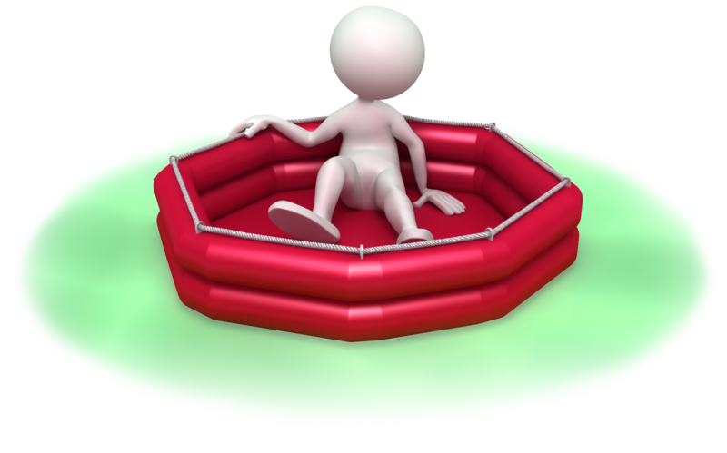
Equipment for children
Equipment used by children can include large or fixed toys, such as climbing frames or paddling pools
Equipment in use by your service should also comply with Australian Consumer Law (ACL) and corresponding product safety requirements.

Slide 134

Risk assessment of toys
For example, toys and equipment may be unsafe to use when:
Parts are small or loose
There are hinges of fixings that may trap fingers or fall suddenly
Edges or corners are sharp of jagged
Batteries are easily accessible
There are long strings and cords attached
These are projectile toys
Etc.

Slide 135
Activity 5F

Slide 136
Minimise risks
5.7 Remove any hazards immediately or secure the area to prevent children accessing the hazard

Slide 137

Controlling hazards
Hazards to health and safety in a child care service may include:
Trip hazards from toys left out
Fall hazards from incorrectly placed toys or
stacked equipment
Slip hazards from spilled drinks or
craft paints
Risk of infection from a child
who is unwell
Etc.

Slide 138

Securing a hazardous area
To make an area secure, you will need to prevent others from accessing the hazardous area. This can be done by placing safety barriers or barricades around the area to prevent access and/or notifying colleagues of the hazard.

Slide 139

Develop children’s awareness to safety
Your service can help children to:
Identify common hazards and dangers
Determine steps to take if confronted with a hazard
Think about how to remain safe when spotting
a hazard
Understand what hazards are and how
they can affect them and others.

Slide 140
Activity 5G

Slide 141
Contribute to the ongoing management of allergies
6.1 Identify and recognise signs, symptoms and key characteristics of allergies and anaphylaxis

Slide 142

Allergies
Common allergies include:
Grass and tree pollen
Foods
Medications
Dust mites
Animal dander (skin flakes or animal hair)
Insect bites and stings
Latex
Mould
Chemicals.

Slide 143

Signs and symptoms of allergies include:
Blocked or runny nose
Sneezing
Red, itchy or watery eyes
Facial swelling
Wheezing or coughing
A red and itchy rash on the skin
Asthma or eczema symptoms
Stomach pains and being sick.

Slide 144
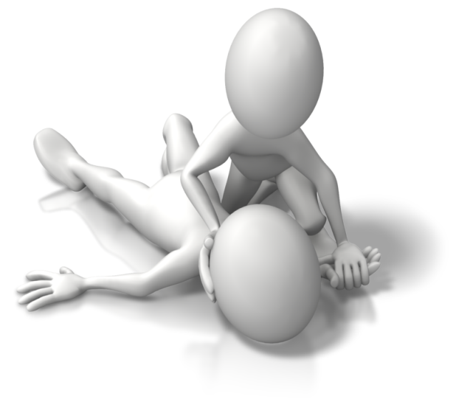
Anaphylaxis
This is where a reaction to an allergen is extreme, causing the affected person to become dangerously ill; this is known as anaphylaxis or an anaphylactic shock.

Slide 145
Activity 6A

Slide 146
Contribute to the ongoing management of allergies
6.2 Apply organisational risk-management strategies for children with severe allergies

Slide 147

Use strategies for managing allergies in children
Risk management strategies should be developed to help all staff interact and work safely with children at risk. These actions help to manage children with allergies and help prevent anaphylaxis; this can also give staff the confidence to handle difficult situations.

Slide 148
Contribute to the ongoing management of allergies
6.3 Follow organisational policies and legislative requirements in relation to medication for anaphylaxis

Slide 149

Adrenalin auto-injectors
A child or person at risk from experiencing anaphylaxis may carry an auto-injector for their personal safety; this should be detailed in the particular child’s medication record
Children will be prescribed adrenalin in an auto-injector specific to their weight, and this must be used by the child it has been prescribed for.

Slide 150

Type of auto-injectors
Currently, the type of auto-injector used by the majority of people in Australia is an EpiPen
Another type of auto-injector, the Anapen, may also be used in Australia.

Slide 151

Storing Adrenalin (epinephrine)
The general advice given for storing adrenalin is that it should be kept between 15 degrees Celsius and 25 degrees Celsius.
Other considerations are:
Keep out of the light (and sunlight) as
this can degrade the strength of the
adrenalin
Do not place in the refrigerator or freezer
and this may impair the mechanics of the pen
Never use after the expiry date.

Slide 152
Activity 6B

Slide 153
Contribute to the ongoing management of asthma
7.1 Identify signs, symptoms and triggers of asthma

Slide 154

Asthma
Asthma is a condition of the airways in the lungs; when a person has an asthma flare-up, the muscles of the airways tighten, and the airways swell and reduce in size, making breathing difficult. There may also be excess mucus in the airways.

Slide 155

Signs and symptoms of asthma:
Breathlessness
Wheezing
Tight feeling in the chest
Hayfever symptoms (e.g., runny or blocked nose, itchy eyes and sneezing)
Prolonged coughing
Unable to speak a full sentence
May experience tugging of the skin between ribs or base of the neck.

Slide 156

Asthma triggers
Triggers of asthma can include:
Exercising
Having allergies
Having an illness which affects the respiratory system
Stress and emotions
Pollution
Food or medication
Chemicals
Pollen
Indoor air pollution.

Slide 157
Activity 7A

Slide 158
Contribute to the ongoing management of asthma
7.2 Identify children who have an asthma management plan and follow that plan

Slide 159
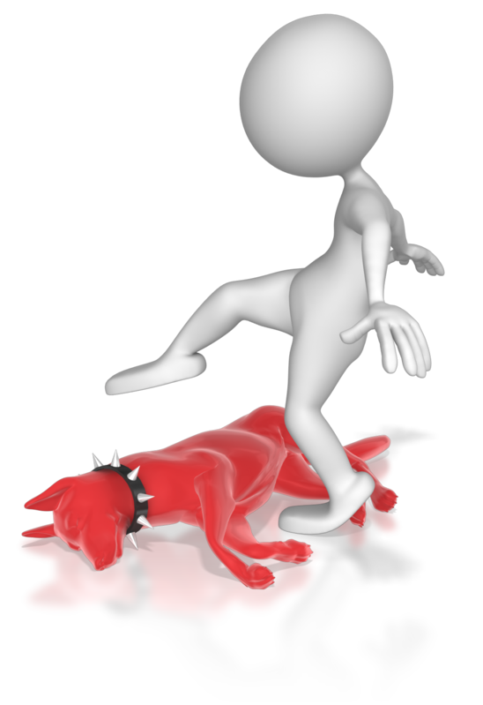
The asthma management/action plan
An asthma management plan will contain information such as:
Maintenance and preventative medications
Individual triggers and how to manage flare-ups
Treating and adjusting treatment to manage symptoms
Medications taken and to be used in a
flare-up or attack
Managing increased severity of asthma
When to seek medical help.

Slide 160
Contribute to the ongoing management of asthma
7.3 Follow organisational policies and legislative requirements in relation to medication for asthma

Slide 161

Organisational and legislative requirements for asthma
Your service should ensure that asthma management is included in managing health needs
Services are required to comply with the Education and Care Service National Law and Regulations regarding medical care of children at the service.

Slide 162
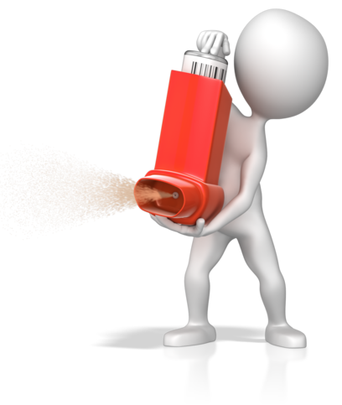
Medication for asthma
Different medications exist to help in the management of asthma; these will be prescribed by the GP/health specialist as part of the child’s/person’s asthma management (or action) plan.
These include:
Preventer medication
Reliever medication
Acute medication
Severe asthma treatments.

Slide 163
Activity 7B

Slide 164
Summative Assessments
Summative assessments consist of:
Skills Activity
Knowledge Activity
Performance Activity.
Your assessor will provide you with further guidance on how and where to complete these assessments.

Slide 165

Summary and Feedback
Did we meet our objectives?
How did you find this session?
Any questions?

