Slide 1
Business Studies
Presented by: Kyla Avila

Slide 2

Year 10 – certificate I IN BUSINESS

Slide 3
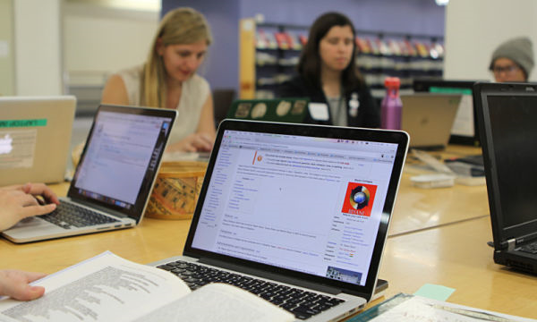
Year 11 – Certificate II IN BUSINESS

Slide 4

Year 11 – certificate ii in Tourism

Slide 5
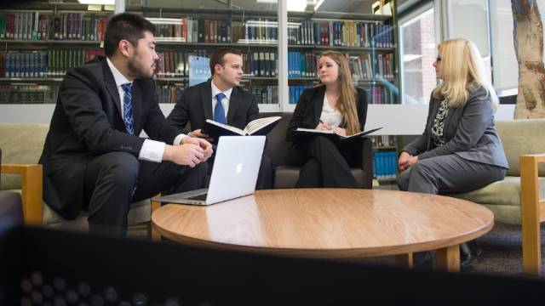
Year 12 – Certificate iii IN BUSINESS

