Slide 1

BSBITU201
Produce simple word processed documents

Slide 2

Housekeeping
Emergency procedures
Mobiles and security Issues
Break times and smoking policy
This course is interactive – ask questions
Practise respect and confidentiality
Ground rules

Slide 3
Objectives
Discover how to prepare to produce documents
Know how to produce documents
Learn how to finalise documents
Gain the skills and knowledge required for this unit

Slide 4

Prepare to produce documents
1.1 Use safe work practices to ensure ergonomic, work organisation, energy and resource conservation requirements are met

Slide 5

Work Health and Safety Act 2012
Duty Holder
Primary Duty of Care
Workers’ responsibilities
General workplace health and
safety.

Slide 6

Ergonomic requirements
Avoiding radiation from computer screens
Chair height, seat and back adjustment
Document holder
Footrest
Keyboard and mouse position.

Slide 7

Ergonomic requirements
Lighting
Noise minimisation
Posture
Screen position
Workstation height and
layout.

Slide 8

Work organisation requirements
Exercise breaks
Mix or repetitive and other activities
Rest periods.

Slide 9

Conservation requirements
Disposing of non-confidential waste paper in recycling bins
Double-sided paper use
Re-using paper for rough drafts (observing confidentiality requirements)
Utilising power-save options for
equipment and lighting
Recycling business equipment
such as computers, machinery
and ink cartridges.

Slide 10

Activity 1A

Slide 11
Prepare to produce documents
1.2 Identify document purpose, audience and presentation requirements, and clarify with relevant personnel as required

Slide 12

Documents
Agendas
Briefing papers
Envelopes
Faxes
Labels
Letters.

Slide 13

Documents
Mail merges
Memos
Minutes
Short reports
Simple one-page flyers
Standard form letters.

Slide 14

Purpose
Inform
Instruct
Persuade
Describe
Educate.

Slide 15
Activity 1B

Slide 16
Prepare to produce documents
1.3 Identify organisational and task requirements for document layout and design

Slide 17
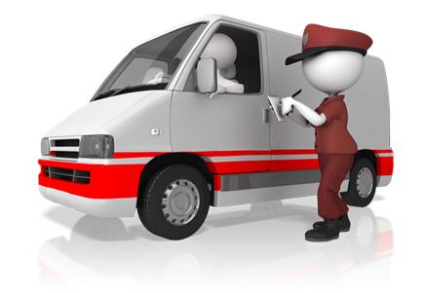
Organisational requirements
Corporate colour scheme
Company logo
Consistent corporate image
Content restrictions
Established guidelines and procedures for document production
House styles
Observing copyright legislation
Organisation name, time, date,
document title, filename etc.
In header/footer
Templates.

Slide 18
Activity 1C

Slide 19
Produce documents
2.1 Format document using appropriate software functions to adjust page layout to meet information requirements, in accordance with organisational style
and presentation requirements

Slide 20
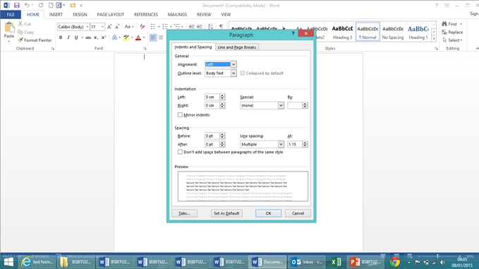
Formatting documents
Alignment on page
Columns
Company logo/letterhead
Enhancements to format - borders, patterns and colours
Enhancements to text –
colour, size, orientation
Headers/footers
Margins
Page orientation.

Slide 21
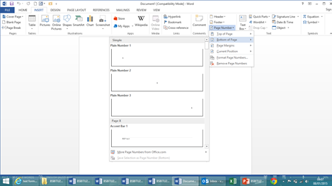
Software functions
Default settings
Document protection
Grammar check
Headers/footers
Indent
Line spacing
Page numbers
Page set up
Paragraph formatting
Spell check
Tabs
Text formatting.

Slide 22
Activity 2A

Slide 23
Produce documents
2.2 Use system features to identify and manipulate screen display options and controls

Slide 24
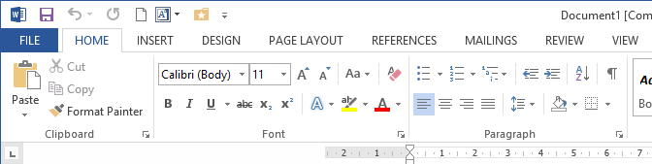
Screen display options
Layout view
Maximise/
minimise
Normal view
Page view
Print preview
Ruler
Toolbars
Zoom percentage.

Slide 25
Activity 2B

Slide 26
Produce documents
2.3 Use manuals, user documentation and online help to overcome problems with document presentation and production

Slide 27
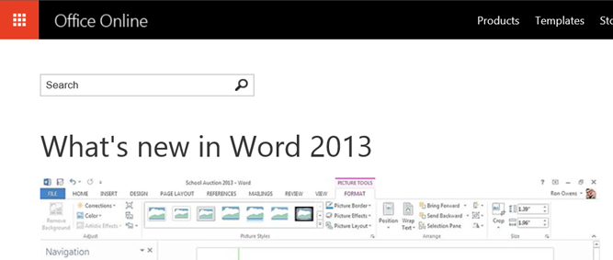
Online assistance
User forums
Manufacturer forums
FAQs on manufacturer websites
Live chat with employees of the manufacturer
Video tutorials
Manual downloads
How-to guides.

Slide 28
Activity 2C

Slide 29
Finalise documents
3.1 Ensure final document is previewed, checked, adjusted and printed in accordance with organisational and task requirements

Slide 30

Checking documents
Accuracy of information
Consistency of layout
Ensuring instructions with regard to content and format have been followed
Grammar
Proofreading
Spelling, electronically and
manually.

Slide 31
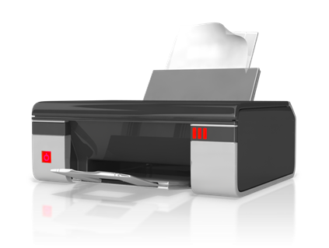
Printing documents
Basic print settings
Multiple copies
Odd or even pages
Print preview
Printer setup
Specified pages
Whole document.

Slide 32
Activity 3A

Slide 33
Finalise documents
3.2 Ensure document is prepared within designated timelines and organisational requirements

Slide 34

Designated time lines
Organisational timeline e.g. Deadline requirements
Timeline agreed with internal/external client
Timeline agreed with supervisor/person requiring document/s.

Slide 35
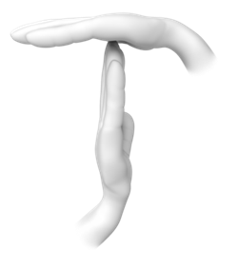
Organisational requirements
Business and performance plans
Personal performance plans
Goals, objectives, plans, systems and processes
Legal and organisation policies, guidelines and requirements
WHS policies, procedures and
programs.

Slide 36
Activity 3B

Slide 37
Finalise documents
3.3 Name and store document in accordance with organisational requirements and exit application without information loss/damage

Slide 38

Naming and storing documents
Appropriate file type
Authorised
File names according to organisational procedure e.g. Numbers rather than names
File names which are easily identifiable in relation to the content
File/directory names which
identify the operator, author,
section, date etc.

Slide 39

Naming and storing documents
Organisational policy for backing up files
Organisational policy for filing hard copies of documents
Security
Storage in folders/sub-folders
Storage on hard/floppy disk drives,
CD-ROM, tape back-up.

Slide 40
Activity 3C

Slide 41
Skills and Knowledge Activity

Slide 42
Major Activity
This activity should take anywhere between an 1-2 hours to complete and can be found at the end of your workbook.
Your instructor will let you know whether they wish for you to complete it in session time or your own time.

Slide 43

Summary and Feedback
Did we meet our objectives?
How did you find this session?
Any questions?

Slide 44

Congratulations!
You have now finished the unit…
‘Produce simple word processed documents’

